Slide 1
Exploring Berkeley for a suitable housing Locaiton
By Keith Goh

Slide 2
Introduction
Berkeley is the location where many students go to for their undergraduate exchange here in SUTD.
However for STEP students we are expected to source our own housing during our time there.
Hence in this project I would like to create a systematic approach to look at all the neighbourhoods in berkeley and find the cheapest neighbourhood by median pricing to live in that is most similar to Singapore

Slide 3
Data Acquisition and Cleaning
The Following Sources were used for the project
I used http://aakashjapi.com/housing-prices-in-berkeley/ for housing prices in Berkeley
I used the Foursquare APi for amenities around the neighbourhoods in Berkeley
I used wikipedia for a list of neighbourhoods in Berkeley
I used Geocoder for latitude and longitude data
I cleaned the data using pandas

Slide 4
Exploratory Data Analysis
The Majority of the data analysis was used using pandas and also plotting on maps using folium

Slide 5
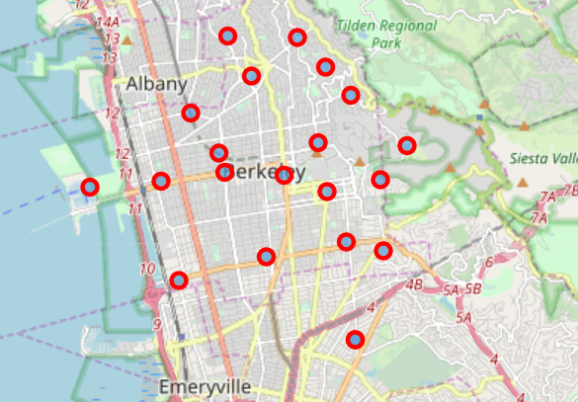
Exploring Data
The First Analysis was done using Folium Map. I ensured that the data points were all in and around the University of Berkeley and removed data points which were far away

Slide 6
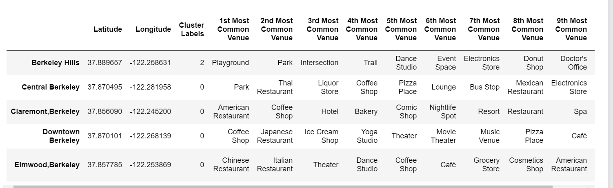
Clustering Using foursquare
I then used Foursquare to get data in order to cluster the points

Slide 7
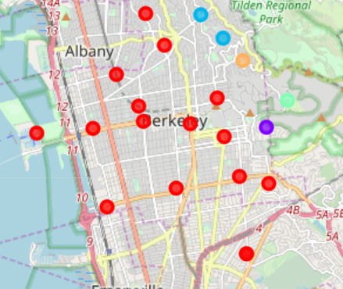
Result of Cluster
Shown are the result of Clustering. Singapore is a part of the rest CLuster so it seemed like there would be many places in Berekely that would be similar to Singapore. Yay.

Slide 8
Filtering
We then filtered out clusters such that only the Cluster that was similar to Sinapore would be added to the final decision.

Slide 9
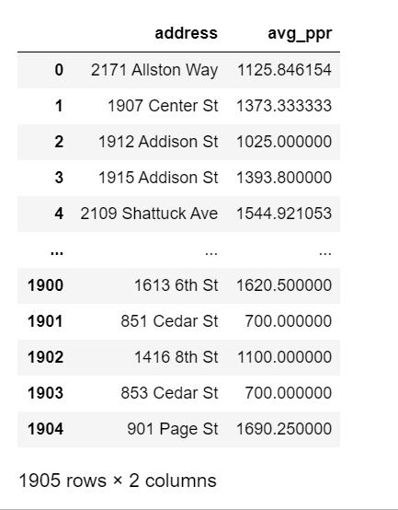
Prices Rank
I used the avg price of rent and used geopy to find the latitude and longitudes of this points. Then i used math in order to calculate the neighbourhoods that they belong to by finding the closest neighbourhood they are to.
This was extremely time intensive as we had to search the latitude and longitude of all the points

Slide 10
Finally
I then sorted the prices by neighbourhood and took the median of the prices
This was because it would be unlikely that i would be able to get the cheapest prices for that neighbourhood and this is an indicator of how much i would spend.

Slide 11
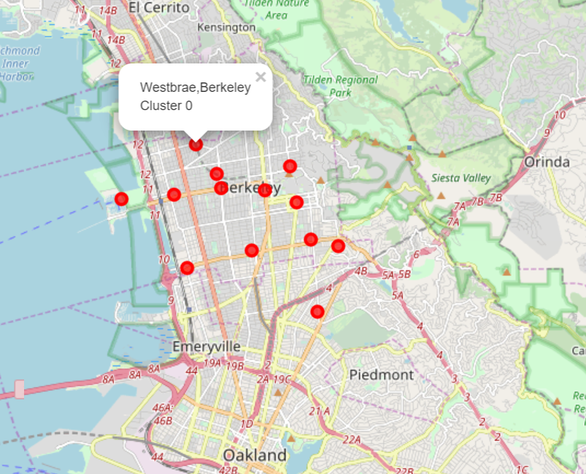
Results
It turned out that Westbrae was the winner.
This is a little unsuprising as westbrae is on the outskirts of Berkeley.

Slide 12
Conclusion
Though i managed to get a result from this experiment.
I would like to emphasize that the trending data is constantly changing hence i would probably need to update my results before going to Berkeley
I would also need to find prices of rent more up to date before going to Berkeley.
I would also need to find out more about the neighbourhoods regarding safety before deciding about the neighbourhood.
However this is a good start for me to start exploring the locations to stay.

