Slide 1
ElbaEC2
Gavin Gresham

Slide 2
Objective
Provide an alternative to Emulab
Utilize the features Amazon provides to improve testing

Slide 3
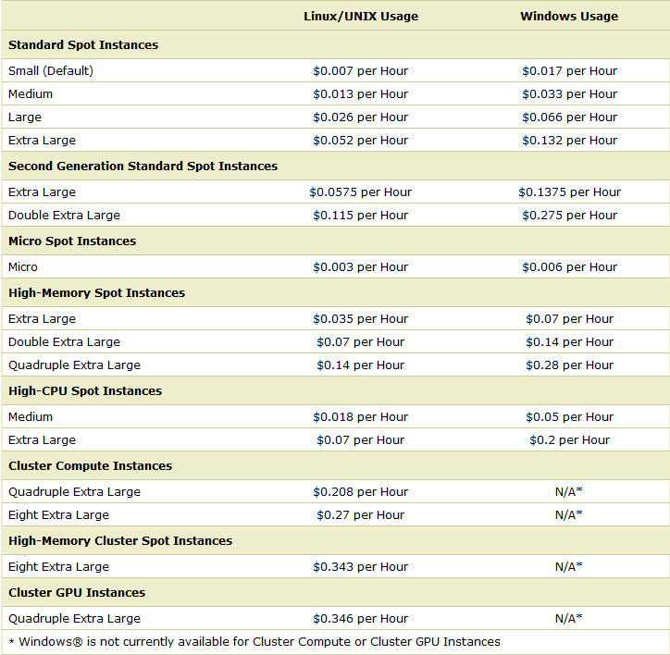

Slide 4
Technologies
Amazon AWS SDK for Java
RUBBoS
EC2
AWS Elastic Load Balancers

Slide 5
Current State
Creation of nodes
Custom operating system (AMI)
XML configuration parsing to Java classes

Slide 6
Future Improvements
Use Amazon SNS for broadcast messages
No more sequential server configuration
Generic server setup
Load balance databases for consistency
Management GUI
Shared file system (EBI)

