Slide 1
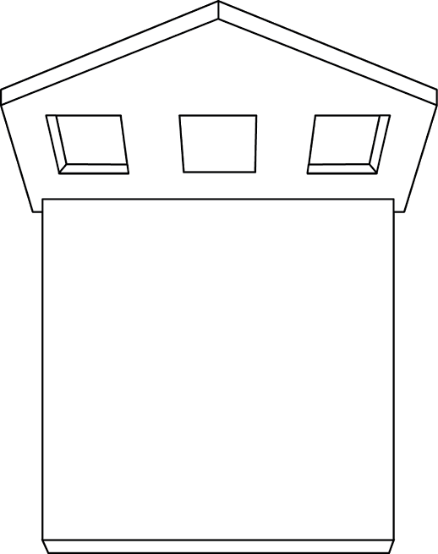
Note which side of it has the most window space.

