Slide 1
UNIVERSAL GATES
AVAH ARTS AND SCIENCE COLLEGE,KULUPPA
DEPARTMENT OF COMPUTER SCIENCE

Slide 2
UNIVERSAL GATES
A universal gate is a gate which can implement any Boolean function without need to use any other gate type.
The NAND and NOR gates are universal gates.
In practice, this is advantageous since NAND and NOR gates are economical and easier to fabricate and are the basic gates used in all IC digital logic families.

Slide 3
NAND GATE
A NAND Gate is constructed by connecting a NOT Gate at the output terminal of the AND Gate.
The output of NAND gate is high (‘1’) if at least one of its inputs is low (‘0’).
The output of NAND gate is low (‘0’) if all of its inputs are high (‘1’).

Slide 4
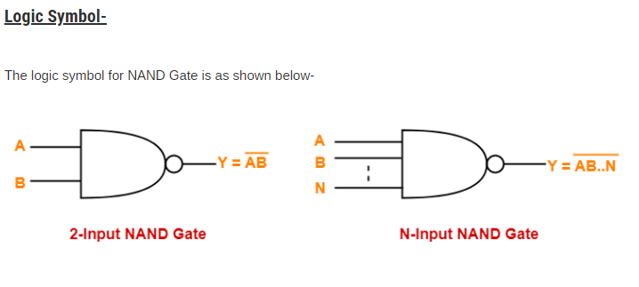

Slide 5
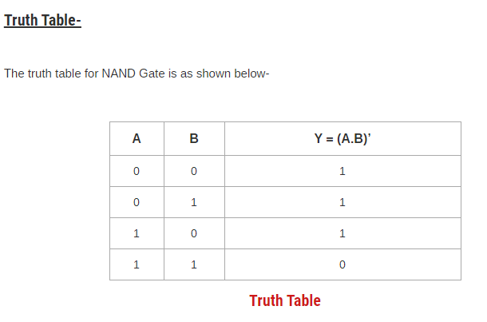

Slide 6
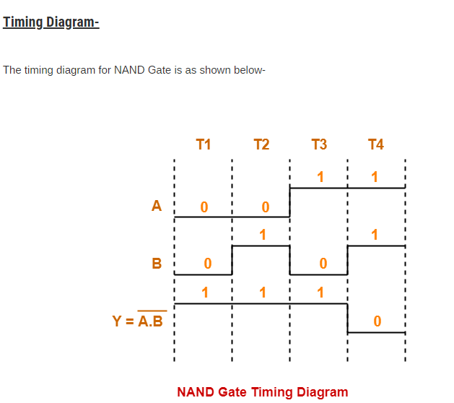

Slide 7
NAND Gate is a Universal Gate: To prove that any Boolean function can be implemented using only NAND gates, we will show that the AND, OR, and NOT operations can be performed using only these gates.

Slide 8
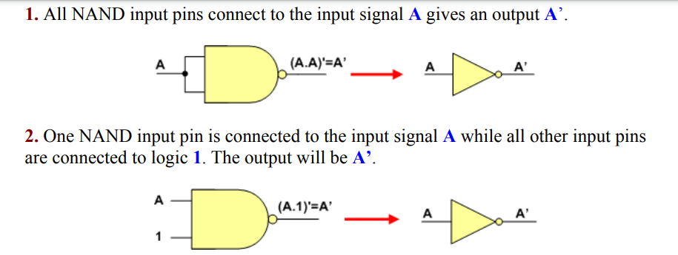
1.Implementing an Inverter Using only NAND Gate
The figure shows two ways in which a NAND gate can be used as an inverter (NOT gate).

Slide 9
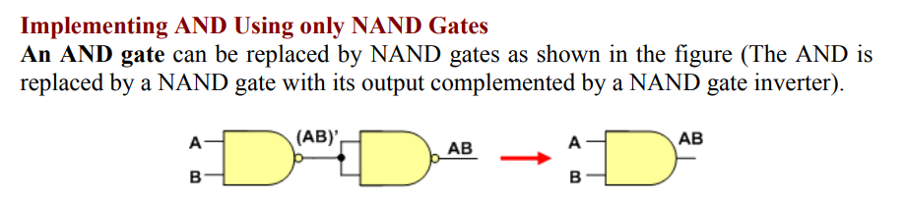
2. Implementing AND Using only NAND Gates

Slide 10
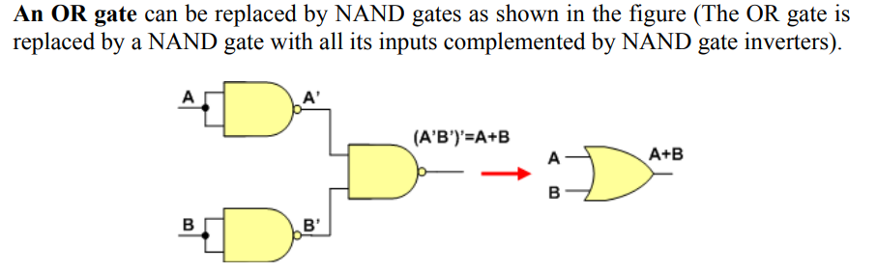
3. Implementing OR Using only NAND Gates

Slide 11
NOR GATE
A NOR Gate is constructed by connecting a NOT Gate at the output terminal of the OR Gate.
The output of NOR gate is high (‘1’) if all of its inputs are low (‘0’).
The output of NOR gate is low (‘0’) if any of its inputs is high (‘1’).

Slide 12
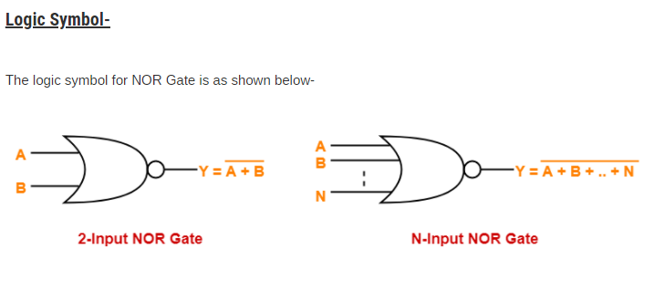

Slide 13
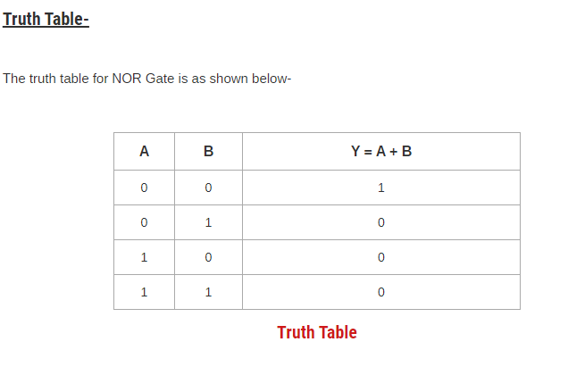

Slide 14
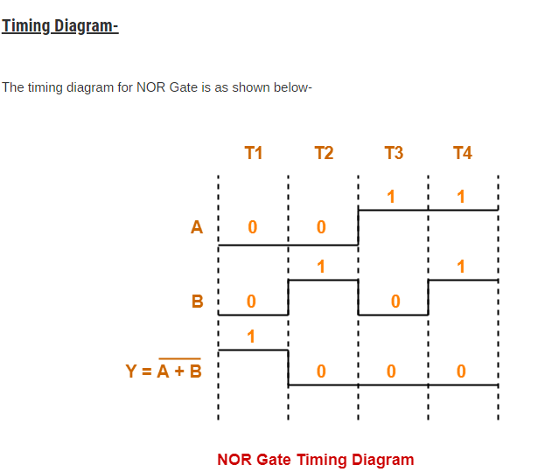

Slide 15
NOR Gate is a Universal Gate: To prove that any Boolean function can be implemented using only NOR gates, we will show that the AND, OR, and NOT operations can be performed using only these gates.

Slide 16
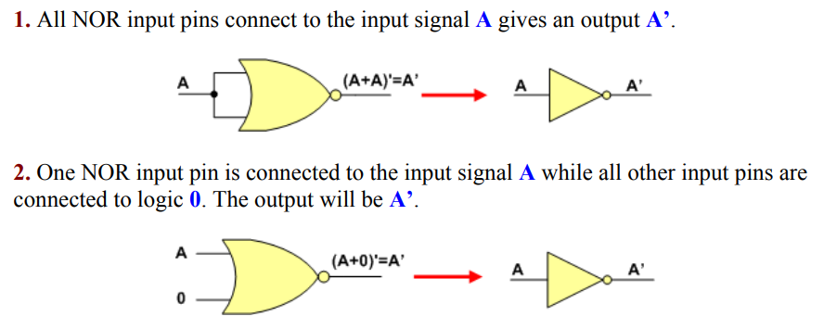
1. Implementing an Inverter Using only NOR Gate
The figure shows two ways in which a NOR gate can be used as an inverter (NOT gate)

Slide 17
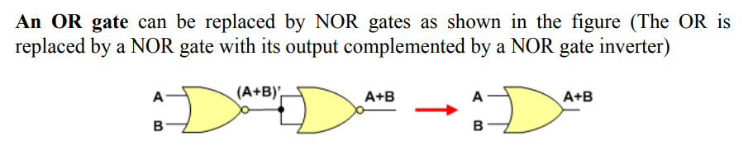
2. Implementing OR Using only NOR Gates

Slide 18
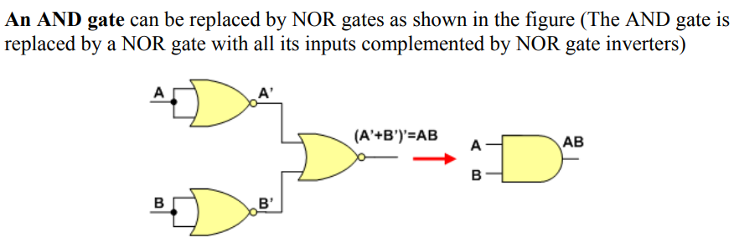
3. Implementing AND Using only NOR Gates

Slide 19
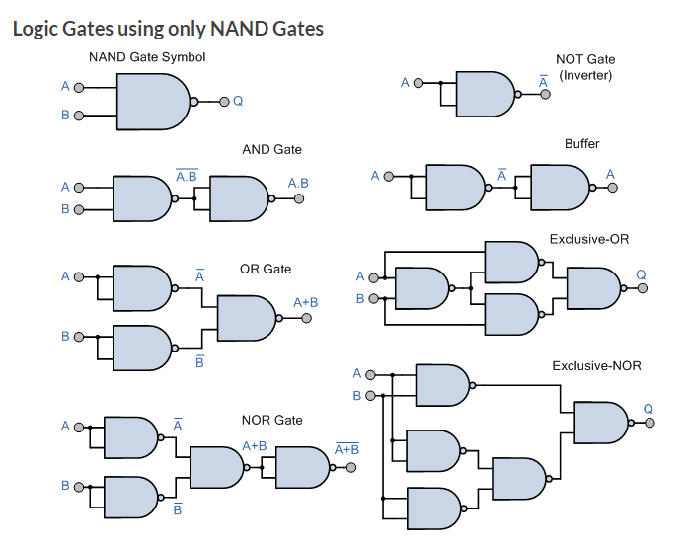

Slide 20
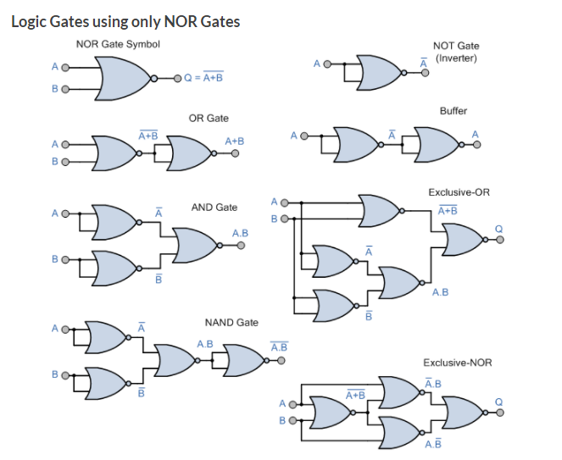

Slide 21
THANK YOU

