Slide 1
BCD TO 7 SEGMENT DECODER

Slide 2
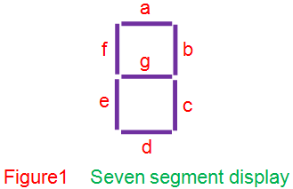
BCD (Binary Coded Decimal) is an encoding scheme which represents each of the decimal numbers by its equivalent 4-bit binary pattern.
Seven segment displays comprise of seven individual segments formed by either Light Emitting Diodes (LEDs) or Liquid Crystal Displays (LCDs) arranged in a definite pattern .

Slide 3
BCD to seven segment decoder is a circuit used to convert the input BCD into a form suitable for the display.
It has four input lines (A, B, C and D) and 7 output lines (a, b, c, d, e, f and g) as shown in Figure . Considering common cathode type of arrangement.

Slide 4
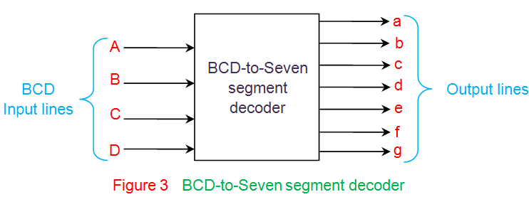

Slide 5
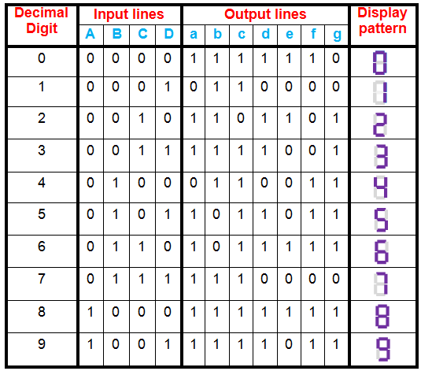
Truth table for common cathode type BCD to seven segment decoder

Slide 6
This table indicates the segments which are to be driven high to obtain certain decimal digit at the output of the seven segment display.
However, it is to be noted that in the case of common anode type, the only change will be to interchange ones and zeros on the table.
This means that from the truth table so obtained one can get to know where low has to be driven so as to obtain the required digit at the output.

Slide 7
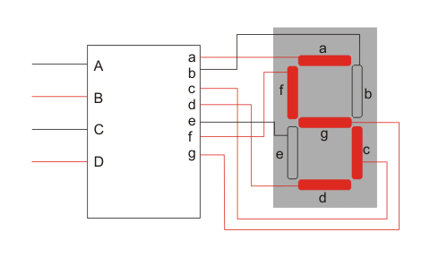

Slide 8
Thank you

