Slide 1
MULTIPLEXER AND
DE-MULTIPLEXER

Slide 2
Multiplexers
A Multiplexer (MUX) can be described as a combinational circuit that receives binary information from one of the 2^n input data lines and directs it to a single output line.
The selection of a particular input data line for the output is decided on the basis of selection lines.
The multiplexer is often called as data selector since it selects only one of many data inputs.

Slide 3
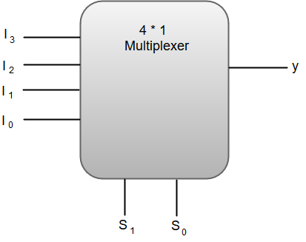
The following image shows the block diagram of a 4 * 1 Multiplexer.
Out of these four input data lines, a particular input data line will be connected to the output based on the combination of inputs present at these two selection lines.

Slide 4
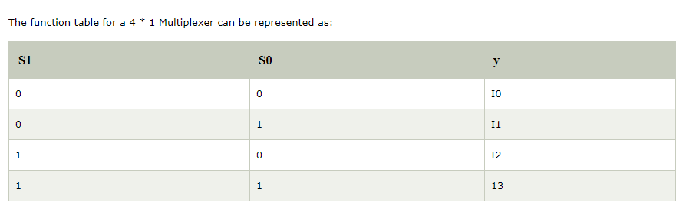

Slide 5
From the function table, we can write the Boolean function for the output (y) as:
y = S1'S0'I0 + S1' S0'I1 + S1S0'I2 + S1S0I3

Slide 6
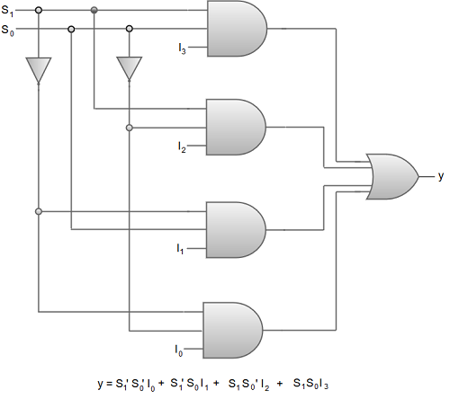
The above equation for output 'y' can be implemented using inverters, three-input AND gates and an OR gate.

Slide 7
De-Multiplexers
A De-multiplexer (De-Mux) can be described as a combinational circuit that performs the reverse operation of a Multiplexer.
A De-multiplexer has a single input, 'n' selection lines and a maximum of 2^n outputs.
The following image shows the block diagram of a 1 * 4 De-multiplexer.

Slide 8
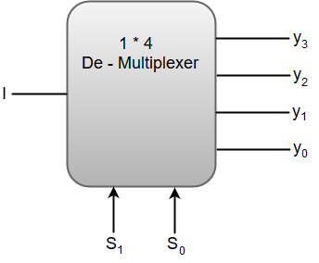

Slide 9
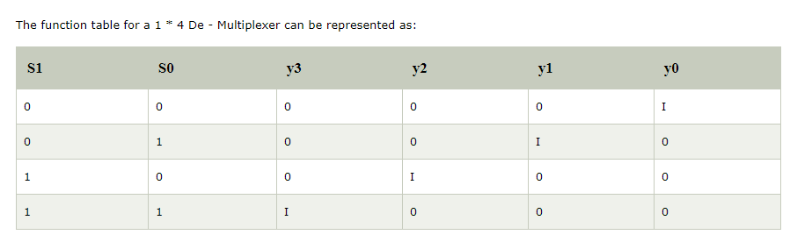

Slide 10
From the above function table, we can write the Boolean function for each output as:
y3 = S1S0 I, y2 = S1S0' I, y1 = S1' S0 I, y0 = S1'S0' I

Slide 11
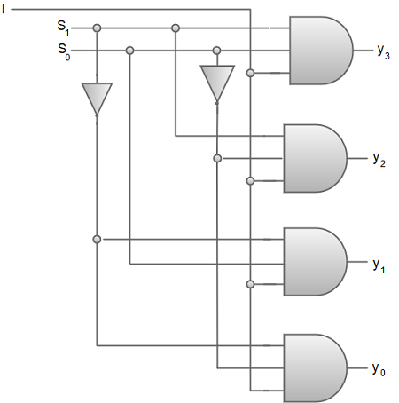
The above equations can be implemented using inverters and three-input AND gates.

Slide 12
THANK YOU

