Slide 1
RIPPLE CARRY ADDER
Department of computer science
AVAH Arts and Science college, kulupa

Slide 2
Ripple Carry Adder is a combinational logic circuit.
It is used for the purpose of adding two n-bit binary numbers.
It requires n full adders in its circuit for adding two n-bit binary numbers.
It is also known as n-bit parallel adder.

Slide 3
A ripple carry adder is a logic circuit in which the carry-out of each full adder is the carry in of the succeeding next most significant full adder.
It is called a ripple carry adder because each carry bit gets rippled into the next stage.

Slide 4
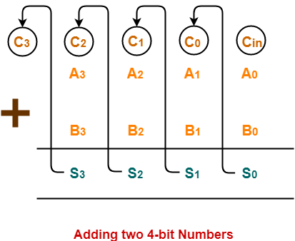
In Mathematics, any two 4-bit binary numbers A₃A₂A₁A₀ and B₃B₂B₁B₀ are added as shown below-

Slide 5
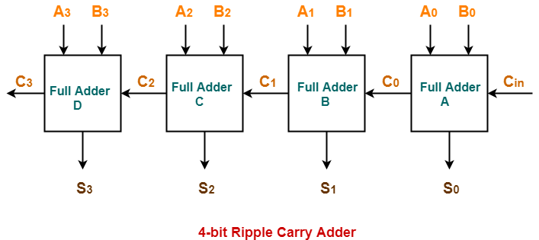
Using ripple carry adder, this addition is carried out as shown by the following logic diagram-

Slide 6
The two 4-bit numbers are 0101 (A₃A₂A₁A₀) and 1010 (B₃B₂B₁B₀).
These numbers are to be added using a 4-bit ripple carry adder.

Slide 7
4-bit Ripple Carry Adder carries out the addition as explained in the following stages-
Stage-01:
When C_{in} is fed as input to the full Adder A, it activates the full adder A.
Then at full adder A, A₀ = 1, B₀ = 0, C_{in} = 0.
Full adder A computes the sum bit and carry bit as-

Slide 8
Calculation of S₀–
S₀ = A₀ ⊕ B₀ ⊕ C_{in}
S₀ = 1 ⊕ 0 ⊕ 0
S₀ = 1
Calculation of C₀–
C₀ = A₀B₀ ⊕ B₀C_{in} ⊕ C_{in}A₀
C₀ = 1.0 ⊕ 0.0 ⊕ 0.1
C₀ = 0 ⊕ 0 ⊕ 0
C₀ = 0

Slide 9
Stage-02:
When C₀ is fed as input to the full adder B, it activates the full adder B.
Then at full adder B, A₁ = 0, B₁ = 1, C₀ = 0.
Full adder B computes the sum bit and carry bit as-
Calculation of S₁–
  S₁ = A₁ ⊕ B₁ ⊕ C₀
  S₁ = 0 ⊕ 1 ⊕ 0
  S₁ = 1
Calculation of C₁–
  C₁ = A₁B₁ ⊕ B₁C₀ ⊕ C₀A₁
  C₁ = 0.1 ⊕ 1.0 ⊕ 0.0
  C₁ = 0 ⊕ 0 ⊕ 0
  C₁ = 0

Slide 10
Stage-03:
When C₁ is fed as input to the full adder C, it activates the full adder C.
Then at full adder C, A₂ = 1, B₂ = 0, C₁ = 0.
Full adder C computes the sum bit and carry bit as-
Calculation of S₂–
  S₂ = A₂ ⊕ B₂ ⊕ C₁
  S₂ = 1 ⊕ 0 ⊕ 0
  S₂ = 1
Calculation of C₂–
  C₂ = A₂B₂ ⊕ B₂C₁ ⊕ C₁A₂
  C₂ = 1.0 ⊕ 0.0 ⊕ 0.1
  C₂ = 0 ⊕ 0 ⊕ 0
  C₂ = 0

Slide 11
Stage-04:
When C₂ is fed as input to the full adder D, it activates the full adder D.
Then at full adder D, A₃ = 0, B₃ = 1, C₂ = 0.
Full adder D computes the sum bit and carry bit as-
Calculation of S₃–
  S₃ = A₃ ⊕ B₃ ⊕ C₂
  S₃ = 0 ⊕ 1 ⊕ 0
  S₃ = 1
Calculation of C₃–
  C₃ = A₃B₃ ⊕ B₃C₂ ⊕ C₂A₃
  C₃ = 0.1 ⊕ 1.0 ⊕ 0.0
  C₃ = 0 ⊕ 0 ⊕ 0
  C₃ = 0
  Thus finally,
  Output Sum = S₃S₂S₁S₀ = 1111
  Output Carry = C₃ = 0

Slide 12
Disadvantages of Ripple Carry Adder-
Ripple Carry Adder does not allow to use all the full adders simultaneously.
Each full adder has to necessarily wait until the carry bit becomes available from its adjacent full adder.
This increases the propagation time.
Due to this reason, ripple carry adder becomes extremely slow.
This is considered to be the biggest disadvantage of using ripple carry adder.

Slide 13
THANK YOU

