Slide 1
Carry Look-Ahead Adder

Slide 2
A carry look-ahead adder reduces the propagation delay by introducing more complex hardware.

Slide 3
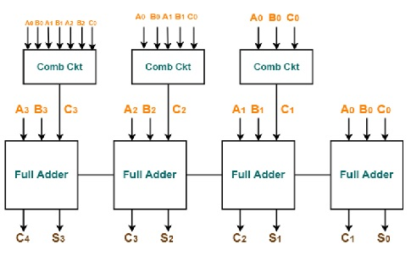
Logic diagram

Slide 4
In this adder, the carry input at any stage of the adder is independent of the carry bits generated at the independent stages.
Here the output of any stage is dependent only on the bits which are added in the previous stages and the carry input provided at the beginning stage.
Hence, the circuit at any stage does not have to wait for the generation of carry-bit from the previous stage and carry bit can be evaluated at any instant of time.

Slide 5
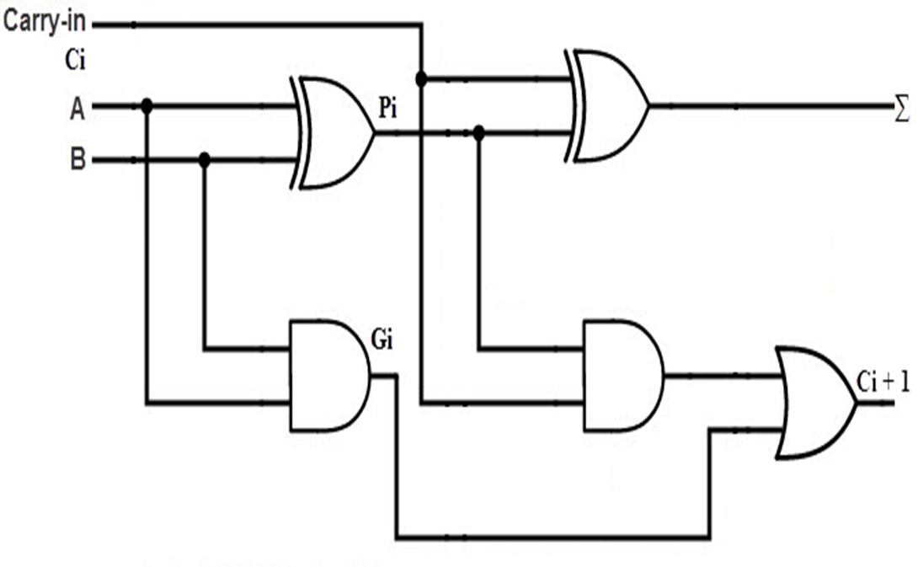

Slide 6
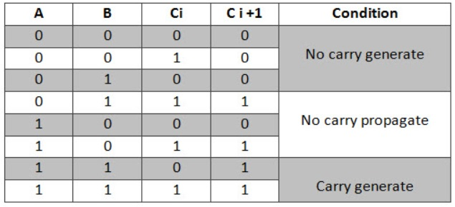

Slide 7
Truth Table of Carry Look-ahead Adder
For deriving the truth table of this adder, two new terms are introduced – Carry generate and carry propagate.
Carry generate Gi =1 whenever there is a carry Ci+1 generated. It depends on Ai and Bi inputs.
Gi is 1 when both Ai and Bi are 1. Hence, Gi is calculated as Gi = Ai. Bi.

Slide 8
Carry propagated Pi is associated with the propagation of carry from Ci to Ci+1.
It is calculated as Pi = Ai ⊕ Bi.

Slide 9
Using the Gi and Pi terms the Sum Si and Carry Ci+1 are given as below –
Si = Pi ⊕ Gi.
Ci+1 = Ci.Pi +Gi.

Slide 10
C1=(A0.B0)+(A0⊕B0).C0
C2=(A1.B1)+(A1⊕B1).C1
C3=(A2.B2)+(A2⊕B2).C2
C4=(A3.B3)+(A3⊕B3).C3
Using Gi = Ai. Bi. and Pi = Ai ⊕ Bi.
C1=G0+P0.C0
C2=G1+P1.C1
C3=G2+P2.C2
C4=G3+P3.C3

Slide 11
Therefore, the carry bits C1, C2, C3, and C4 can be calculated as
C1 =G0+ P0.C0.
C2 = G1+P1.C1
=G1 +P1.(G0+ P0.C0)
C3 =G2+ P2.C2
=G2+P2. (G1+P1.C1) =G2+P2(G1+P1.(G0+P0.C0))
C4 = G3 +P3.C3.
=G3+ P3.(G2+ P2.C2)
=G3+P3.(G2+P2.(G1+P1.C1))
=G3+P3.(G2+P2.(G1+P1(G0+ P0.C0)))

Slide 12
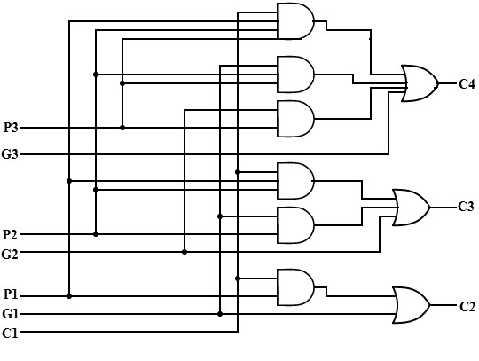

Slide 13
THANK YOU

