Slide 1
DECODERS

Slide 2
A Decoder can be described as a combinational circuit that converts binary information from the 'n' coded inputs to a maximum of 2^n different outputs.

Slide 3
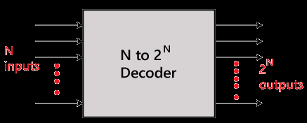

Slide 4
There are various types of decoders which are as follows:
2 to 4 line decoder:
In the 2 to 4 line decoder, there is a total of three inputs, i.e., A₀, and A₁ and E and four outputs, i.e., Y₀, Y₁, Y₂, and Y₃.
For each combination of inputs, when the enable 'E' is set to 1, one of these four outputs will be 1.

Slide 5
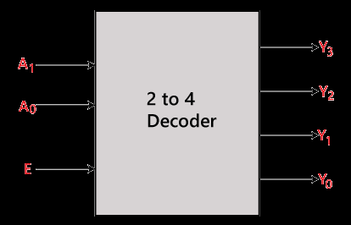
Block Diagram:

Slide 6
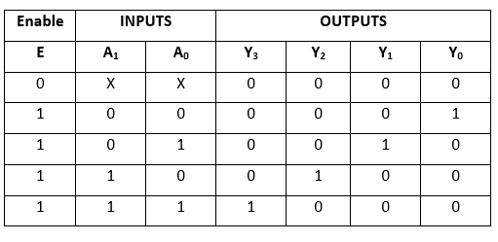
Truth Table:

Slide 7
The logical expression of the term Y0, Y0, Y2, and Y3 is as follows:
Y₃=E.A₁.A₀
Y₂=E.A₁.A₀'
Y₁=E.A₁'.A₀
Y0=E.A₁'.A₀'

Slide 8
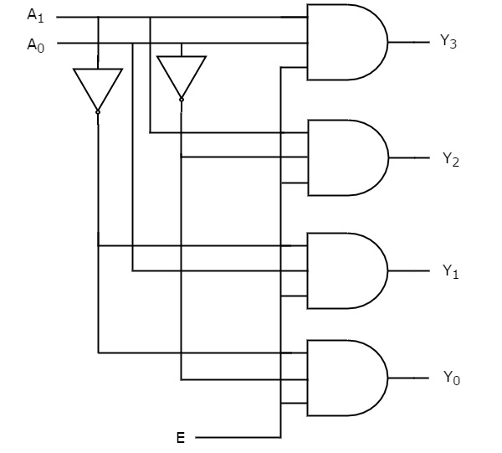
Logical circuit of the above expressions is given below:

Slide 9
3 to 8 line decoder:
The 3 to 8 line decoder is also known as Binary to Octal Decoder.
In a 3 to 8 line decoder, there is a total of eight outputs, i.e., Y₀, Y₁, Y₂, Y₃, Y₄, Y₅, Y₆, and Y₇ and three outputs, i.e., A₀, A1, and A₂.
This circuit has an enable input 'E'. Just like 2 to 4 line decoder, when enable 'E' is set to 1, one of these four outputs will be 1.

Slide 10
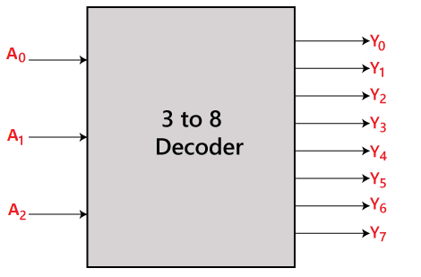
Block Diagram:

Slide 11
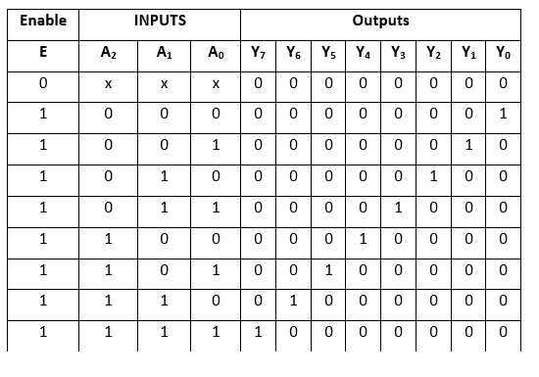
Truth Table:

Slide 12
The logical expression of the term Y₀, Y₁, Y₂, Y₃, Y₄, Y₅, Y₆, and Y₇ is as follows:
Y₀=A₀'.A₁'.A₂'
Y₁=A₀.A₁'.A₂'
Y₂=A₀'.A₁.A₂'
Y₃=A₀.A₁.A₂'
Y₄=A₀'.A₁'.A₂
Y₅=A₀.A₁'.A₂
Y₆=A₀'.A₁.A₂
Y₇=A₀.A₁.A₂

Slide 13
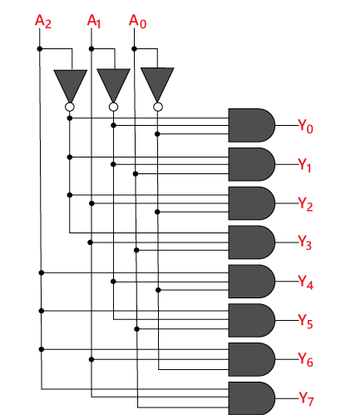
Logical circuit of the above expressions is given below:

Slide 14
THANK YOU

