Slide 1
ENCODERS

Slide 2
An Encoder is a combinational circuit that performs the reverse operation of Decoder.
It has maximum of 2^{n} input lines and ‘n’ output lines. It will produce a binary code equivalent to the input, which is active High.
Therefore, the encoder encodes 2^{n} input lines with ‘n’ bits. It is optional to represent the enable signal in encoders.

Slide 3
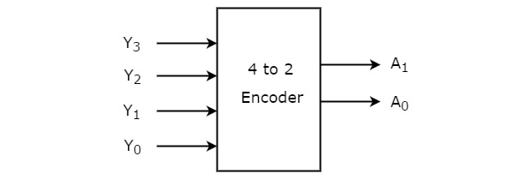
4 to 2 Encoder
Let 4 to 2 Encoder has four inputs Y₃, Y₂, Y₁ & Y₀ and two outputs A₁ & A₀. The block diagram of 4 to 2 Encoder is shown in the following figure.

Slide 4
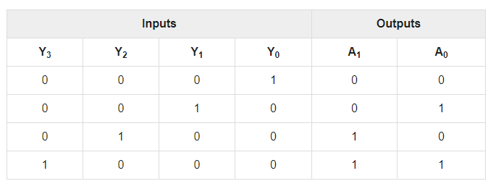
At any time, only one of these 4 inputs can be ‘1’ in order to get the respective binary code at the output. The Truth table of 4 to 2 encoder is shown below.

Slide 5
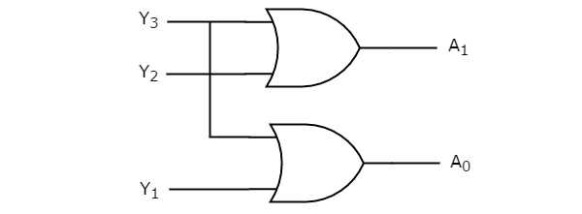
CIRCUIT DIAGRAM
The logical expression of the term A0 and A1 is as follows:
A₁=Y₃+Y₂
A₀=Y₃+Y₁

Slide 6
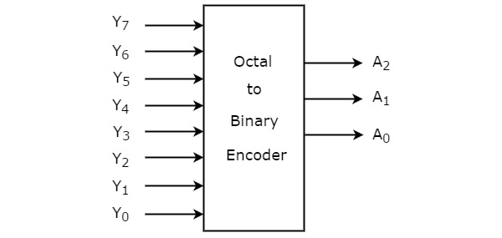
Octal to Binary Encoder
Octal to binary Encoder has eight inputs, Y₇ to Y₀ and three outputs A₂, A₁ & A₀. Octal to binary encoder is nothing but 8 to 3 encoder. The block diagram of octal to binary Encoder is shown in the following figure.

Slide 7
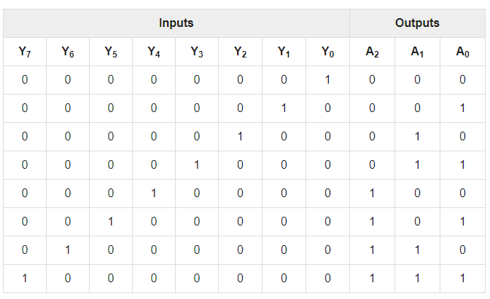
The Truth table of octal to binary encoder is shown below.

Slide 8
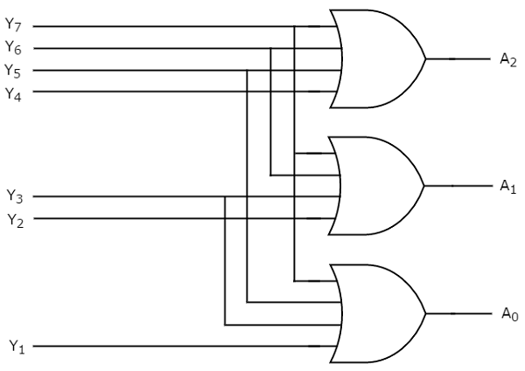
The circuit diagram of octal to binary encoder is shown in the following figure.
The logical expression of the term A0, A1, and A2 are as follows:
A₂=Y₄+Y₅+Y₆+Y₇
A₁=Y₂+Y₃+Y₆+Y₇
A₀=Y₇+Y₅+Y₃+Y₁

Slide 9
Drawbacks of Encoder
There is an ambiguity, when all outputs of encoder are equal to zero. Because, it could be the code corresponding to the inputs, when only least significant input is one or when all inputs are zero.
If more than one input is active High, then the encoder produces an output, which may not be the correct code. For example, if both Y₃ and Y₆ are ‘1’, then the encoder produces 111 at the output. This is neither equivalent code corresponding to Y₃, when it is ‘1’ nor the equivalent code corresponding to Y₆, when it is ‘1’.

Slide 10
THANK YOU

