Slide 1
ADDERS AND SUBTRACTORS

Slide 2
Combinational Circuits
Combinational Circuits (CC) are circuits made up of different types of logic gates.
he output of combinational circuit at any instant of time, depends only on the levels present at input terminals.
The combinational circuit do not use any memory. The previous state of input does not have any effect on the present state of the circuit.
A combinational circuit can have an n number of inputs and m number of outputs.

Slide 3
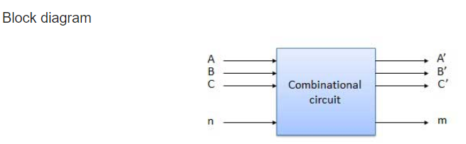

Slide 4
HALF ADDER
Half adder is a combinational logic circuit with two inputs and two outputs.
The half adder circuit is designed to add two single bit binary number A and B.
It is the basic building block for addition of two single bit numbers.
This circuit has two outputs carry and sum.

Slide 5
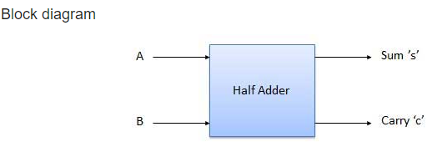

Slide 6
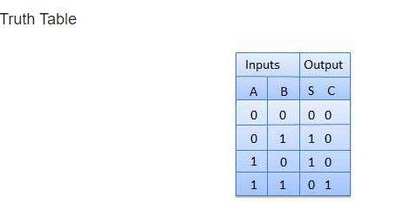

Slide 7
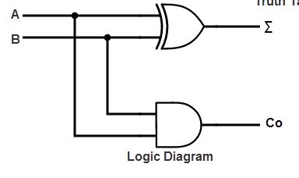
CIRCUIT DIAGRAM

Slide 8
Full Adder
Full adder is developed to overcome the drawback of Half Adder circuit.
It can add two one-bit numbers A and B, and carry c.
The full adder is a three input and two output combinational circuit.

Slide 9
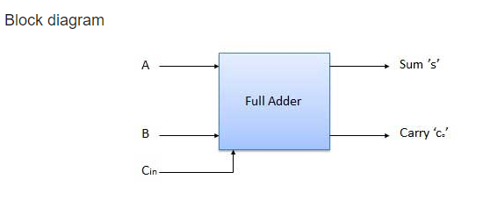

Slide 10
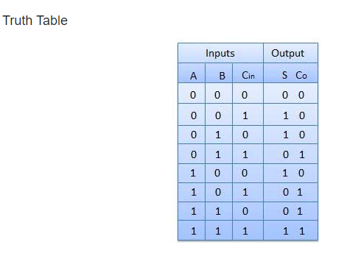

Slide 11
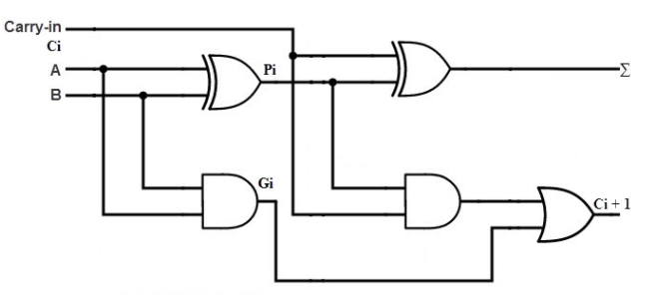

Slide 12
Half Subtractors
Half subtractor is a combination circuit with two inputs and two outputs (difference and borrow).
It produces the difference between the two binary bits at the input and also produces an output (Borrow) to indicate if a 1 has been borrowed.
In the subtraction (A-B), A is called as Minuend bit and B is called as Subtrahend bit.

Slide 13
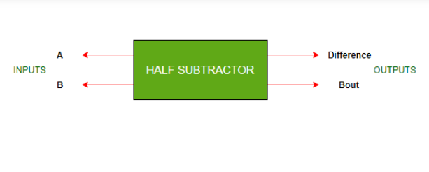

Slide 14
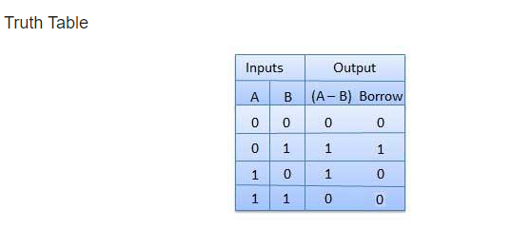

Slide 15
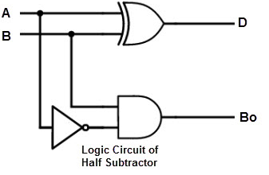

Slide 16
Full Subtractors
The disadvantage of a half subtractor is overcome by full subtractor.
The full subtractor is a combinational circuit with three inputs A,B,C and two output D and C'.
A is the 'minuend', B is 'subtrahend', C is the 'borrow' produced by the previous stage, D is the difference output and C' is the borrow output.

Slide 17
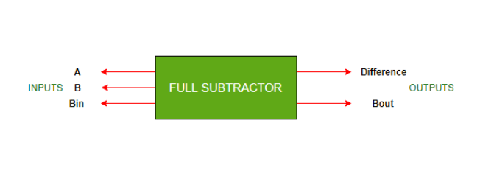

Slide 18
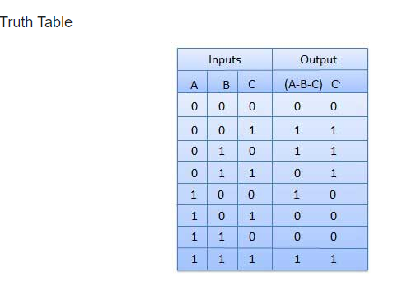

Slide 19
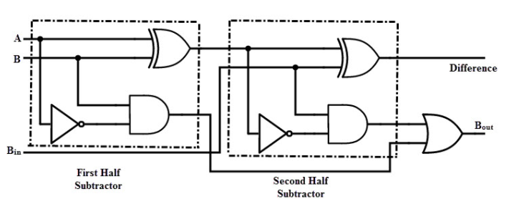

Slide 20
THANK YOU

