Slide 1
LOGIC GATES

Slide 2
Logic Gates
Logic gates are the basic building blocks of any digital system.
A logic gate is an idealized or physical electronic device implementing a Boolean function, a logical operation performed on one or more binary inputs that produces a single binary output.
Based on this, logic gates are named as AND gate, OR gate, NOT gate etc.

Slide 3
Standard commercially available digital logic gates are available in two basic families or forms,
  TTL which stands for Transistor-Transistor Logic
  CMOS which stands for Complementary Metal-Oxide-Silicon
This notation of TTL or CMOS refers to the logic technology used to manufacture the integrated circuit, (IC) or a “chip” as it is more commonly called.

Slide 4
Integrated Circuits or IC’s as they are more commonly called, can be grouped together into families according to the number of transistors or “gates” that they contain.

Slide 5
Classification of Integrated Circuits
Small Scale Integration or (SSI) – Contain up to 10 transistors or a few gates within a single package such as AND, OR, NOT gates.
Medium Scale Integration or (MSI) – between 10 and 100 transistors or tens of gates within a single package and perform digital operations such as adders, decoders, counters, flip-flops and multiplexers.
Large Scale Integration or (LSI) – between 100 and 1,000 transistors or hundreds of gates and perform specific digital operations such as I/O chips, memory, arithmetic and logic units.

Slide 6
Very-Large Scale Integration or (VLSI) – between 1,000 and 10,000 transistors or thousands of gates and perform computational operations such as processors, large memory arrays and programmable logic devices.
Super-Large Scale Integration or (SLSI) – between 10,000 and 100,000 transistors within a single package and perform computational operations such as microprocessor chips, micro-controllers, basic PICs and calculators.
Ultra-Large Scale Integration or (ULSI) – more than 1 million transistors – the big boys that are used in computers CPUs, GPUs, video processors, micro-controllers, FPGAs and complex PICs.

Slide 7
Digital Logic States
In digital logic design only two voltage levels or states are allowed and these states are generally referred to as Logic “1” and Logic “0”, or HIGH and LOW, or TRUE and FALSE.
These two states are represented in Boolean Algebra and standard truth tables by the binary digits of “1” and “0” respectively.

Slide 8
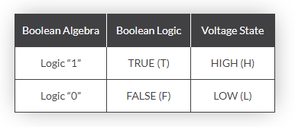
Then we can summarise the relationship between these various digital states as being:

Slide 9
POSITIVE AND NEGATIVE LOGICS
Most digital logic gates and digital logic systems use “Positive logic”.
In positive logic representation Bit 1 represents Logic high and Bit 0 represent a Logic low as shown in fig 2 a and b. High is represented by +5 Volts and low is represented by -5 Volts or 0 Volts.

Slide 10
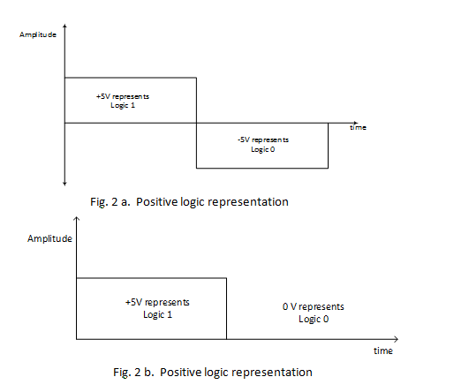

Slide 11
In Negative logic representation Bit 1 represents logic low and Bit 0 represents logic high .
In terms of voltage level, bit 1 can be represented as +5V and bit 0 can be represented as 0 V or -5 Volts

Slide 12
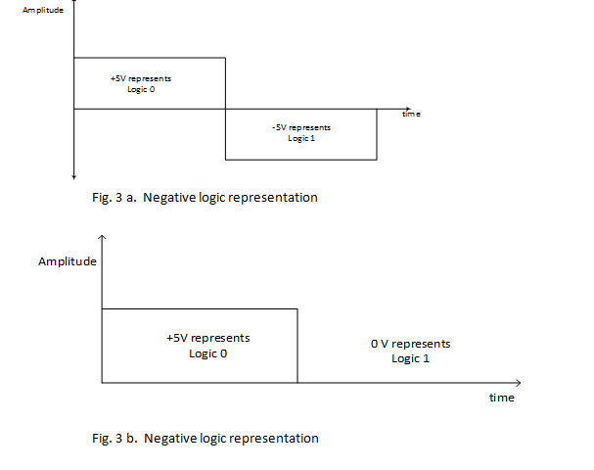

Slide 13
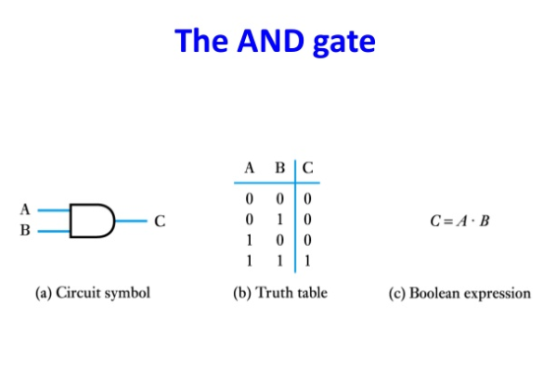

Slide 14
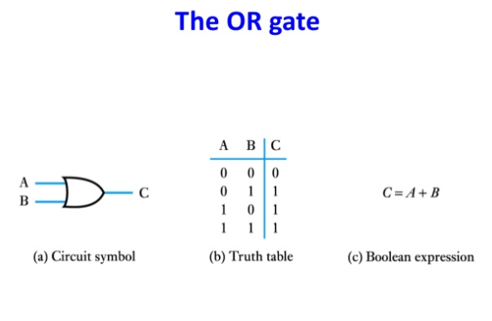

Slide 15
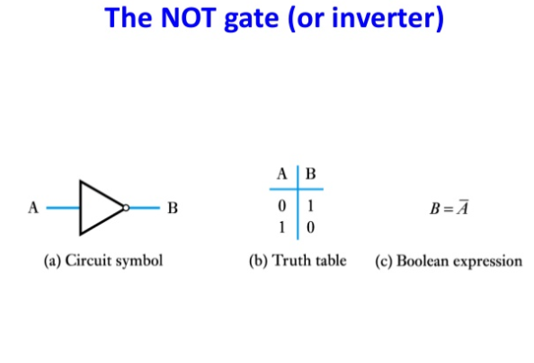

Slide 16
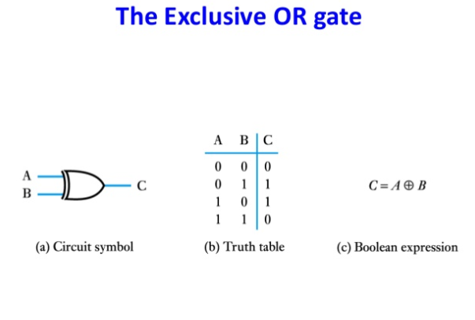

Slide 17
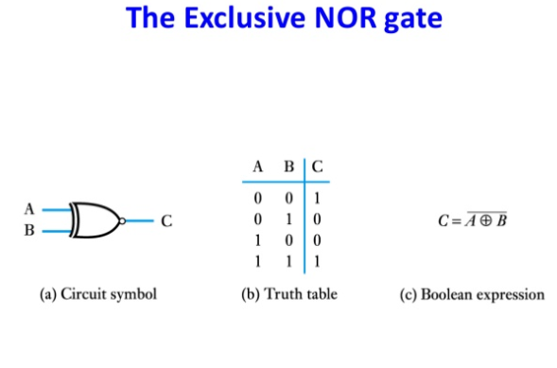

Slide 18
THANK YOU

