Slide 1
INSTRUCTION FORMAT

Slide 2
Computer perform task on the basis of instruction provided.
An instruction in computer comprises of groups called fields.
These field contains different information as for computers every thing is in 0 and 1 so each field has different significance on the basis of which a CPU decide what to perform.
The most common fields are:
  Operation field which specifies the operation to be performed like addition.
  Address field which contain the location of operand, i.e., register or memory location.
  Mode field which specifies how operand is to be founded.

Slide 3
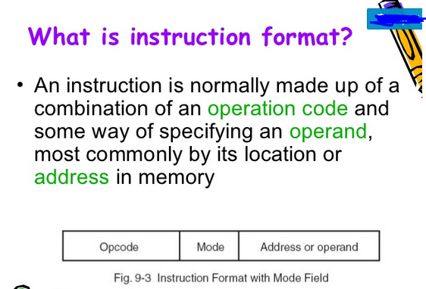

Slide 4
An instruction is of various length depending upon the number of addresses it contain. Generally CPU organization are of three types on the basis of number of address fields.
They are:
  General register organization
  Single Accumulator organization
  Stack organization

Slide 5
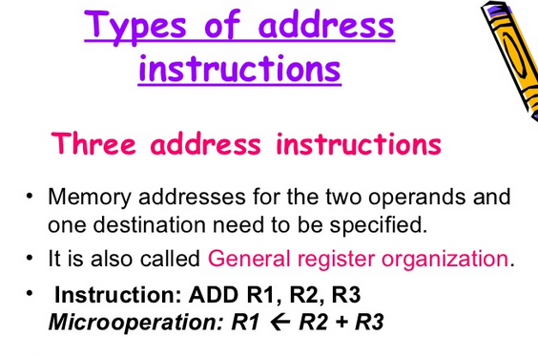

Slide 6
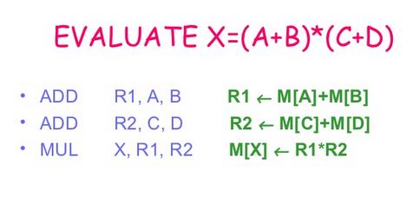

Slide 7
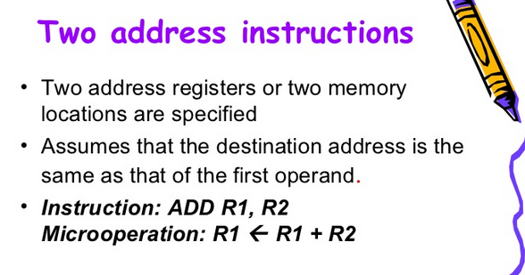

Slide 8
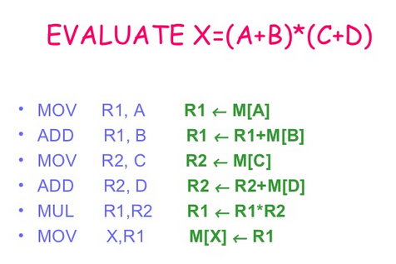

Slide 9
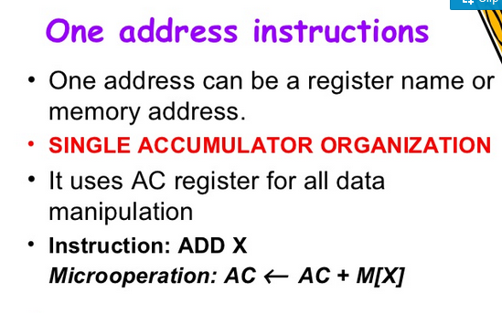

Slide 10
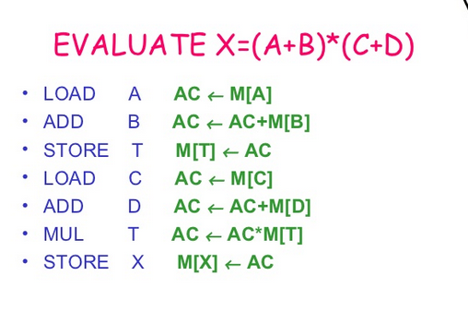

Slide 11
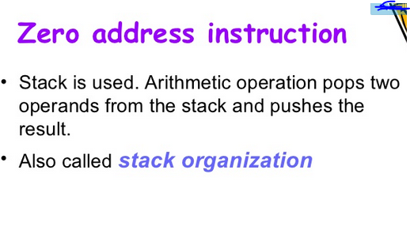

Slide 12
