Slide 1
Sequential Logic Circuits

Slide 2
The combinational circuit does not use any memory.
Hence the previous state of input does not have any effect on the present state of the circuit.
But sequential circuit has memory so output can vary based on input.
This type of circuits uses previous input, output, clock and a memory element.

Slide 3
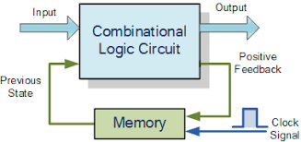

Slide 4
The sequential circuit is a special type of circuit that has a series of inputs and outputs.
The outputs of the sequential circuits depend on both the combination of present inputs and previous outputs.
The previous output is treated as the present state.
So, the sequential circuit contains the combinational circuit and its memory storage elements.
A sequential circuit doesn't need to always contain a combinational circuit. So, the sequential circuit can contain only the memory element

Slide 5
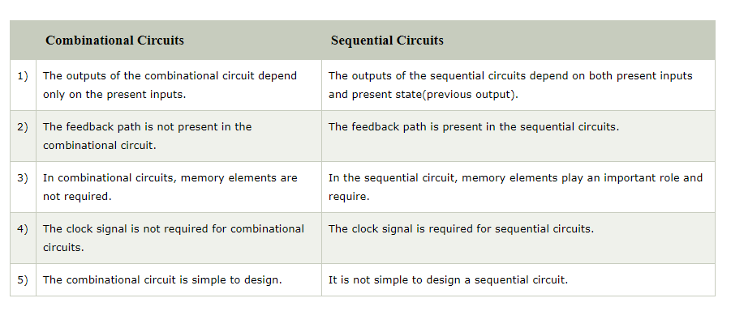

Slide 6
Types of Sequential Circuits
Asynchronous sequential circuits
  The clock signals are not used by the Asynchronous sequential circuits.
  The asynchronous circuit is operated through the pulses. So, the changes in the input can change the state of the circuit.
  The asynchronous circuits do not use clock pulses. The internal state is changed when the input variable is changed.

Slide 7
Synchronous sequential circuits
  In synchronous sequential circuits, synchronization of the memory element's state is done by the clock signal.
  The output is stored in either flip-flops or latches(memory devices).
  The synchronization of the outputs is done with either only negative edges of the clock signal or only positive edges.

Slide 8
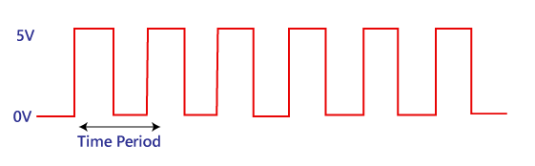
Clock Signal and Triggering
Clock signal
  A clock signal is a periodic signal in which ON time and OFF time need not be the same.
  When ON time and OFF time of the clock signal are the same, a square wave is used to represent the clock signal.
  Below is a diagram which represents the clock signal:

Slide 9
Types of Triggering
These are two types of triggering in sequential circuits:
Level triggering
The logic High and logic Low are the two levels in the clock signal. In level triggering, when the clock pulse is at a particular level, only then the circuit is activated. There are the following types of level triggering:

Slide 10
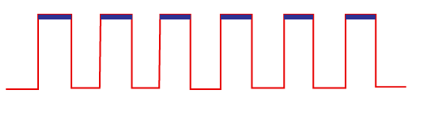
  Positive level triggering
  In a positive level triggering, the signal with Logic High occurs. So, in this triggering, the circuit is operated with such type of clock signal. Below is the diagram of positive level triggering:

Slide 11
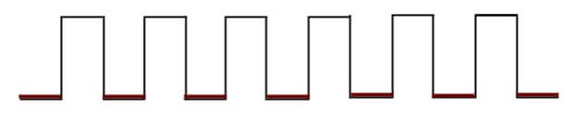
  Negative level triggering
  In negative level triggering, the signal with Logic Low occurs. So, in this triggering, the circuit is operated with such type of clock signal. Below is the diagram of Negative level triggering:

Slide 12
2.Edge triggering
In clock signal of edge triggering, two types of transitions occur, i.e., transition either from Logic Low to Logic High or Logic High to Logic Low.

Slide 13
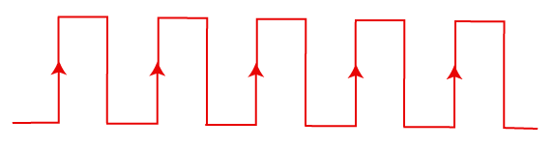
  Positive edge triggering
  The transition from Logic Low to Logic High occurs in the clock signal of positive edge triggering. So, in positive edge triggering, the circuit is operated with such type of clock signal. The diagram of positive edge triggering is given below.

Slide 14
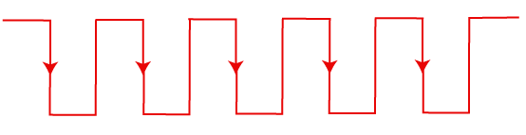
  Negative edge triggering
  The transition from Logic High to Logic low occurs in the clock signal of negative edge triggering. So, in negative edge triggering, the circuit is operated with such type of clock signal. The diagram of negative edge triggering is given below.

Slide 15
Thank you

