Slide 1
LATCHES AND FLIP-FLOP

Slide 2
There are two types of memory elements based on the type of triggering that is suitable to operate it.
Latches
Flip-flops
Latches operate with enable signal, which is level sensitive. Whereas, flip-flops are edge sensitive.

Slide 3
Latches
Latches are basic storage elements that operate with signal levels .
Latches controlled by a clock transition are flip-flops.
Latches are level-sensitive devices.
Latches are useful for the design of the asynchronous sequential circuit.

Slide 4
SR Latch
SR Latch is also called as Set Reset Latch.
This latch affects the outputs as long as the enable, E is maintained at ‘1’.
The circuit diagram of SR Latch is shown in the following figure.
It can be constructed from a pair of cross-coupled NOR logic gates.
The stored bit is present on the output marked Q.

Slide 5
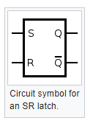
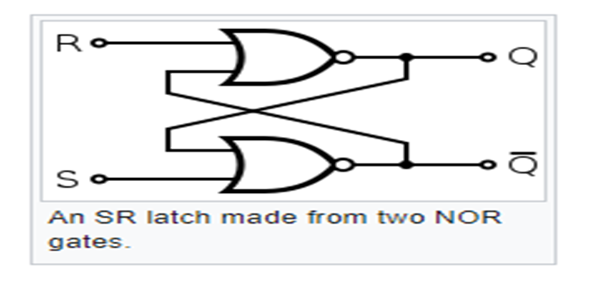

Slide 6
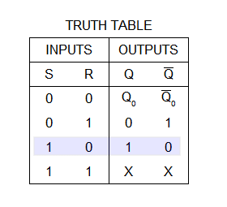

Slide 7
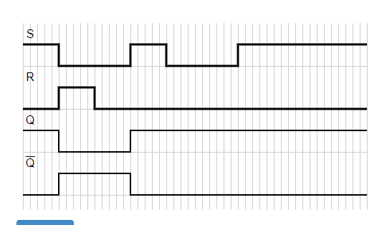

Slide 8
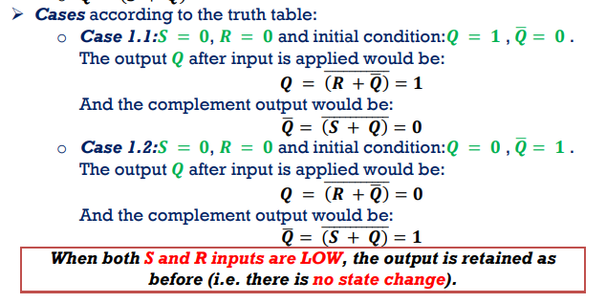

Slide 9
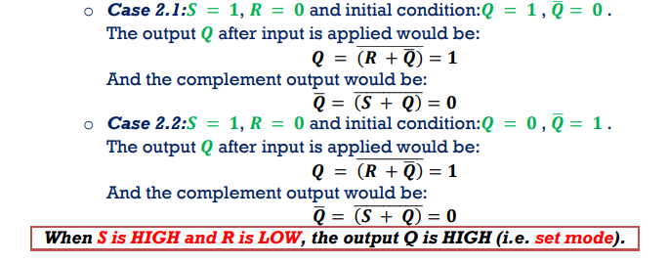

Slide 10
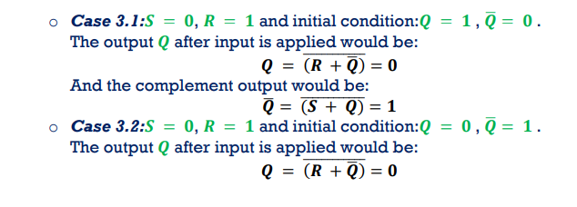
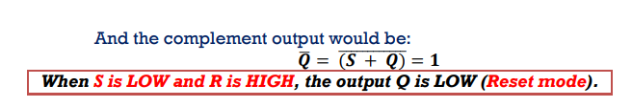

Slide 11
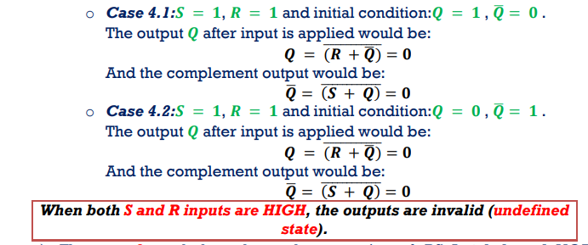

Slide 12
Thank you

