Slide 1
CLOUD COMPUTING

Slide 2




Cloud
Based
Welcome
CLOUD COMPUTING

Slide 3
CONTENT
01
INTRODUCTION
05
COMPONENTS & ARCHITECTURE OF CLOUD
02
TIMELINE OF CLOUD COMPUTING
06
NIST MODEL
ADVANTAGE & DISADVANTAGE OF CLOUD COMPUTING
03
HISTORY &EVOLUTION
07
04
CHARACTERSTICS
08
REFERENCE

Slide 4
INTRODUCTION OF CLOUD COMPUTING
Cloud computing is a paradigm of distributed computing to provide the customers on-demand, utility based computing services. Cloud users can provide more reliable, available and updated services to their clients in turn. Cloud itself consists of physical machines in the data centers of cloud providers. Virtualization is provided on top of these physical machines. These virtual machines are provided to the cloud users. Different cloud provider provides cloud services of different abstraction level. E.g. Amazon EC2 enables the users to handle very low level details where Google App-Engine provides a development platform for the developers to develop their applications.

Slide 5
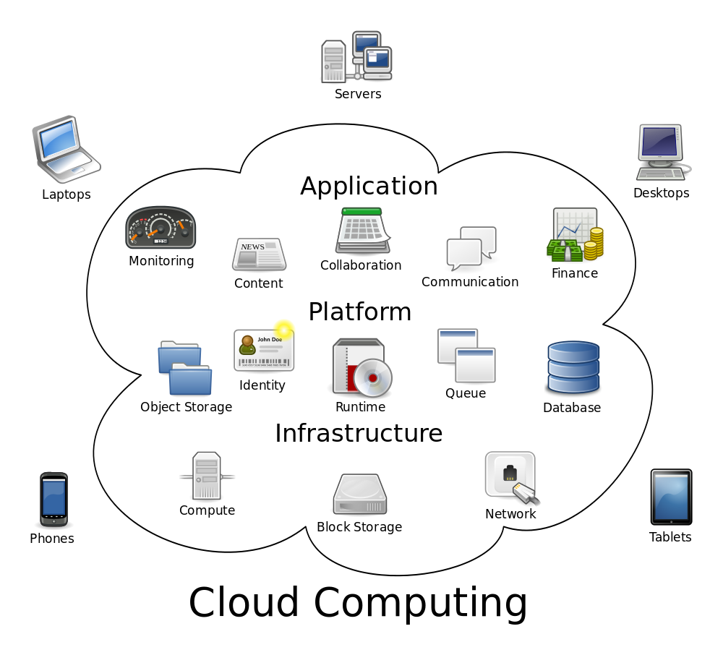

Slide 6
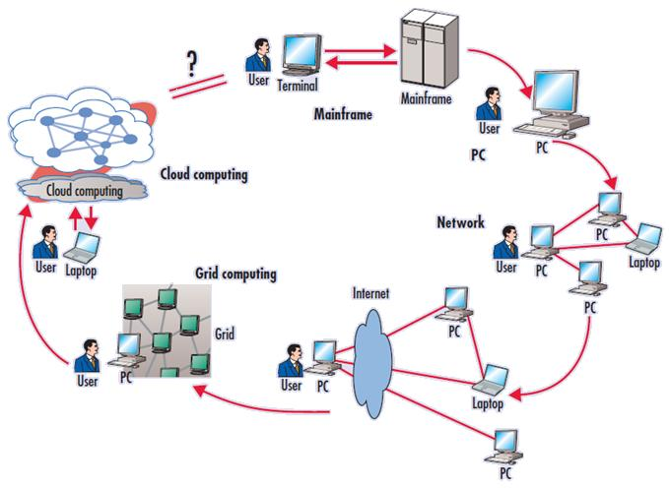
EVOLUTION OF VARIOUS CLOUD COMPUTING

Slide 7
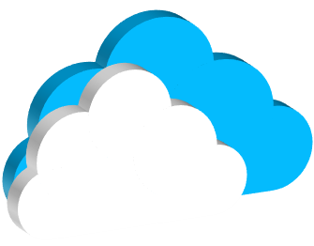
TIMELINE OF CLOUD COMPUTING
Beyond 2010
1950s
1990s
Client/Server Architecture
Cloud Computing
Mainframes
01
02
03
04
05
Rise Of The PC
Hosted Environment
1960s
2000

Slide 8
HISTORY & EVOLUTION OF CLOUD COMPUTING
The Fifth Generation of Computing (after Mainframe, Personal Computer, Client-Server Computing, and the web) is the Cloud Computing. The Computing is the systematic study of algorithmic processes that describe and transform information, their theory, analysis, design, efficiency, implementation, and application. The term "computing" is synonymous of counting and calculating. Cloud computing is defined as Internet-based computing, whereby shared resources, software and information are provided to computers and other devices on-demand, like the electricity grid. Mainframe:- Computing In early 1950s, programmers were having limitation in the form of batch files, in which complete jobs were submitted on the punch cards and operators were supposed to run it on a complex computer hardware consisting of power consuming mechanical relays, transistors, vacuum electronic I/O devices.

Slide 9
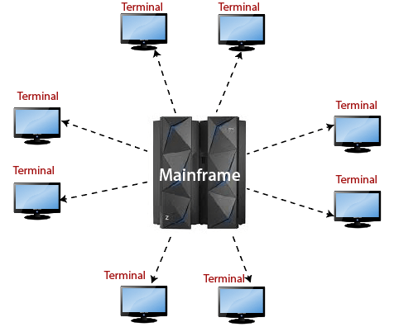
CONTI..
Multi-programmed, batched systems were introduced to effectively utilize various system resources which then extended into time sharing systems in which CPU executes multiple jobs for several users switching among them. In time sharing system, now group of people, mainly programmers, could interact with computer, so it was significant milestone in interactive use of computer. In Time sharing systems, programmers were interacting with the computer using the terminals attached to the mainframes using a command line interface.

Slide 10
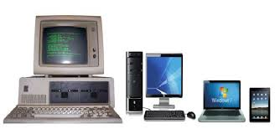
CONTI..
Personal Computing (PC):- Personal Computing systems considerably smaller and less expense then Mainframe Systems and more suitable for typical office environments and necessary for every personal executive. Traditionally executively were used to setting on a desk performing several tasks by using a set of tools spread on the top of the desk. Soon a personal computer starting occupying an important place on an executive’s desk and all other tools on the desk including the time-clock become the part of the desktop interface of the PC. In Personal Computing, interaction focused on addressing the single user engaged in a dialog with the computer in order to carry out a series of tasks. Humans are by nature multitasking as they can think about more than one think at a time.

Slide 11
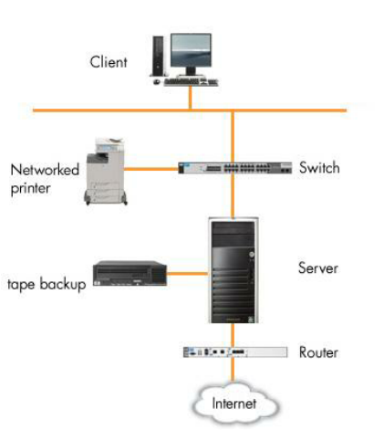
CONTI..
Client-Server:- As personal computers and laptops become cheaper, organizations started to replace their mainframe terminals with PCs linked together in a network. At the heart of the network of PCs (clients) is a server (which might be a mainframe or a powerful PC) which stores some of the data, applications software and other instructions that the network users need in order to communicate and process transactions on the network. There are different types of servers.

Slide 12
CONTI..
A web server provides web pages to users, an application server assigns specific tasks to other servers to enable a faster more efficient response to client requests than a single mainframe trying to do everything. Large organizations use a multi-tiered client/server architecture that has several different levels of servers. Client/server computing systems are comprised of two logical parts: a server that provides services and a client that requests services of the server. A good example of a client/server system is a simple automated teller machine (ATM) network. Users typically use ATMs as clients to interface with a small sub-server, which collaborates with a larger server that manages all of the smaller servers. In this model, the sub-servers are servers to the ATMs and clients to the master server.

Slide 13
CONTI..
ATMs provide the user interface and can be customized as required (e.g. for multilingual support), while the intermediate servers provide the application logic, such as checking account balances and transferring money between accounts. The sub-servers allow the system to be scaled since adding servers allows an increased number of ATMs to be supported. However, the application logic is provided only with the help of the centralized server. The results of the services are communicated to the user through the ATMs. The centralized server provides additional application logic, such as ensuring that concurrent transactions are handled correctly. It also serves as a central brokerage for all account information so that users can access their accounts from any ATM worldwide.

Slide 14
CONTI..
Internet Computing:- The Internet is the massive network of networks connects millions of computers together worldwide, forming a network in which any computer can communicate with any other computer provided that they are both connected to the Internet. The World Wide Web (WWW), or simply Web, is a way of accessing information over the medium of the Internet. WWW consists of billions of web pages, spread across thousands and thousands of servers all over the world. It is an information-sharing model that is built on top of the Internet. The most well-known example of a distributed system is the collection of web servers. Hypertext is a document containing words that bond to other documents in the Web. These words are known as links and are selectable by the user. A single hypertext document can hold links to many documents.

Slide 15
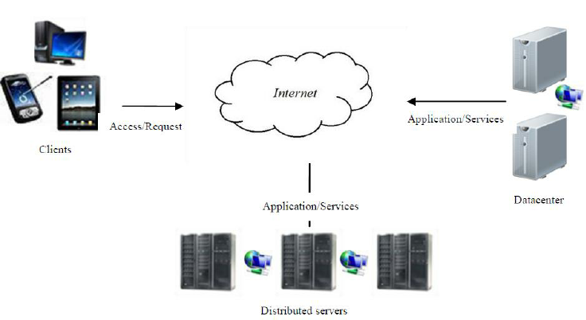
CONTI..
High Level Of Architecture Of Internet Computing

Slide 16
CHARACTERISTICS OF CLOUD COMPUTING
On-Demand Self Service
Measured Service
Board Network Access
CLOUD
Resource Polling
Rapid Elasticity

Slide 17
CONTI..
On-demand Self-service:- A consumer can unilaterally provision computing capabilities, such as server time and network storage, as needed automatically without requiring human interaction with each service provider.
Broad Network Access:- Capabilities are available over the network and accessed through standard mechanisms that promote use by heterogeneous thin or thick client platforms (e.g., mobile phones, tablets, laptops, and workstations).
Rapid Elasticity:- Capabilities can be expanded or released automatically (i.e., more CPU power, or ability to handle additional users). To the customer this appears seamless, limitless, and responsive to their changing requirements

Slide 18
CONTI..
Resource Pooling:- The provider’s computing resources are pooled to serve multiple consumers. Resources can be dynamically assigned and reassigned according to customer demand. Customer generally may not care where the resources are physically located but should be aware of risks if they are located offshore
Measured Service:- Customers are charged for the services they use and the amounts. There is a metering concept where customer resource usage can be monitored, controlled, and reported, providing transparency for both the provider and consumer of the utilized service

Slide 19
COMPONENTS OF CLOUD
Client infrastructure:- client infrastructure is a front end component it provides GUI (Graphical User Interface) to interact with the cloud.
Application:- The application may be any software or platform that a clients wants to access.
Service:- A cloud services manages that which type of services you access according to the clients requirement. There are three type of services Software as a Services, Platform as a Services, Infrastructure as a Services.
Runtime Cloud:- Runtime cloud provides the execution and runtime environment to the virtual machines.
Storage:- Storage is one of the most important components of cloud computing. It provides a huge amount of storage capacity in the cloud to store and manage data.

Slide 20
CONTI..
Infrastructure:- It provides services on the host level, application level, and network level. Cloud infrastructure includes hardware and software components such as servers, storage, network devices, virtualization software, and other storage resources that are needed to support the cloud computing model.
Management:- It is used to manage components such as application service, runtime cloud, storage, infrastructure, and other security issues in the backend and established coordination between them.
Security:- It is an in-built back end component of cloud computing. It implements a security mechanism in the back end.
Internet:- The internet is medium through which front end and back end can interact and communicate with each other.

Slide 21
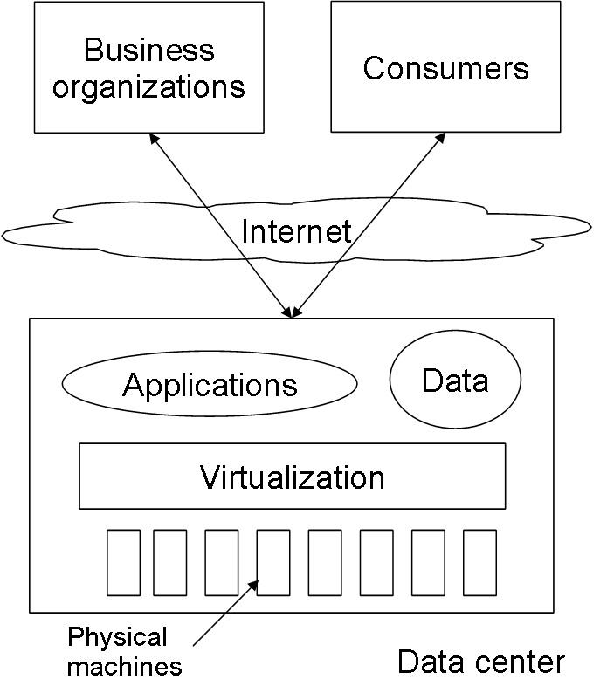
CLOUD ARCHITECTURE
The cloud providers actually have the physical data centers to provide virtualized services to their users through Internet. The cloud providers often provide separation between application and data. This scenario is shown in the Figure 2. The underlying physical machines are generally organized in grids and they are usually geographically distributed. Virtualization plays an important role in the cloud scenario. The data center hosts provide the physical hardware on which virtual machines resides. User potentially can use any OS supported by the virtual machines used
Basic Cloud Computing Architecture

Slide 22
CONTI..
Operating systems are designed for specific hardware and software. It results in the lack of portability of operating system and software from one machine to another machine which uses different instruction set architecture. The concept of virtual machine solves this problem by acting as an interface between the hardware and the operating system called as system VMs. Another category of virtual machine is called process virtual machine which acts as an abstract layer between the operating system and applications. Virtualization can be very roughly said to be as software translating the hardware instructions generated by conventional software to the understandable format for the physical hardware. Virtualization also includes the mapping of virtual resources like registers and memory to real hardware resources.

Slide 23
NIST MODEL
NIST defined cloud computing as a model for enabling ubiquitous, convenient, on-demand network access to a shared pool of configurable computing resources (e.g., networks, servers, storage, applications, and services) that can be rapidly provisioned and released with minimal management effort or service provider interaction. NISTs definition identified self-service, accessibility from desktops, laptops, and mobile phones, resources that are pooled among multiple users and applications, elastic resources that can be rapidly reapportioned as needed, and measured service as the five essential characteristics of cloud computing. When these characteristics are combined, they create cloud computing infrastructure that contains both a physical layer and an abstraction layer.

Slide 24
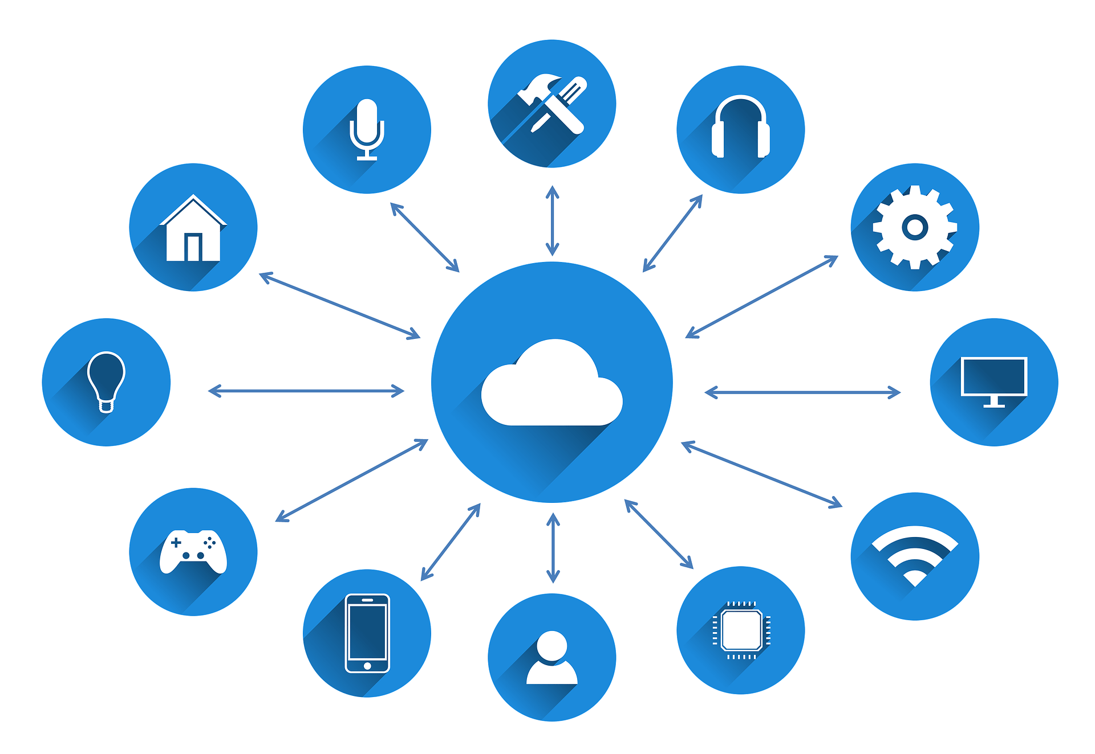
CONTI..
The physical layer consists of hardware resources that support the cloud services (i.e. servers, storage and network components). The abstraction layer consists of the software deployed across the physical layer, thereby expressing the essential characteristics of the cloud per NISTs definition.

Slide 25
CONTI..
Deployment Models:- A cloud deployment models represent a specific type of cloud environment that are distinguished by ownership, size, and access. NIST offers guidance via their definitions of each of the four deployment cloud models (Private, Community, Public, and Hybrid). Although a one-size-fits all cloud solution does not exist, each model offers to fill a specific niche for a client based on its inherent features and abilities.
Service Models:- The many paradigms of cloud computing can be broken down into three unique service model classifications: Software as a Service (SaaS), Platform as a Service (PaaS), and Infrastructure as a Service (IaaS). NIST defines each of these three service models in a highly technical sense.

Slide 26
ADVANTAGE OF CLOUD COMPUTING
Cost Savings:- Cost saving is one of the biggest Cloud Computing benefits. It helps you to save substantial capital cost as it does not need any physical hardware investments. Also, you do not need trained personnel to maintain the hardware. The buying and managing of equipment is done by the cloud service provider.
Strategic edge:- Cloud computing offers a competitive edge over your competitors. It is one of the best advantages of Cloud services that helps you to access the latest applications any time without spending your time and money on installations.
High Speed:- Cloud computing allows you to deploy your service quickly in fewer clicks. This faster deployment allows you to get the resources required for your system within fewer minutes.

Slide 27
CONTI..
Back-up and restore data:- Once the data is stored in a Cloud, it is easier to get the back-up and recovery of that, which is otherwise very time taking process on-premise.
Automatic Software Integration:- In the cloud, software integration is something that occurs automatically. Therefore, you don't need to take additional efforts to customize and integrate your applications as per your preferences.
Reliability:- Reliability is one of the biggest benefits of Cloud hosting. You can always get instantly updated about the changes.
Mobility:- Employees who are working on the premises or at the remote locations can easily access all the could services. All they need is an Internet connectivity.

Slide 28
CONTI..
Unlimited storage capacity:- The cloud offers almost limitless storage capacity. At any time you can quickly expand your storage capacity with very nominal monthly fees.
Collaboration:- The cloud computing platform helps employees who are located in different geographies to collaborate in a highly convenient and secure manner.
Quick Deployment:- Last but not least, cloud computing gives you the advantage of rapid deployment. So, when you decide to use the cloud, your entire system can be fully functional in very few minutes. Although, the amount of time taken depends on what kind of technologies are used in your business.

Slide 29
DISADVANTAGE OF CLOUD COMPUTING
Performance Can Vary:- When you are working in a cloud environment, your application is running on the server which simultaneously provides resources to other businesses. Any greedy behavior or DDOS attack on your tenant could affect the performance of your shared resource.
Technical Issues:- Cloud technology is always prone to an outage and other technical issues. Even, the best cloud service provider companies may face this type of trouble despite maintaining high standards of maintenance.
Security Threat in the Cloud:- Another drawback while working with cloud computing services is security risk. Before adopting cloud technology, you should be well aware of the fact that you will be sharing all your company's sensitive information to a third-party cloud computing service provider.

Slide 30
CONTI..
Downtime:- Downtime should also be considered while working with cloud computing. That's because your cloud provider may face power loss, low internet connectivity, service maintenance, etc.
Internet Connectivity:- Good Internet connectivity is a must in cloud computing. You can't access cloud without an internet connection. Moreover, you don't have any other way to gather data from the cloud.
Lower Bandwidth:- Many cloud storage service providers limit bandwidth usage of their users. So, in case if your organization surpasses the given allowance, the additional charges could be significantly costly
Lacks of Support:- Cloud Computing companies fail to provide proper support to the customers. Moreover, they want their user to depend on FAQs or online help, which can be a tedious job for non-technical persons.

Slide 31
REFERENCE
cloud_computing_final_report.pdf
Evolution_of_Cloud_Computing_and_Enabling_Technolo.pdf
https://www.guru99.com/advantages-disadvantages-cloud-computing.html
https://www.stratospherenetworks.com/advantages-and-disadvantages-of-cloud.html
https://en.wikipedia.org/wiki/Cloud_computing

Slide 32
THANK YOU

