Slide 1
Bertrand Paradox
Hansen Liem
7 July 2021

Slide 2
What is it?
Principle of indifference
Without any relevant information, we assign equal probabilities to all possible outcomes
Think rolling a dice, flipping a coin etc
In its simplest form, the Bertrand paradox goes against the principle of indifference

Slide 3
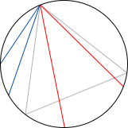

Setting up the problem
What is the probability that a chord within a unit circle is greater than length $\sqrt{3}$?

Slide 4
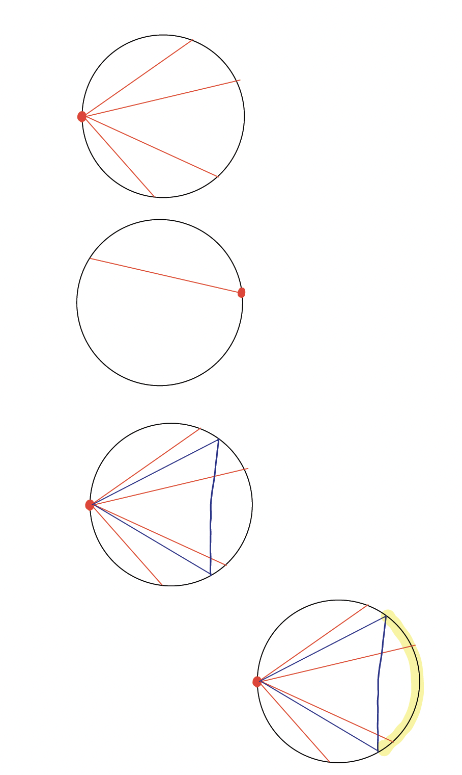
Method 1: Leftmost endpoint

Slide 5
Method 1: Leftmost endpoint
Why it works?
Recall that the circle is symmetric. Since a chord must have two endpoints on the circumference of the circle, just rotate the circle such that one of the endpoints is now the leftmost point

Slide 6

Method 1: Leftmost Endpoint
Note that we can inscribe an equilateral triangle with side of length $\sqrt{3}$ with one of the endpoints at the left most endpoint

Slide 7
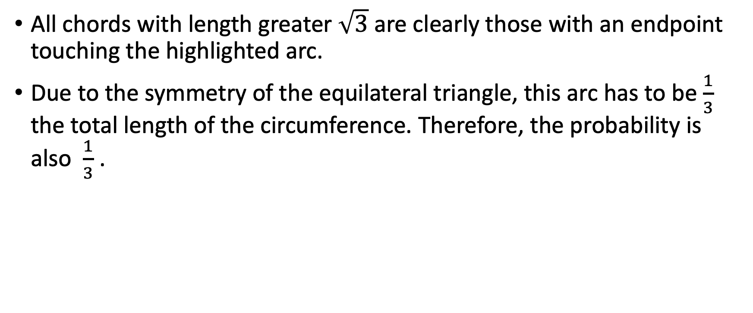
Method 1: Leftmost Endpoint
All chords with length greater $\sqrt{3}$ are clearly those with an endpoint touching the highlighted arc.
Due to the symmetry of the equilateral triangle, this arc has to be$\frac{1}{3}$ the total length of the circumference. Therefore, the probability is also $\frac{1}{3}$ .

Slide 8
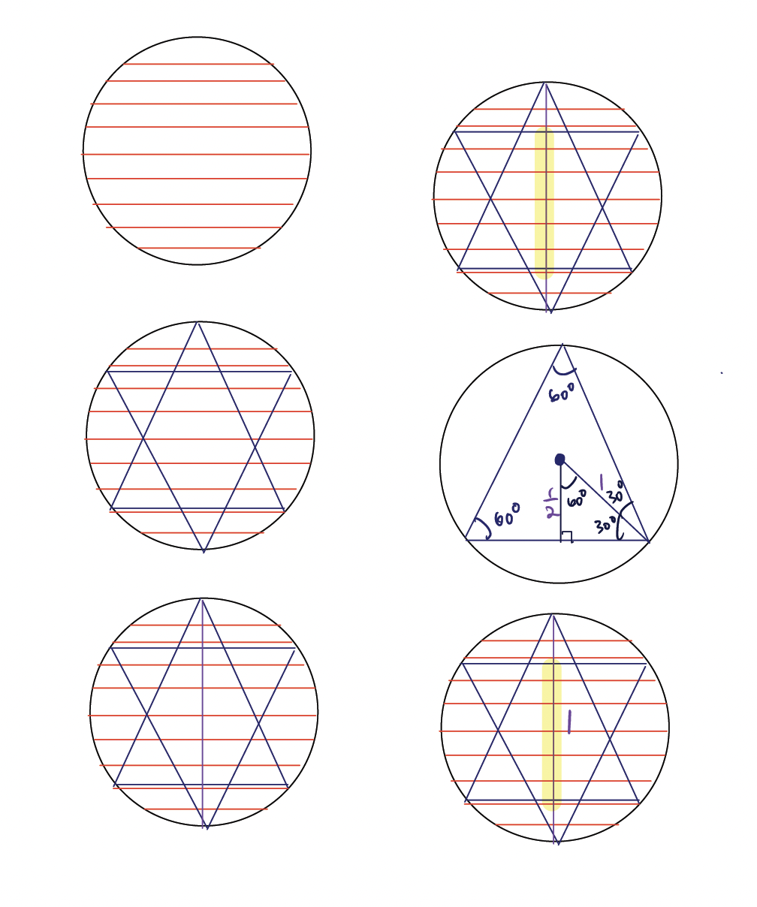
Method 2: Horizontal Chords
Why this works?
Similar to above in that a circle is symmetric. Just rotate the circle until the chord is horizontal.

Slide 9
Method 2: Horizontal Chords
We want to find which of these chords are longer than the desired length. We again inscribe an equilateral triangle but this time we inscribe 2.

Slide 10
Method 2: Horizontal Chords
We see that there is a line of symmetry that can be drawn inside the circle
Significant as all chords have their midpoint on this line of symmetry

Slide 11

Method 2: Horizontal Chords
We note that all chords with length greater than $\sqrt{3}$ are those with their midpoint on the highlighted region

Slide 12
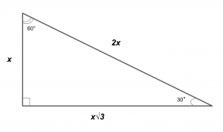
Method 2: Horizontal Chords
Let us find the length of this highlighted line of symmetry

Slide 13

Method 2: Horizontal Chords
The length of the highlighted section of the chord is 1. Since this is a unit circle with diameter 2, then the probability of the chords with length longer than $\sqrt{3}$must be $\frac{1}{2}$.

Slide 14
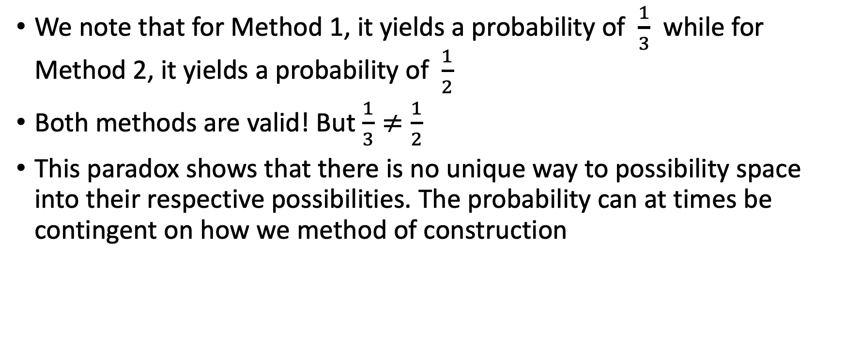
Conclusion
We note that for Method 1, it yields a probability of $\frac{1}{3}$ while for Method 2, it yields a probability of $\frac{1}{2}$
Both methods are valid! But $\frac{1}{3}≠\frac{1}{2}$
This paradox shows that there is no unique way to possibility space into their respective possibilities. The probability can at times be contingent on how we method of construction

Slide 15
Works Cited
Grinstead and Snell Sec 2.1
DrJamesTanton. “Bertrand's Paradox (TANTON Mathematics).” YouTube, YouTube, 16 June 2010, www.youtube.com/watch?v=uI2FnUmBeeo&t=210s&ab_channel=DrJamesTanton.

