Slide 1
HW2 Q5
Sam Lefkowitz

Slide 2
The Question:
Shuffle a standard deck of 52 cards
Deal 13 cards to each of the 4 players
What is the probability that each player gets an Ace?

Slide 3
Approaches to the Problem
Permutations
Combinations
Probability Distribution

Slide 4
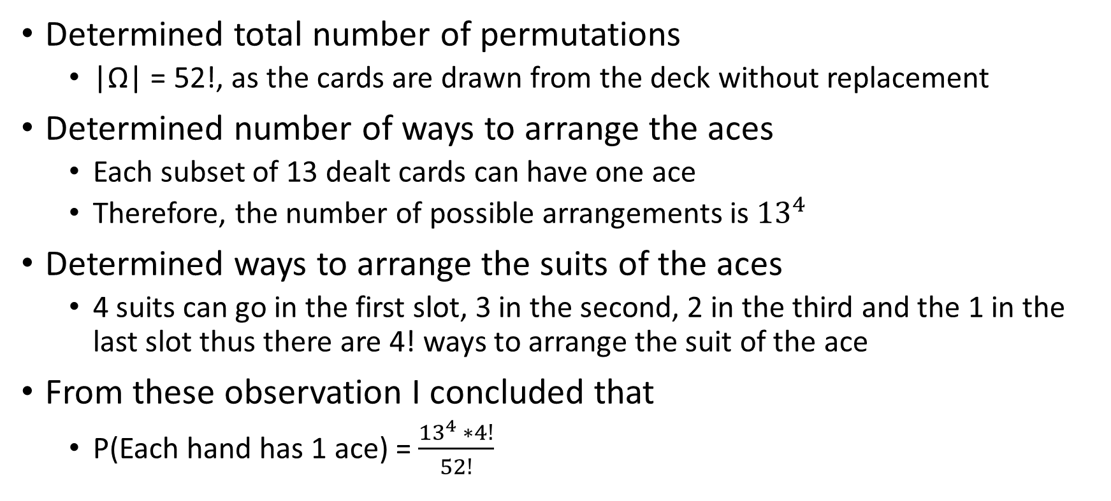
Original Approach to Permutations
Determined total number of permutations
|Ω| = 52!, as the cards are drawn from the deck without replacement
Determined number of ways to arrange the aces
Each subset of 13 dealt cards can have one ace
Therefore, the number of possible arrangements is ${13}^{4}$
Determined ways to arrange the suits of the aces
4 suits can go in the first slot, 3 in the second, 2 in the third and the 1 in the last slot thus there are 4! ways to arrange the suit of the ace
From these observation I concluded that
P(Each hand has 1 ace) = $\frac{{13}^{4} ∗4!}{52!}$

Slide 5
Why is this wrong?
Fails to account for the arrangement of the non-Ace cards
To account for all possible arrangements of the non-Ace cards we must consider the unique ways these 48 cards can be permuted.
Since there are 48 cards for the 1st slot, 47 for 2nd , …, 1 for 48th slot
48! ways to arrange non-Ace cards

Slide 6
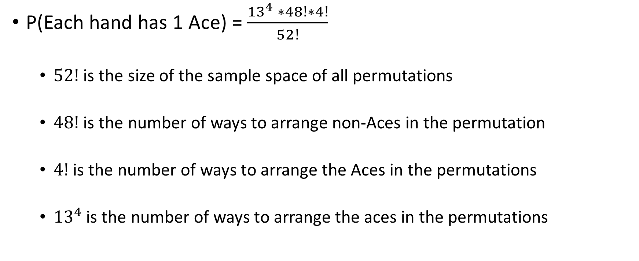
A Correct Solution to Permutation Approach
P(Each hand has 1 Ace) = $\frac{{13}^{4} ∗48!∗4!}{52!}$
$52!$ is the size of the sample space of all permutations
$48!$ is the number of ways to arrange non-Aces in the permutation
$4!$ is the number of ways to arrange the Aces in the permutations
${13}^{4}$ is the number of ways to arrange the aces in the permutations

Slide 7

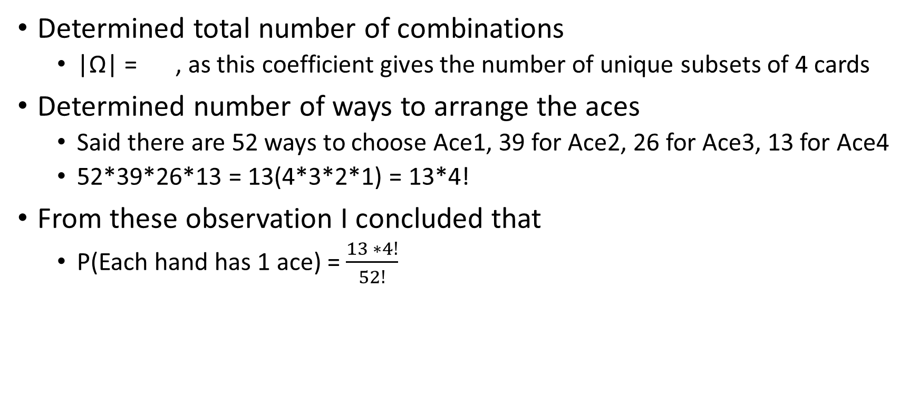
Original Approach to Combinations
Determined total number of combinations
|Ω| = , as this coefficient gives the number of unique subsets of 4 cards
Determined number of ways to arrange the aces
Said there are 52 ways to choose Ace1, 39 for Ace2, 26 for Ace3, 13 for Ace4
52*39*26*13 = 13(4*3*2*1) = 13*4!
From these observation I concluded that
P(Each hand has 1 ace) = $\frac{13 ∗4!}{52!}$

Slide 8
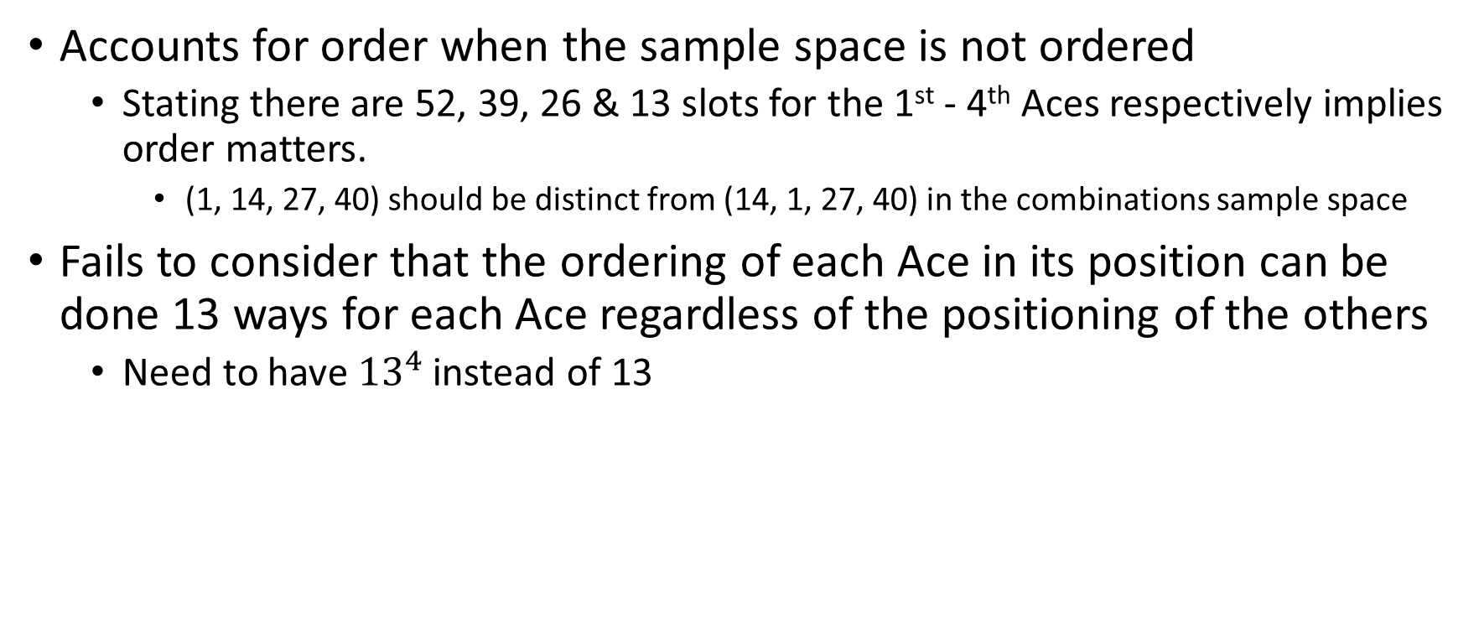
Why is this wrong?
Accounts for order when the sample space is not ordered
Stating there are 52, 39, 26 & 13 slots for the 1st - 4th Aces respectively implies order matters.
(1, 14, 27, 40) should be distinct from (14, 1, 27, 40) in the combinations sample space
Fails to consider that the ordering of each Ace in its position can be done 13 ways for each Ace regardless of the positioning of the others
Need to have ${13}^{4}$ instead of 13

Slide 9

A Correct Solution to Combination Approach
P(Each hand has 1 Ace) = $\frac{{13}^{4} }{ }$
is the size of the sample space of all combinations
${13}^{4}$ is the number of ways to arrange the aces in the combinations

Slide 10

Using Probability Distribution Approach
After reading chapter 5 in Grinstead & Snell, I observed the process of dealing a hand is accurately described by the hypergeometric distribution
Hypergeometric Distribution: h(N, k, n, x) =
N: number of elements in sample space
k: number of elements with specific property in sample space
n: number of elements drawn without replacement from sample space
x: number of elements drawn with property k

Slide 11

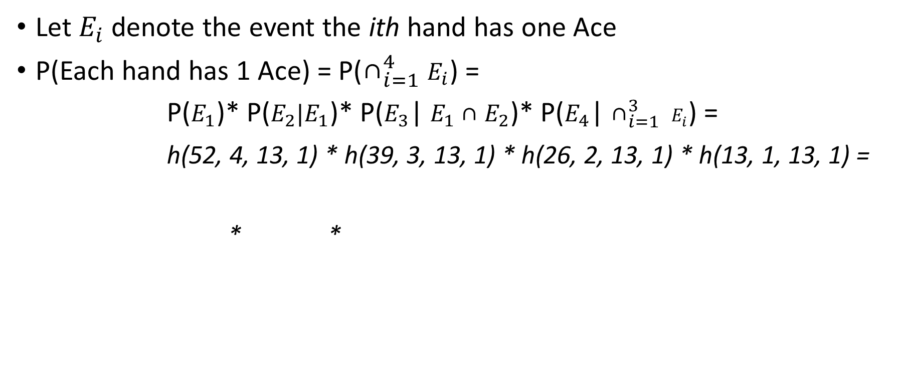
Using Hypergeometric Distribution
Let $E_{i}$ denote the event the ith hand has one Ace
P(Each hand has 1 Ace) = P(${\text{∩}}_{i=1}^{4}$ $E_{i}$) =
P($E_{1}$)* P($E_{2}|E_{1}$)* P($E_{3}$| $E_{1}{\text{∩} E}_{2}$)* P($E_{4}$| ${\text{∩}}_{i=1}^{3} E_{i}$) =
h(52, 4, 13, 1) * h(39, 3, 13, 1) * h(26, 2, 13, 1) * h(13, 1, 13, 1) =
* *

Slide 12
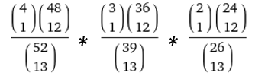


All Approaches Result in the Same Value
Hypergeometric: = $\frac{4! ∗ \frac{48!}{{(12!)}^{4}}}{\frac{52!}{{(13!)}^{4}}}$ =
$\frac{4! ∗48!}{52!}$ * $\frac{{(13!)}^{4}}{{(12!)}^{4}}$ = $\frac{4! ∗48!∗{13}^{4}}{52!}$
Permutation: $\frac{{13}^{4} ∗ 48! ∗ 4!}{52!}$ = ${13}^{4}∗$ $\frac{48! ∗ 4!}{52!}$ = ${13}^{4}∗$ $\frac{1}{\frac{52!}{48! ∗ 4!}}$ =
Combination:

