Slide 1
1. Business understanding

Slide 2
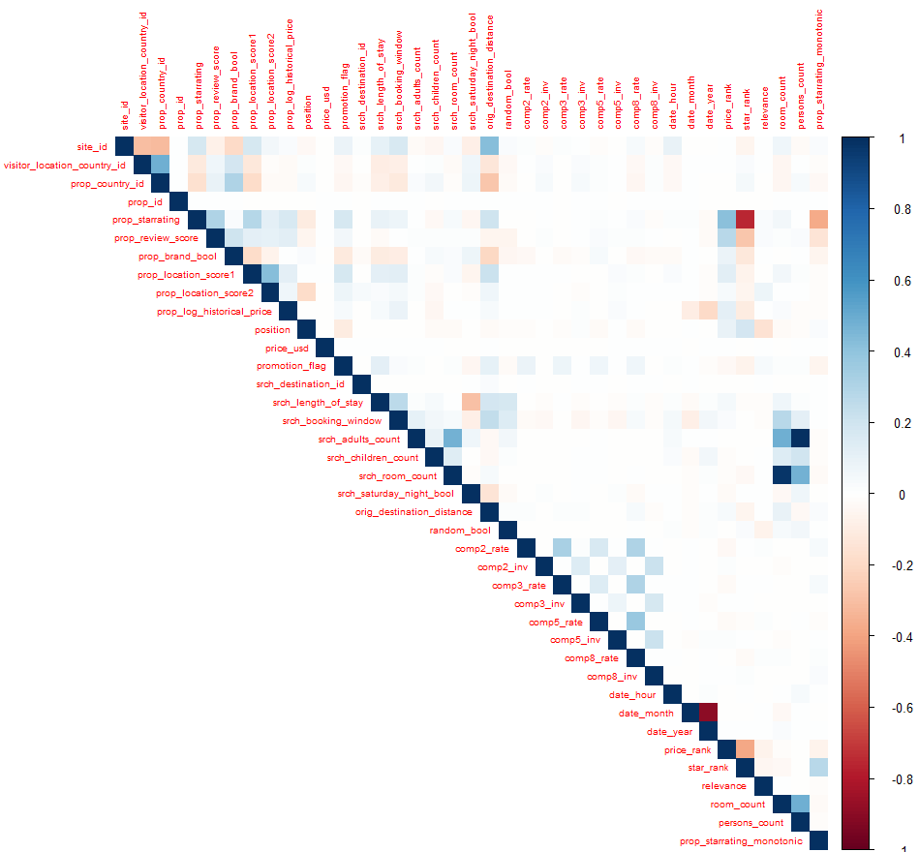
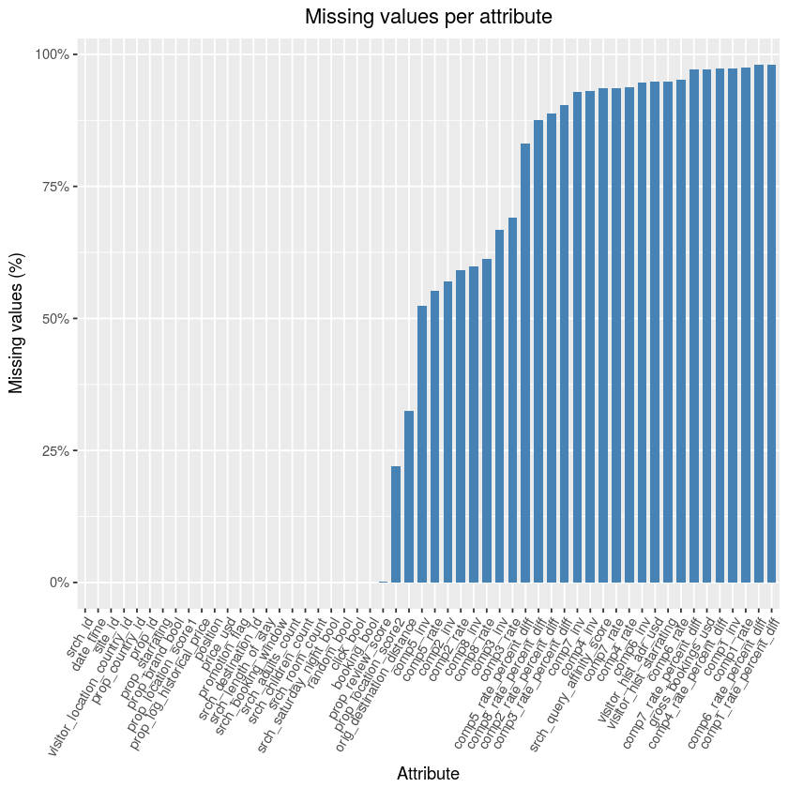
2. Data understanding

Slide 3
3. Data preparation
usd_di f f = jprice_usd 􀀀 visitor_hist_adr_usdj
starrating_di f f = jprop_starrating 􀀀 visitor_hist_starratingj
F1_F2 = F1 max(F2) + F2
prop_starrating_monotonic = jprop_starrating 􀀀 mean(prop_starrating[booking_bool])j

Slide 4
3.1. Data engineering

Slide 5
3.2. Split the data

Slide 6
3.3. Missing values

Slide 7
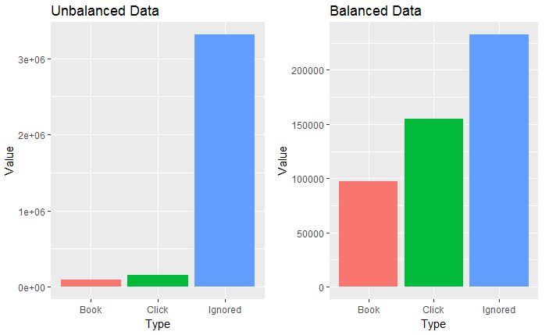
3.4. Balance the data

Slide 8
4. Modeling and Evaluation
4.0.2 Evaluation method
4.1. First modeling approach
4.1.1 Multinomial logistic Regression
4.1.2 Random Forest
4.2. Second modeling approach
4.2.1 Binomial Logistic Regression
4.2.2 Ranger
4.2.3 LambdaMART

Slide 9
4.1.1 Multinomial logistic Regression

Slide 10
4.1.2 Random Forest

Slide 11
4.2.1 Binomial Logistic Regression

Slide 12
4.2.2 Ranger

Slide 13
4.2.3 LambdaMART

Slide 14
5. Discussion and Conclusions

Slide 15
6. Further Approaches and Report Assessment

