Slide 1
ASSIGNMENT 2 Data Mining Techniques
Kevin de Vries
Silvia Espada Burriel
Clara Ferrer Castellà

Slide 2

1. Approach
Analyze the performance of Logistic Regression, Ranger and LambdaMART to predict the best hotel ranking in a hotel search
Preparation of the data for this aim

Slide 3
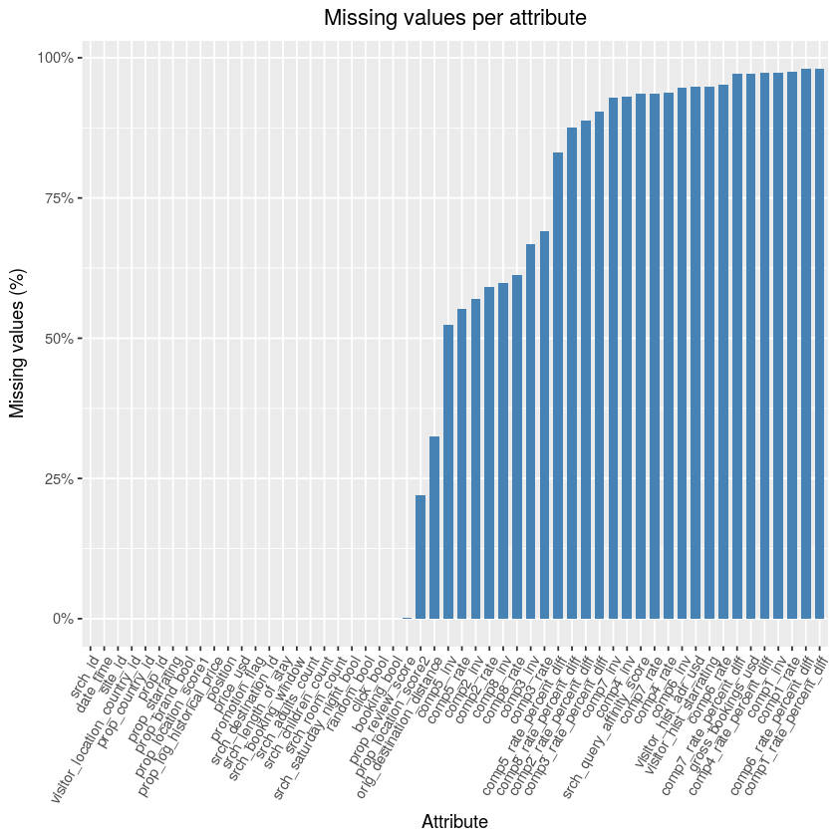
2. Data understanding
Visualization of missing values
in the dataset

Slide 4
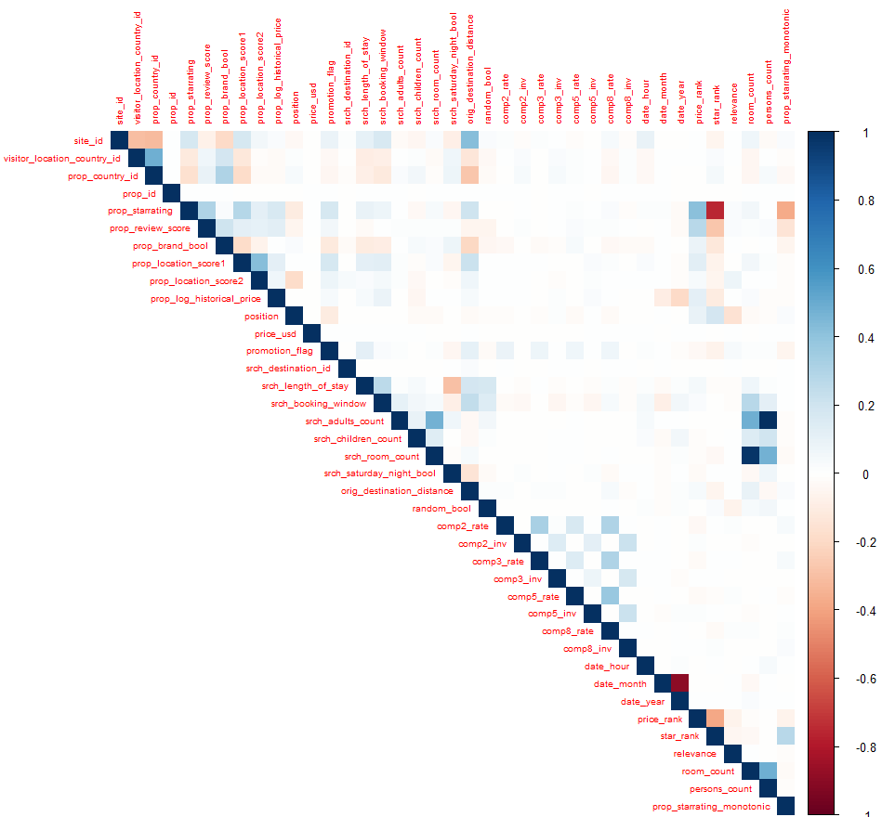
2. Data understanding
Correlation matrix between the
variables

Slide 5

3. Data preparation
Data engineering
Split the data
Missing values
Balance the data

Slide 6
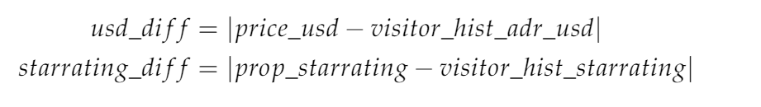

3.1. Data engineering
Composite features (persons_count, room_count):

Slide 7
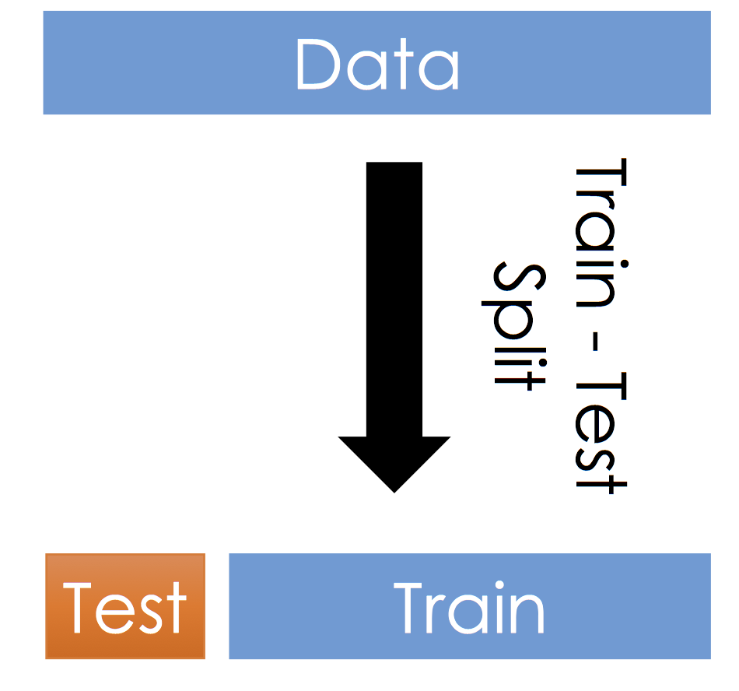
3.2. Split the data
20 % 80%

Slide 8
3.3. Missing values

Slide 9
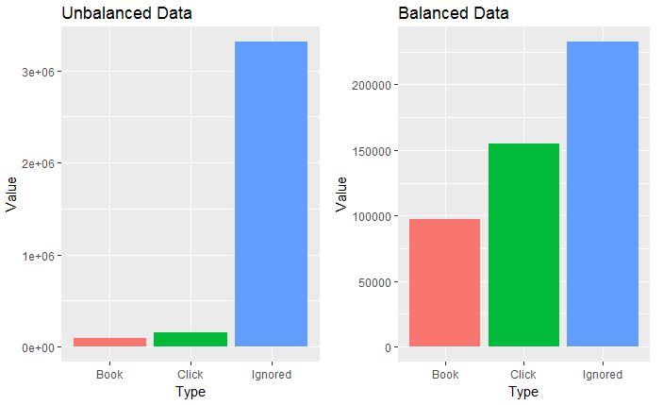
3.4. Balance the data

Slide 10

4. Modeling and Evaluation
4.0.2 Evaluation method
4.1. First modeling approach
4.1.1 Multinomial logistic Regression
4.1.2 Random Forest
4.2. Second modeling approach
4.2.1 Binomial Logistic Regression
4.2.2 Ranger
4.2.3 LambdaMART

Slide 11
4.1.1 Multinomial logistic Regression
Adapted for Learning to Rank → ranking probabilities ignored, clicked and booked per search ID
NDCG = 0.3998
NDCG = 0.4021 (feature engineering)
NDCG = 0.4011 (feature engineering + variables with a higher influence)

Slide 12
4.1.2 Random Forest
+10 hours running (all the variables)
+10 hours running (variables - 75% NA’s)
+10 hours running (variables - 50% NA’s)

Slide 13
4.2.1 Binomial Logistic Regression
Adapted for Learning to Rank → ranking probabilities no booked and booked per search ID
NDCG = 0.4620 (feature engineering)
NDCG = 0.4038 (feature engineering + variables with a higher influence)

Slide 14
4.2.2 Ranger
Fast implementation of Random Forest
NDCG = 0. 4061 (feature engineering)
NDCG = 0. 3990 (feature engineering + variables with a higher influence)

Slide 15
4.2.3 LambdaMART

Slide 16
5. Discussion and Conclusions

