Slide 1

Sistemi Wearable e Telemetria Medica
A.A 2024-25
(Final course project)
Wireless UHF RFID based bladder pressure sensor
TASK 3
Laboratorio
Elettromagnetismo
Pervasivo
Prof. G. Marrocco
Tutor: Ing. Francesca Nanni
1

Slide 2
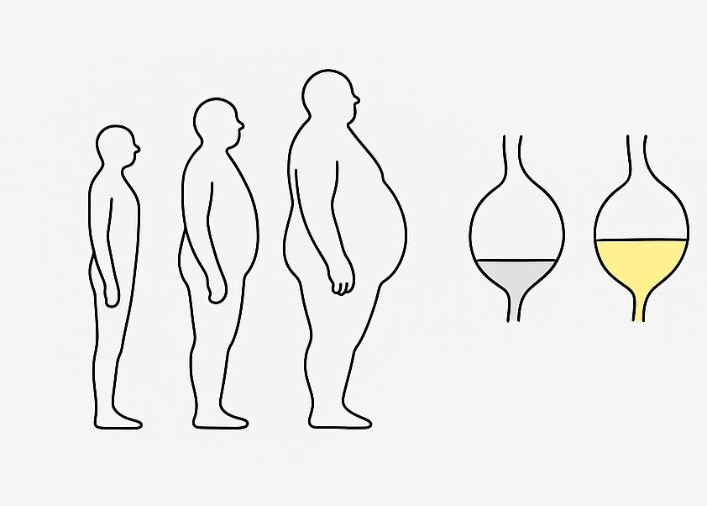
Introduction
Hypothesis:
Tissue & fluid effects
Simultaneous input and output adaptation
No encapsulation losses

Slide 3

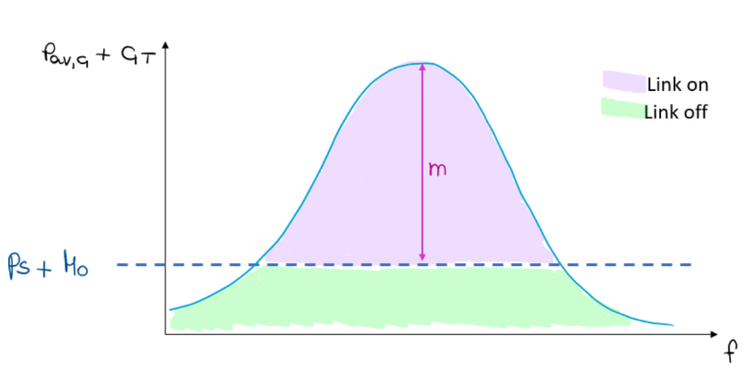
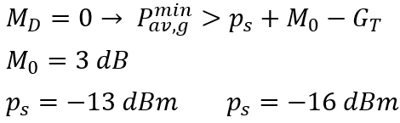
Mid-Field link

Slide 4

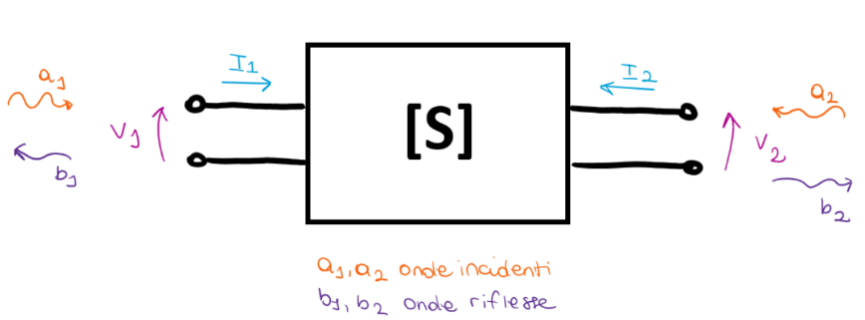
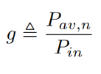

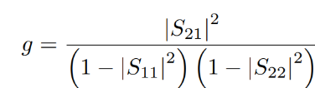

Upper bound performance
=1

Slide 5
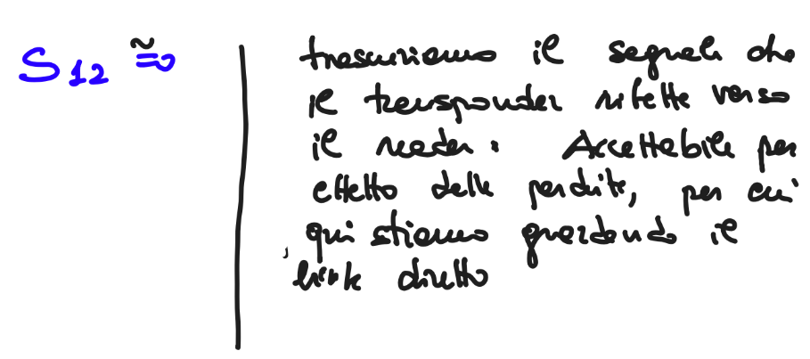
MAG vs g
If S12 ≈ 0 then MAG = g. Is this the case?
YES, BUT...
Not because of this
Because of this
"It's true that S12 = 0 but only because of the high losses, and also S21 = 0, in fact the network has to be reciprocal S12 = S21. Furthermore considering S12=S21=0 leads to the same result that is MAG = g."
S12 does not depend on "how" the network will be used.
"It would mean not to consider the network reciprocal"

Slide 6
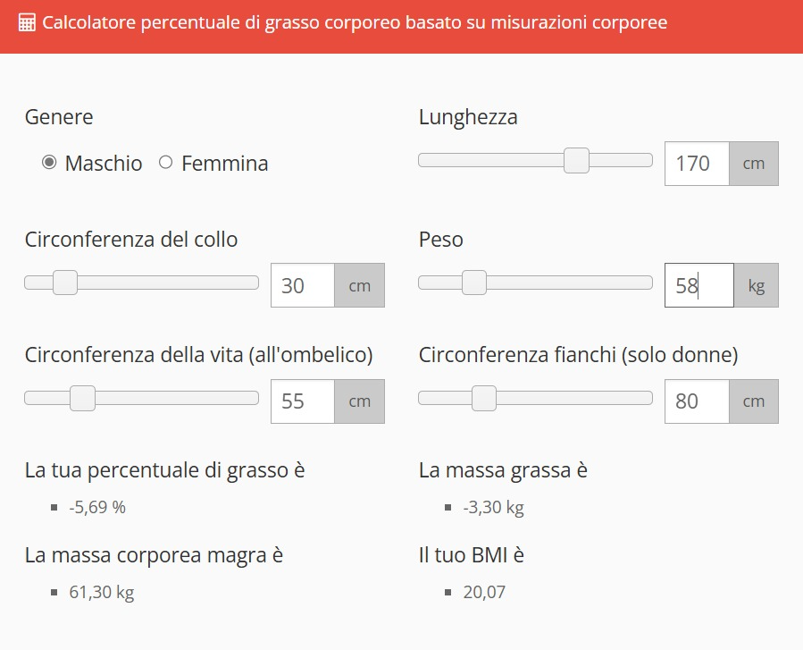
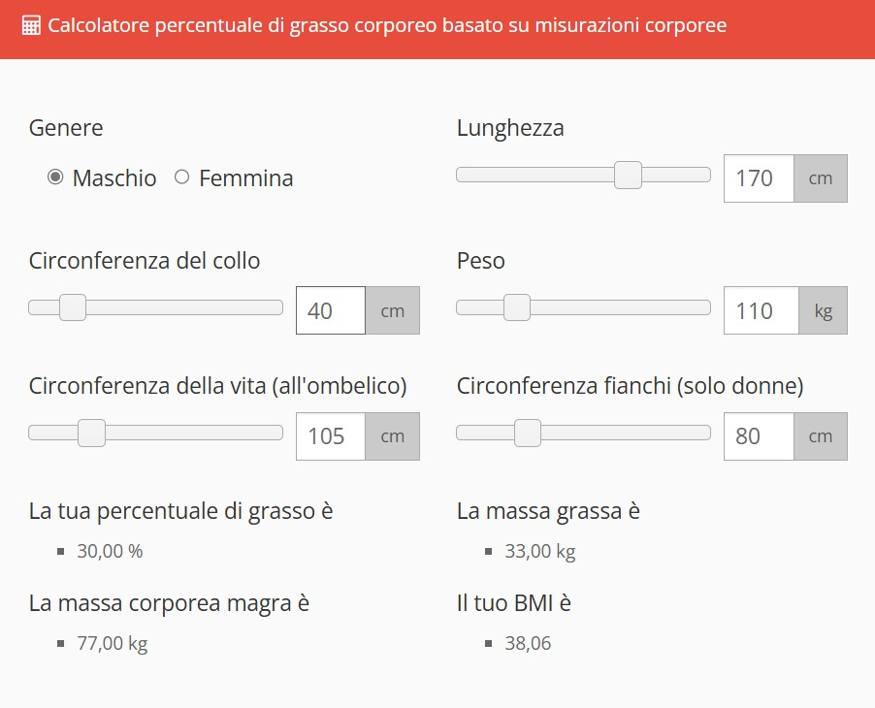
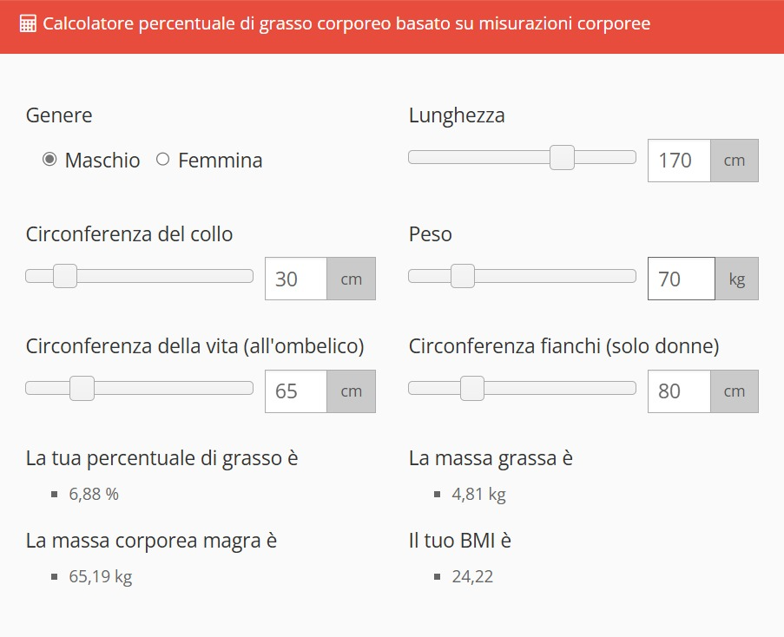
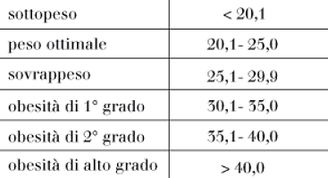
References

Slide 7
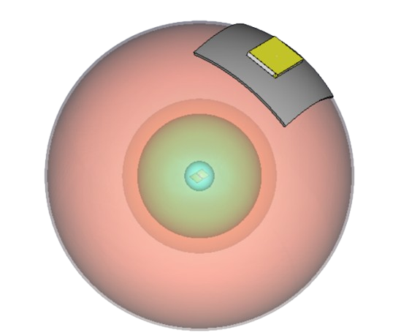
CST Spherical Model
Fat
Slot Antenna Reader
Short Dipole inside lossless implantation
Skin
Bladder
Bladder Wall

Slide 8
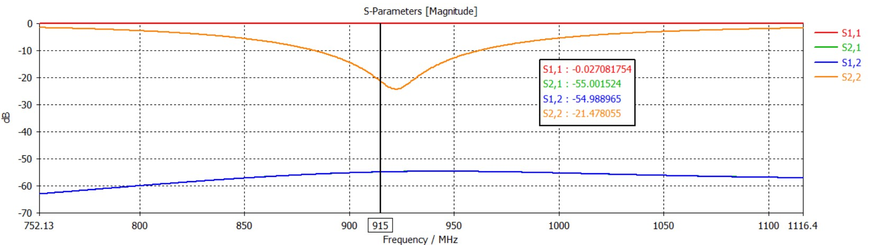
Bladder 50% urine and 50% air
Normal weight
 | Ps=-13dBm | Ps=-16dBm
Pav,g [W] | 0,194 | 0,097
g = MAG = -32,9 dB

Slide 9
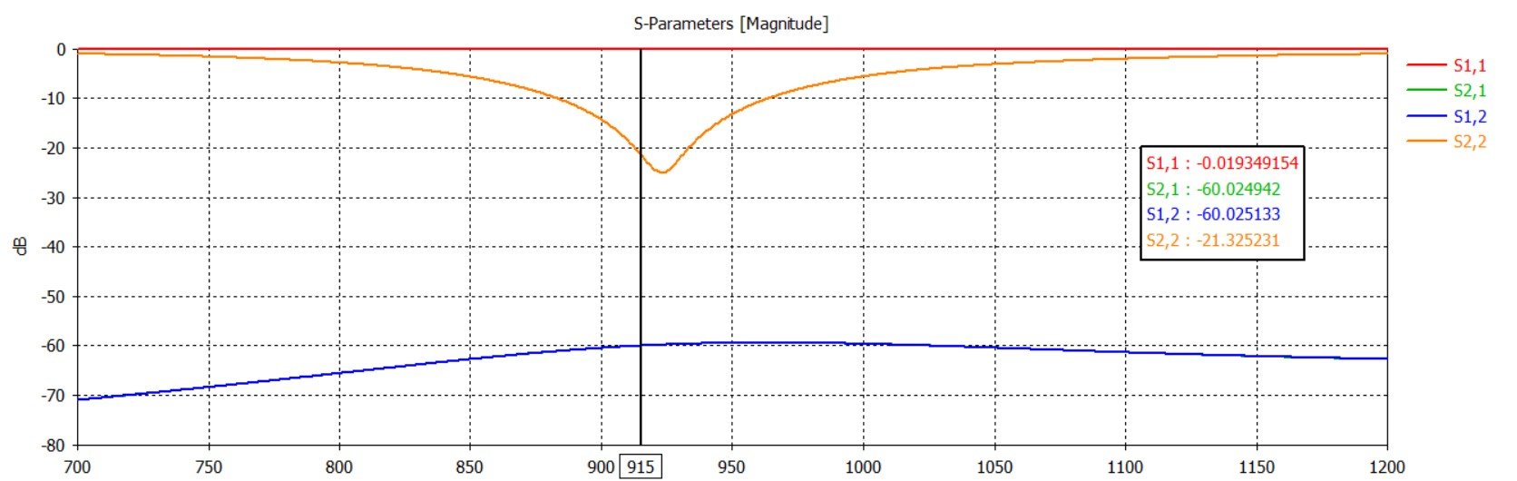
Full Bladder
Normal weight
 | Ps=-13dBm | Ps=-16dBm
Pav,g [W] | 0,433 | 0,222
g = MAG = -36,47 dB

Slide 10
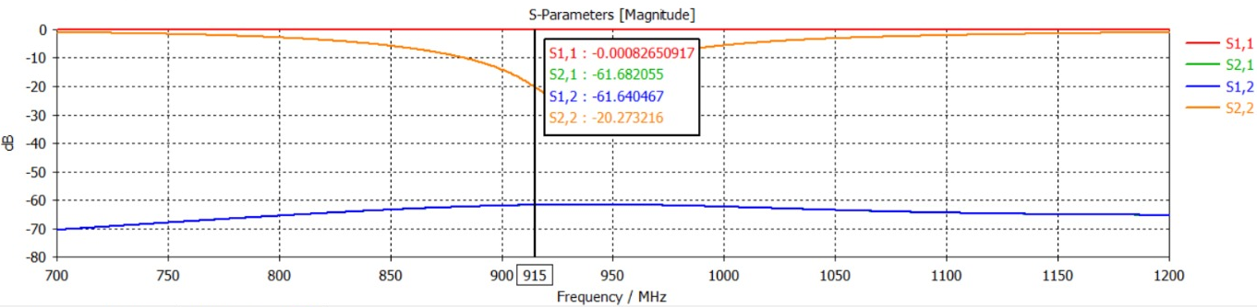
Empty Bladder
Normal weight
 | Ps=-13dBm | Ps=-16dBm
Pav,g [W] | 0,027 | 0,013
g = MAG = -24,43 dB

Slide 11
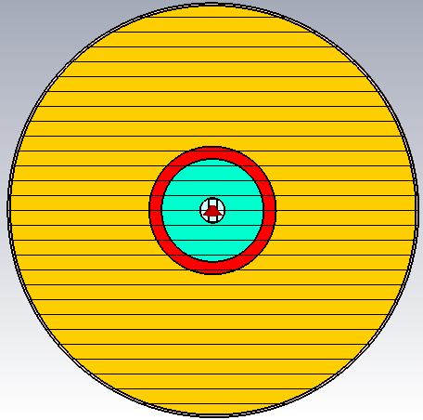
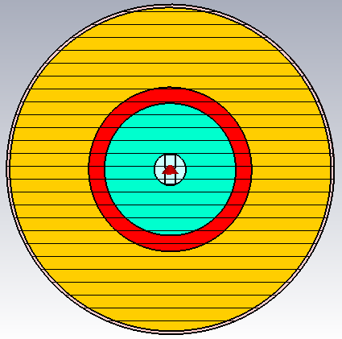
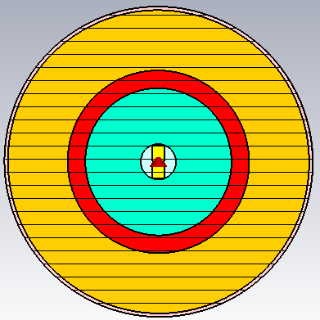
Bladder 50% urine and 50% air
ε = 34,5 ; σ= 0,82 S/m ; urine_radius = 41,5 mm
Overweight
Normal weight
Underweight
fat_radius=165mm
fat_radius=101,5mm
fat_radius=85,5mm
g = MAG = -38,5 dB
g = MAG = -32,9 dB
g = MAG = -30,3 dB
 | Ps=-13dBm | Ps=-16dBm
Pav,g [W] | 0,707 | 0,354
 | Ps=-13dBm | Ps=-16dBm
Pav,g [W] | 0,194 | 0,097
 | Ps=-13dBm | Ps=-16dBm
Pav,g [W] | 0,107 | 0,053

Slide 12
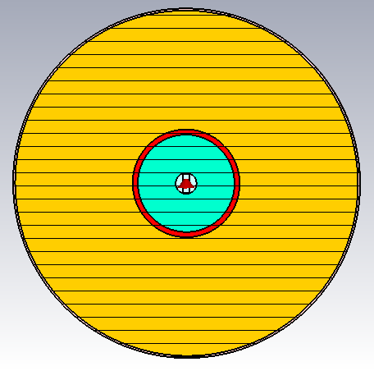
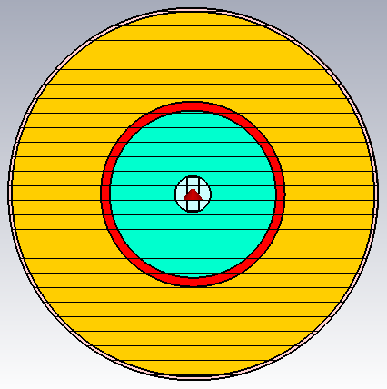
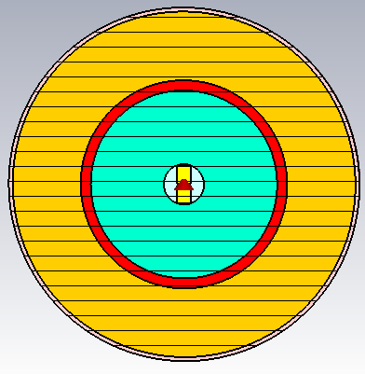
Full Bladder
ε = 68,89 ; σ= 1,64 S/m ; urine_radius = 46,5 mm
Overweight
Normal weight
Underweight
fat_radius=165mm
fat_radius=101,5mm
fat_radius=85,5mm
g = MAG = -42,2 dB
g = MAG = -36,47 dB
g = MAG = -33,7 dB
 | Ps=-13dBm | Ps=-16dBm
Pav,g [W] | 1,659 | 0,831
 | Ps=-13dBm | Ps=-16dBm
Pav,g [W] | 0,433 | 0,222
 | Ps=-13dBm | Ps=-16dBm
Pav,g [W] | 0,234 | 0,117

Slide 13
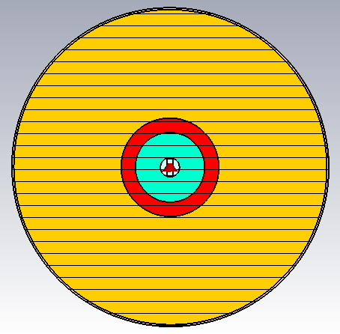
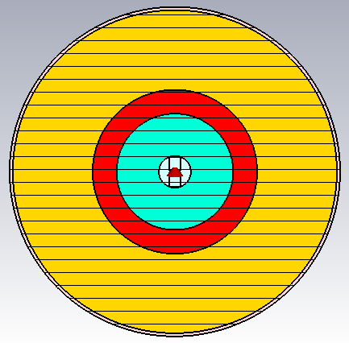
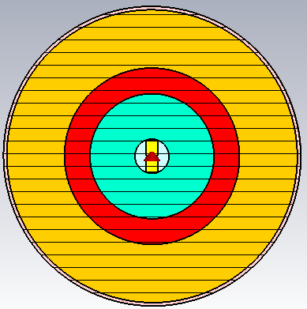
Empty Bladder
ε = 1 ; σ= 0 S/m ; urine_radius = 36,5 mm
Overweight
Normal weight
Underweight
fat_radius=165mm
fat_radius=101,5mm
fat_radius=85,5mm
g = MAG = -30 dB
g = MAG = -24,43 dB
g = MAG = -21,5 dB
 | Ps=-13dBm | Ps=-16dBm
Pav,g [W] | 0,1 | 0,05
 | Ps=-13dBm | Ps=-16dBm
Pav,g [W] | 0,027 | 0,013
 | Ps=-13dBm | Ps=-16dBm
Pav,g [W] | 0,014 | 0,007

Slide 14
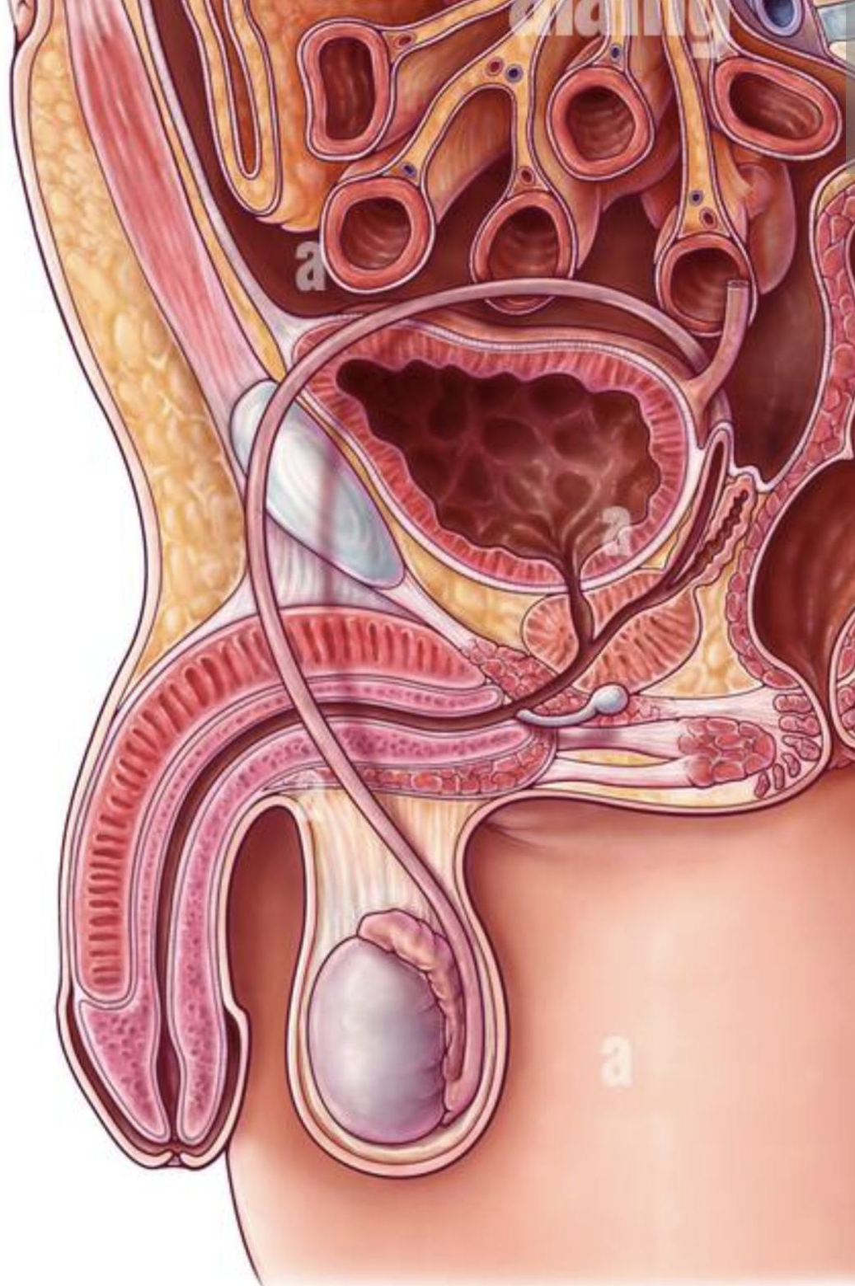
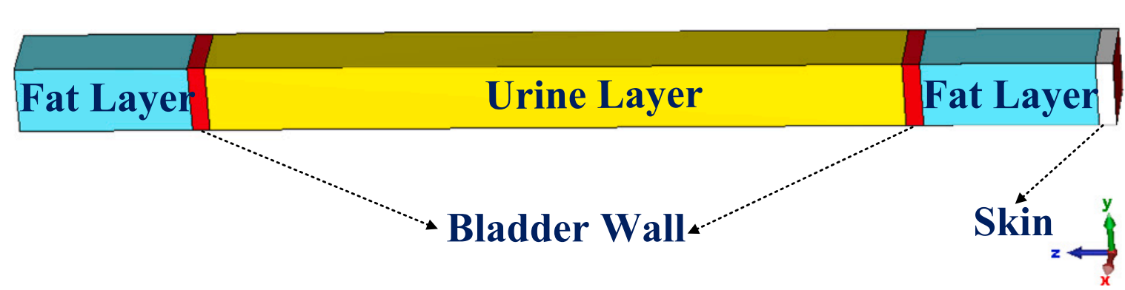
Model Consideration
This was our reference model
What if we consider the abdominal muscle layer?
Can we be more accurate?
Let's add a muscular layer!

Slide 15
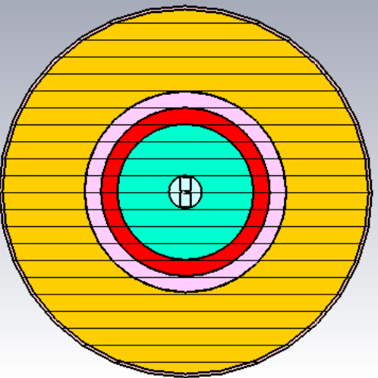
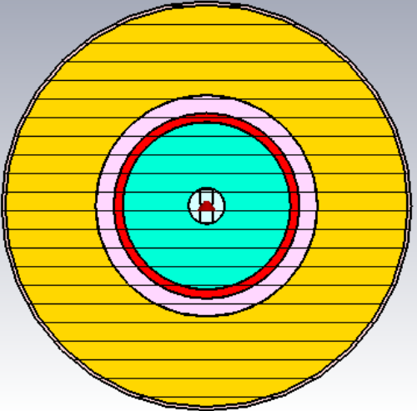
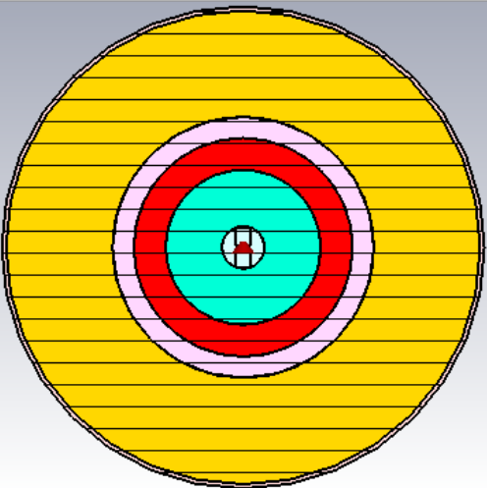
Normal Weight Simulation
50% urine 50 % air
Full Bladder
Empty Bladder
g = MAG = -37.7 dB
g = MAG = -39,7 dB
g = MAG = -28,4 dB
 | Ps=-13dBm | Ps=-16dBm
Pav,g [W] | 0,6 | 0,3
 | Ps=-13dBm | Ps=-16dBm
Pav,g [W] | 0,94 | 0,47
 | Ps=-13dBm | Ps=-16dBm
Pav,g [W] | 0,07 | 0,035

Slide 16
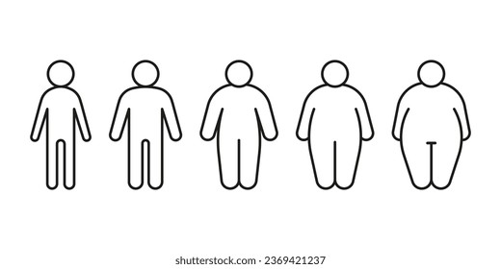

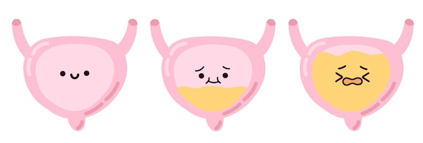
Conclusions/Final Considerations
Problems concerning future antenna design:
Input impedance changes too much between different filling configurations
Decision on the incapsulation material (beacuse it will probably also affects the input impedance)
MAG decreases
Pav,g increases

