Slide 1

Sistemi Wearable e Telemetria Medica
A.A 2024-25
(Final course project)
Wireless UHF RFID based bladder pressure sensor
TASK 6
Laboratorio
Elettromagnetismo
Pervasivo
Prof. G. Marrocco
Tutor: Ing. Francesca Nanni
1

Slide 2
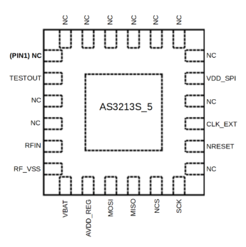

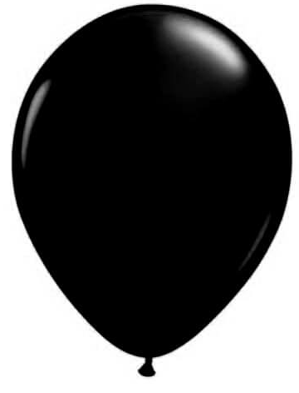

Approaching the final design
Adding chip footprint and matching the impedance
$Z_{chip}$ (@915 MHz)= 30 - i$∙$195Ω
Simulations
Real bladder
Bladder as a balloon

Slide 3
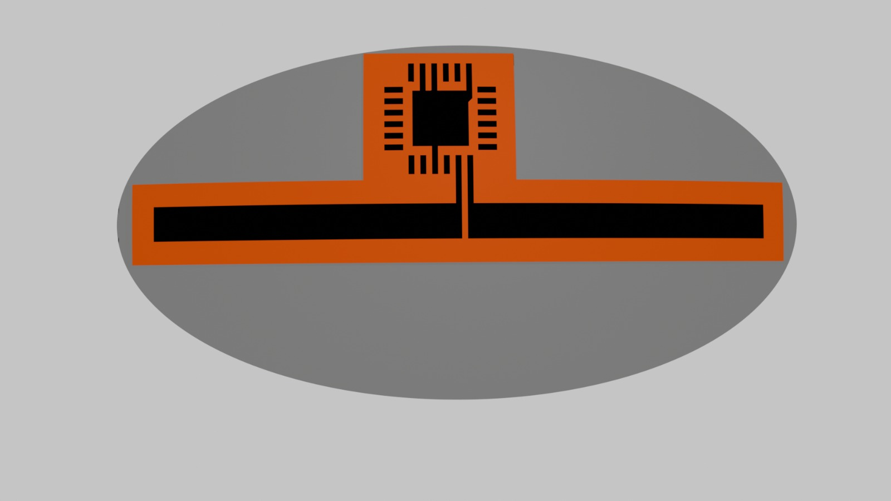
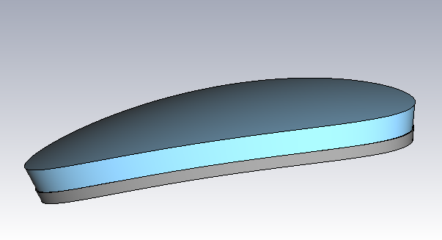
Final Model Dimension
Asygn AS3213S_5 Footprint
Dipole L = 27mm x W = 1.5 mm
Elliptical Incapsulation:
-Major axis 30 mm
-Minor axis 15 mm
Elliptical Incapsulation:
-Bottom silicon layer 1 mm
-Top low-ε material 2 mm

Slide 4
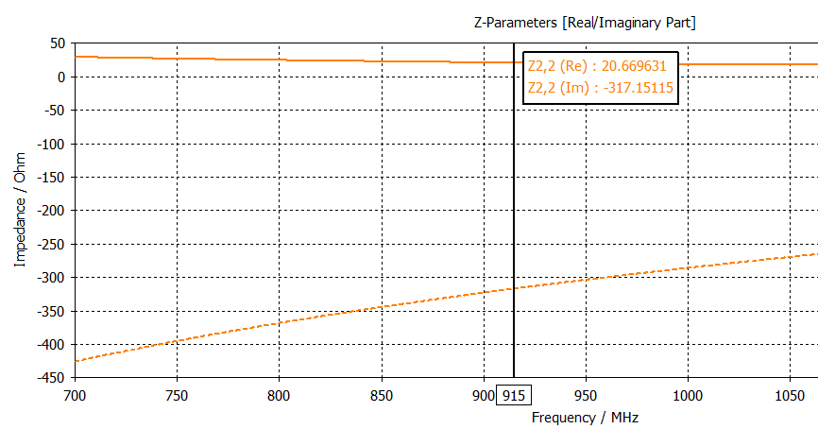
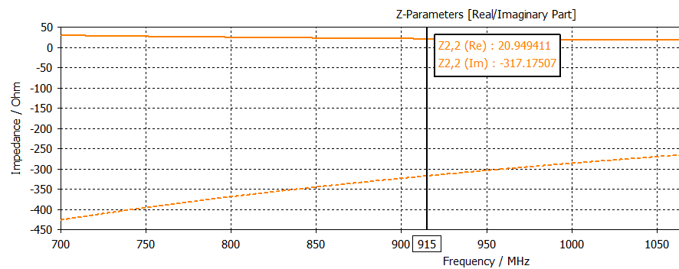
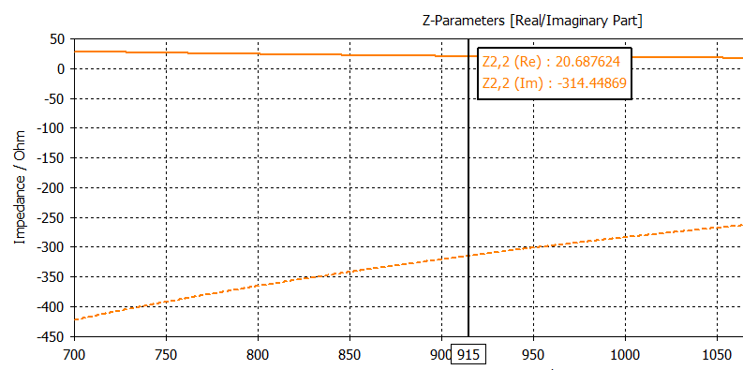
Real Bladder Tag Impedance
Including chip footprint
Empty bladder
Half-Filled bladder
Full bladder
No variations with filling condition (as we already knew)

Slide 5
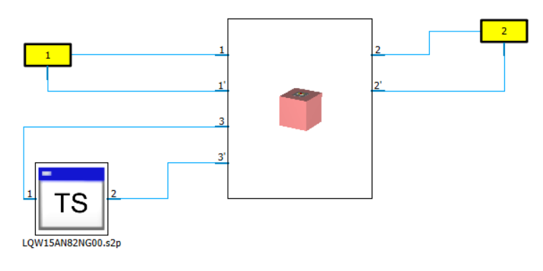
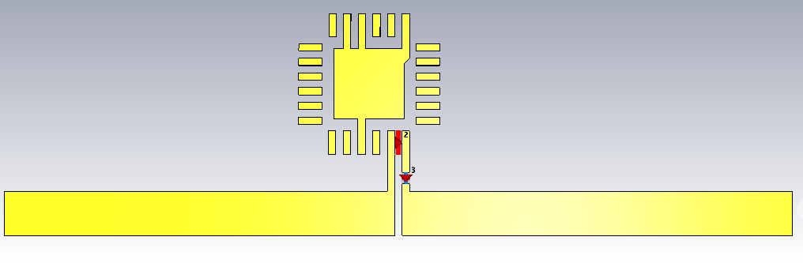
Schematic model
Ideally we would need an 89 nH series inductor to match chip's impedance
Reader Antenna
82nH inductor
According to available real inductors, 82 nH showed best performances

Slide 6
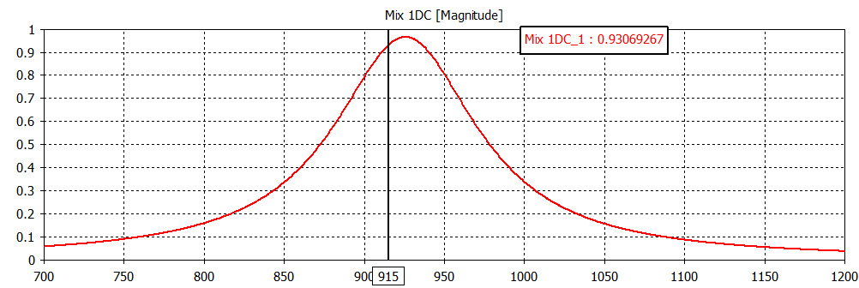
Real bladder τ
50% air and 50% urine

Slide 7
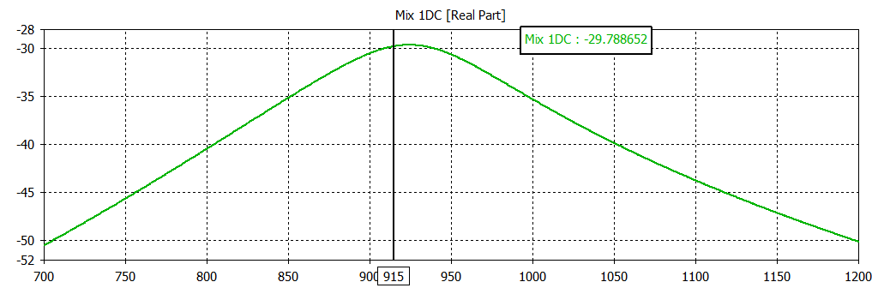
Real bladder GT
50% air and 50% urine
Nothing changes between the three types of filling (empty, 50/50, full), therefore fluid in the bladder is not a determining factor.

Slide 8
Balloon's dielectric characteristics
Cole – Cole model for latex
Equation models the complex permittivity ε* as the sum of two dielectric relaxations and a conductivity term, where ε∞,d, Δε1, and Δε2 depend on the dry rubber content (DRC), σd depends on both temperature and DRC, and ε0,space is the permittivity of free space.
Used fluid: saline solution → ε= 72, σ = 1,5 (Very similar to the one used until now)
Balloon thickness considered= 0,1 mm
Results:
ε = 15
σ = 0,5
"Characterisation of the dielectric properties of rubber latex from 0.5 to 33 GHz"

Slide 9
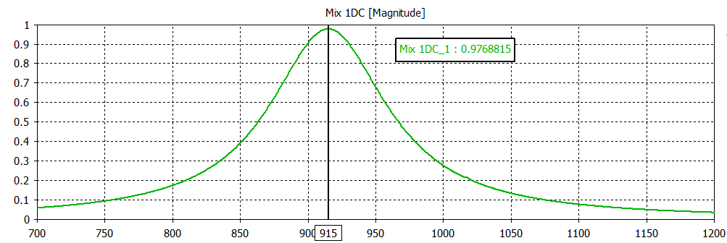
Bladder as balloon τ
50% air and 50% urine
We ran all the simulations using always the same 82 nH inductor

Slide 10
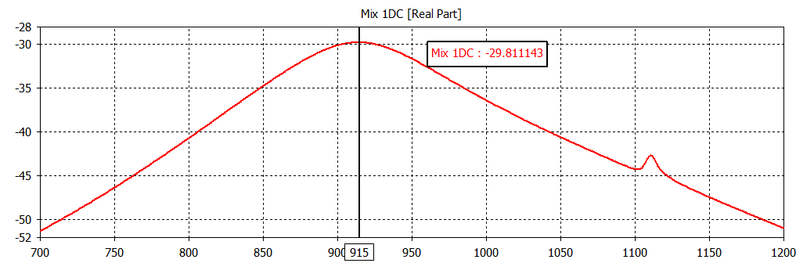
Bladder as balloon GT
50% air and 50% urine

Slide 11
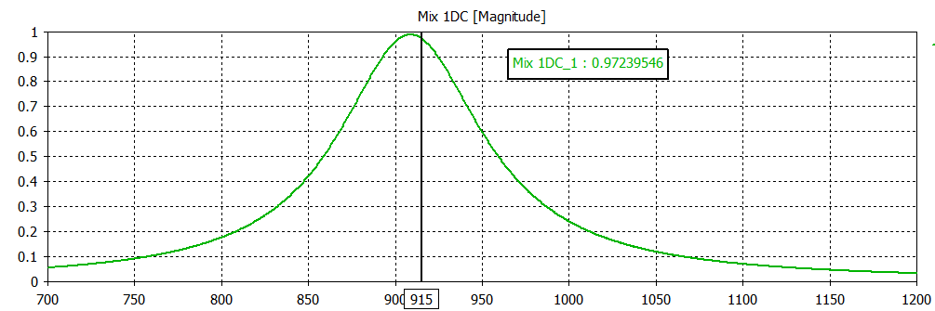
Bladder as balloon τ
Full
With half and full filling conditions the impedance matching still reaches good values

Slide 12
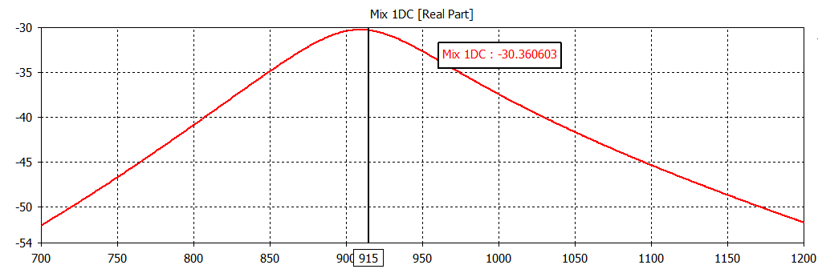
Bladder as balloon GT
Full

Slide 13
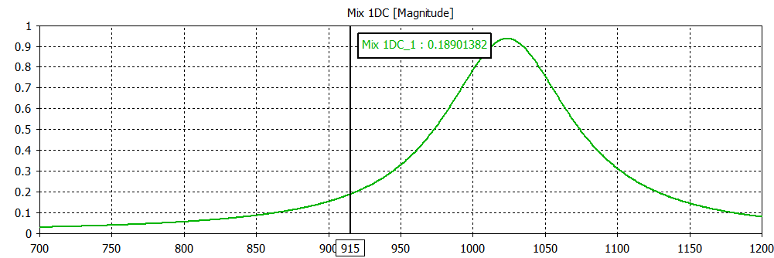
Bladder as balloon τ
Empty
Due to the thin layer of the balloon, the tag will sense the content of the "bladder". For empty configuration there is a big change in impedance

Slide 14
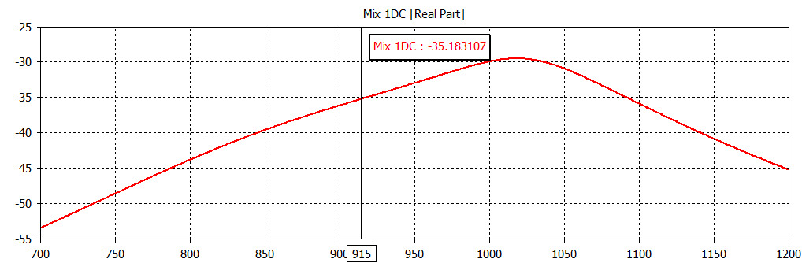
Bladder as balloon GT
Empty
Despite the matching worsening, a Gt = -35 dB should still be enough to communicate

Slide 15
Conclusions
The simulated prototype showed good performances in almost all the cases, also considering a thin balloon instead of a realistic bladder.
82 nH Inductor can match the tag impedance for full and half filled bladder
Even in the worst case (empty bladder), the transducer gain should be high enough to close the communication link
Now it's time for prototyping...

