Slide 1
Spatial architecture
Decision and timing
Order within one slot
Server 1 (near edge)
1 Retention action
7B
1.8B
tiny
2 Task arrival
compute 6 GFLOP/ms · mem-bw 900 MB/ms
226 Mbps
3 Routing
1 ms
User
Server 2 (mid edge)
4 Service
147 Mbps
Queueing across slots
8 ms
7B
1.8B
tiny
task 1: 7B, rate 0.06
compute 12 GFLOP/ms · mem-bw 900 MB/ms
busy-until
task 2: 1.8B, rate 0.15
107 Mbps
task A: reload + inference
task 3: tiny, rate 0.30
40 ms
task B arrives
Server 3 (cloud)
B waits
t
t+1
t+2
t+3
7B
1.8B
tiny
slot length 100 ms
compute 30 GFLOP/ms · mem-bw 2000 MB/ms
Learning structure (CTDE)
Actor 1
Actor 2
Actor 3
server 1
server 2
server 3
Centralized critic (training only)
pinned by QoS (leading layers)
unloaded, reload on demand
resident, unloadable

Slide 2
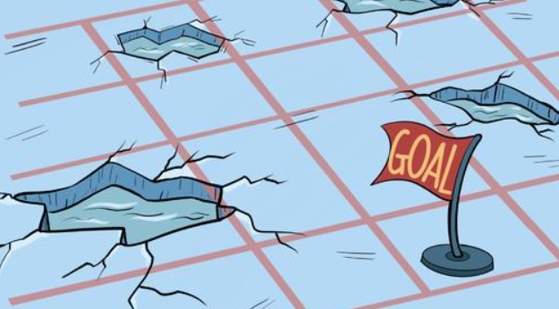




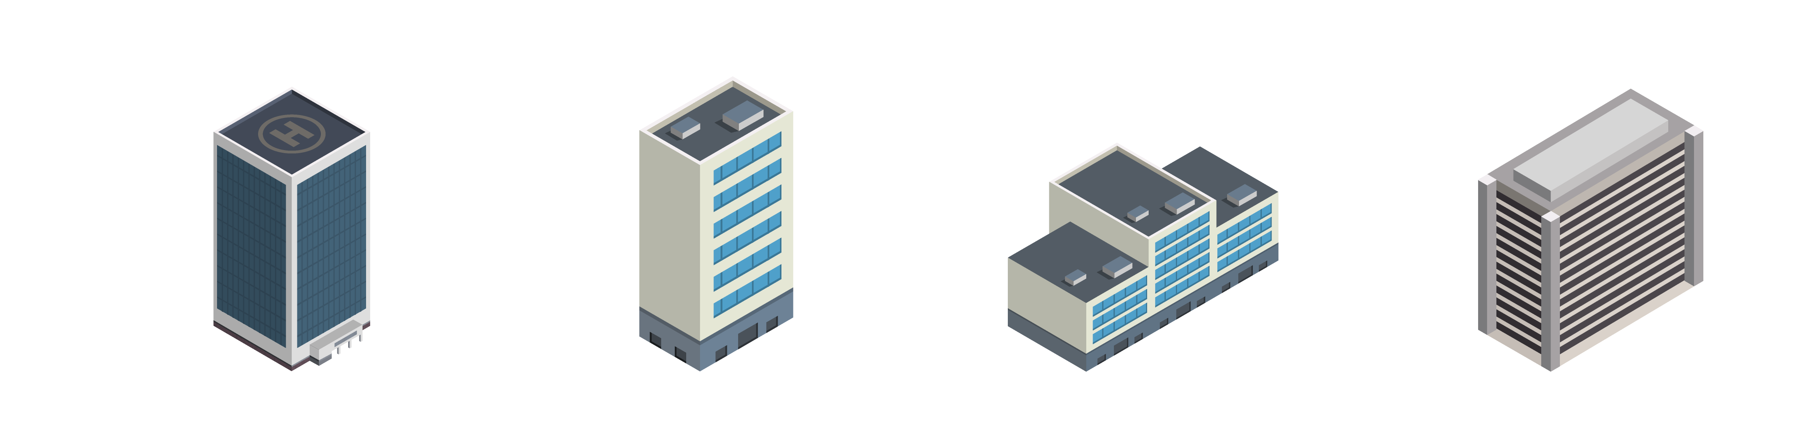
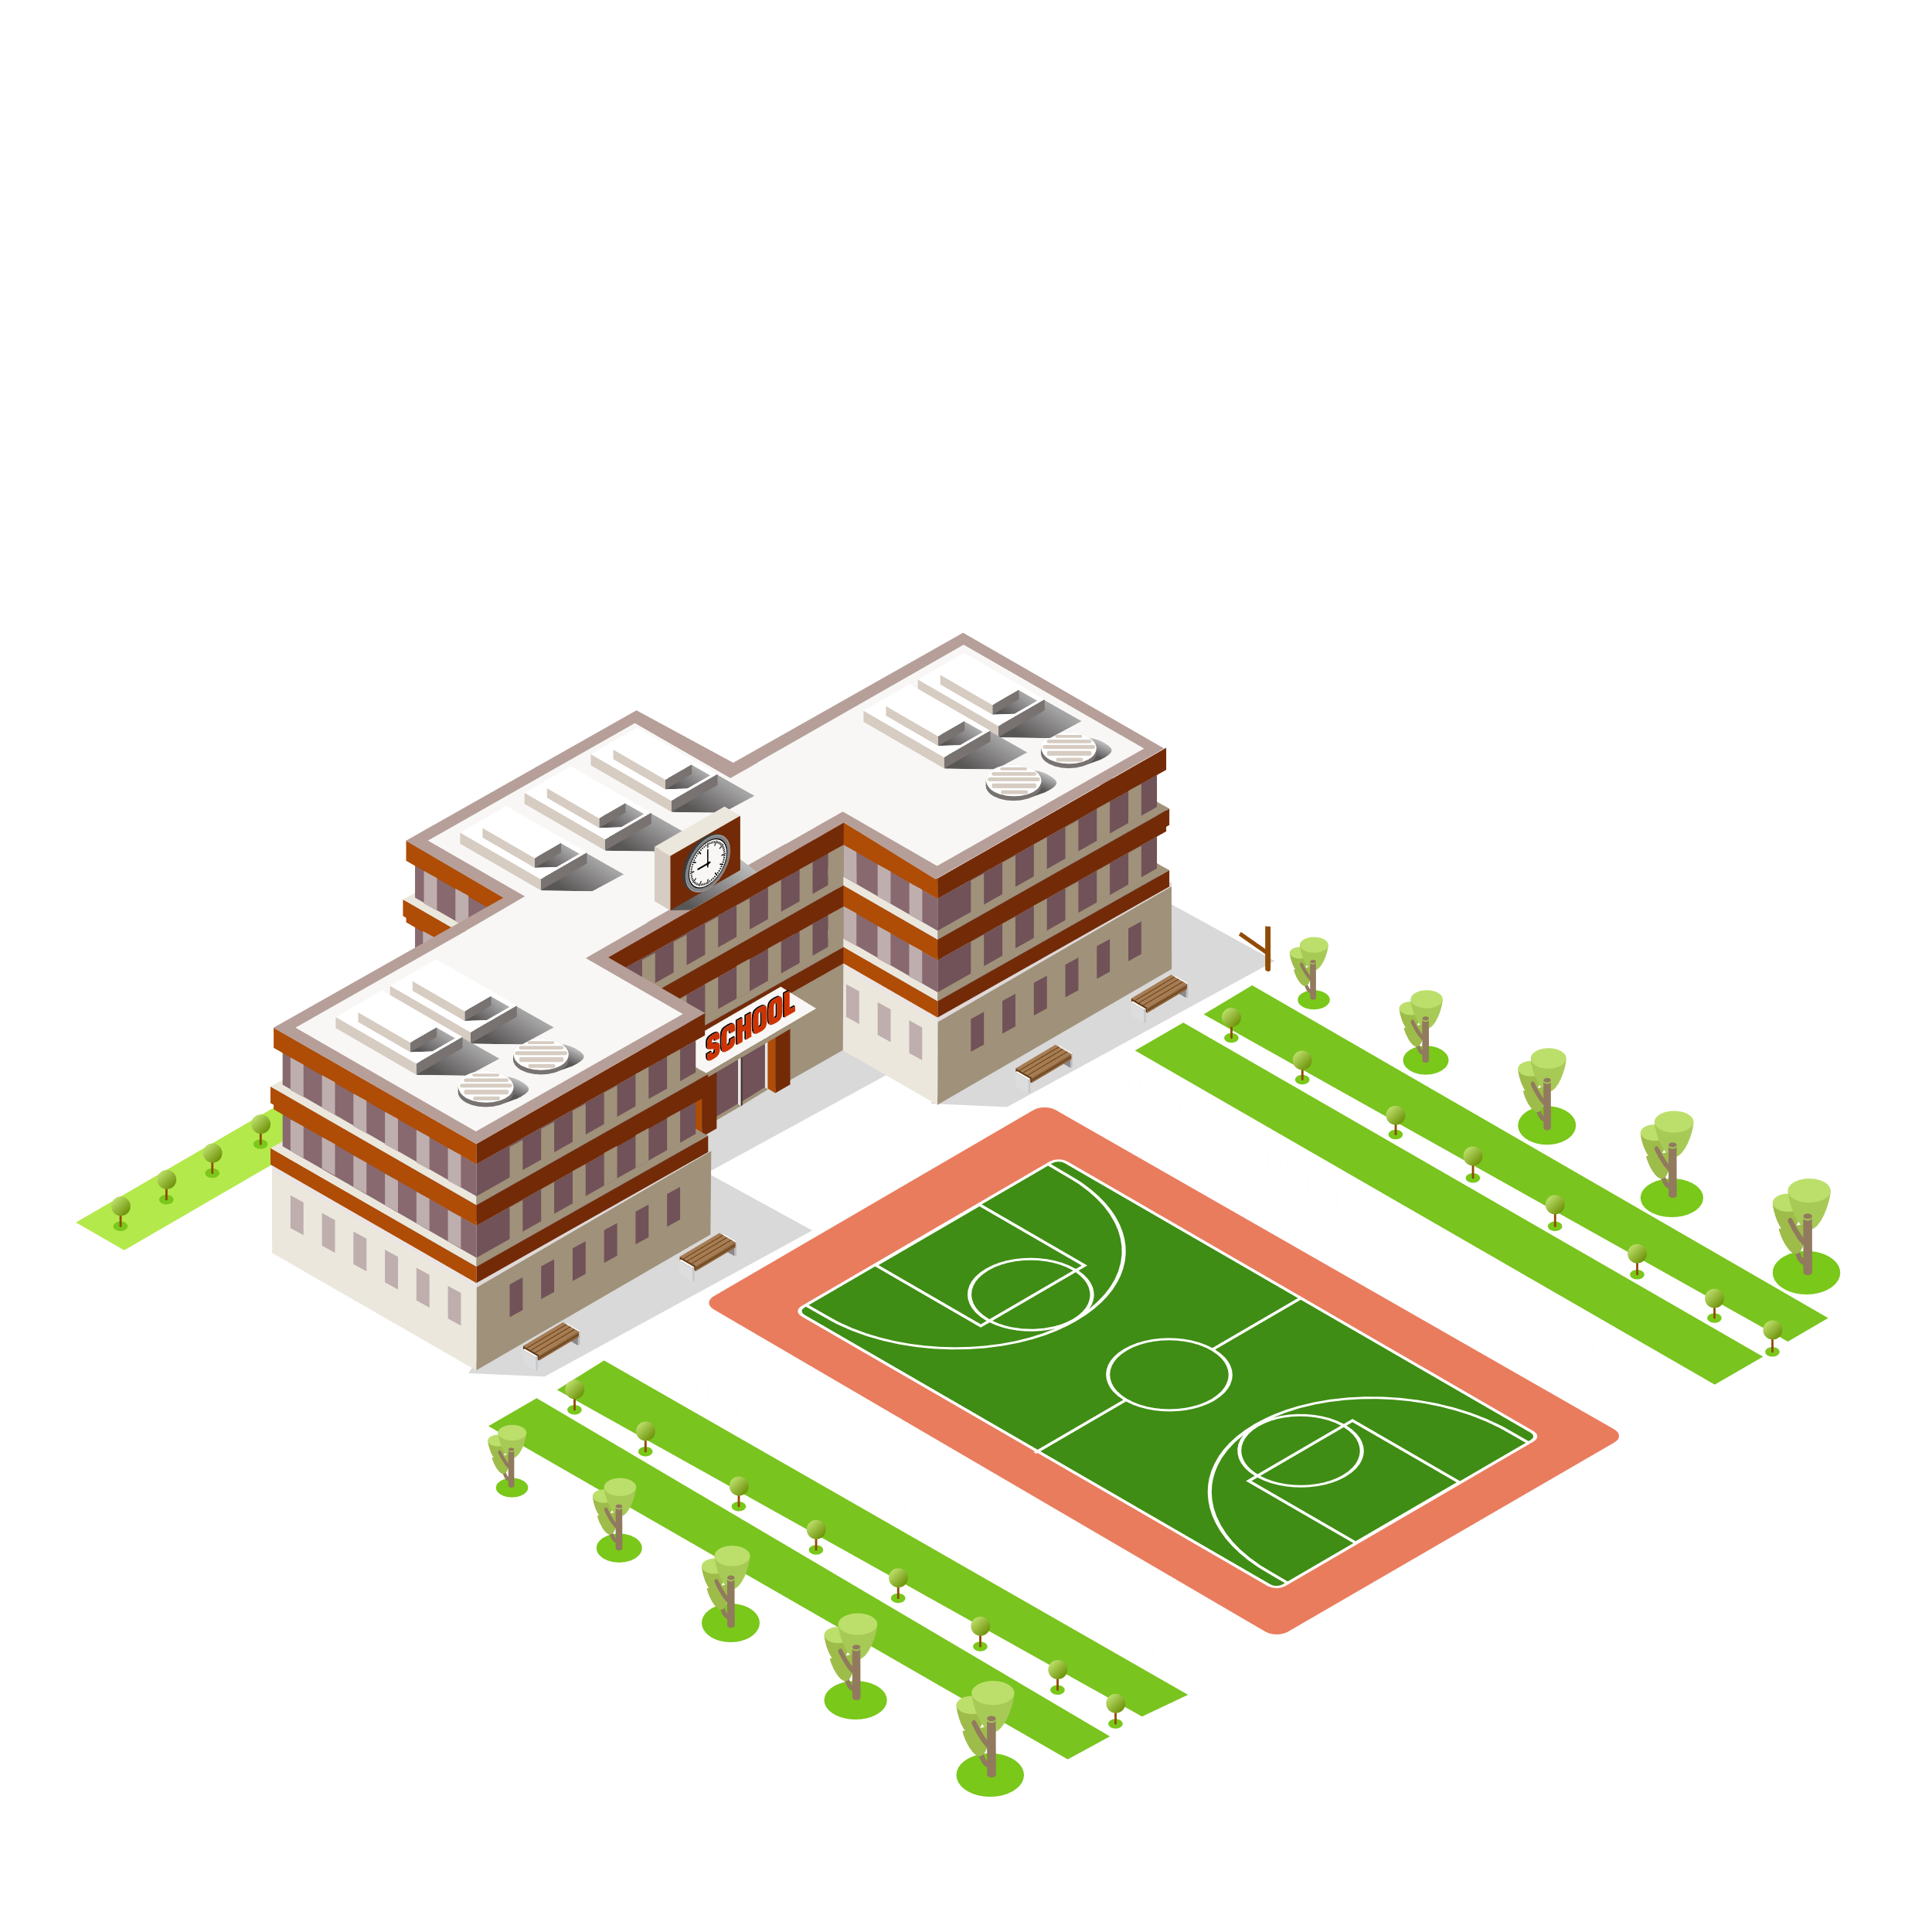







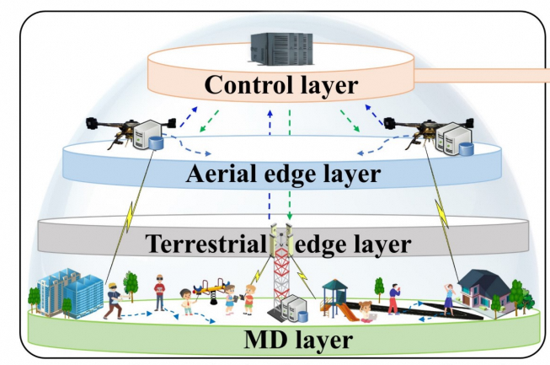





飞行轨迹
充电
通信
z
飞行区域
y
x
基站
目标
目标

Slide 3
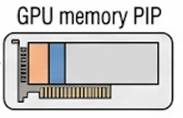

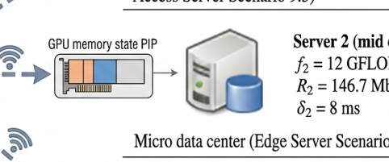


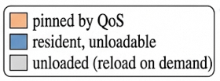

Cloud layer
mid edge layer
Near edge layer
User

Slide 4



Short timescale
Long timescale
Decision making
1
$$τ$$
Task routing
2
$$Δ$$
1
Layer retention
…
10
State update
Task arrivals
Layer retention state
…
Server queue
$$T$$
$$T_{0}$$
slot
epoch
GPU memory occupancy
Channel state

Slide 5
