Slide 1
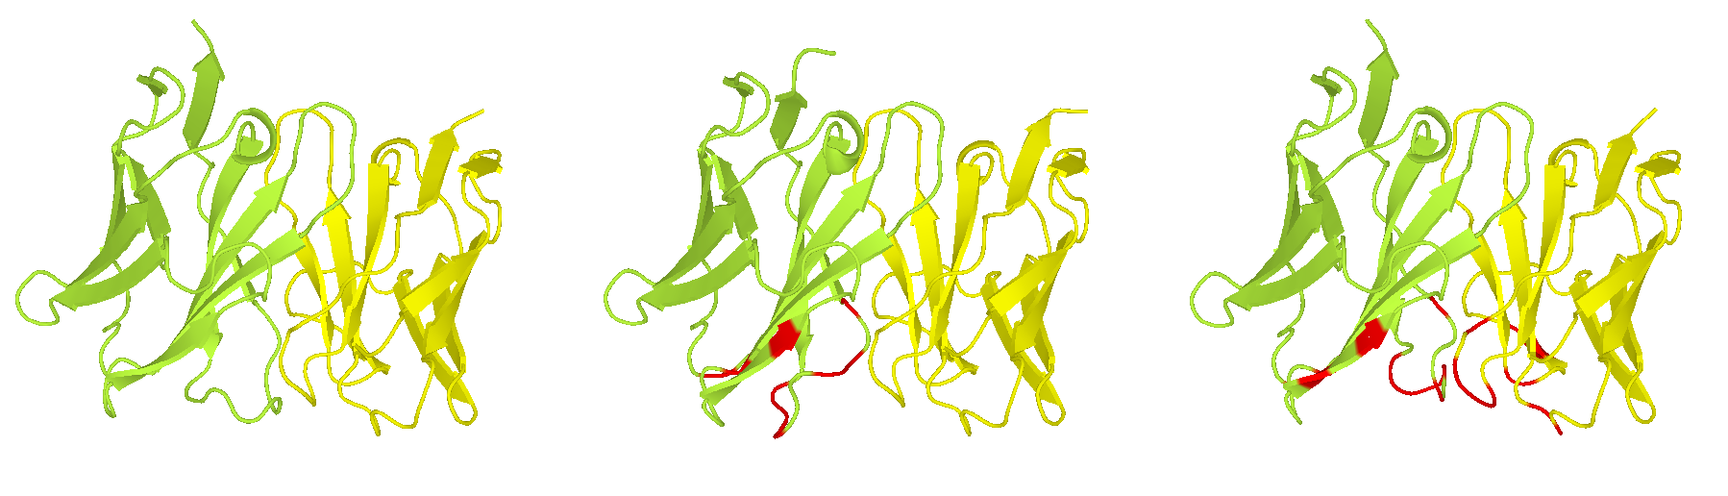

sbio-nipahgpg-055 (peleke-phi-4) | sbio-nipahgpg-120 (sbio-nipahgpg-055 + AntiBMPNN) | sbio-nipahgpg-148 (sbio-nipahgpg-120 + AntiBMPNN)

Slide 2
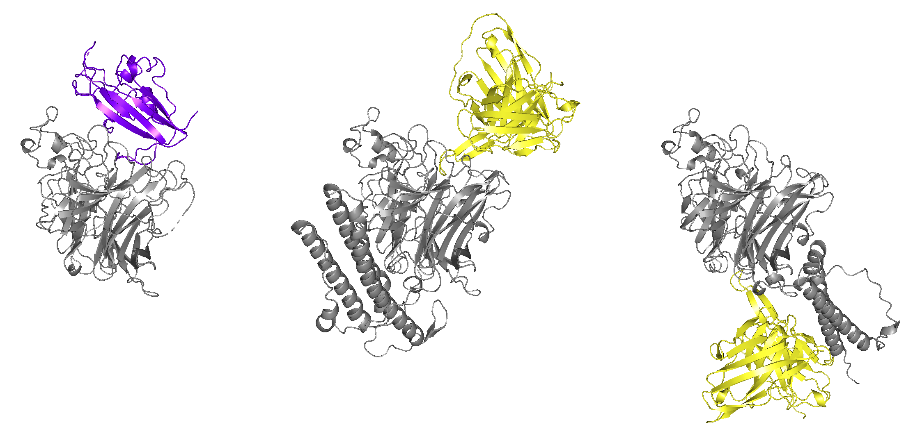
Glycoprotein G with Ephrin B2 (PDB: 2VSM) | sbio-nipahgpg-028 (from Local Folding) | sbio-nipahgpg-028 (from Proteinbase)
ipSAE: 0.73 | ipSAE: 0.74 | ipSAE: 0.19

Slide 3
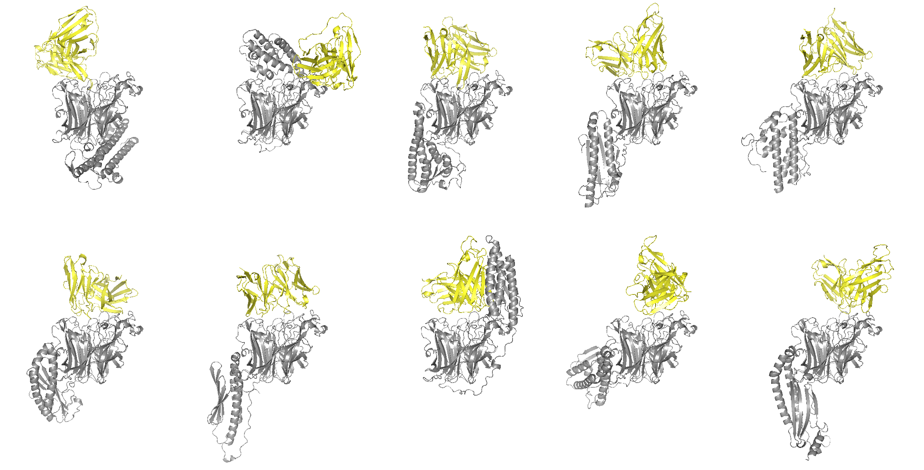
sbio-nipahgpg-028 | sbio-nipahgpg-035 | sbio-nipahgpg-059 | sbio-nipahgpg-064 | sbio-nipahgpg-073
sbio-nipahgpg-119 | sbio-nipahgpg-124 | sbio-nipahgpg-141 | sbio-nipahgpg-152 | sbio-nipahgpg-159

Slide 4
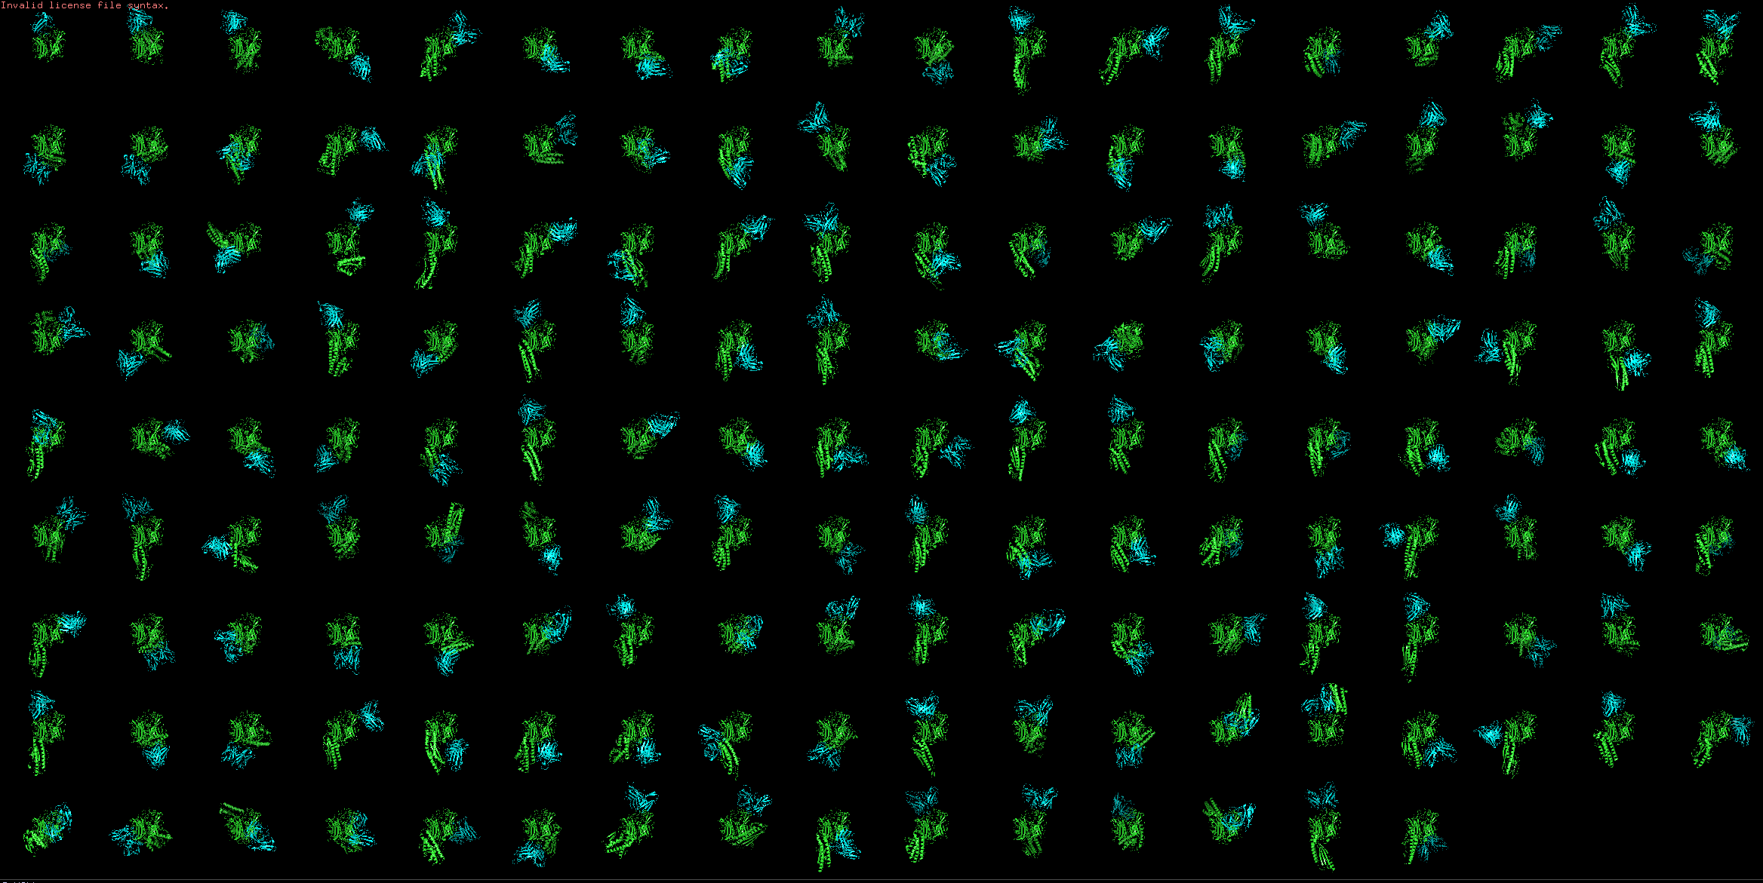
0 | 1 | 2 | 3 | 4 | 5 | 6 | 7 | 8 | 9 | 10 | 11 | 12 | 13 | 14 | 15 | 16 | 17
18 | 19 | 20 | 21 | 22 | 23 | 24 | 25 | 26 | 27 | 28 | 29 | 30 | 31 | 32 | 33 | 34 | 35
36 | 37 | 38 | 39 | 40 | 41 | 42 | 43 | 44 | 45 | 46 | 47 | 48 | 49 | 50 | 51 | 52 | 53
54 | 55 | 56 | 57 | 58 | 59 | 60 | 61 | 62 | 63 | 64 | 65 | 66 | 67 | 68 | 69 | 70 | 71
72 | 73 | 74 | 75 | 76 | 77 | 78 | 79 | 80 | 81 | 82 | 83 | 84 | 85 | 86 | 87 | 88 | 89
90 | 91 | 92 | 93 | 94 | 95 | 96 | 97 | 98 | 99 | 100 | 101 | 102 | 103 | 104 | 105 | 106 | 107
108 | 109 | 110 | 111 | 112 | 113 | 114 | 115 | 116 | 117 | 118 | 119 | 120 | 121 | 122 | 123 | 124 | 125
126 | 127 | 128 | 129 | 130 | 131 | 132 | 133 | 134 | 135 | 136 | 137 | 138 | 139 | 140 | 141 | 142 | 143
144 | 145 | 146 | 147 | 148 | 149 | 150 | 151 | 152 | 153 | 154 | 155 | 156 | 157 | 158

