Slide 1
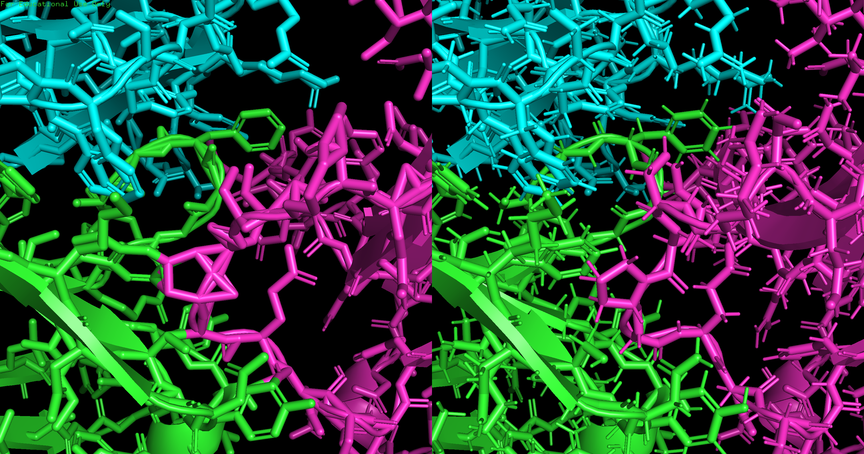
Before Relaxation:
score: -149.6238
vdw: -74.9676
elec: -153.022
desolv: -44.0518
bsa: 3392.16
After Relaxation:
score: -168.0074
vdw: -73.4337
elec: -133.155
desolv: -67.9427
bsa: 3179.66

