Slide 1
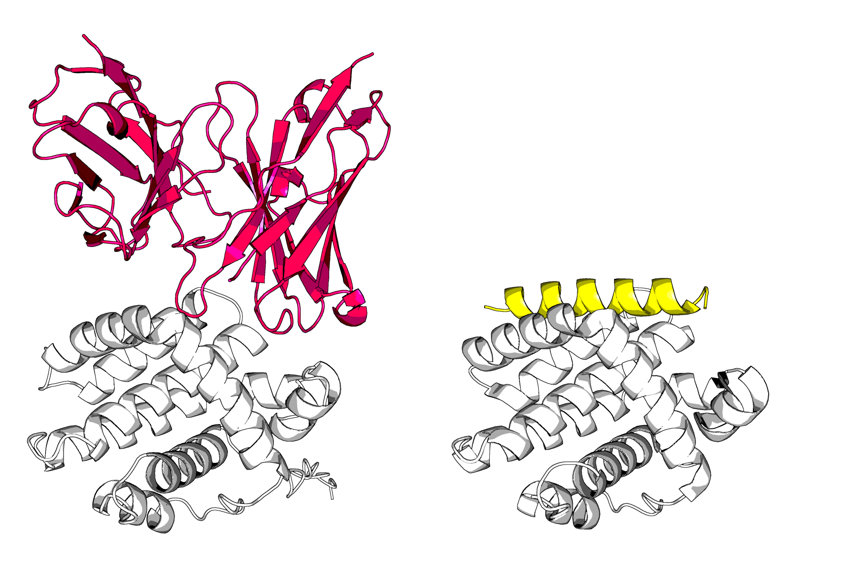
A | B
peleke-phi-4_BHRF1_0a | PDB: 2WH6

Slide 2
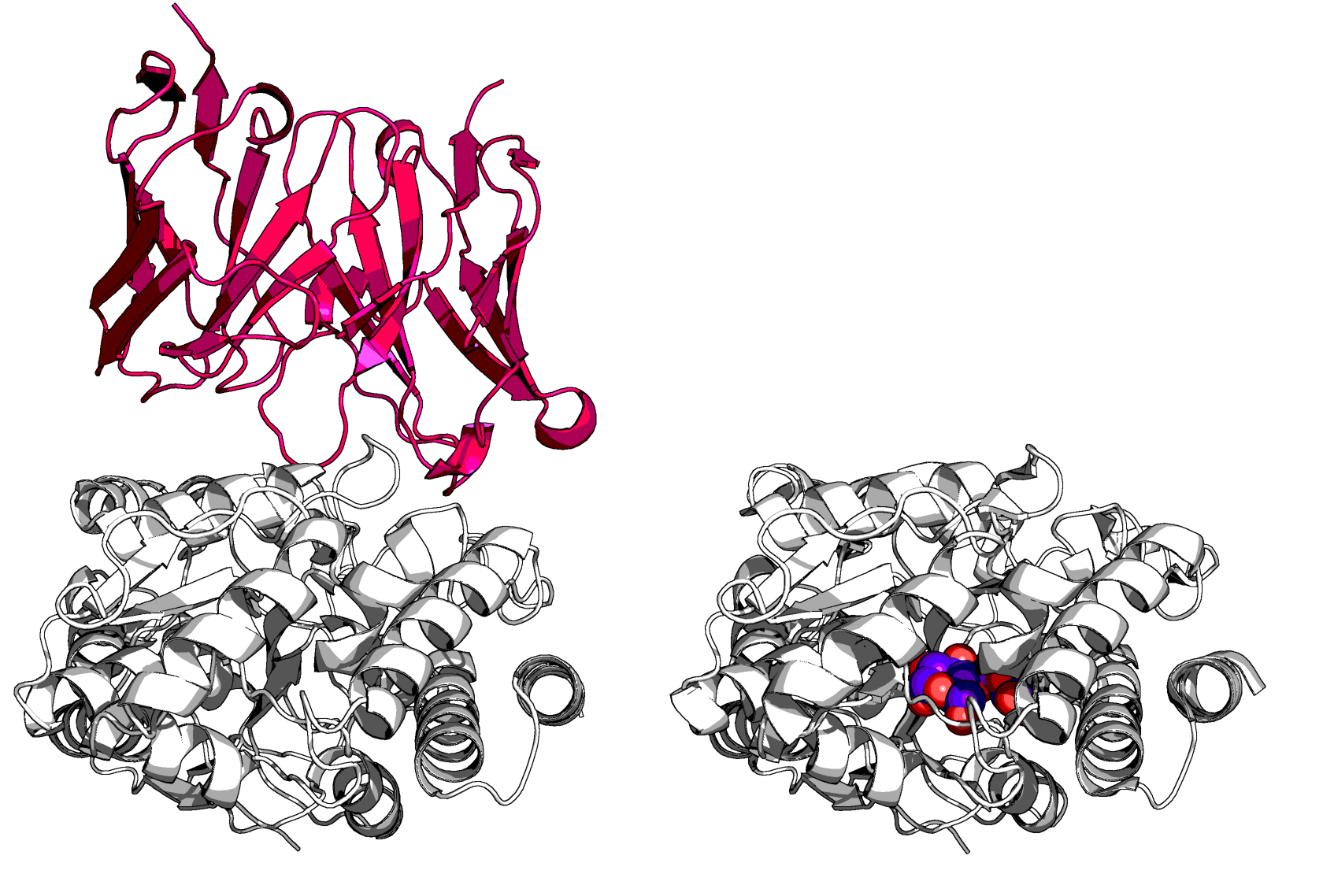
A | B
peleke-phi-4_MBP_20 | PDB: 1NL5

Slide 3
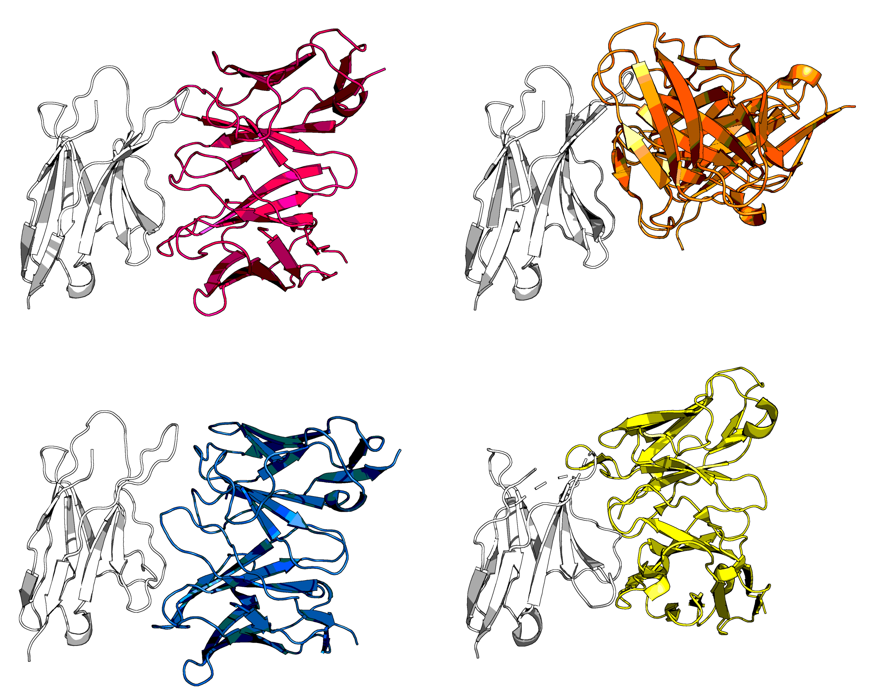
A | B
peleke-phi-4_PD-1_18 | peleke-mistral-7b-instruct-v0.2_PD-1_12
C | D
peleke-llama-3.1-8b-instruct_PD-1_30 | Pembrolizumab, PDB: 5JXE

