Slide 1

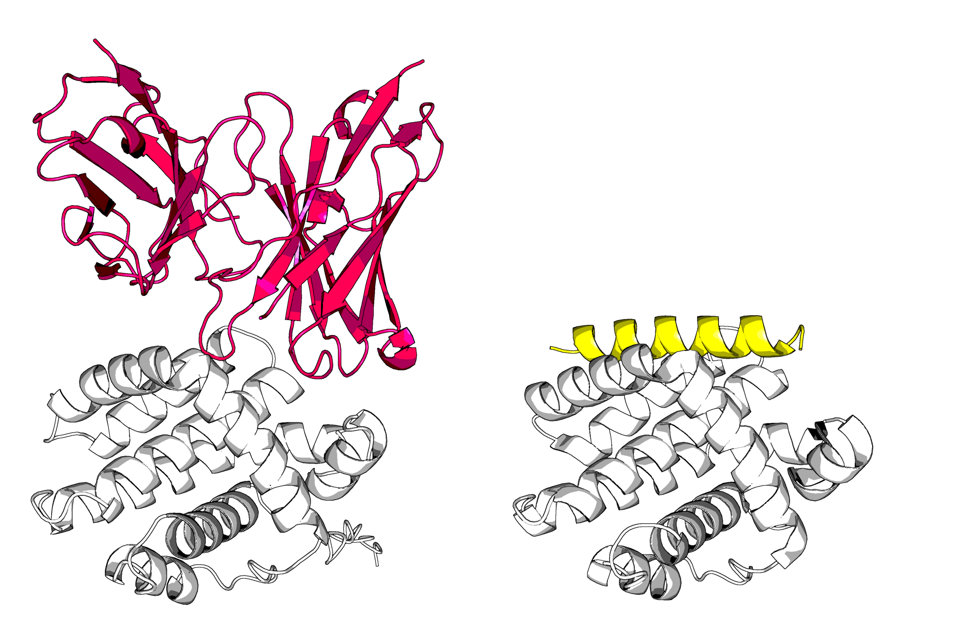
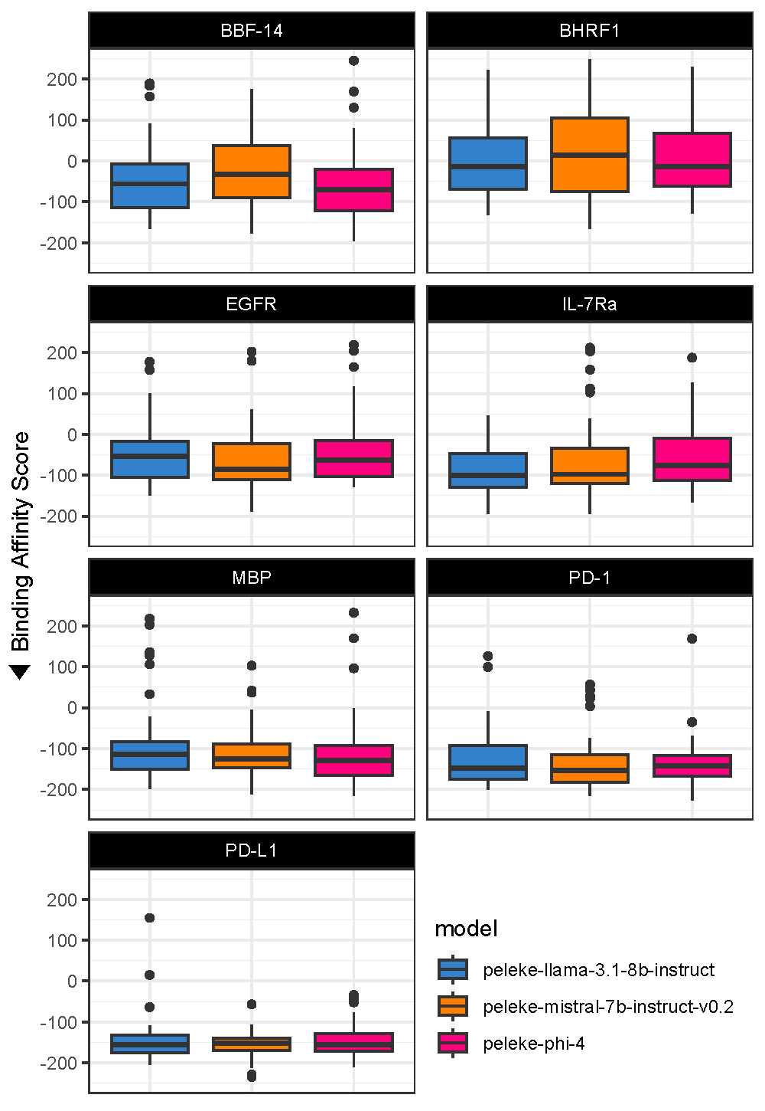
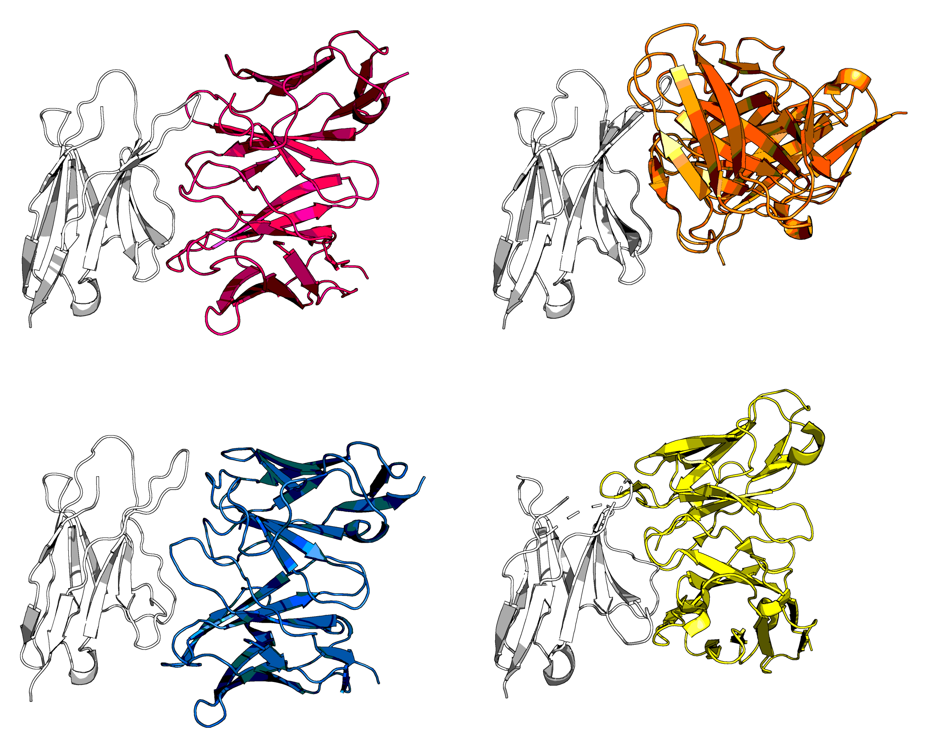

🦋 peleke-1: A Suite of Protein Language Models Fine-Tuned for Targeted Antibody Sequence Generation
Silico
Biosciences
A <Tuple> venture.
Nicholas Santolla*, Trey Pridgen*, Prbhuv Nigam, and Colby T. Ford
Abstract
Targeted Antibody Generation
Predicted Binding Performance
Here we present peleke-1, a suite of protein language models fine-tuned from state-of-the-art large language models using curated antibody-antigen complex data. These models generate targeted antibody Fv sequences for a given antigen sequence input at-scale. This suite of models provides a reliable, artificial intelligence-driven approach for in silico therapeutic antibody discovery along with an open-source framework for future antibody language model tuning.
Across the 1,050 generated Fv sequences (50 × 7 benchmark antigens), many have epitopes in the resulting predicted structures that closely match the desired epitope residues defined in the model input prompt.
Predicted antibody-antigen binding affinities were considerably stable between the base models but varied depending on the benchmark antigen.
Antigen | peleke-1 Fine-Tuned Model
 | llama-3.1-8b-instruct | mistral-7b-instruct-v0.2 | phi-4
BBF-14 | 22.73% (63.34) | 15% (106.84) | 18.42% (49.88)
BHRF1 | 2.63% (218.86) | 10.81% (289.61) | 9.3% (131.62)
EGFR | 20% (101.64) | 23.26% (24.66) | 20% (163.88)
IL-7Ra | 36.17% (-3.46) | 46.81% (-10.11) | 31.91% (13.64)
MBP | 67.39% (-52.56) | 57.78% (-52.52) | 69.39% (-57.98)
PD-1 | 73.47% (-66.72) | 79.59% (-82.51) | 76.6% (-70.12)
PD-L1 | 79.59% (-71.53) | 70.83% (-62.52) | 72.92% (-73.38)
A | B
peleke-phi-4_BHRF1_0a | PDB: 2WH6
Tuning and Inferencing Workflow
Data Curation
Collect antibody data from SAbDab
Download PDB entries from Protein Data Bank
Retrieve antibody and antigen sequences
Detect epitope residues
Percentage of complexes with van der Waals energies <-25 kcal/mol (median value shown in parentheses) by fine-tuned model and antigen.
Model Tuning
Retrieve open-source model from Hugging Face
Update tokenizer with transformers
Set up PEFT adapter
Tune model for multiple epochs
Inferencing
Comparison of (A) peleke-phi-4_BHRF1_0a, a generated anti-BHRF1 Fv structure, in pink; and (B) a BCL-2-like protein 11 (in yellow) bound to BHRF1 (in white, PDB: 2WH6)
Generate 50 Fv sequences for each antigen and model
Fold each generated Fv sequence and antigen as a multimer with ESM3
A | B
peleke-phi-4_PD-1_18 | peleke-mistral-7b-instruct-v0.2_PD-1_12
C | D
peleke-llama-3.1-8b-instruct_PD-1_30 | Pembrolizumab, PDB: 5JXE
Evaluation
Predict antibody binding affinity with HADDOCK3
Predict protein complex stability with FoldX
Predict Fv sequence humanness with Humatch
The peleke-1 suite consists of multiple protein-language models (PLMs), fine-tuned from existing large language models (LLMs) that span varying architectures and parameter magnitudes. To perform the fine-tuning, copious antibody-antigen sequence information was collected to form a curated training dataset.
Now Available on
Hugging Face:
peleke-llama-3.1-8b-instruct
Antibody-Antigen Complex Training Data
peleke-mistral-7b-instruct-v0.2
peleke-phi-4
Comparison of 3 novel anti-PD-1 candidates: (A) peleke-phi-4_PD-1_18 (in pink); (B) peleke-mistral-7b-instruct-v0.2_PD-1_12 (in orange); and (C) peleke-llama-3.1-8b-instruct_PD-1_30} (in blue); with (D) pembrolizumab (in yellow),
all bound to PD-1 (in white, PDB: 5JXE)
Boxplots depicting the predicted binding affinity score distribution by antigen and model. More negative values (HADDOCK scores) indicate better overall binding.
Note that the y-axis is showing scores between [-250, 250].
huggingface.co/silicobio/
silico.bio/peleke
github.com/silicobio/peleke

