Slide 1
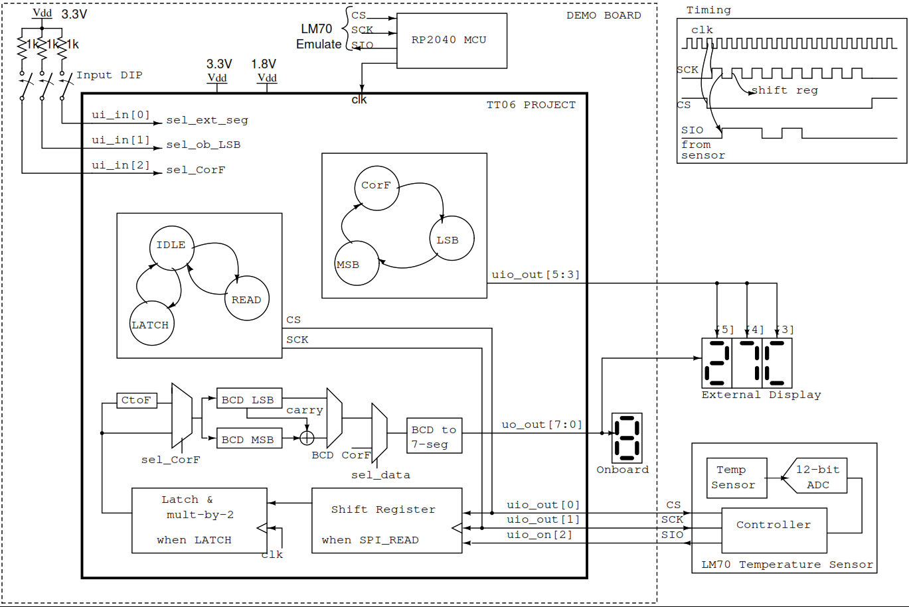

Slide 2
Temperature | Digital Output
 | Binary (11-bit Data) | Hex
+25°C | 0000 1100 1001 1111 | 0x0B9F
Sign bit
11-bit data
2°C
0.25°C

Slide 3
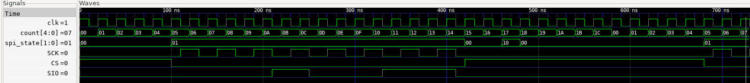
4-clk “IDLE”
16-clk (8-SCK) “READ”
6-clk “IDLE”
Next Read
“IDLE”
“LATCH”

