Slide 1
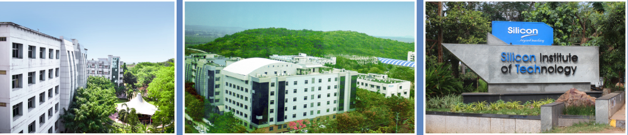

SI 2026 Analog IC Design
Semiconductor
IC Devices
Saroj Rout
Prasant Swain
Santunu Sarangi
04 June 2026

Slide 2
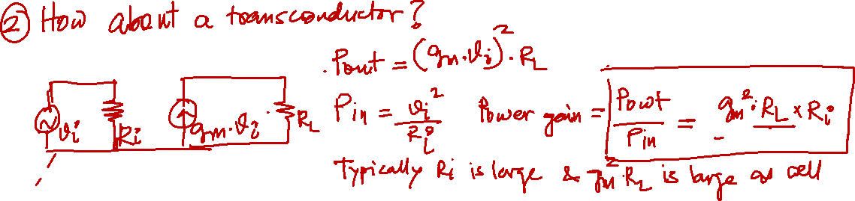
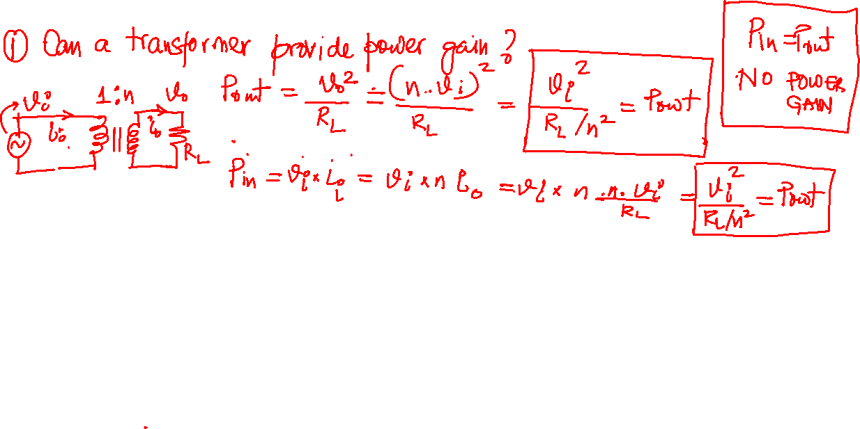
Motivation for Semiconductor Device: Power Gain

Slide 3
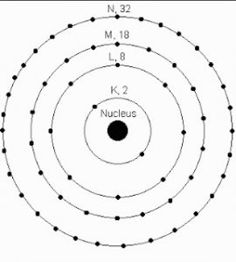
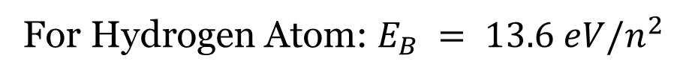
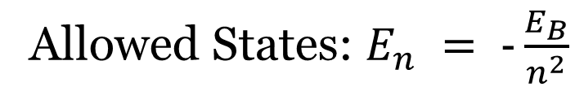
Bohr’s Atomic Model
Allowed States: $E_{n} = −\frac{E_{B}}{n^{2}}$
For Hydrogen Atom: $E_{B} = 13.6 eV/n^{2}$

Slide 4
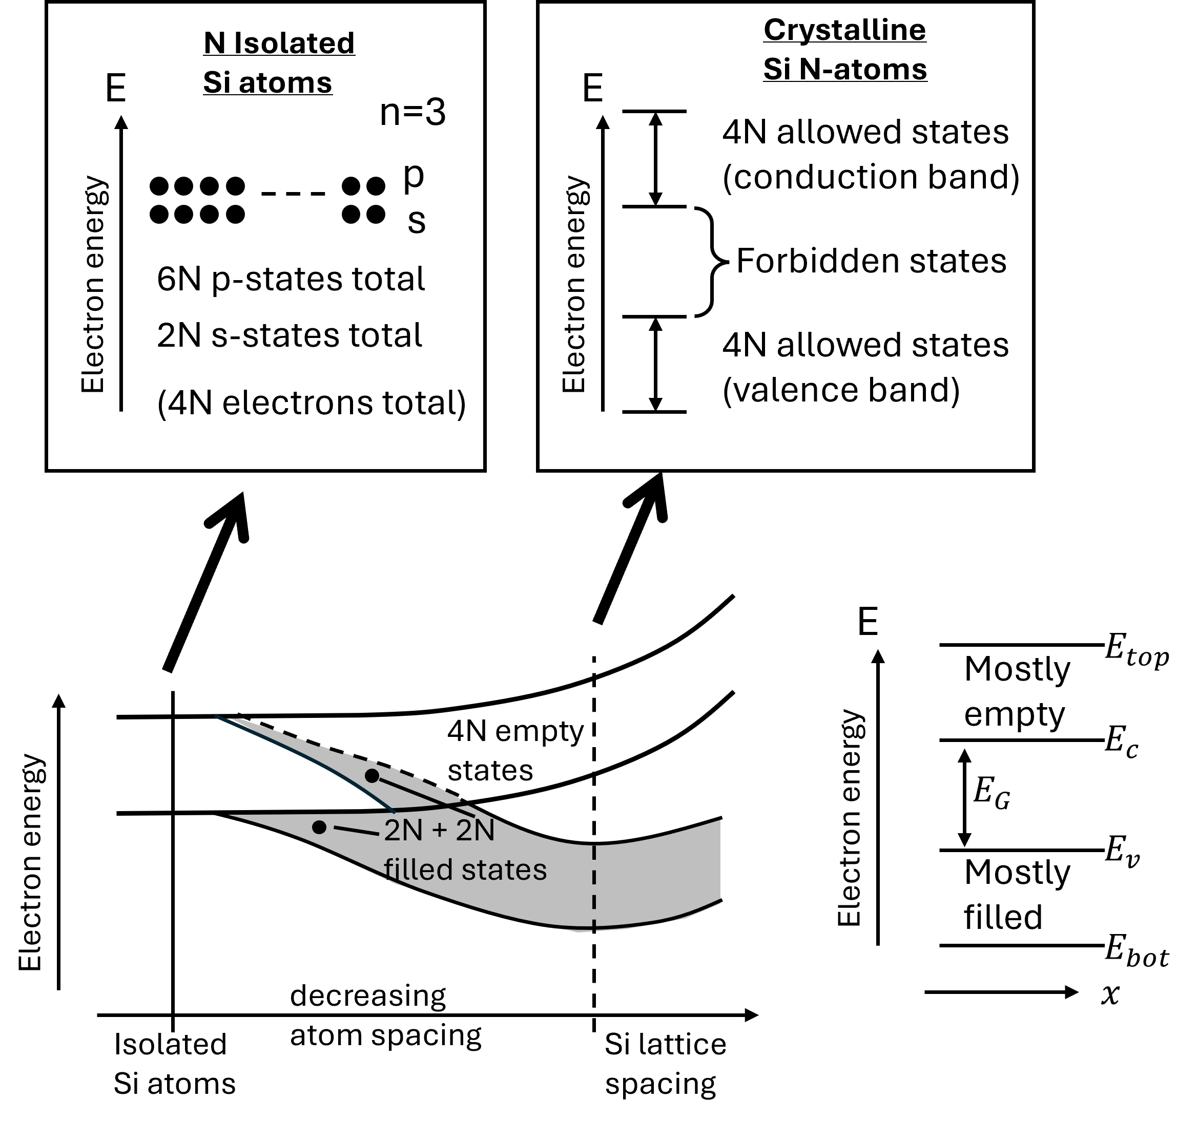
Energy Band Model

Slide 5
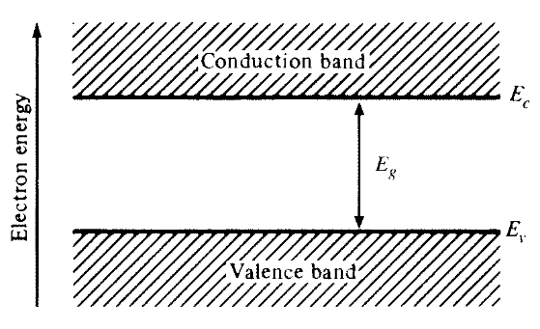
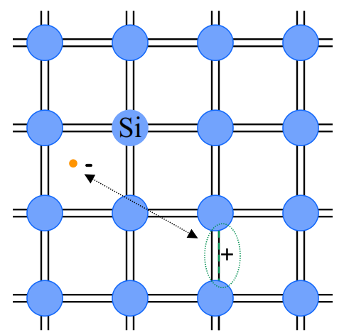
Band Diagram / Intrinsic Semiconductor
Band diagram is a representation of the allowable energy states for electrons.
Fermi Level : P(electron occupying empty state) = 0.5 (50%)
Notes:
Band diagram is a representation of the allowable energy states for electrons.
In an intrinsic semi, electrons bound to the atom have no more energy than Ev
Due to thermal agitation, electron acquire energy > Ec and jump to the conduction band.
The extra energy E-Ec is converted to kinetic energy
Energy level Ec is simply the potential energy of the electron in conduction band.
Eg is the forbidden states known as the “band gap”
The intrinsic carrier ni = pi = about 10¹⁰ /cm^3 at room temp which is about 2 out of 10¹³ atoms. Every electron that leaves the atom leaves behind a hole that is why they are equal.
Mass action law : np = ni²

Slide 6
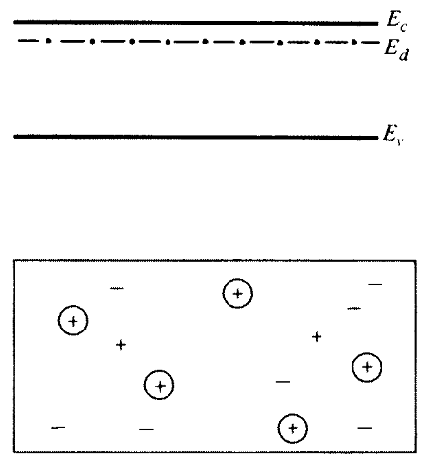
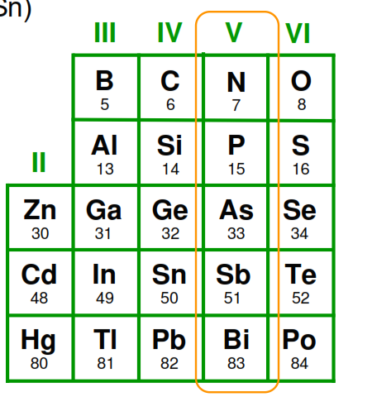
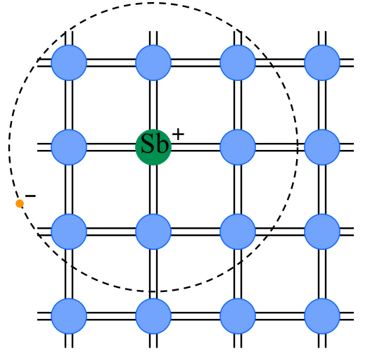
Extrinsic Semiconductor n-type
Notes:
Dopants area added to increase the number of free electrons or holes such that more(or less) electrons area available than needed for the perfect bonding of the silicon atoms.
The extra electron from the dopant has energy level E_{d}.
Room temp is enough for it to jump so the electron concentration is same the dopant concentration ie. n = N_{D} and p = ni²/N_{D}
Unlike initrinsic, when an electron leaves, it leaves behind an unbound positive charge and NOT A hole.
Same explanation for p-type except all polarities reversed.
P+/n+ means much heavily doped and almost acts conductors.

Slide 7
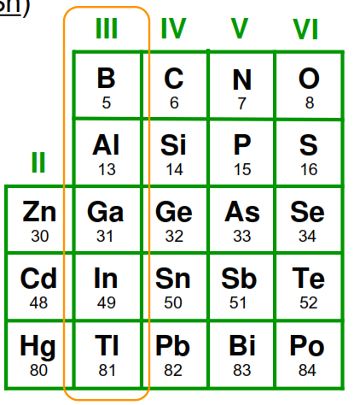
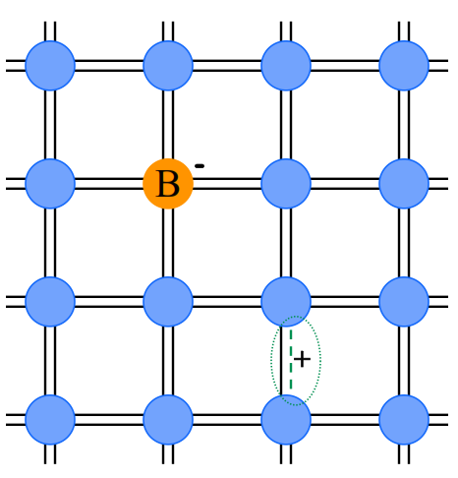
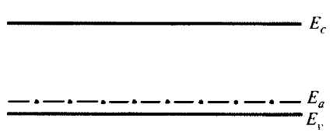
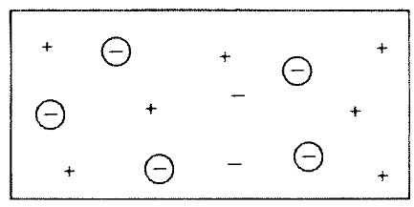

Extrinsic Semiconductor p-type
Notes:
Dopants area added to increase the number of free electrons or holes such that more(or less) electrons area available than needed for the perfect bonding of the silicon atoms.
The extra electron from the dopant has energy level E_{d}.
Room temp is enough for it to jump so the electron concentration is same the dopant concentration ie. n = N_{D} and p = ni²/N_{D}
Unlike initrinsic, when an electron leaves, it leaves behind an unbound positive charge and NOT A hole.
Same explanation for p-type except all polarities reversed.
P+/n+ means much heavily doped and almost acts conductors.

Slide 8
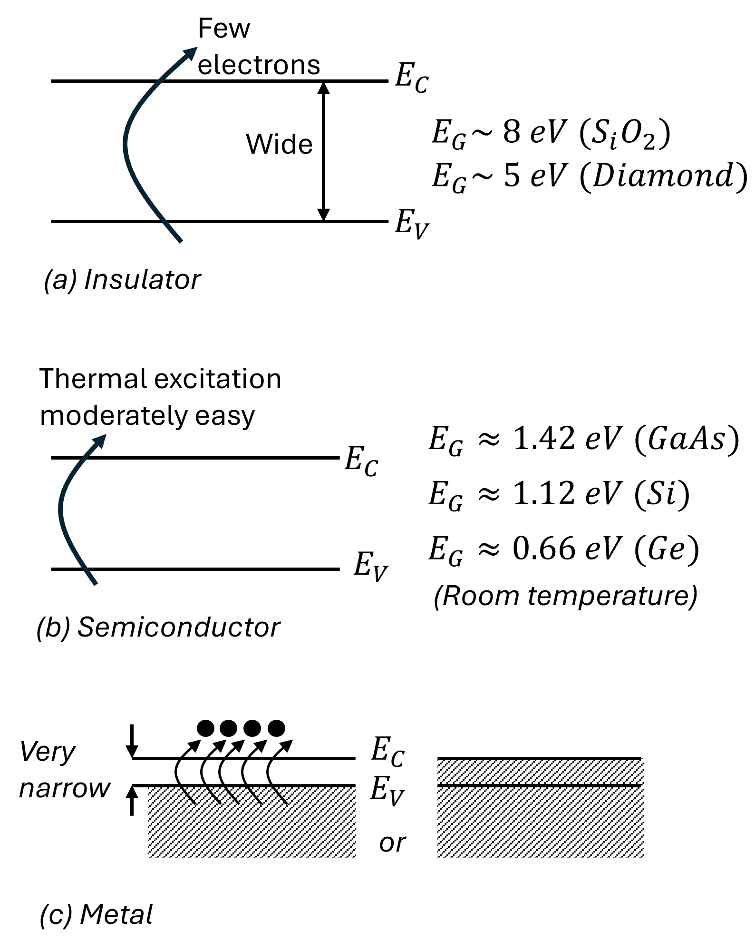
Material Classification

Slide 9
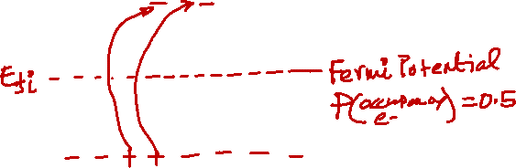
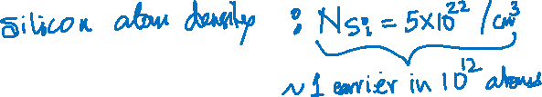

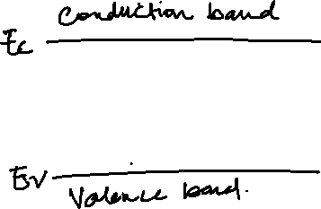
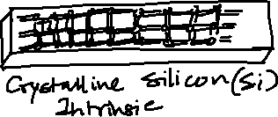
Semiconductor: Intrinsic

Slide 10

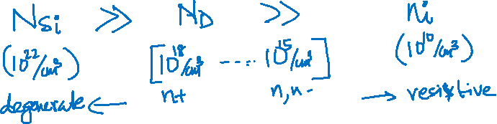
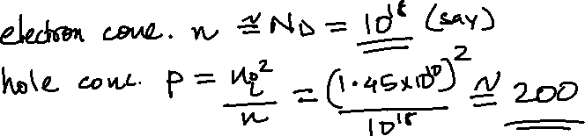
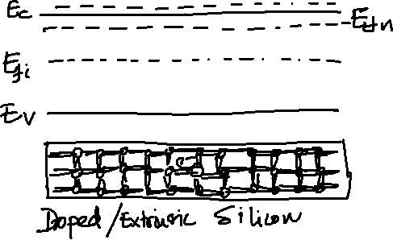
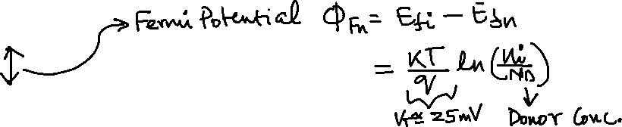
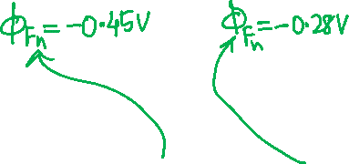
Semiconductor: Extrinsic (n-type)

Slide 11
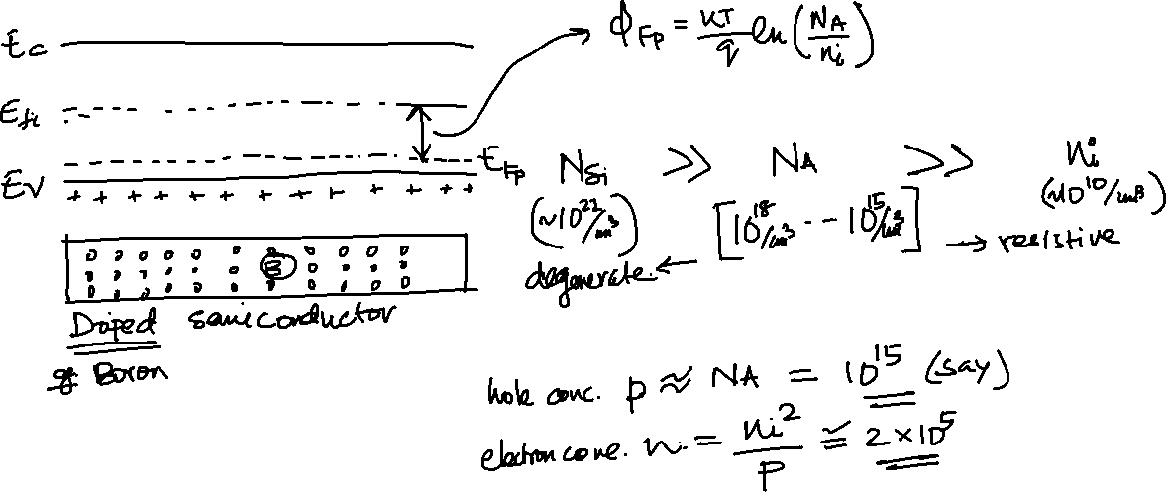
Semiconductor: Extrinsic (p-type)

Slide 12
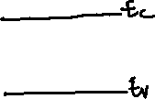

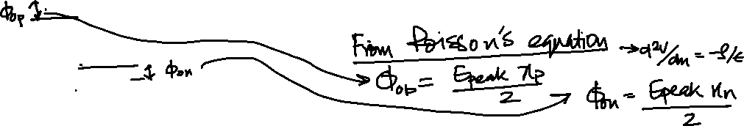
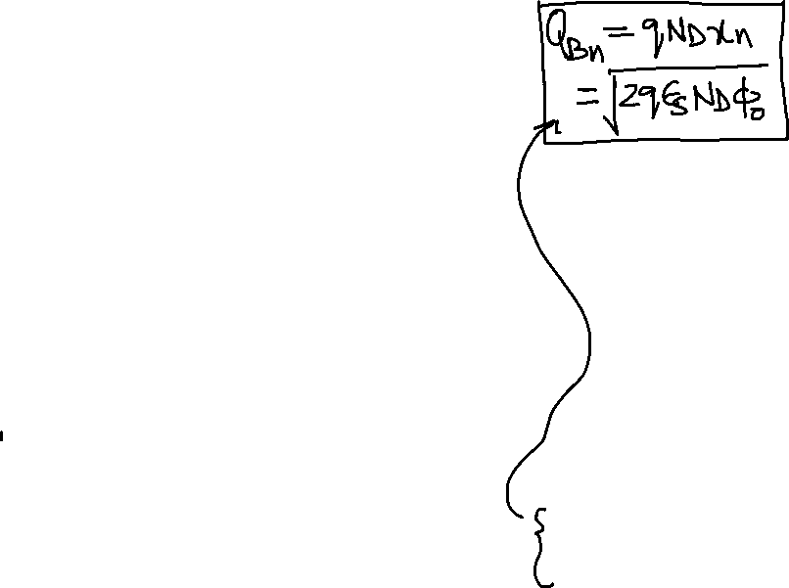
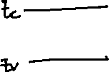
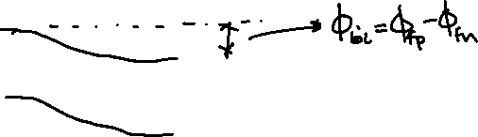

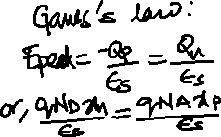
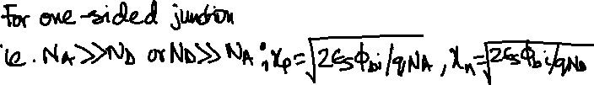
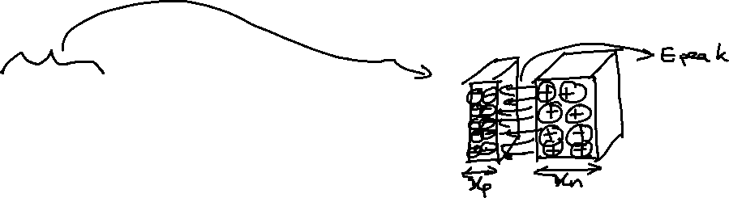
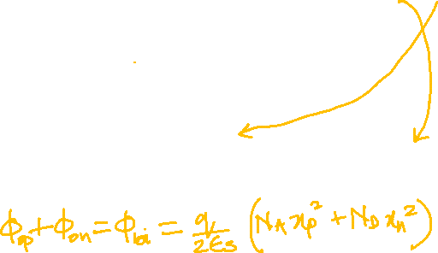
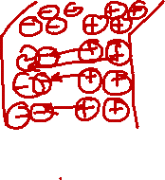
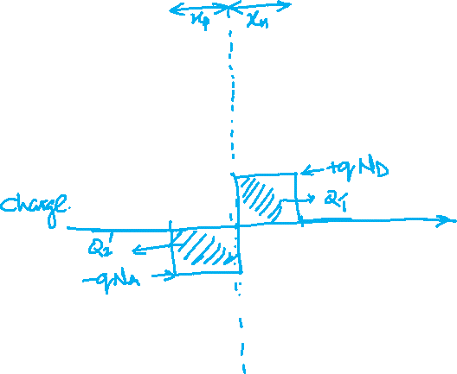

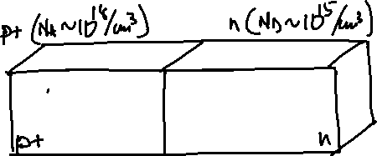
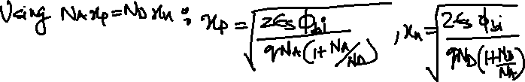
pn-junction

Slide 13
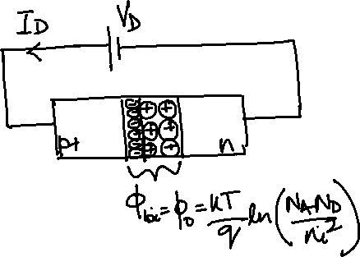
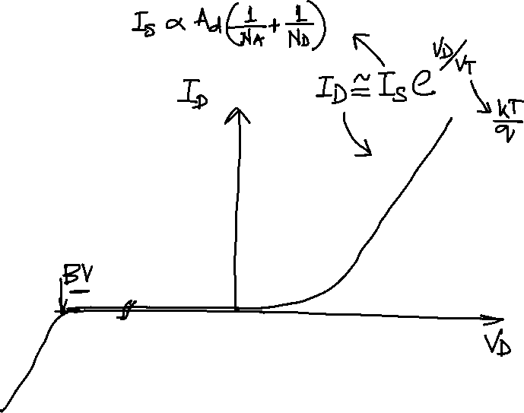
Forward-biased pn-junction

Slide 14
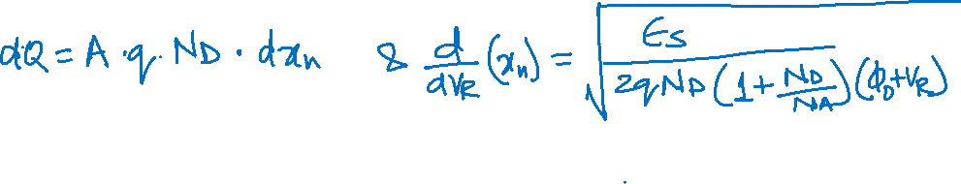
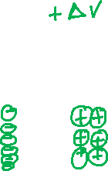
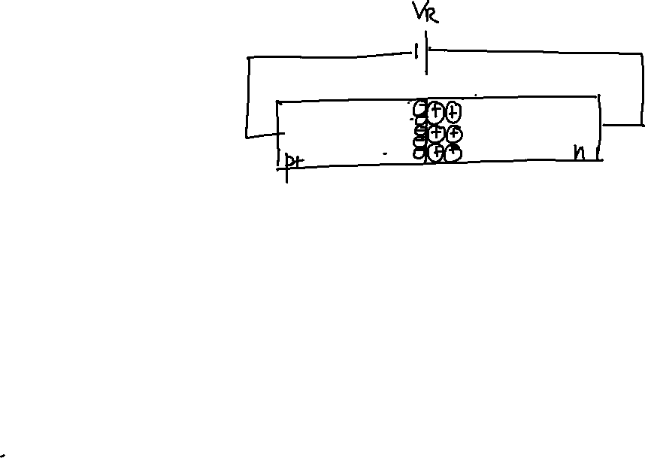
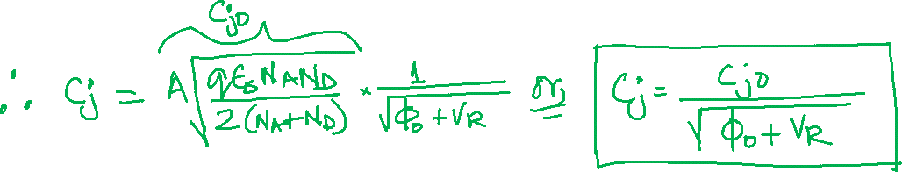

Reverse-biased pn-junction

Slide 15
MOS Devices-I
Threshold Voltage

Slide 16
Metal-Oxide-Semiconductor (MOS): Two-Terminal Device
M
Oxide
p-type

Slide 17
Contact Potential

Slide 18
Metal-Oxide-Semiconductor (MOS): Two-Terminal Device
M
Oxide
p-type

Slide 20
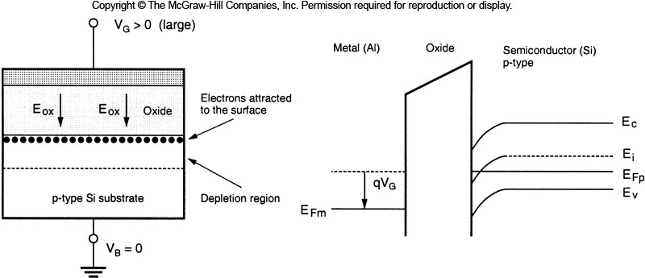
MOS Capacitance
Notes:
If we increase the positive gate bias, mid-gap energy level E_{i} becomes smaller than the Fermi level E_{Fp}. Then semiconductor in this region becomes n-type : Surface inversion:
The n-type layer near the surface is called inversion layer
Inversion layer will be used for channel of MOSFET devices.

Slide 21
Polysilicon (Metal)
Oxide
Semiconductor (p-sub)

Slide 22
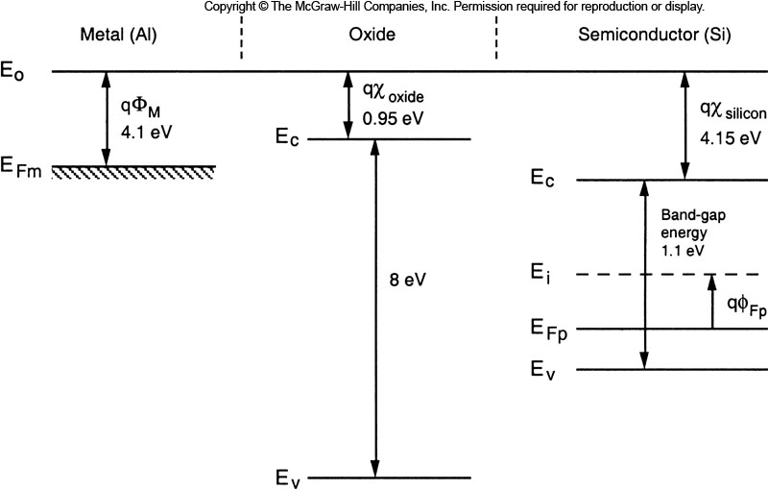
Notes:
Three separate components of MOSFET system have different energy band diagram.

Slide 23
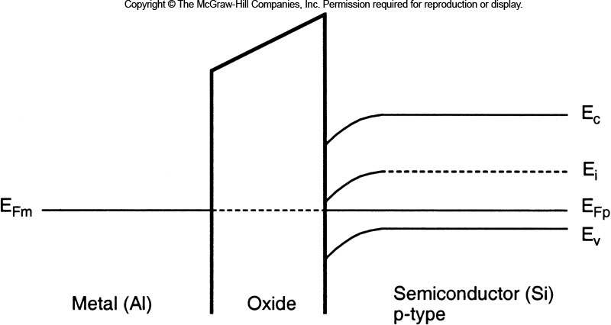

Slide 25
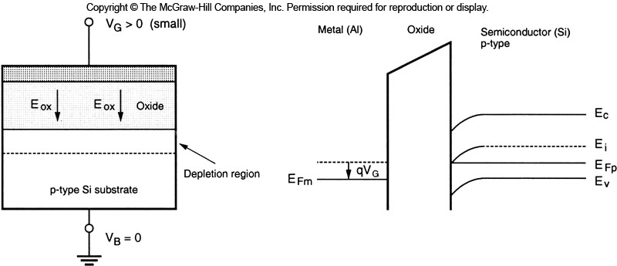

Slide 26


Slide 27

Body Effect

Slide 28
MOS Device II
I-V Characteristics

Slide 29









Conduction in Semiconductors : Drift

Slide 30

Ids for Small Vds

Slide 31

Gradual Channel Approximation
Notes:
Gradual Channel Approx: Vertical field is dominant and lateral field is non-dominant

Slide 32


Gradual Channel Approximation
Notes:
Assume that all the mobile electron in the inversion layer have a constant surface mobility μ_{n}. Then we can express the incremental resistance as follows
Remember, this is a pictorial representation of SHEET-CHARGE DENSITY

Slide 33





Saturation (Pinch-Off) Region

Slide 34






$I_{DS} vs. V_{DS} (V_{GS} const.)$

Slide 35











Channel Length Modulation

Slide 36


$I_{DS} vs. V_{DS} (V_{GS} const.)$

Slide 37




$I_{DS} vs. V_{GS} (V_{DS}>V_{GS}−V_{T})$

Slide 38


nMOS Transistor
Gate
S/D
S/D
3-D View
W
L
P-substrate

Slide 39

pMOS Transistor
S/D
Gate
S/D
W
L
N-well
P-substrate

Slide 40

I-V Equation for nMOS
$I_{D}=0$ | For $V_{GS}<V_{T}$
$I_{D}\left(lin\right)= \frac{μ_{n}C_{OX}}{2}\frac{W}{L}\left[2\left(V_{GS}−V_{T}\right)V_{DS}−V_{DS}^{2}\right]$ $$I_{D}\left(lin\right)= \frac{μ_{n}C_{OX}}{2}\frac{W}{L}\left[2\left(V_{GS}−V_{T}\right)V_{DS}\right]$$ | For $V_{GS}≥V_{T}$ and $V_{DS}<V_{GS}−V_{T}$ For $V_{GS}≥V_{T}$ and $V_{DS} is small$
$I_{D}\left(sat\right)= \frac{μ_{n}C_{OX}}{2}\frac{W}{L}{\left(V_{GS}−V_{T}\right)}^{2}(1+λV_{DS})$ | For $V_{GS}≥V_{T}$ and $V_{DS}≥V_{GS}−V_{T}$

Slide 41

I-V Equation for pMOS
$I_{D}=0$ | For $V_{GS}>V_{T}$
$I_{D}\left(lin\right)= \frac{μ_{p}C_{OX}}{2}\frac{W}{L}\left[2\left(V_{GS}−V_{T}\right)V_{DS}−V_{DS}^{2}\right]$ $$I_{D}\left(lin\right)= \frac{μ_{p}C_{OX}}{2}\frac{W}{L}\left[2\left(V_{GS}−V_{T}\right)V_{DS}\right]$$ | For $V_{GS}≤V_{T}$ and $V_{DS}>V_{GS}−V_{T}$ For $V_{GS}≤V_{T}$ and $V_{DS} is small$
$I_{D}\left(sat\right)= \frac{μ_{p}C_{OX}}{2}\frac{W}{L}{\left(V_{GS}−V_{T}\right)}^{2}(1+λV_{DS})$ | For $V_{GS}≤V_{T}$ and $V_{DS}≤V_{GS}−V_{T}$

Slide 42



Structure and Operation of MOSFET
Circuit Symbols of MOSFETs
The source is the n+(p+) region which has a lower (higher) potential than the other n+(p+) region in an n-channel (p-channel) MOSFET device.
All the terminal voltage of the device are defined with respect to the source potential.

Slide 43


MOSFET Operation : A Quick View
For V_{GS}>V_{T0} , V_{DS}=0
Drain current I_{D} equal to zero.
For V_{GS}>V_{T0} , 0 < V_{DS} < V_{DSAT}
Drain current I_{D} proportional to V_{DS}
Called the linear mode (or linear region).
For V_{GS}>V_{T0} , V_{DS} = V_{DSAT}
Inversion charge at the drain is reduced to zero : pinch-off point.
For V_{GS}>V_{T0} , V_{DS} > V_{DSAT}
A depleted surface region forms adjacent to the drain and grows toward source.
Called Saturation mode (or saturation region)

Slide 44
MOS Capacitance

Slide 45










MOS Capacitance
Notes:
Oxide Capacitances: $C_{G}=WL C_{OX}, C_{OL}=WL_{D}C_{OX}$
Depletion Capacitance : Csb, Cdb, Cjc

Slide 46







Bias Dependent MOS Capacitance: Cut-Off

Slide 47



Bias Dependent MOS Capacitance: Linear

Slide 48




Bias Dependent MOS Capacitance: Saturation

Slide 49
Notes:
Oxide Capacitances: $C_{G}=WL C_{OX}, C_{OL}=WL_{D}C_{OX}$
Depletion Capacitance : Csb, Cdb, Cjc

Slide 50



MOS Capacitance
Notes:
Oxide Capacitances: $C_{G}=WL C_{OX}, C_{OL}=WL_{D}C_{OX}$
Depletion Capacitance : Csb, Cdb, Cjc

