Slide 1
CMOS Fabrication
CMOS transistors are fabricated on silicon wafer
Lithography process similar to printing press
On each step, different materials are deposited or etched
Easiest to understand by viewing both top and cross-section of wafer in a simplified manufacturing process
0: Introduction

Slide 2
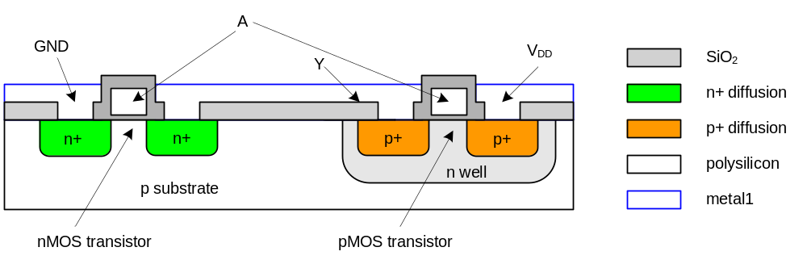
Inverter Cross-section
Typically use p-type substrate for nMOS transistors
Requires n-well for body of pMOS transistors
0: Introduction

Slide 3
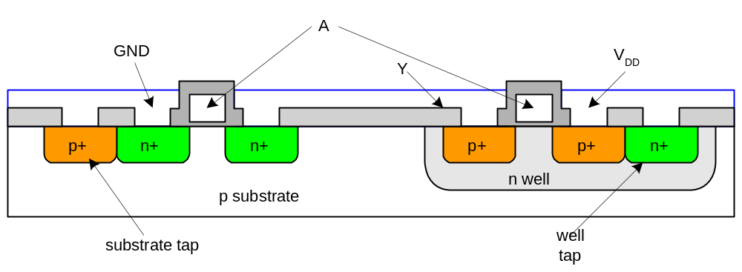
Well and Substrate Taps
Substrate must be tied to GND and n-well to V_{DD}
Metal to lightly-doped semiconductor forms poor connection called Shottky Diode
Use heavily doped well and substrate contacts / taps
0: Introduction

Slide 4
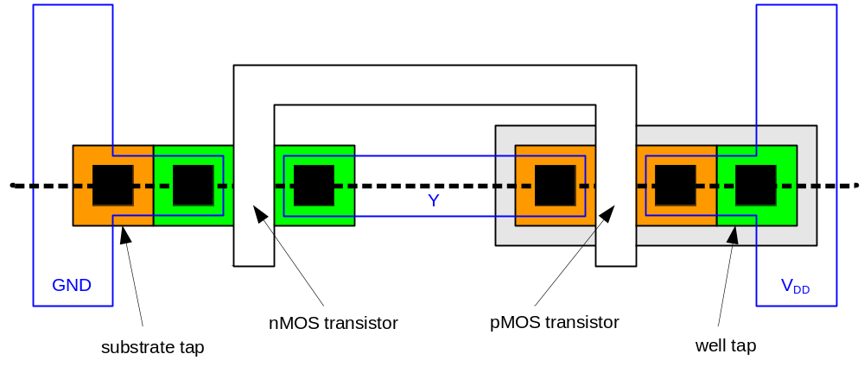
Inverter Mask Set
Transistors and wires are defined by masks
Cross-section taken along dashed line
0: Introduction

Slide 5
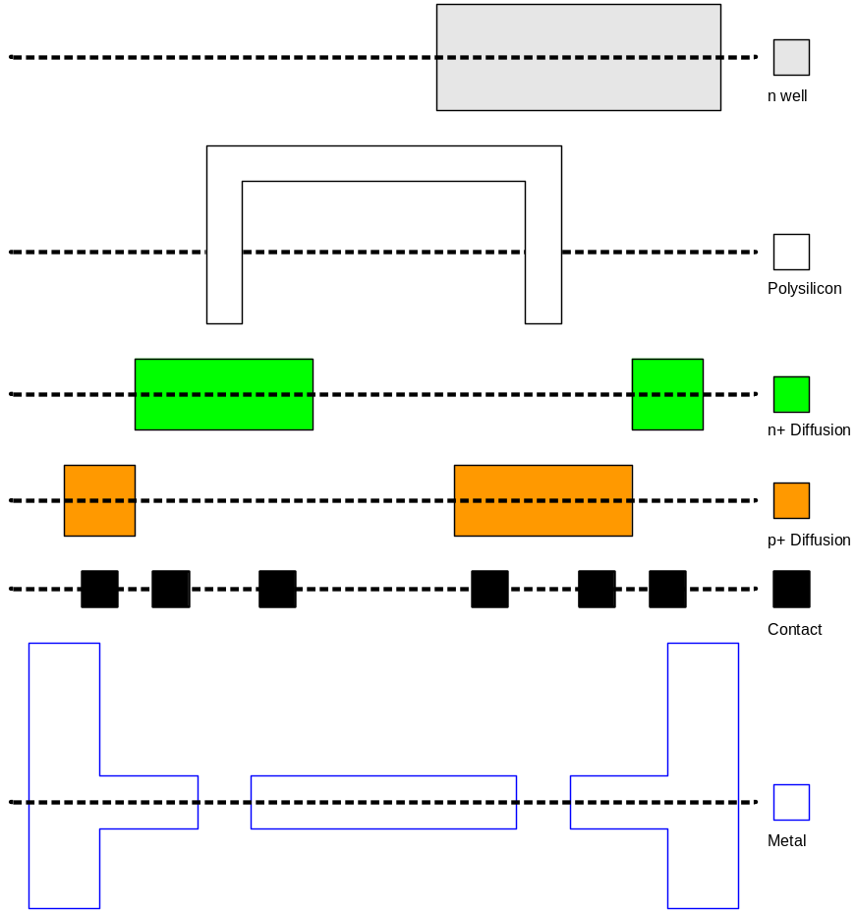
Detailed Mask Views
Six masks
  n-well
  Polysilicon
  n+ diffusion
  p+ diffusion
  Contact
  Metal
0: Introduction

Slide 6
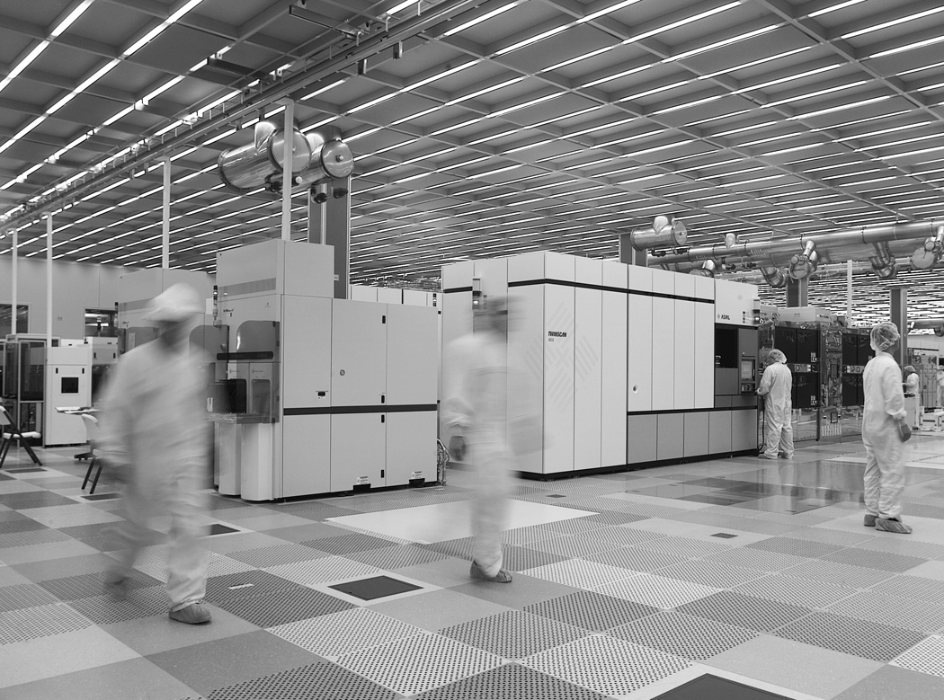
Fabrication
Chips are built in huge factories called fabs
Contain clean rooms as large as football fields
Courtesy of International
Business Machines Corporation.
Unauthorized use not permitted.
0: Introduction

Slide 7

Fabrication Steps
Start with blank wafer
Build inverter from the bottom up
First step will be to form the n-well
  Cover wafer with protective layer of SiO₂ (oxide)
  Remove layer where n-well should be built
  Implant or diffuse n dopants into exposed wafer
  Strip off SiO₂
0: Introduction

Slide 8
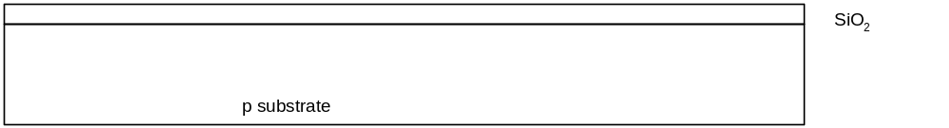
Oxidation
Grow SiO₂ on top of Si wafer
  900 – 1200 C with H₂O or O₂ in oxidation furnace
0: Introduction

Slide 9
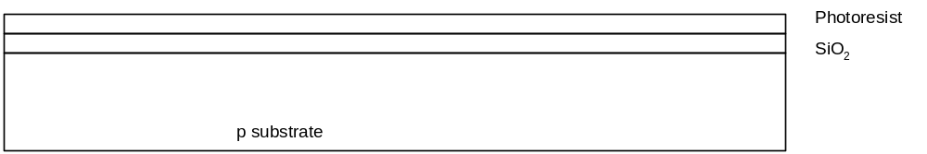
Photoresist
Spin on photoresist
  Photoresist is a light-sensitive organic polymer
  Softens where exposed to light
0: Introduction

Slide 10
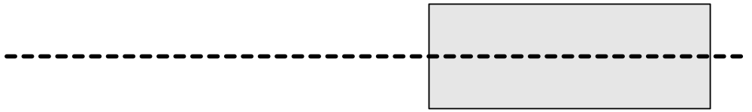
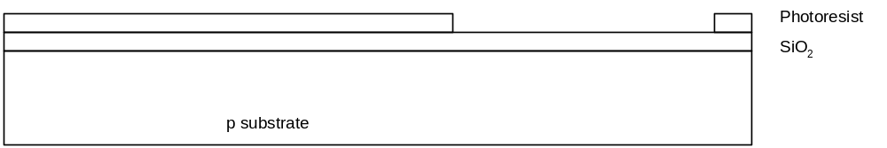
Lithography
Expose photoresist through n-well mask
Strip off exposed photoresist
0: Introduction

Slide 11
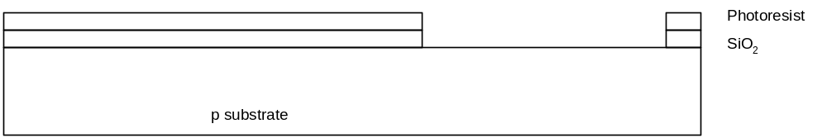
Etch
Etch oxide with hydrofluoric acid (HF)
  Seeps through skin and eats bone; nasty stuff!!!
Only attacks oxide where resist has been exposed
0: Introduction

Slide 12
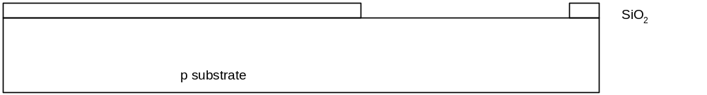
Strip Photoresist
Strip off remaining photoresist
  Use mixture of acids called piranah etch
Necessary so resist doesn’t melt in next step
0: Introduction

Slide 13
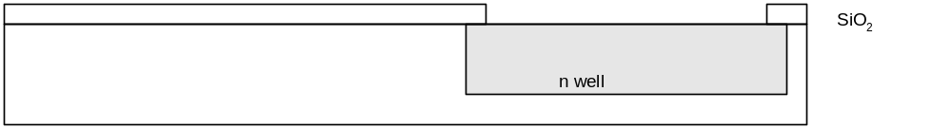
n-well
n-well is formed with diffusion or ion implantation
Diffusion
  Place wafer in furnace with arsenic gas
  Heat until As atoms diffuse into exposed Si
Ion Implanatation
  Blast wafer with beam of As ions
  Ions blocked by SiO₂, only enter exposed Si
0: Introduction

Slide 14

Strip Oxide
Strip off the remaining oxide using HF
Back to bare wafer with n-well
Subsequent steps involve similar series of steps
0: Introduction

Slide 15
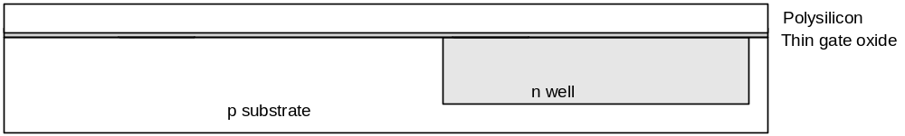
Polysilicon
Deposit very thin layer of gate oxide
  < 20 Å (6-7 atomic layers)
Chemical Vapor Deposition (CVD) of silicon layer
  Place wafer in furnace with Silane gas (SiH₄)
  Forms many small crystals called polysilicon
  Heavily doped to be good conductor
0: Introduction

Slide 16
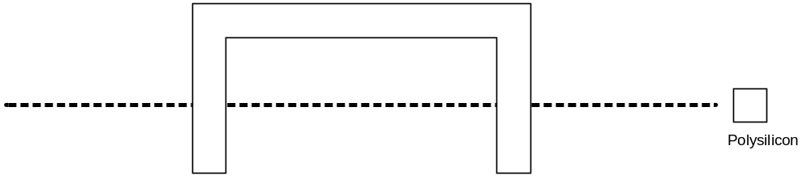
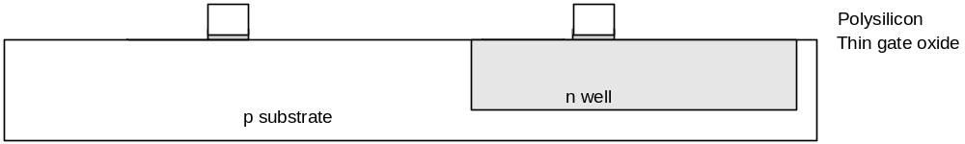
Polysilicon Patterning
Use same lithography process to pattern polysilicon
0: Introduction

Slide 17
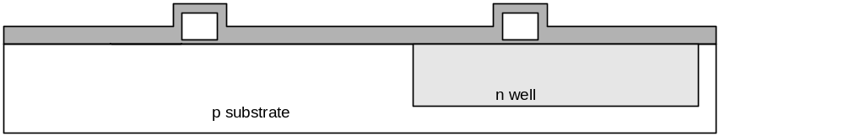
Self-Aligned Process
Use oxide and masking to expose where n+ dopants should be diffused or implanted
N-diffusion forms nMOS source, drain, and n-well contact
0: Introduction

Slide 18
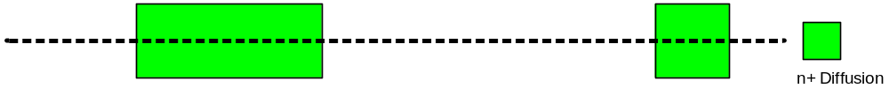
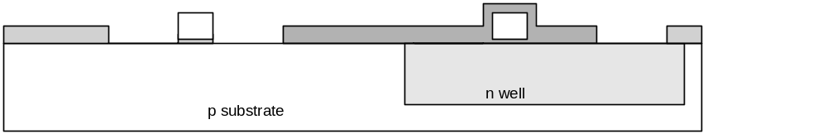
N-diffusion
Pattern oxide and form n+ regions
Self-aligned process where gate blocks diffusion
Polysilicon is better than metal for self-aligned gates because it doesn’t melt during later processing
0: Introduction

Slide 19
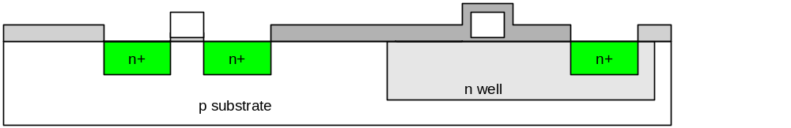
N-diffusion cont.
Historically dopants were diffused
Usually ion implantation today
But regions are still called diffusion
0: Introduction

Slide 20

N-diffusion cont.
Strip off oxide to complete patterning step
0: Introduction

Slide 21
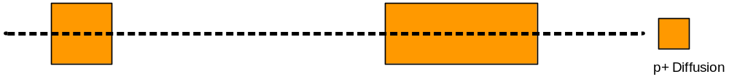
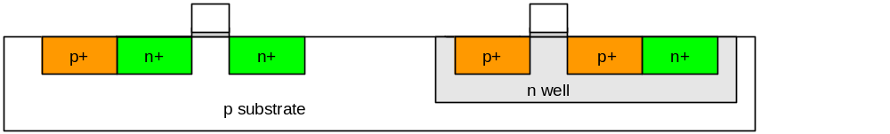
P-Diffusion
Similar set of steps form p+ diffusion regions for pMOS source and drain and substrate contact
0: Introduction

Slide 22
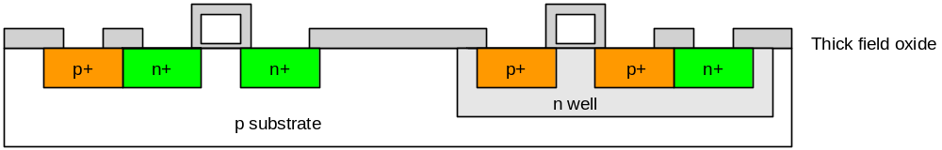
Contacts
Now we need to wire together the devices
Cover chip with thick field oxide
Etch oxide where contact cuts are needed
0: Introduction

Slide 23
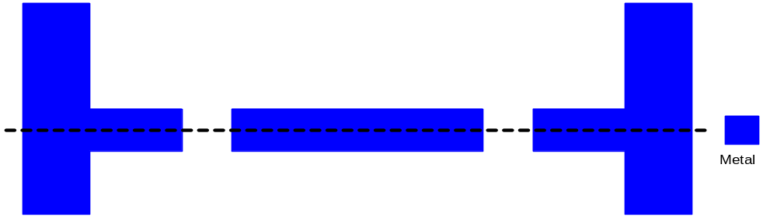
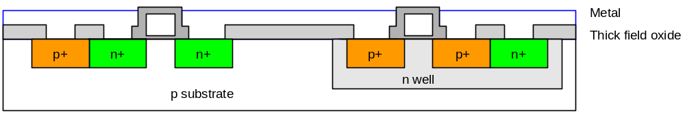
Metalization
Sputter on aluminum over whole wafer
Pattern to remove excess metal, leaving wires
0: Introduction

Slide 24
Layout
Chips are specified with set of masks
Minimum dimensions of masks determine transistor size (and hence speed, cost, and power)
Feature size f = distance between source and drain
  Set by minimum width of polysilicon
Feature size improves 30% every 3 years or so
Normalize for feature size when describing design rules
Express rules in terms of λ = f/2
  E.g. λ = 0.3 μm in 0.6 μm process
0: Introduction

Slide 25
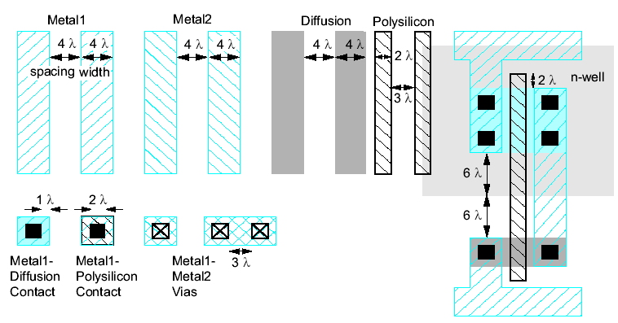
Simplified Design Rules
Conservative rules to get you started
0: Introduction

Slide 26
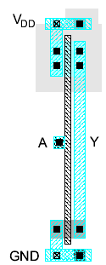
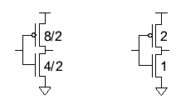
Inverter Layout
Transistor dimensions specified as Width / Length
  Minimum size is 4λ / 2λ, sometimes called 1 unit
  In f = 0.6 μm process, this is 1.2 μm wide, 0.6 μm long
0: Introduction

Slide 27
Summary
MOS transistors are stacks of gate, oxide, silicon
Act as electrically controlled switches
Build logic gates out of switches
Draw masks to specify layout of transistors
Now you know everything necessary to start designing schematics and layout for a simple chip!
0: Introduction

Slide 28
About these Notes
Lecture notes © 2011 David Money Harris
These notes may be used and modified for educational and/or non-commercial purposes so long as the source is attributed.
0: Introduction

