Slide 1

Digital Implementation 101
Session2 : Logical Equivalence Check

Slide 2
1. Understanding LEC

Slide 3
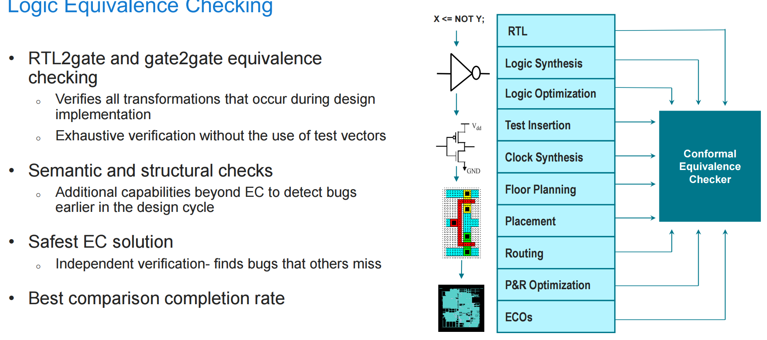
Notion of LEC

Slide 4
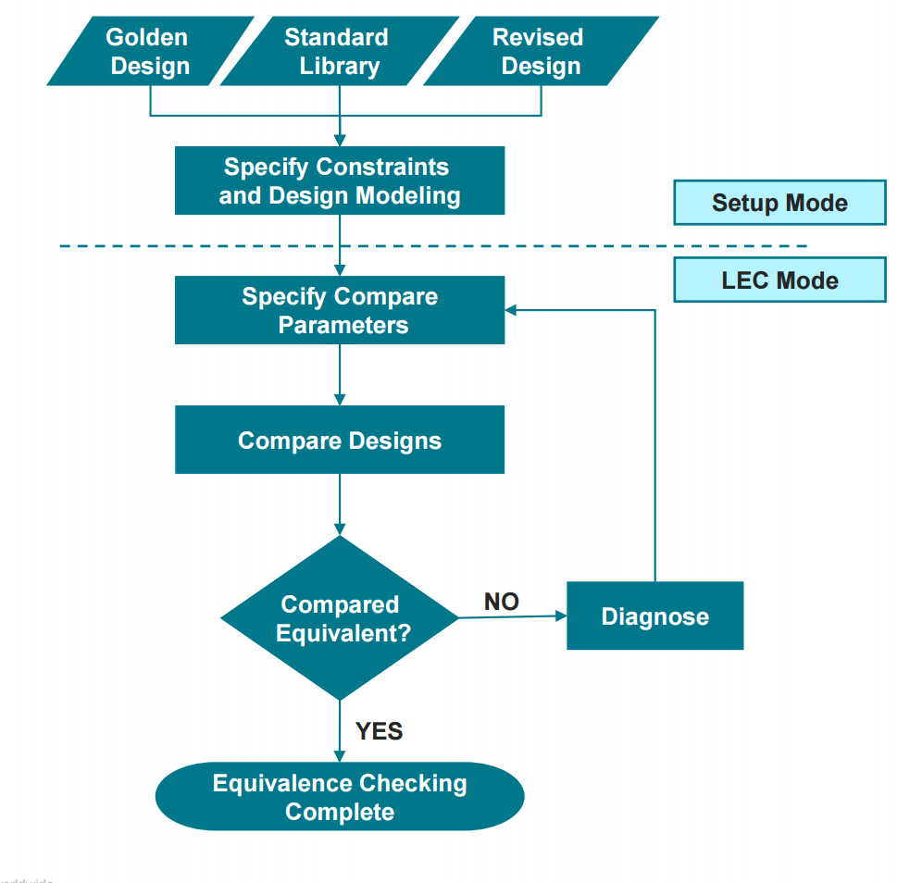
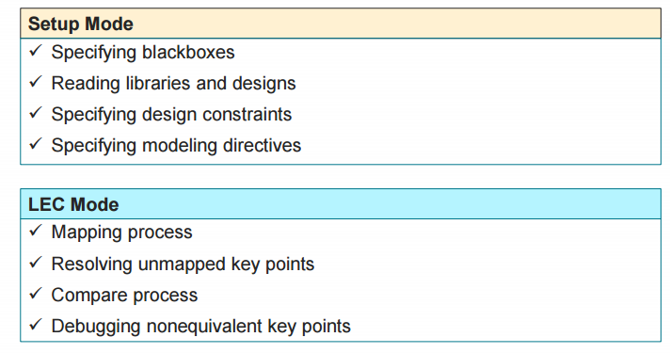
LEC Flow

Slide 5
Input Files
LEC
PDK
(.lib/.db file for std/io cells)
RTL Source
(.v files for synthesis)
Gate Level Netlist
Equivalence Check
(Conformal)

Slide 6
LAB

Slide 7
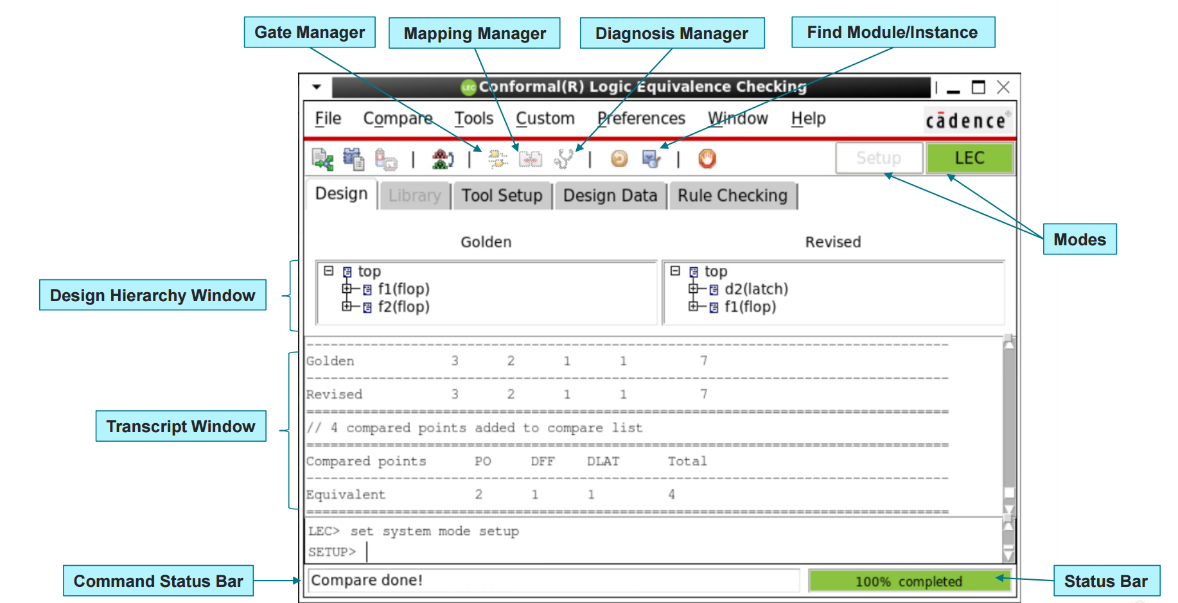
실습
GUI

Slide 8
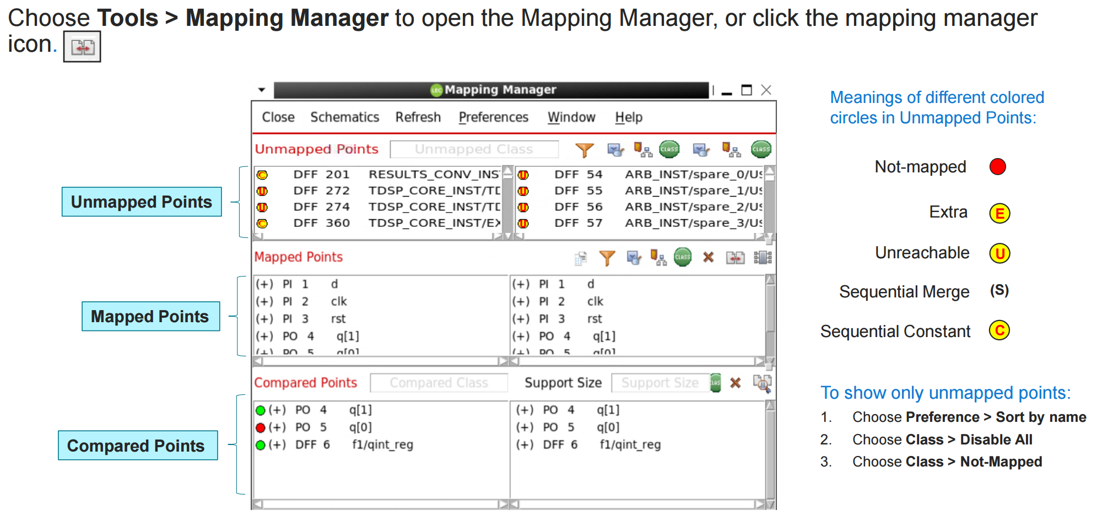
실습
Mapping Manager

Slide 9
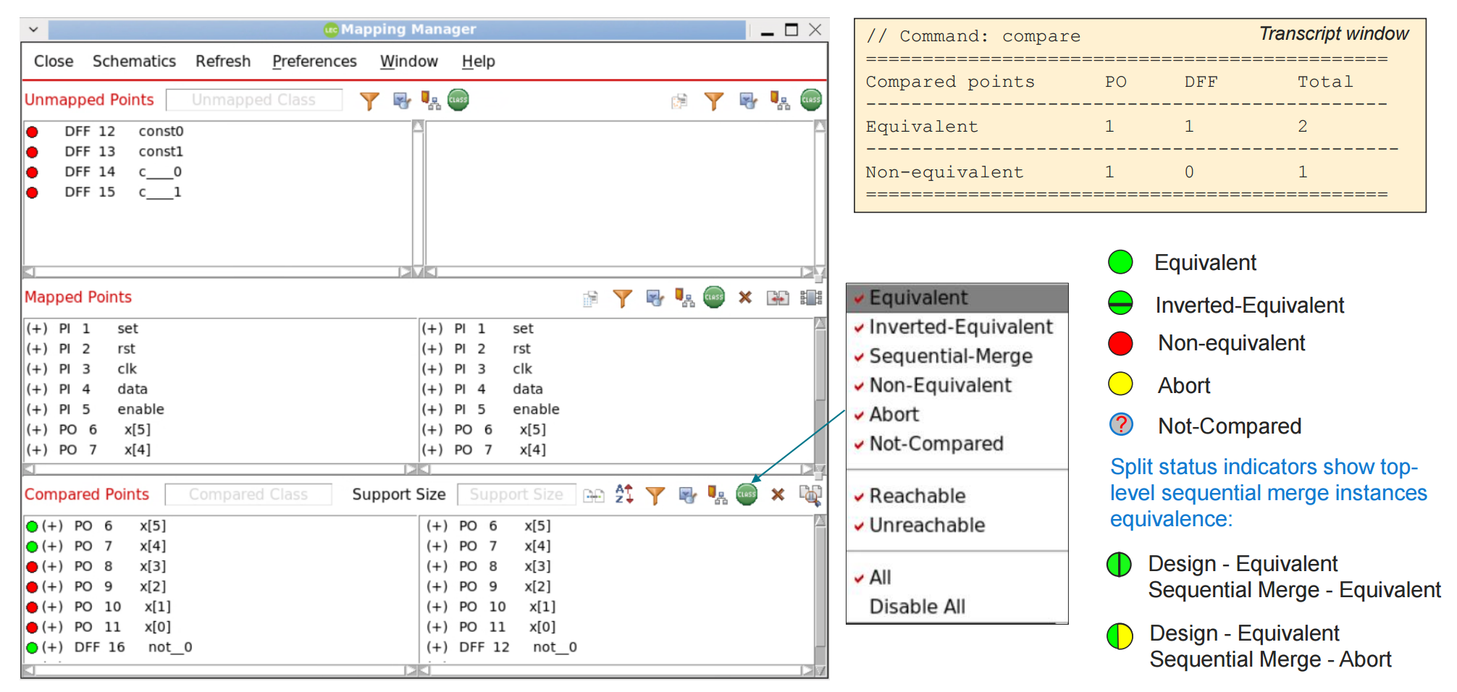
실습
Mapping Manager – Comparison Results

Slide 10
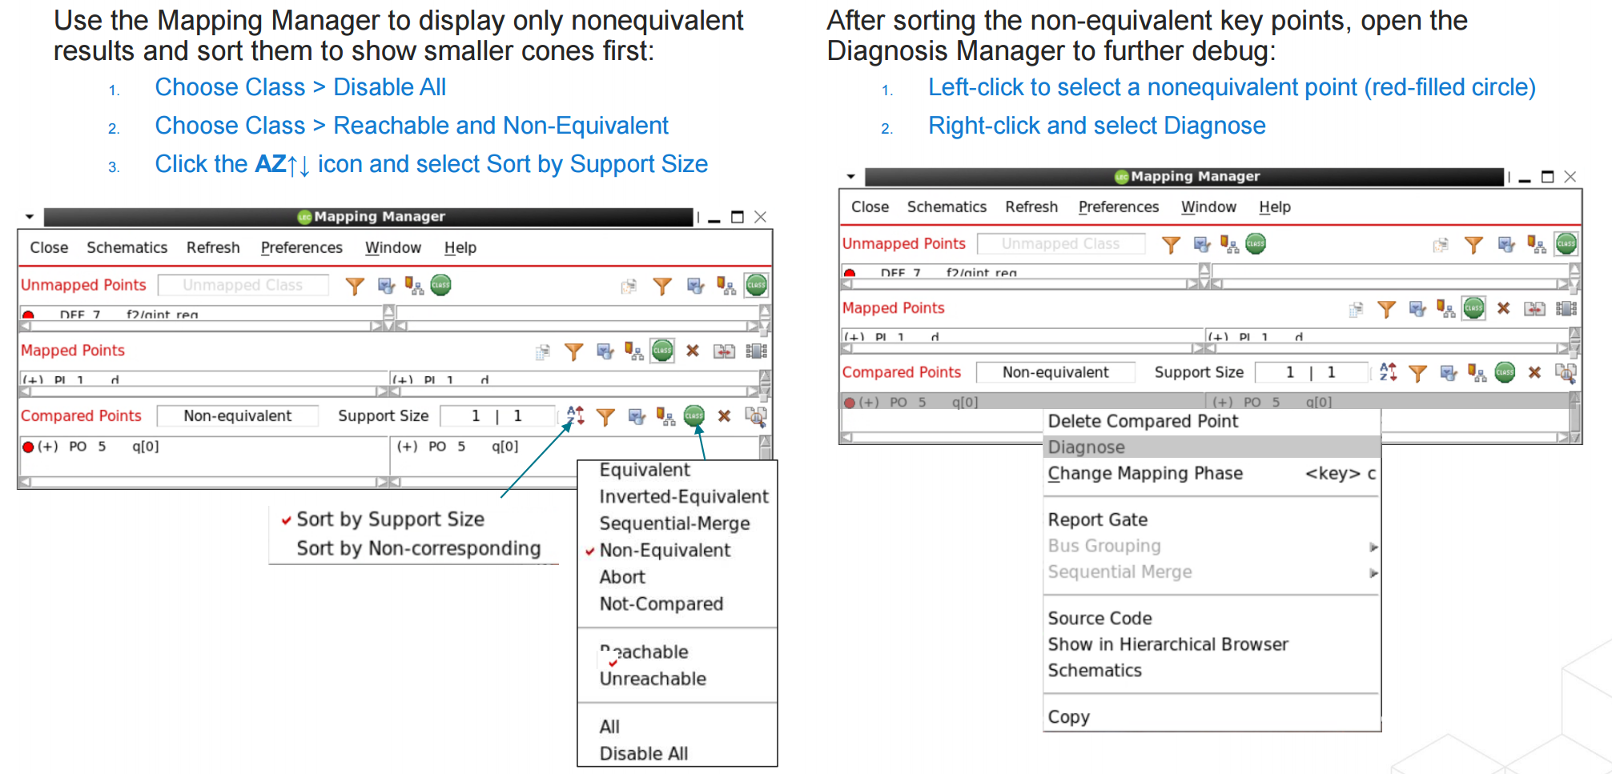
실습
Mapping Manager – Comparison Results

Slide 11
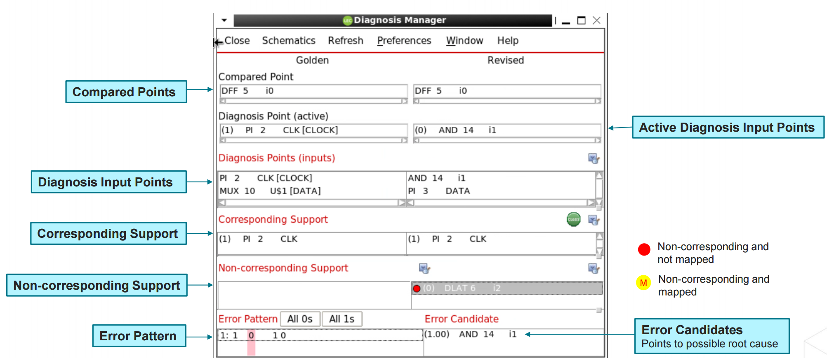
실습
Diagnosis Manager

Slide 12
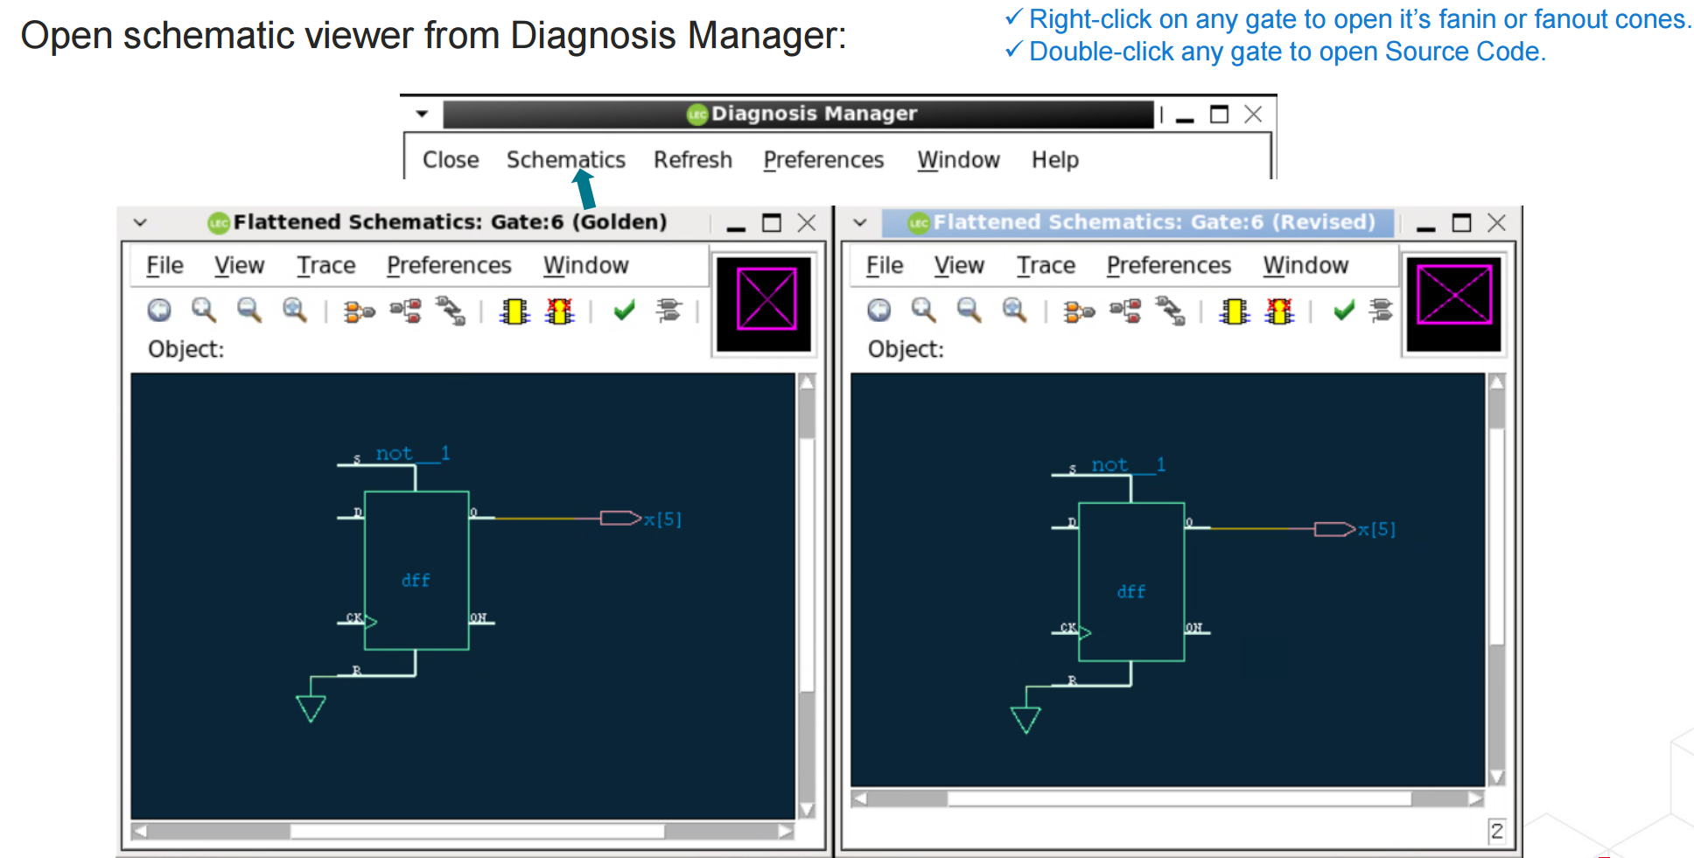
실습
Schematic Viewer

Slide 13
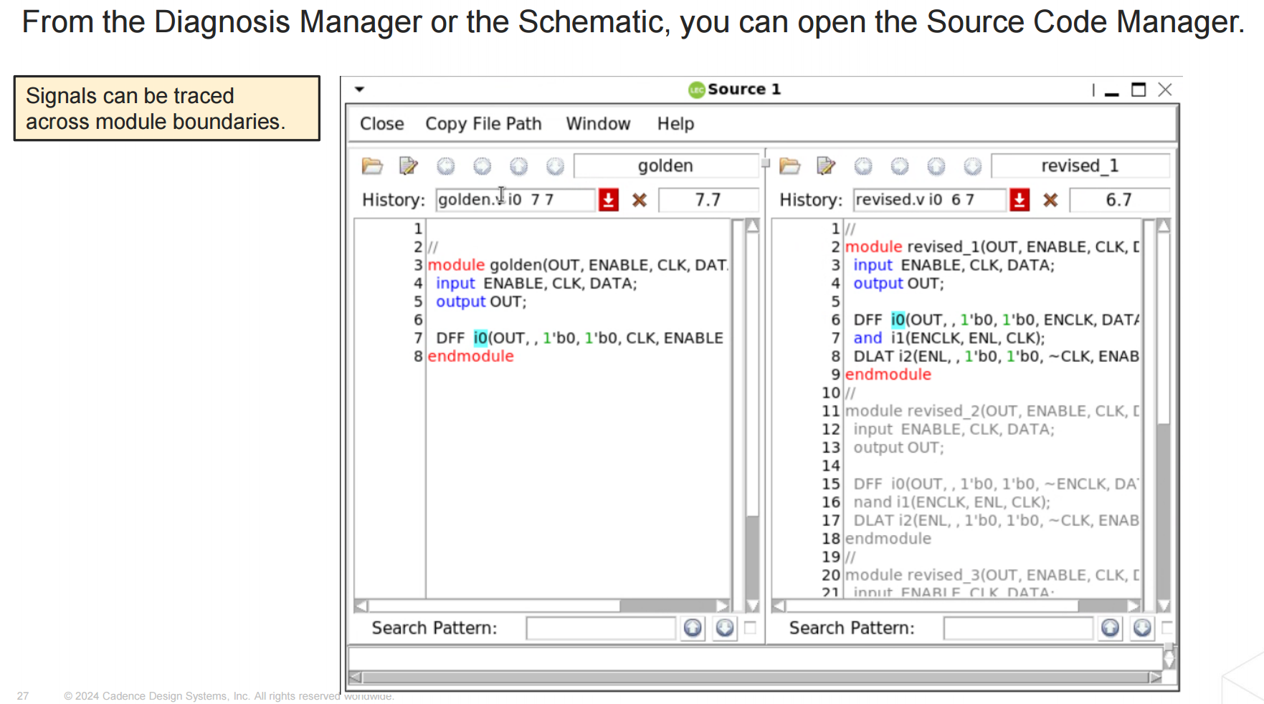
실습
Source Code Manager

Slide 14
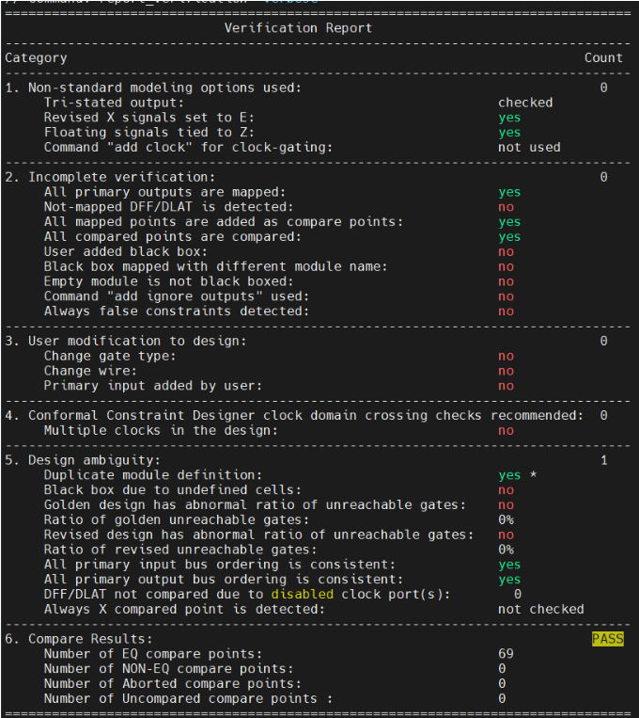
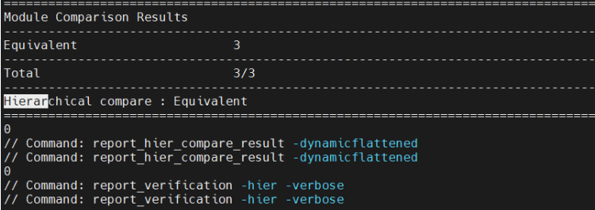
실습
do file : Automated Code from Genus

Slide 15
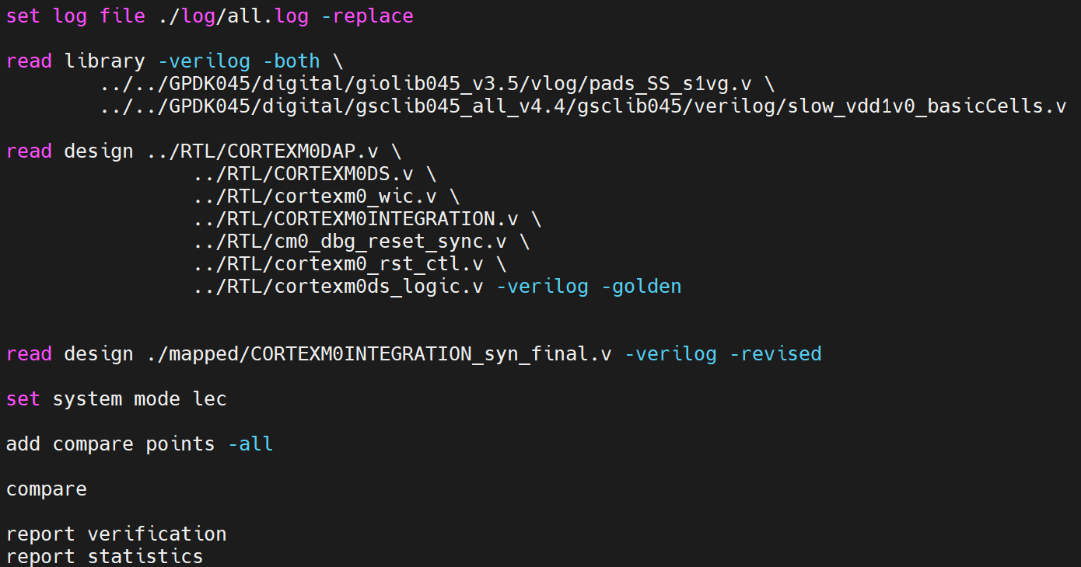
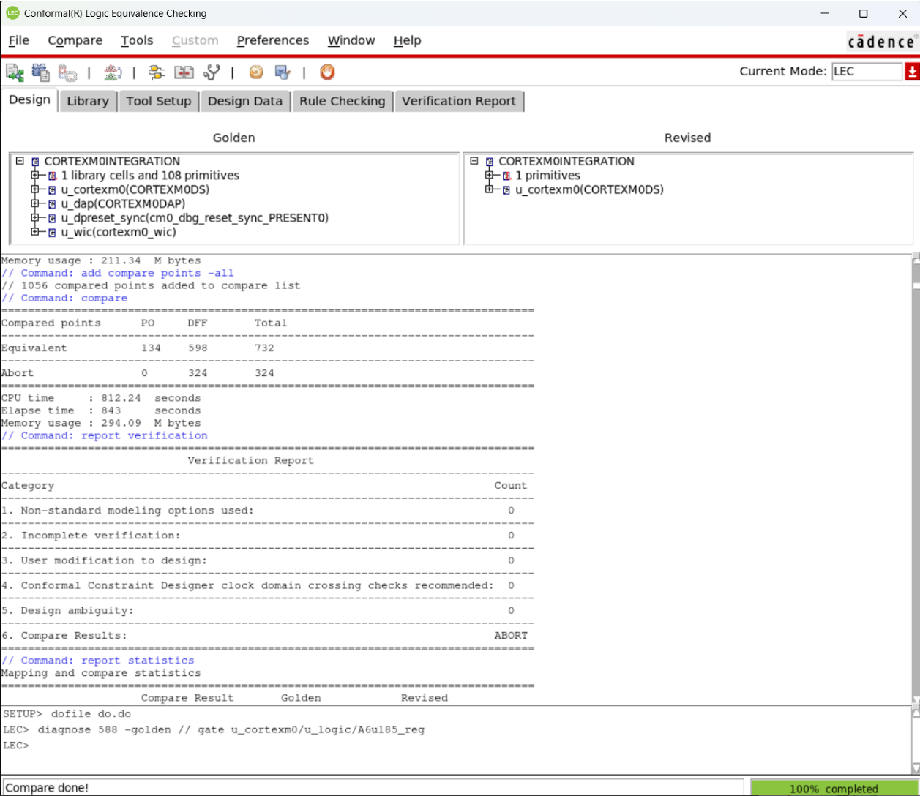
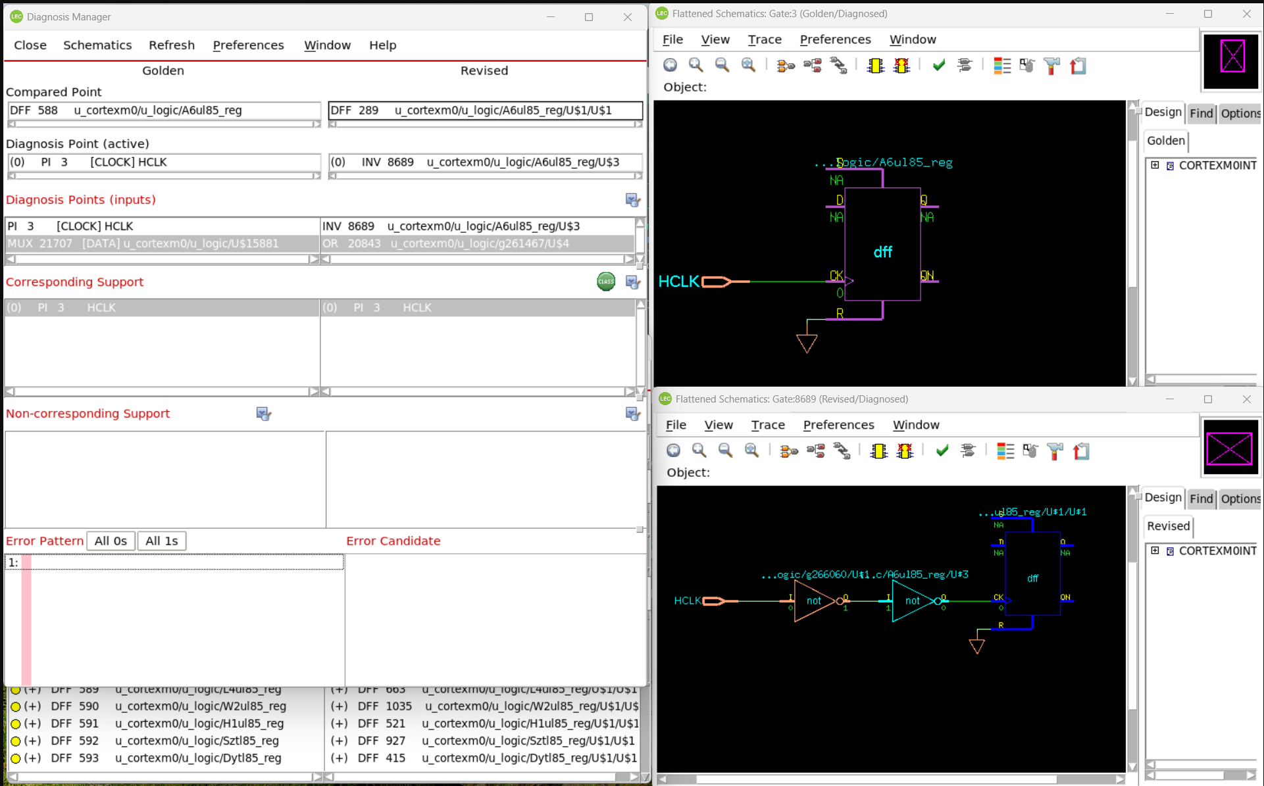
참고 – Abort의 예시
do file : RTL Source Code를 직접 지정 (no fv_map)

