Slide 1

SoC 100
Session1 : Socio-economical Background of
Semiconductor Design Development

Slide 2


CHIP WAR

Slide 3

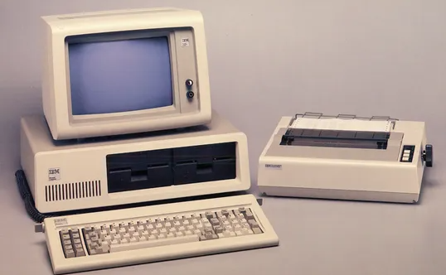
Economics of Scale
Source : IBM

Slide 4

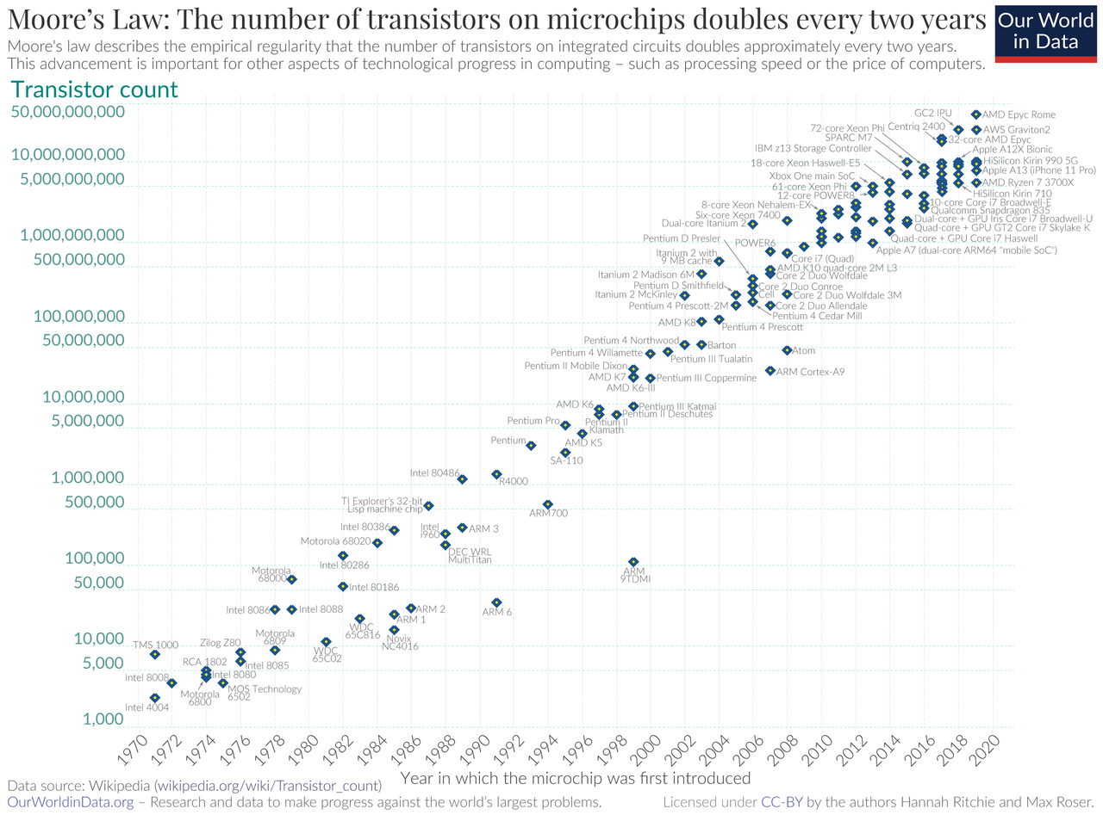
Moore’s Law

Slide 5



Drive momentum

Slide 6
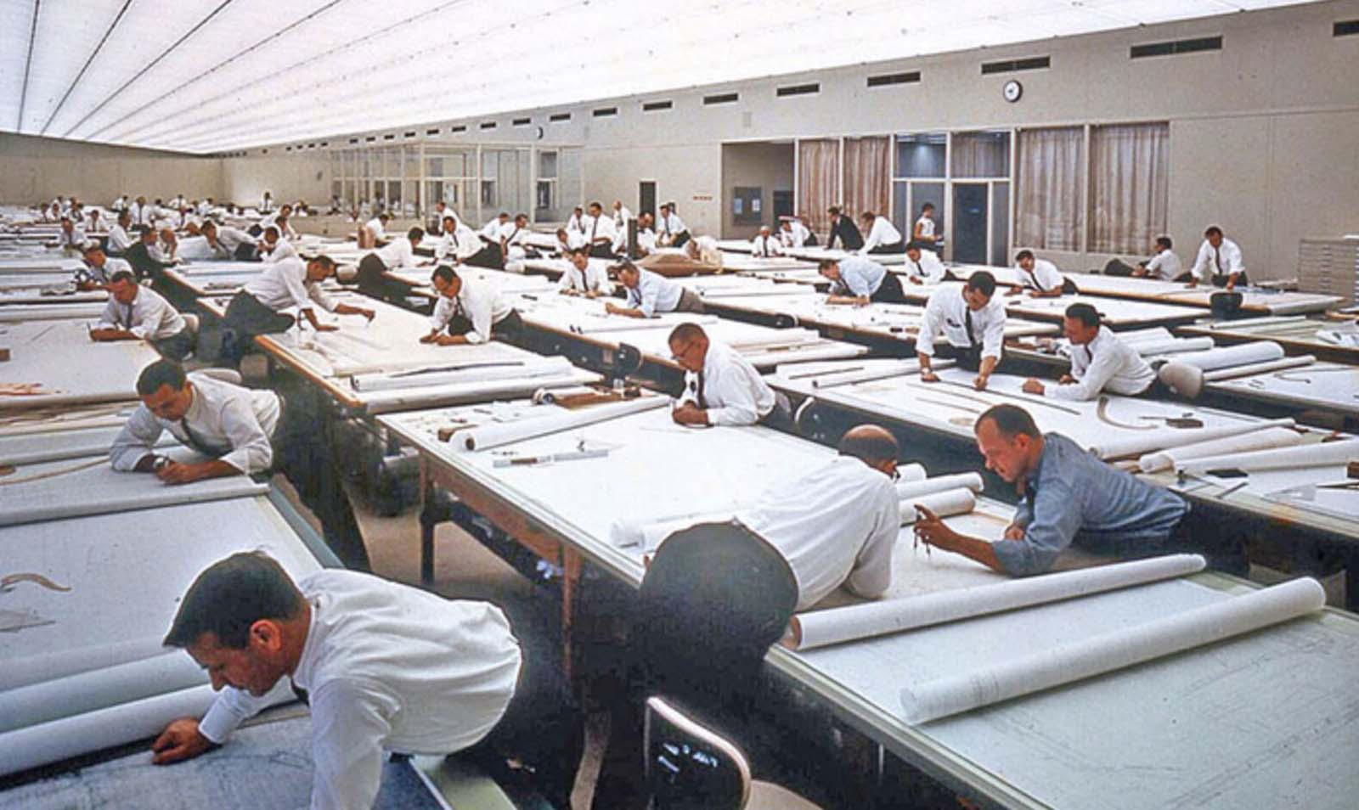
Early Designer : Handcrafting
Source: General Motors

Slide 7
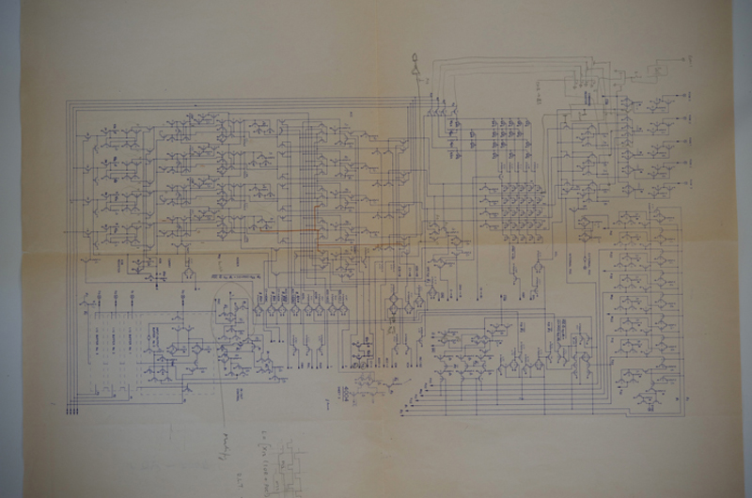
Early Designer : Schematic Capture
Source: Intel 4004(Memory Block, Hand Written Schematic, 1 of 3 pages, drawn by Federico

Slide 8
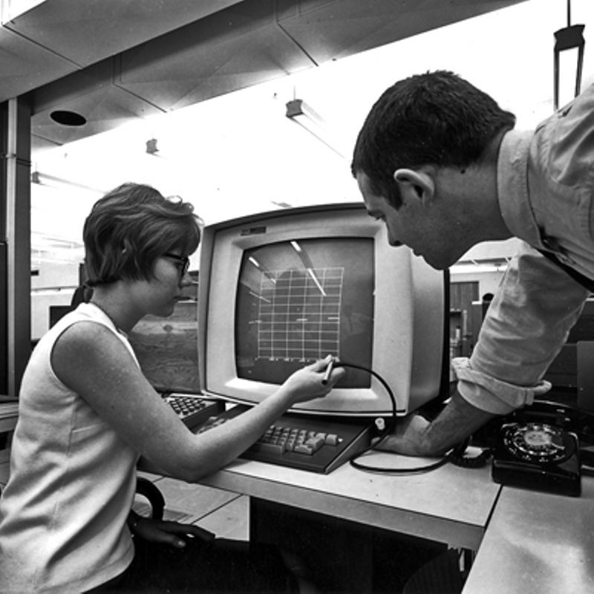
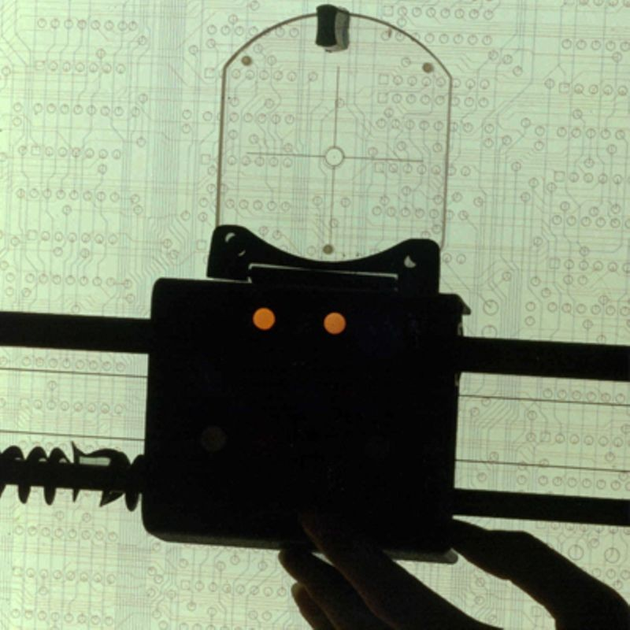
Early EDA System
1966, IBM360/37 mainframe-powered CAD at Fairchild
Mask layout drawing hand digitizing system at Intel

Slide 9
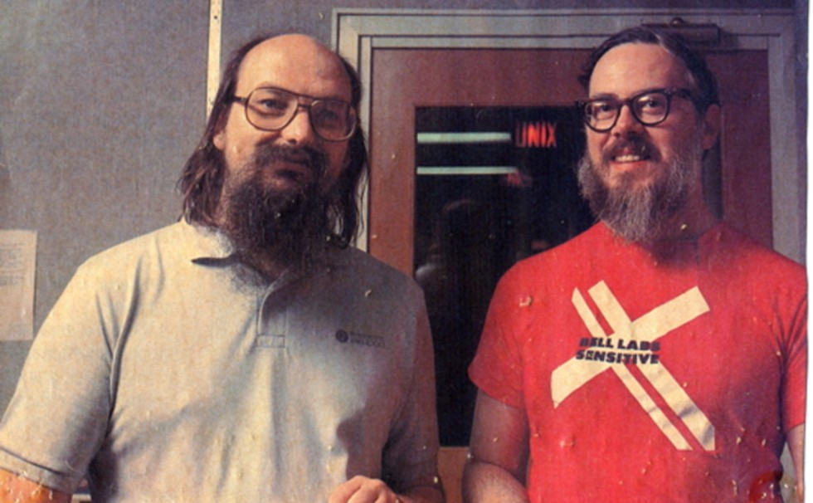
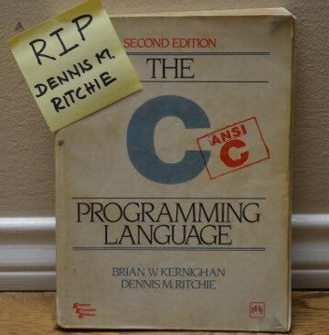
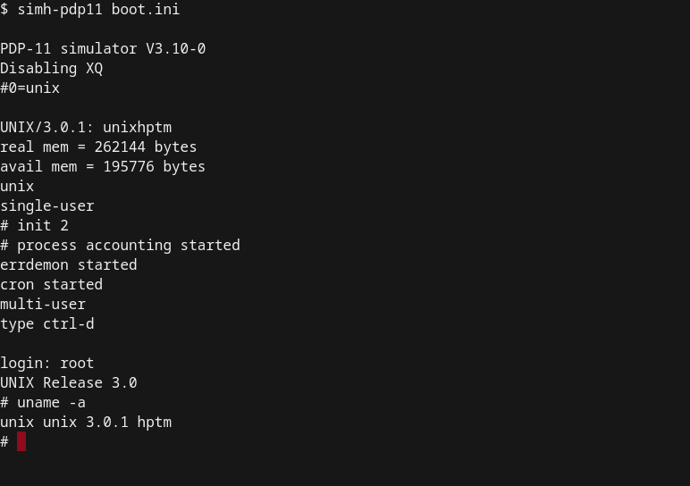
Software Revolution
TCPL: The C Programming Language
UNIX running on PDP-11

Slide 10
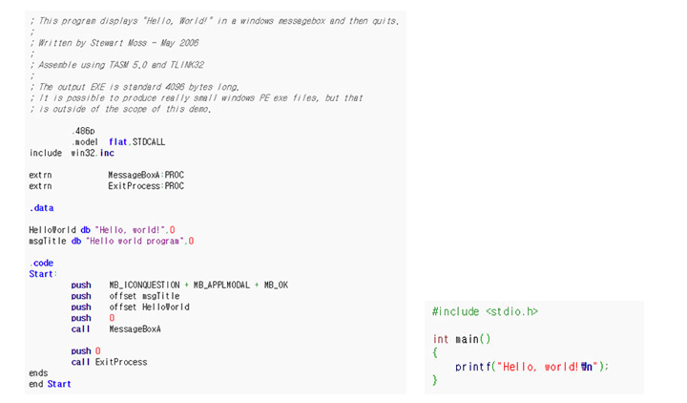
Contribution

Slide 11
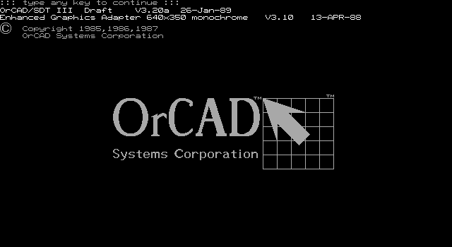
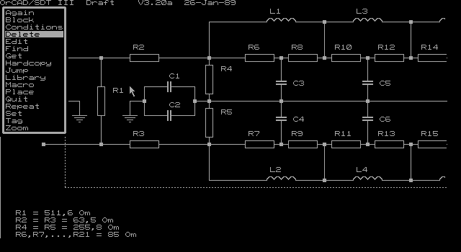
Early ECAD System

Slide 12
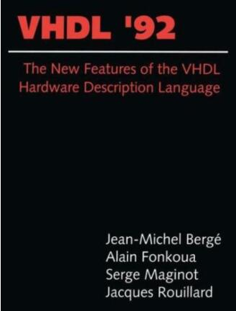
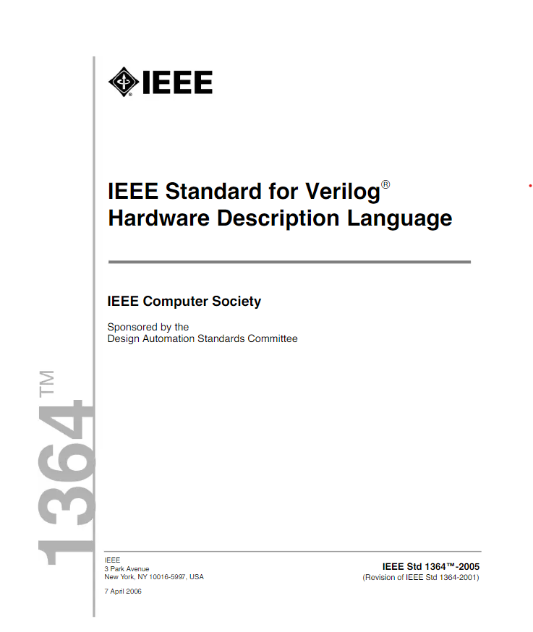
Hardware Descriptive Language

Slide 13
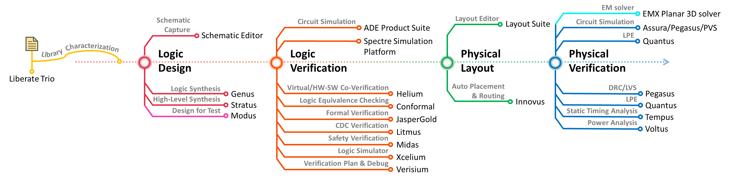
Semiconductor Fabrication
Full-custom IC
Analog IC
Semi-custom IC
Digital IC

Slide 14
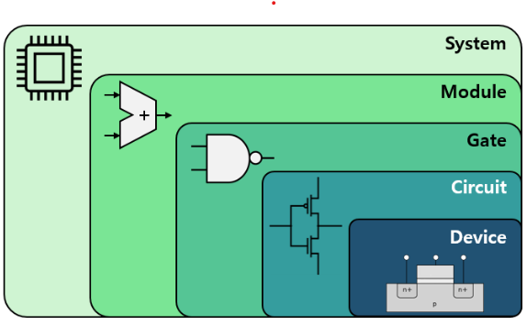
Diverse Viewpoint to view semiconductor
High
Device Level : 소자의 연구
Circuit Level : TR 기반의 회로설계
Gate Level : Logic Gate Netlist
RTL Level : 레지스터간 데이터 흐름/논리연산모델링기반 설계
System Level : 시스템 모듈 및 인터페이스를 통한 전체 시스템 설계
Abstraction Level
Low

Slide 15
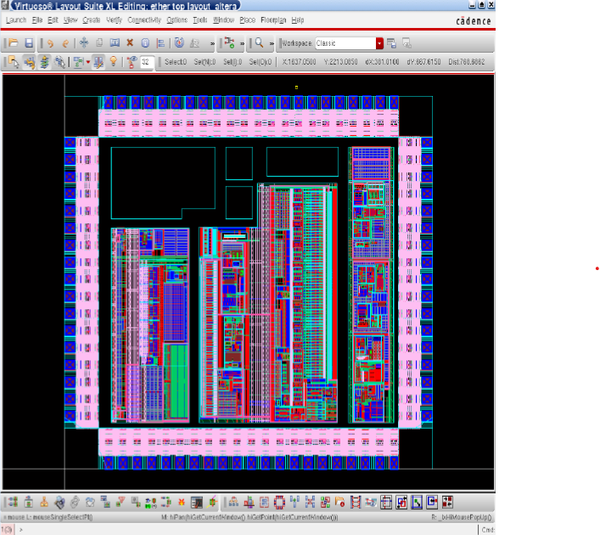
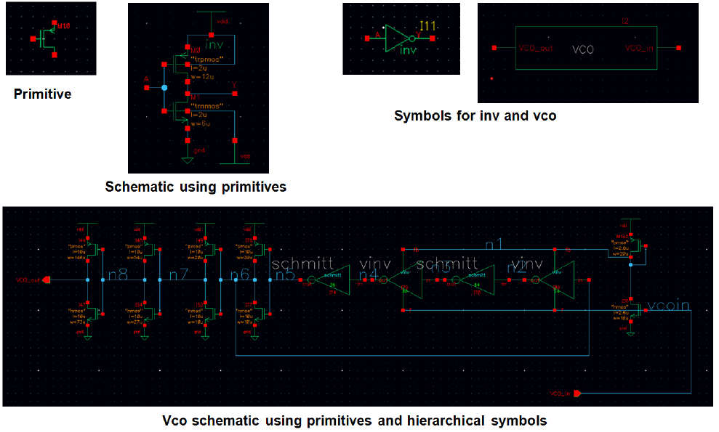
Full Custom Design(1)
Full Custom IC
Circuit Level Design(Handcraft)
Transistor / Resistor / Capacitor 기반
Logic Design
Physical Implementation: Layout

Slide 16
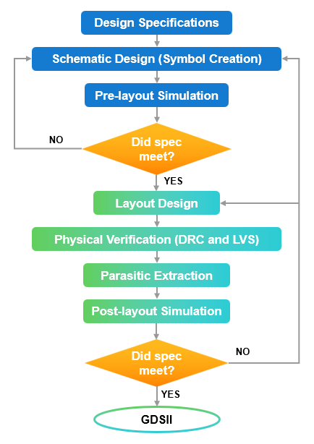
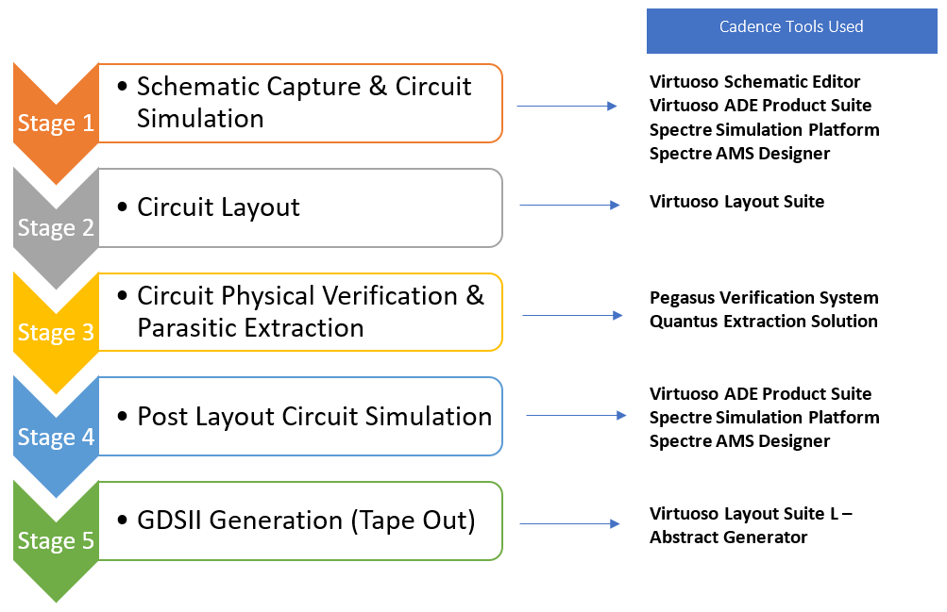
Full Custom Design(2)

Slide 17
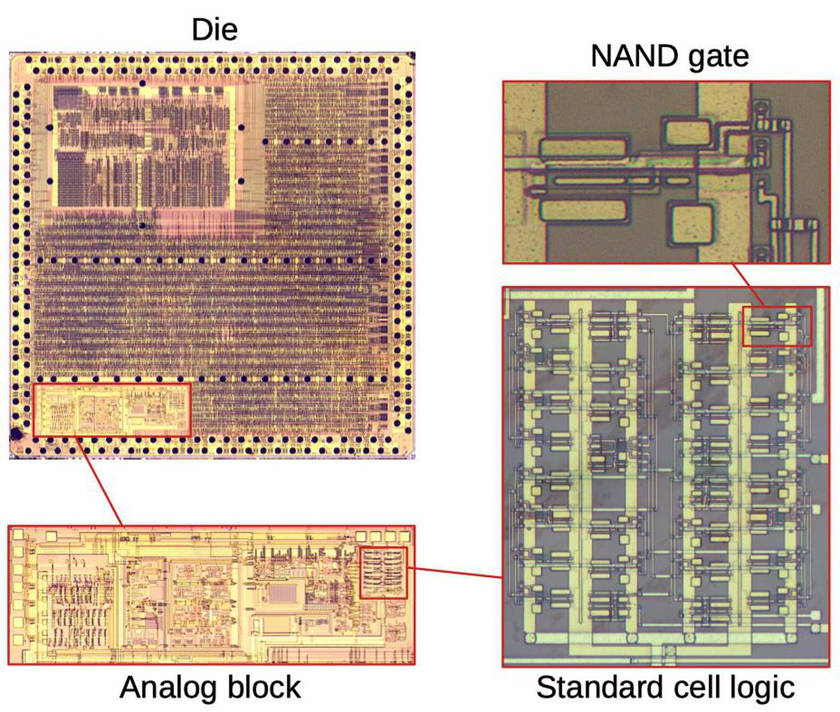
Semi Custom Design(1)
Semi Custom IC(Cell Based Design)
RTL Level에서 설계 진행
Standard Cell 기반
Source: IBM

Slide 18
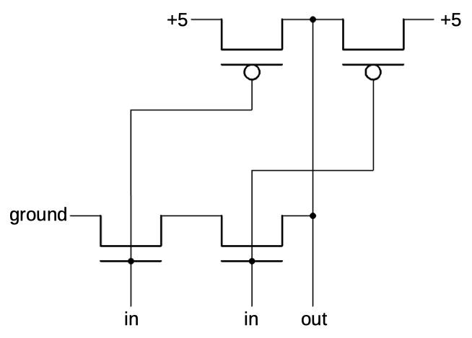
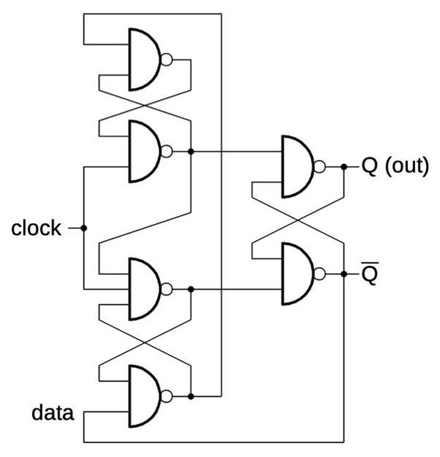
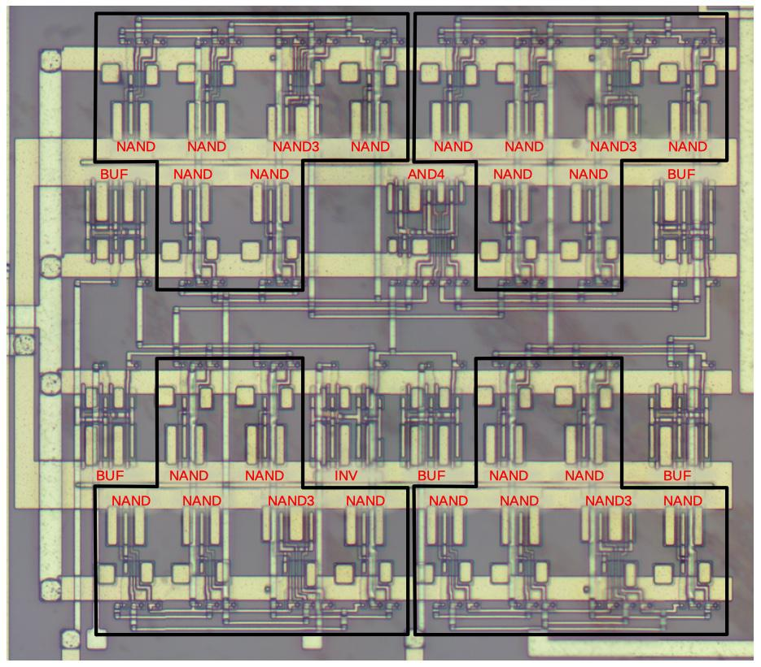
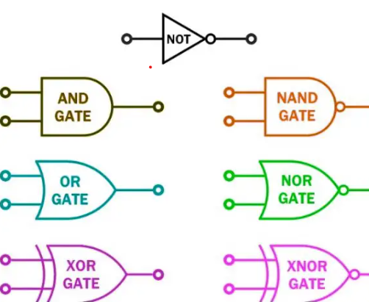
Semi Custom Design(2)
Standard Cell Library
Implementation: Auto Place & Route(APR)
Logic HW Design

Slide 19
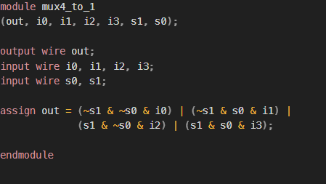
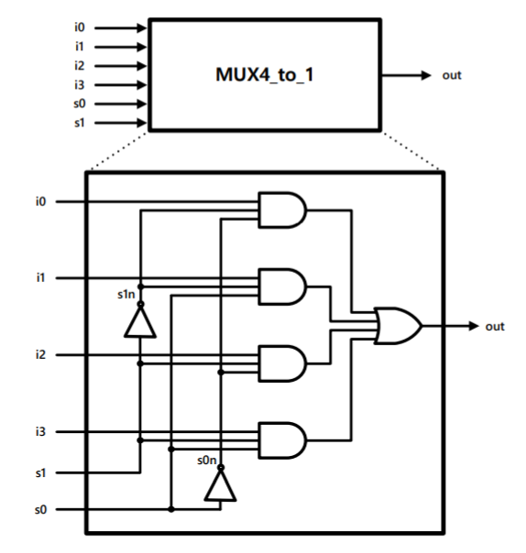
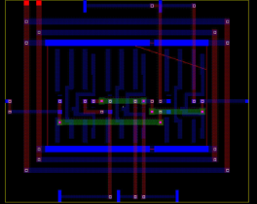
Semi Custom Design(3)
Back End
HDL Logic Design
Logic Synthesis
Physical Implementation : Auto Place & Route
Front End

Slide 20
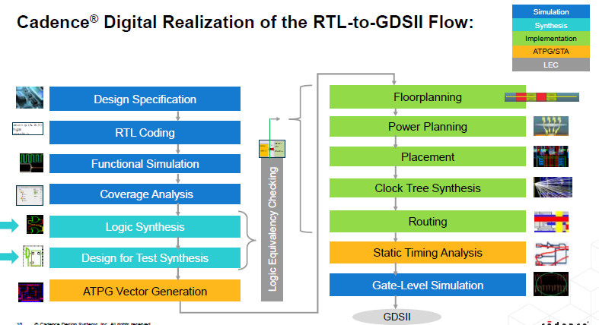
Semiconductor Fabrication
Design Spec & Logic Design
Back End
Front End
Source: Cadence

Slide 21
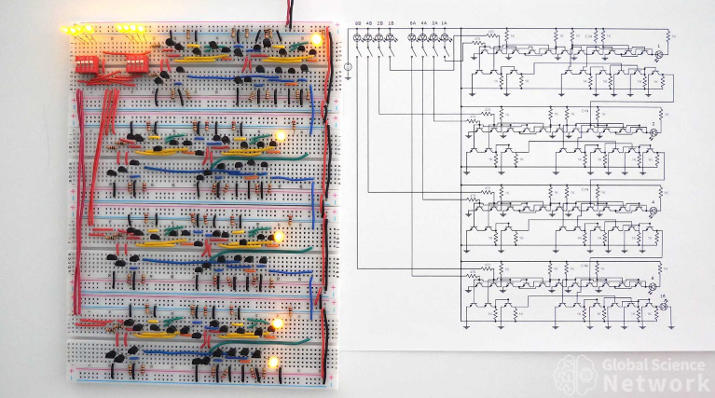
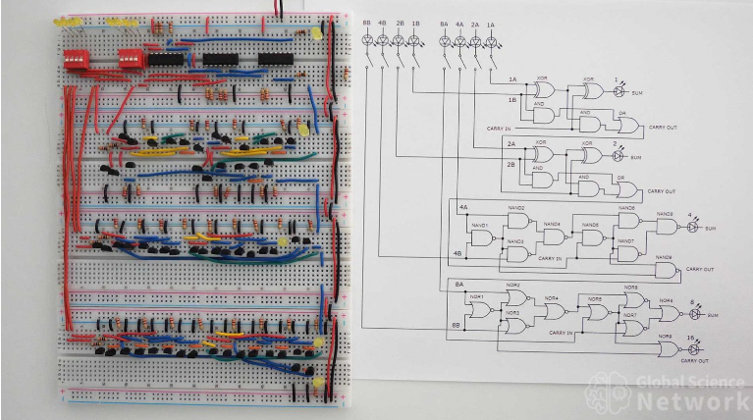
Full Custom vs Semi Custom
Source: Global Science Network

Slide 22
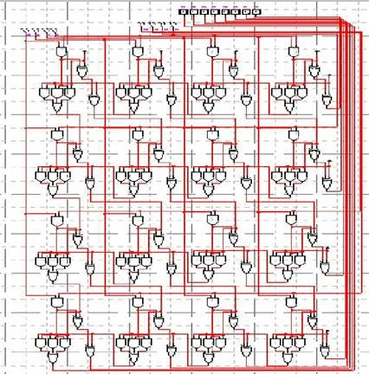
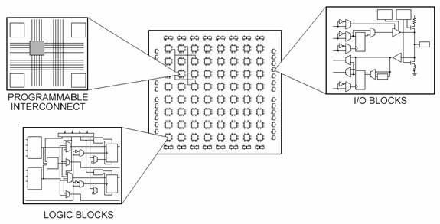
Field Programmable Gate Array(FPGA)
FPGA(Field Programmable Gate Array)
Cell Based Design
Reusable Circuit
Emulation / Prototyping

