Slide 1
SoC101
Capstone : Clock

Slide 2
Clock Making

Slide 3
Capstone : Specification
top_watch
gen_one_sec
Second Block
clk
rst_n
clk
rst_n
o_one_sec
Minute Block
i_start_clock
w_o_one_sec
i_start_clock
i_set_freq
o_sec
o_min
o_hour
i_set_freq
Hour Block

Slide 4
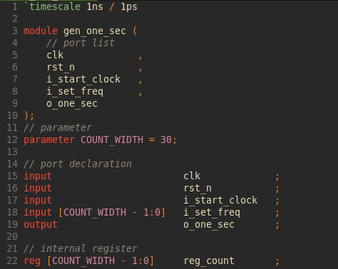
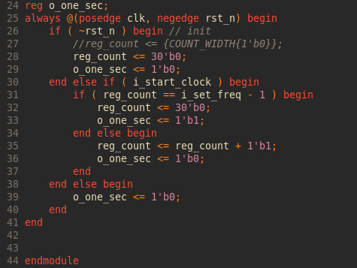
DUT1 : Generate 1 second

Slide 5
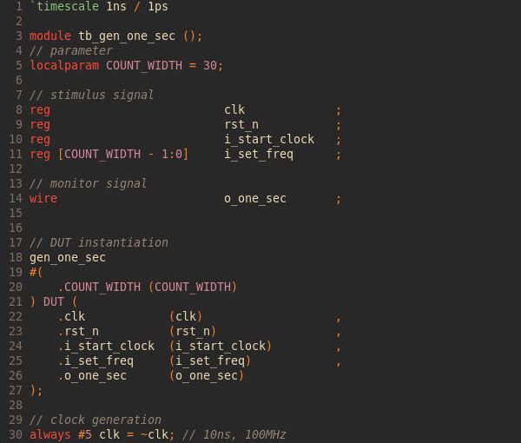
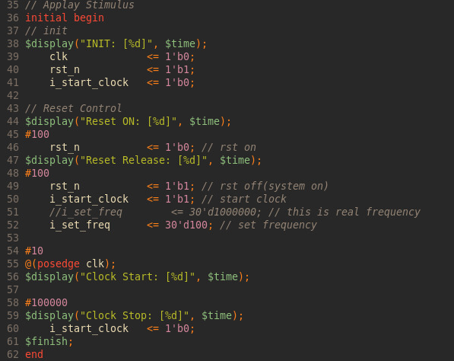
Testbench for DUT1

Slide 6
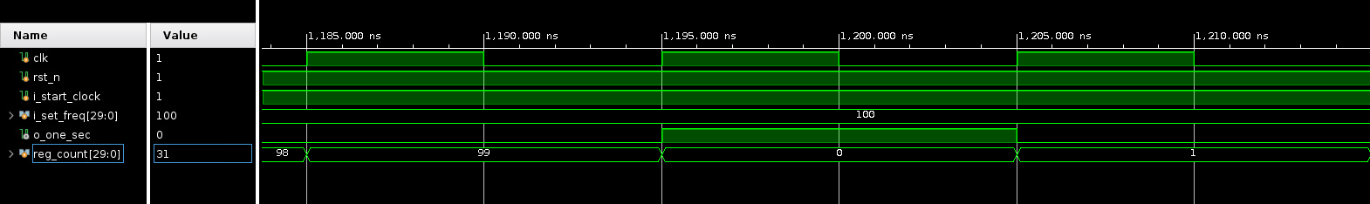
Waveform for DUT1

Slide 7
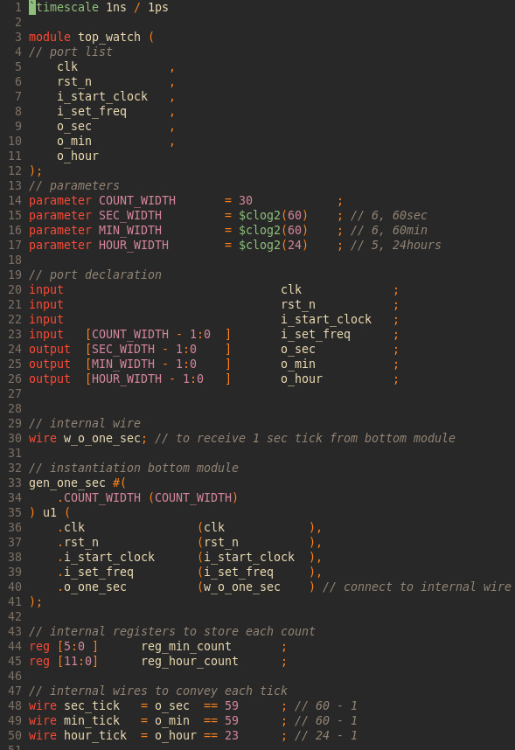
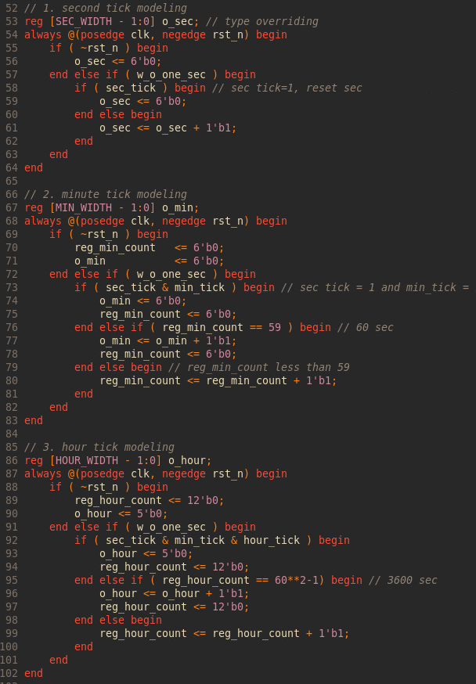
DUT2 : TOP Moule(Generate minute and hour)

Slide 8
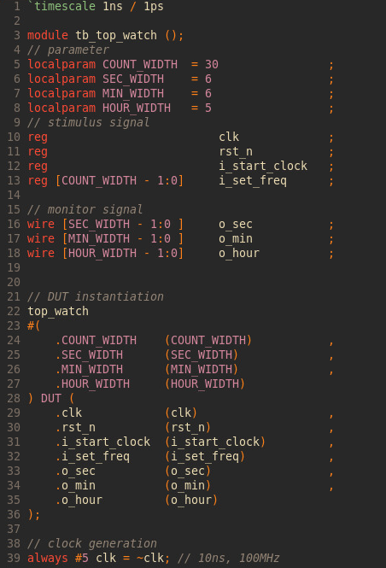
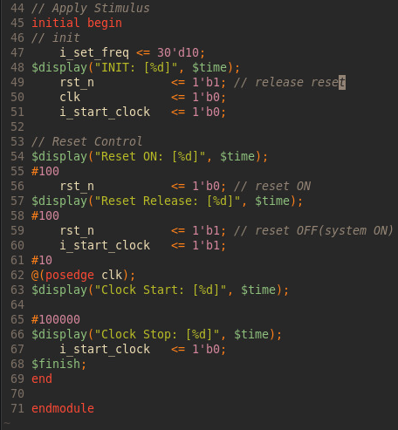
Testbench for DUT2

Slide 9
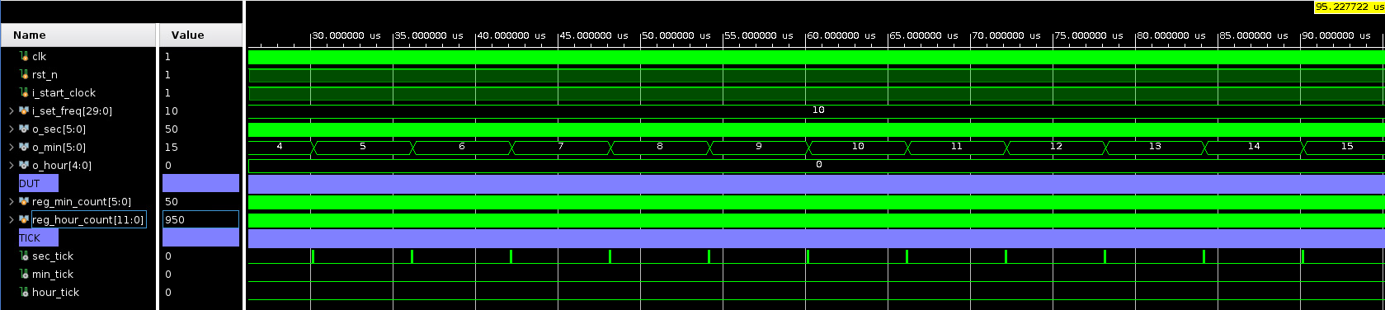
Waveform for DUT2

