Slide 1

SoC 102: Implementation
Session3 : Auto Place and Route

Slide 2
1. Auto Place and Route(APR) Flow

Slide 3
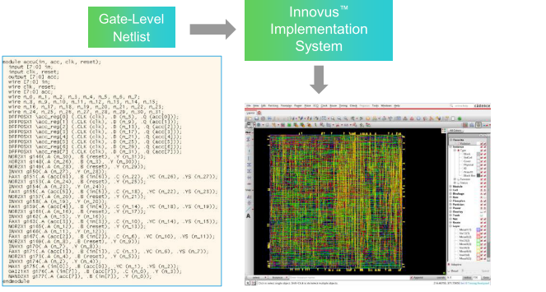
Notion of Implementation

Slide 4
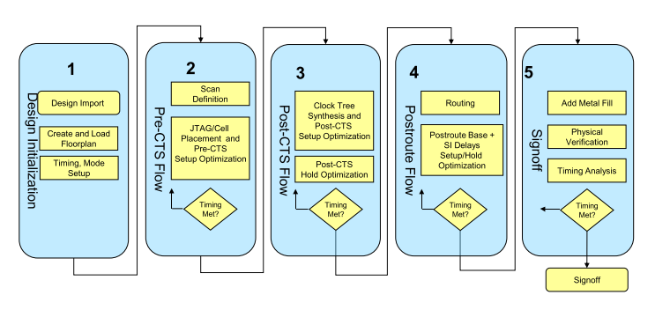
Implementation Flow

Slide 5
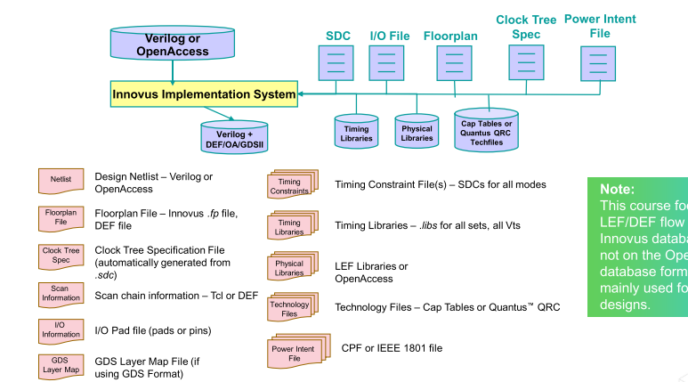
Input Files

Slide 6
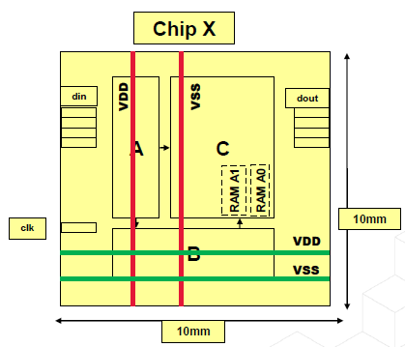
Floor Plan

Slide 7
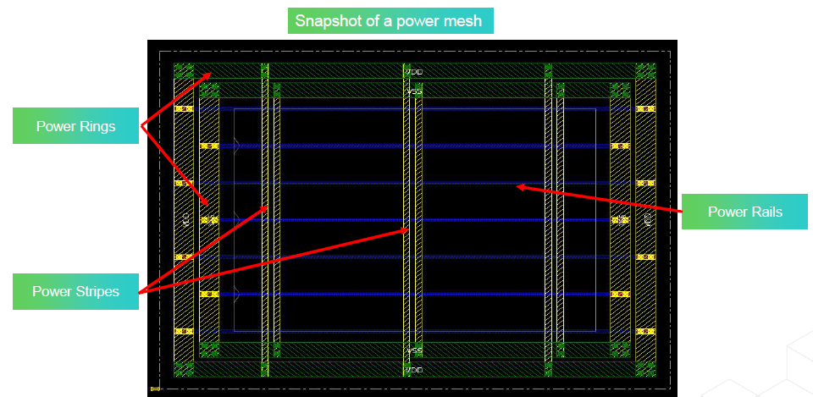
Power Plan
1. Power Ring
2. Power Stripe
3. Power Rail

Slide 8
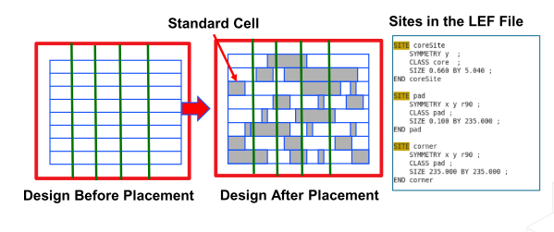
Placement

Slide 9
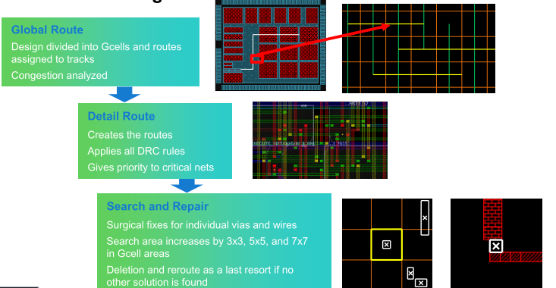
Routing

Slide 10
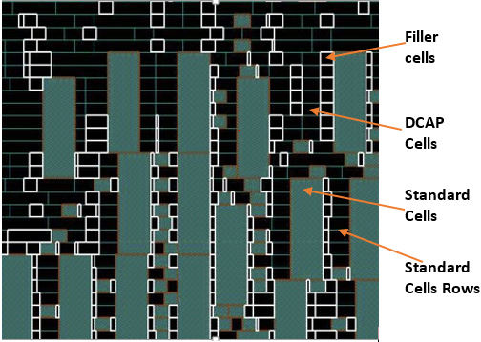
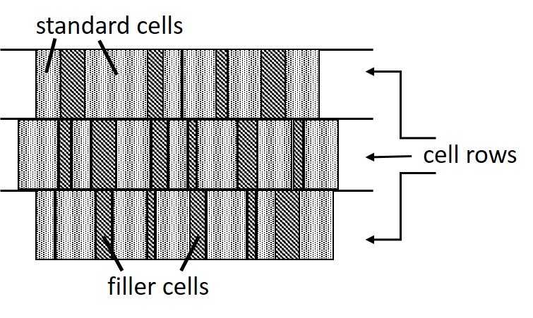
Adding Filler and Chip Finish

Slide 11
2. Interactive APR

Slide 12
Init Design

Slide 13
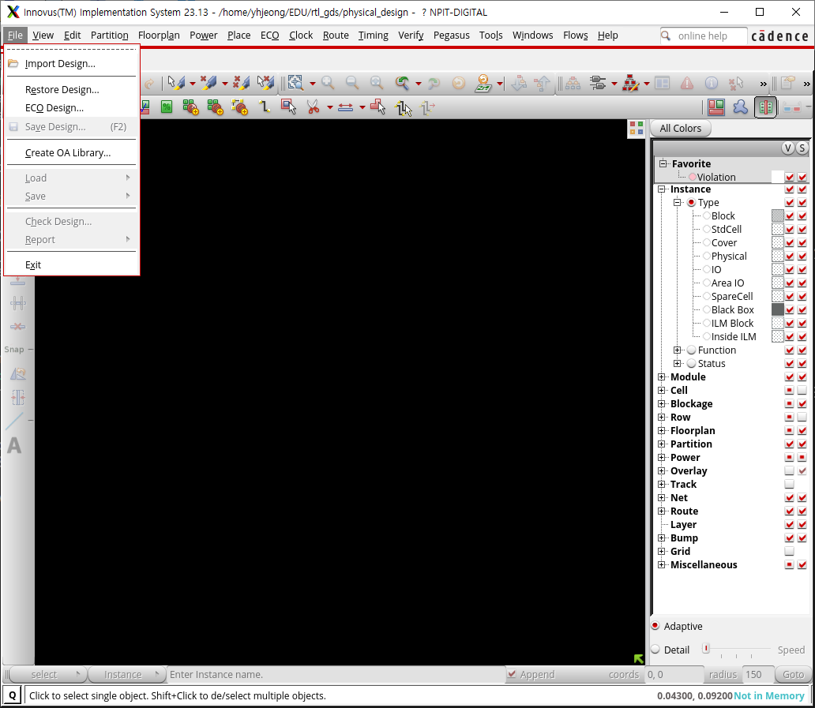
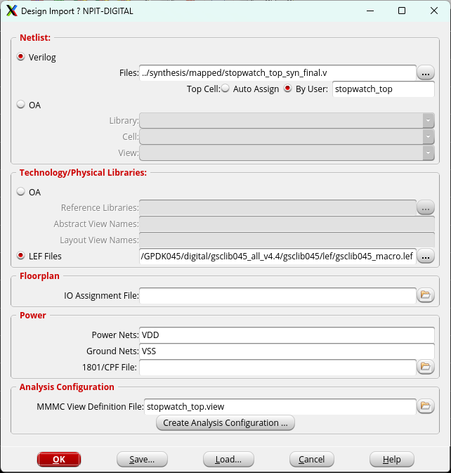
Import Design

Slide 14
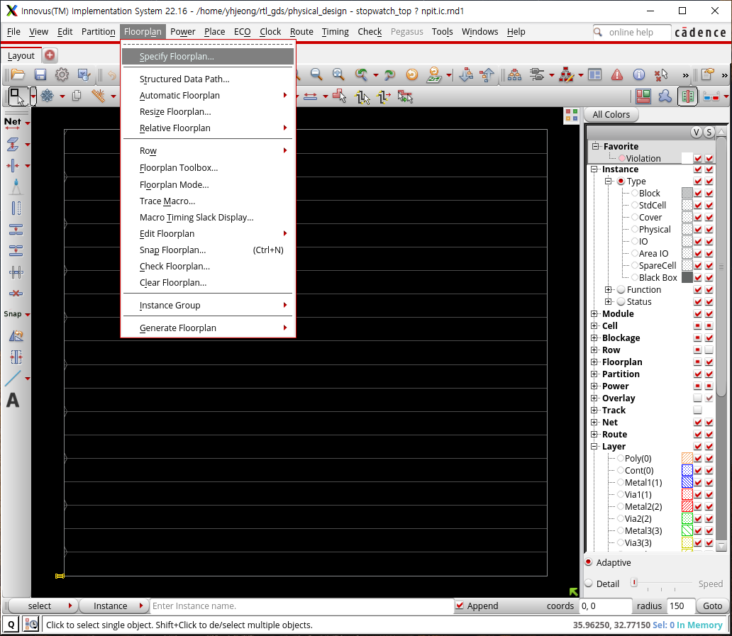
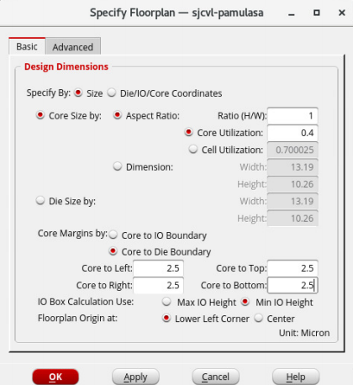
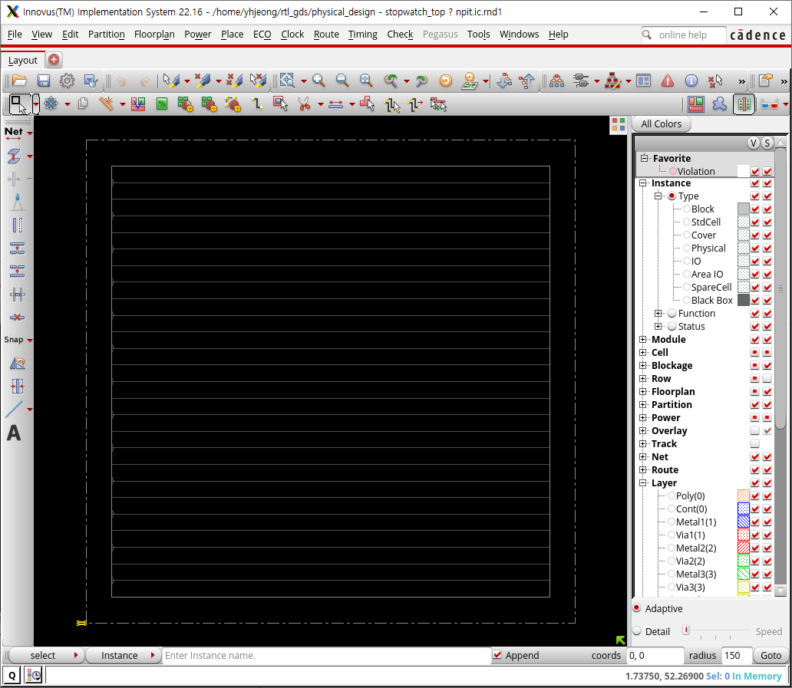
Specify Floorplan

Slide 15
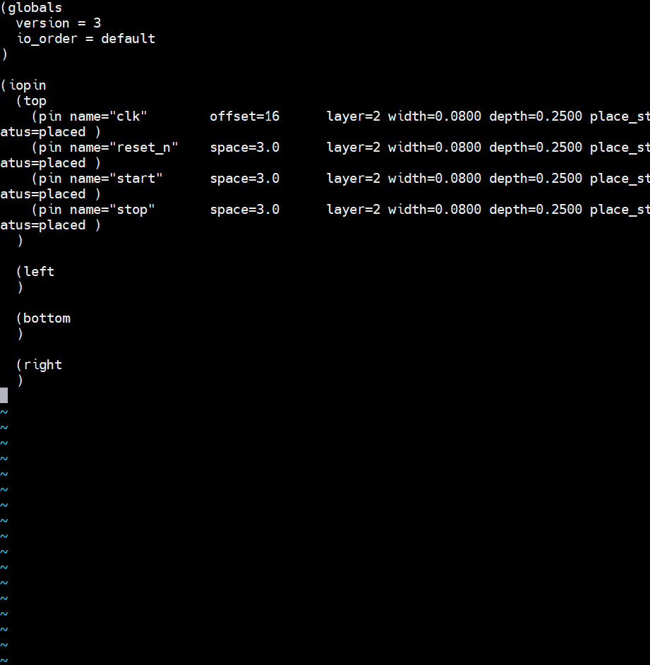
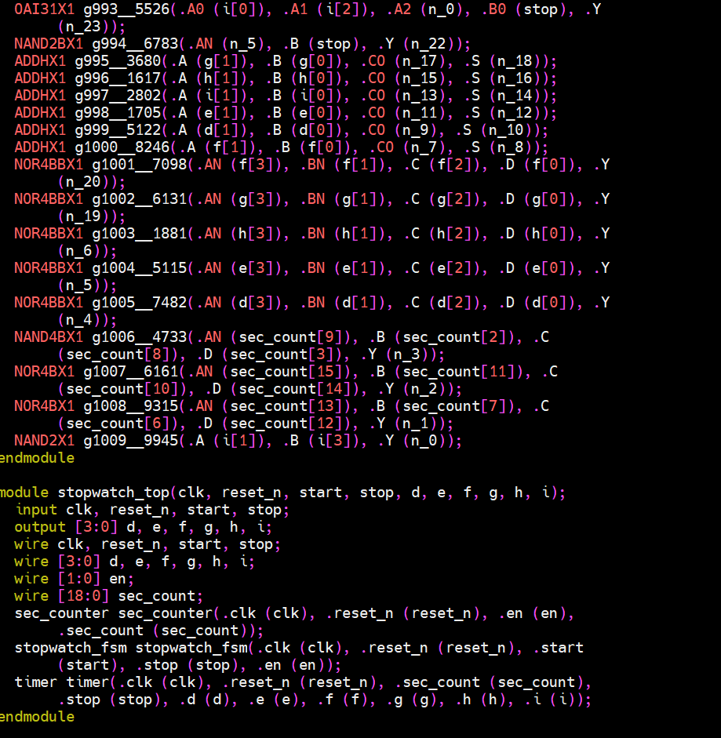
Pin Location 작성(Option)

Slide 16
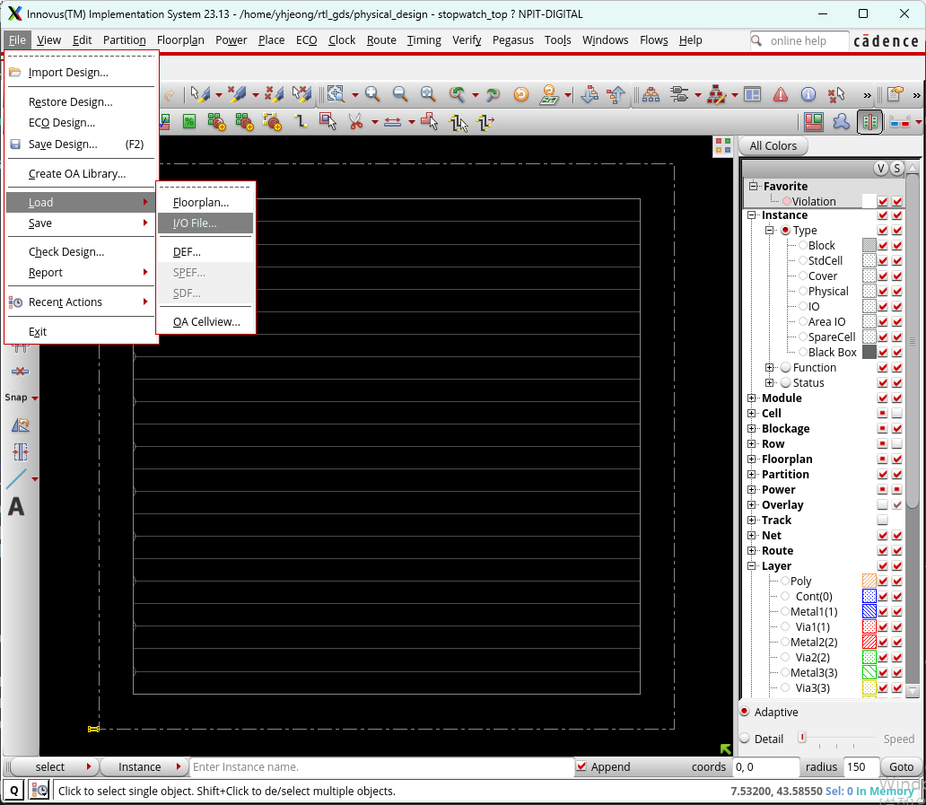
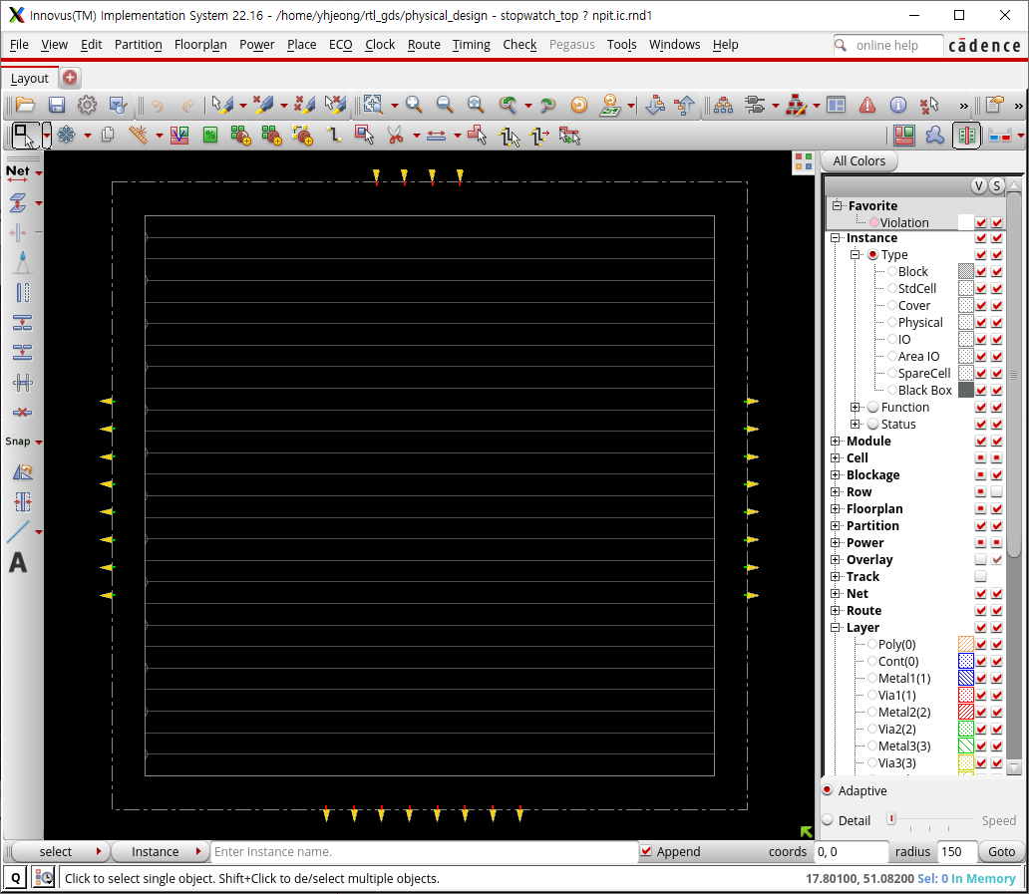
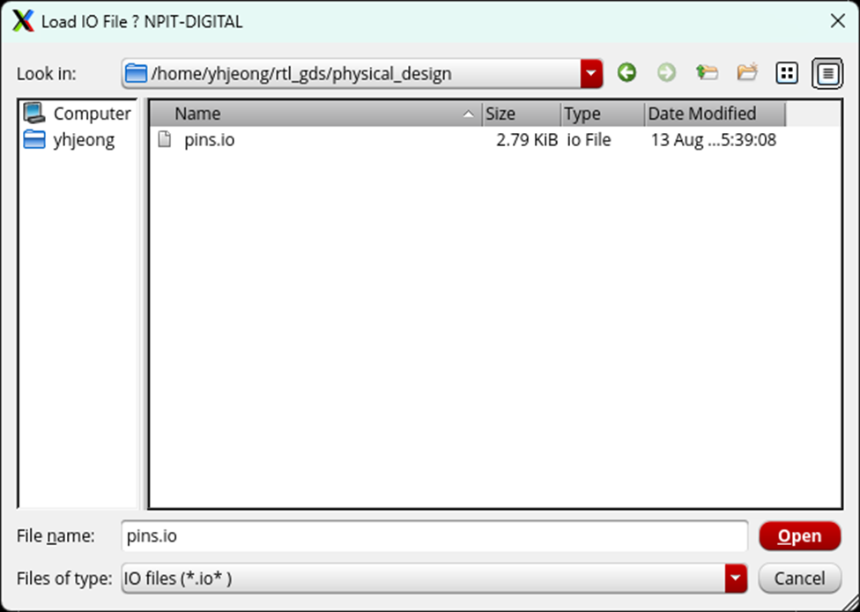
Load IO(Option)

Slide 17
Power Plan

Slide 18
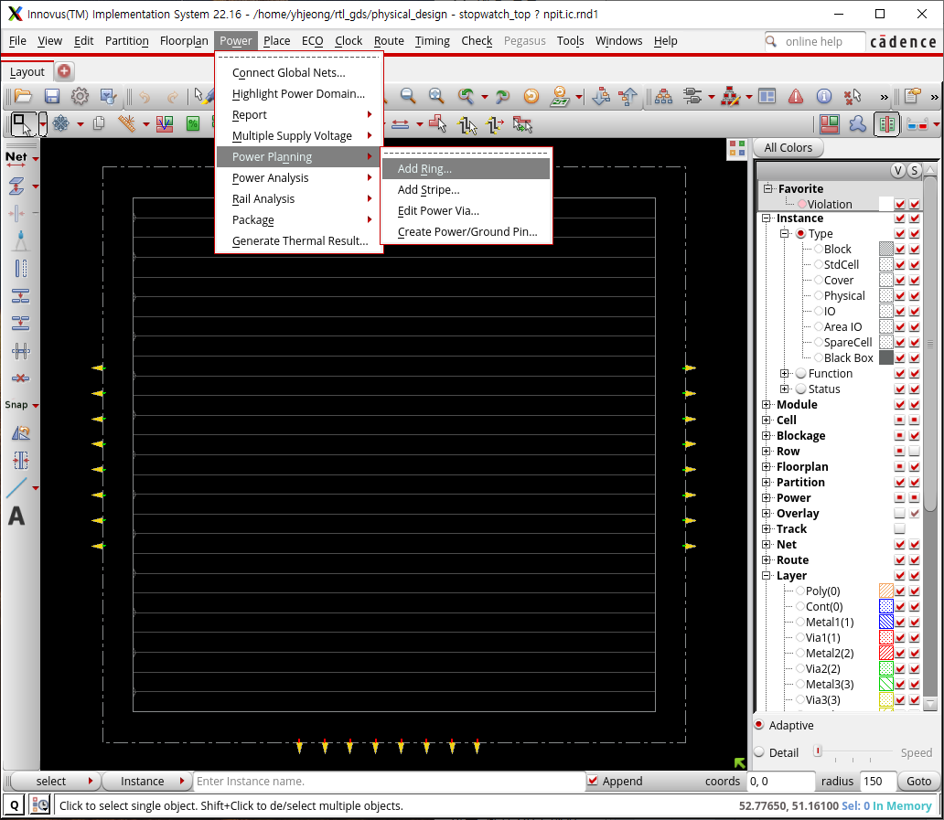
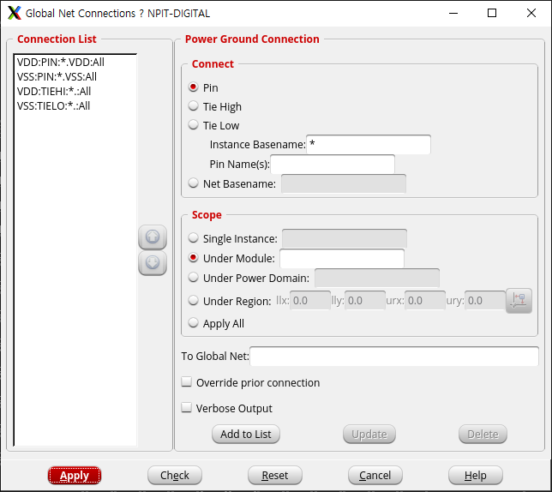
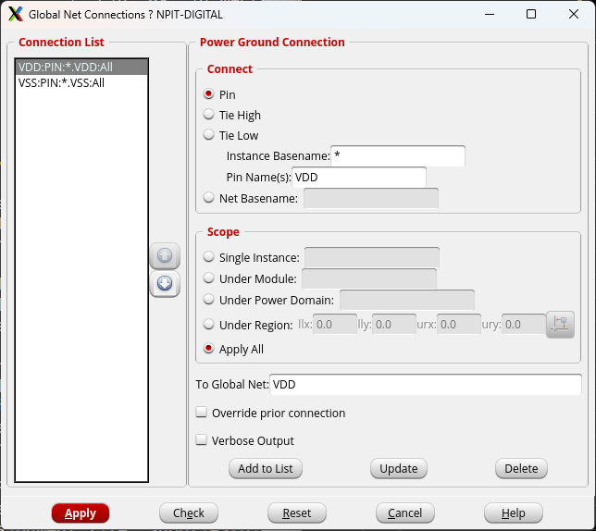
Connect Global Nets
@innovus 3> connect_global_net VDD -type pg_pin -pin VDD –inst_base_name *
@innovus 4> connect_global_net VSS -type pg_pin -pin VSS –inst_base_name *

Slide 19
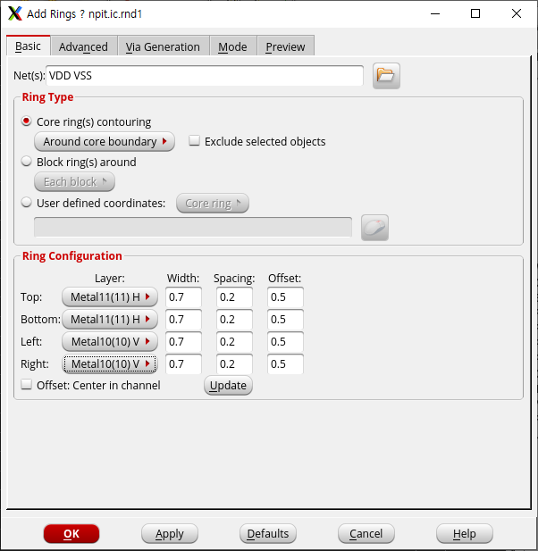
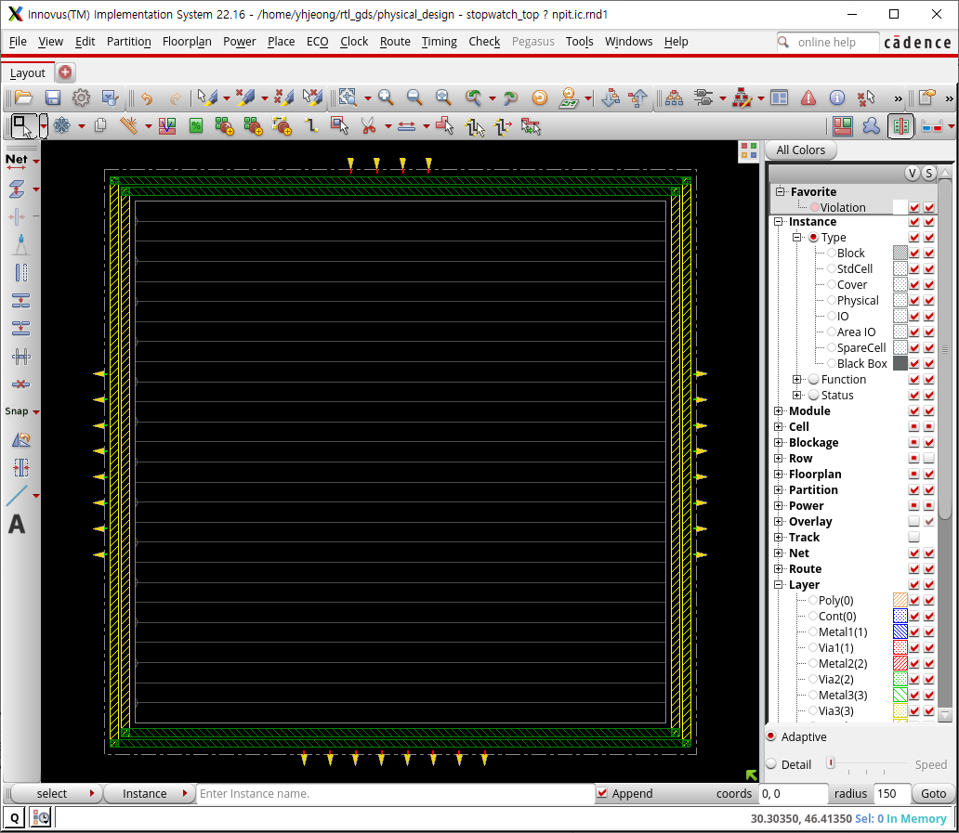
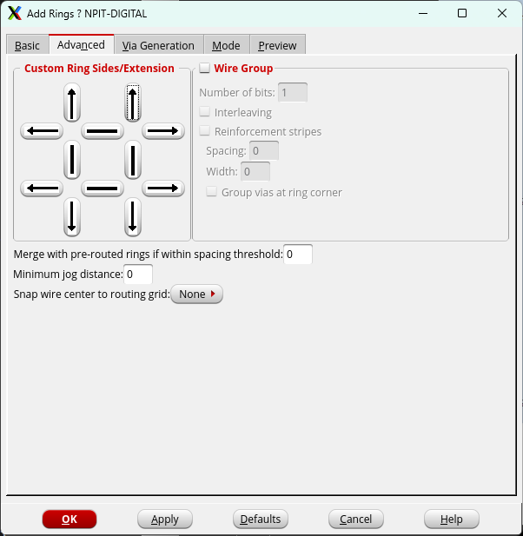
Add Rings

Slide 20
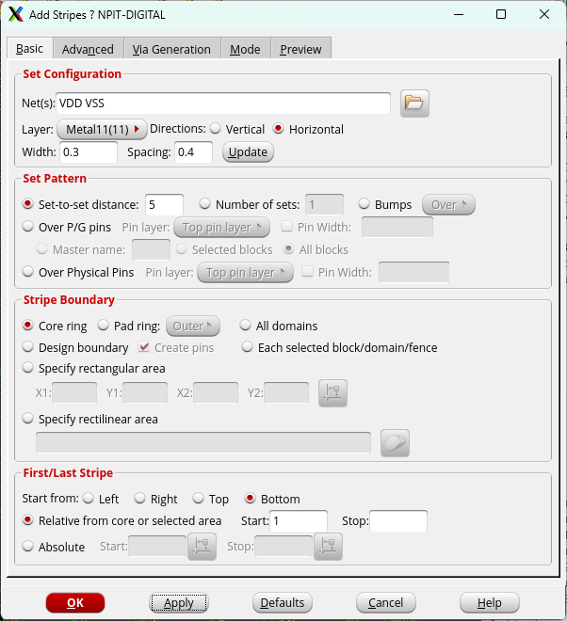
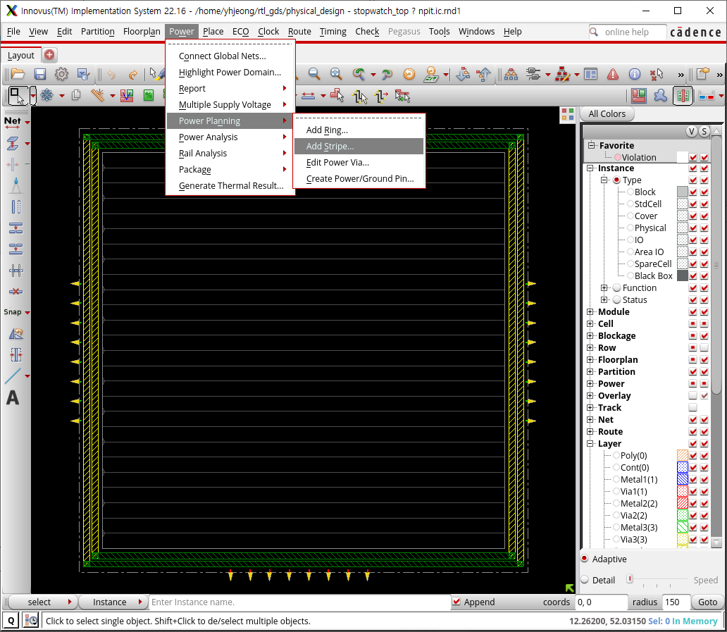
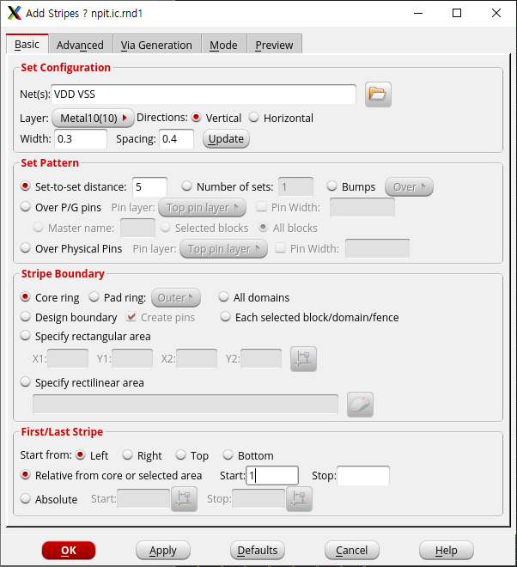
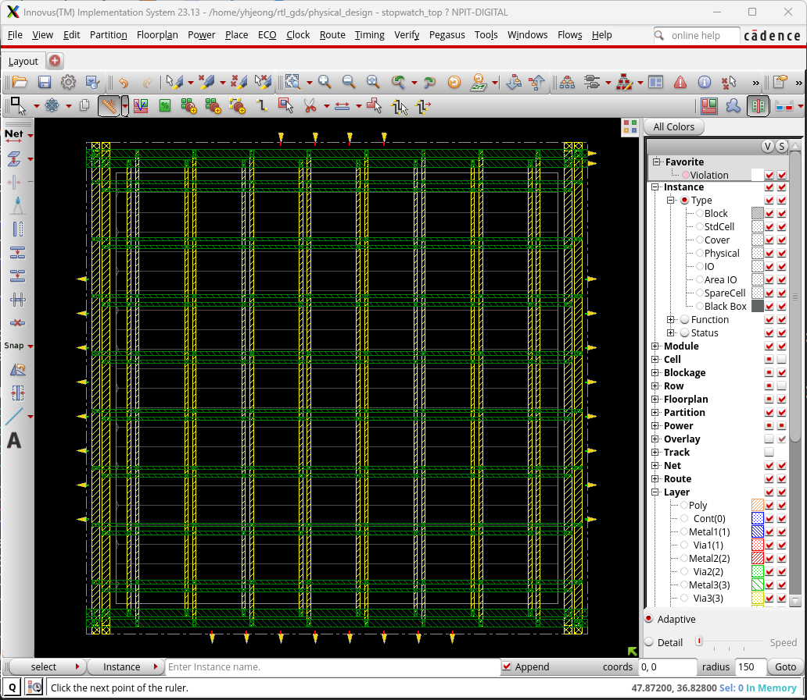
Add Stripes

Slide 21
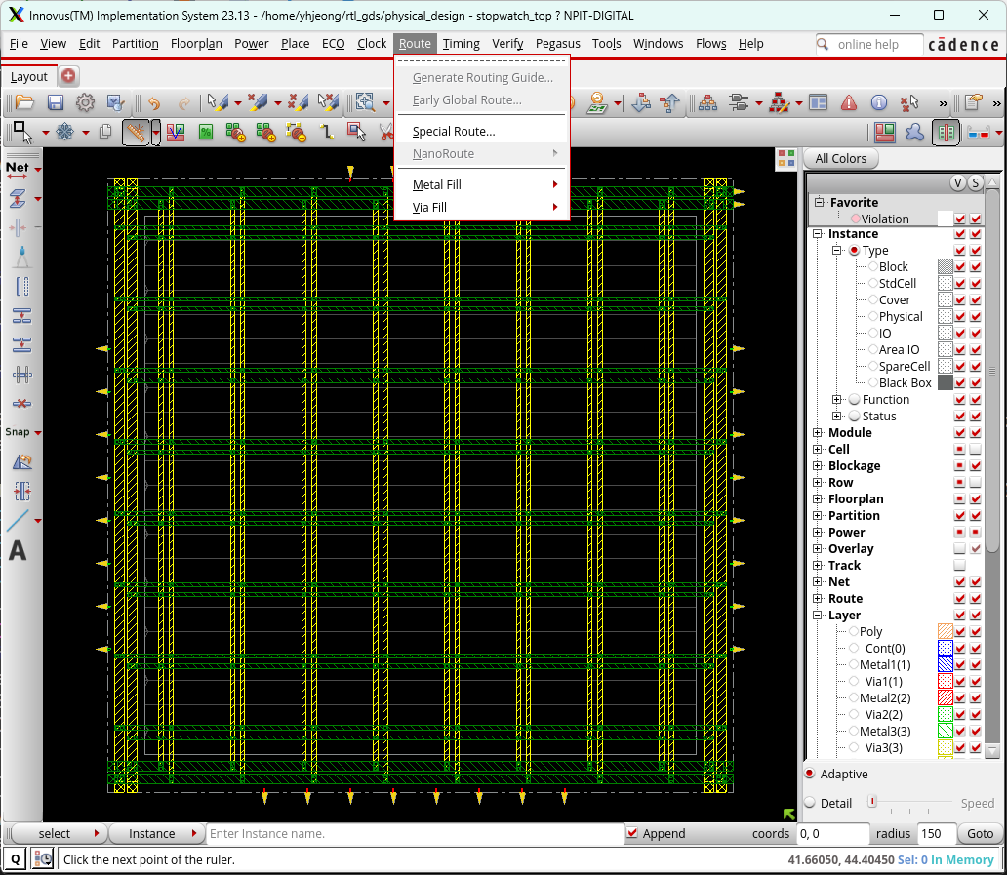
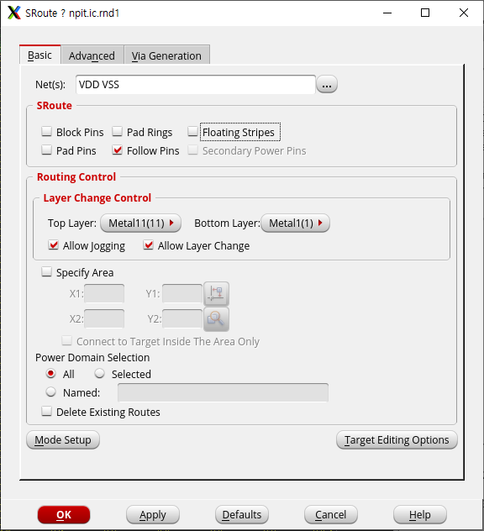
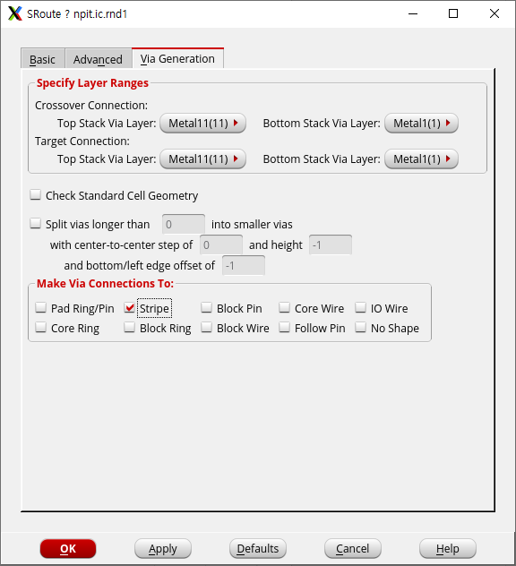
SRoute

Slide 22
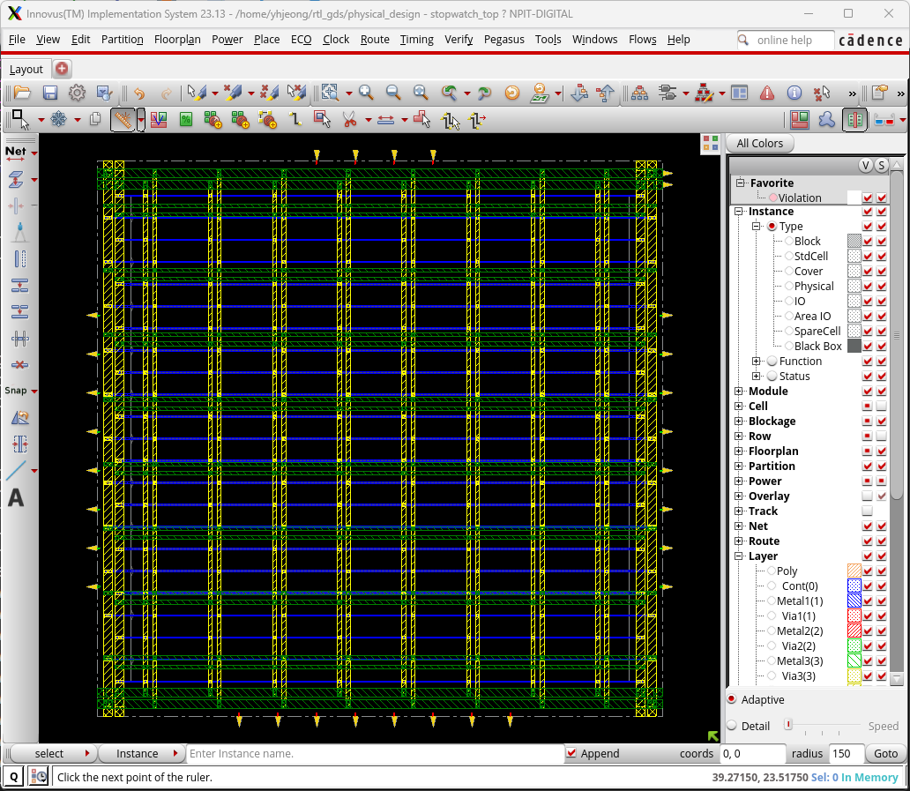
Result

Slide 23
Placement

Slide 24
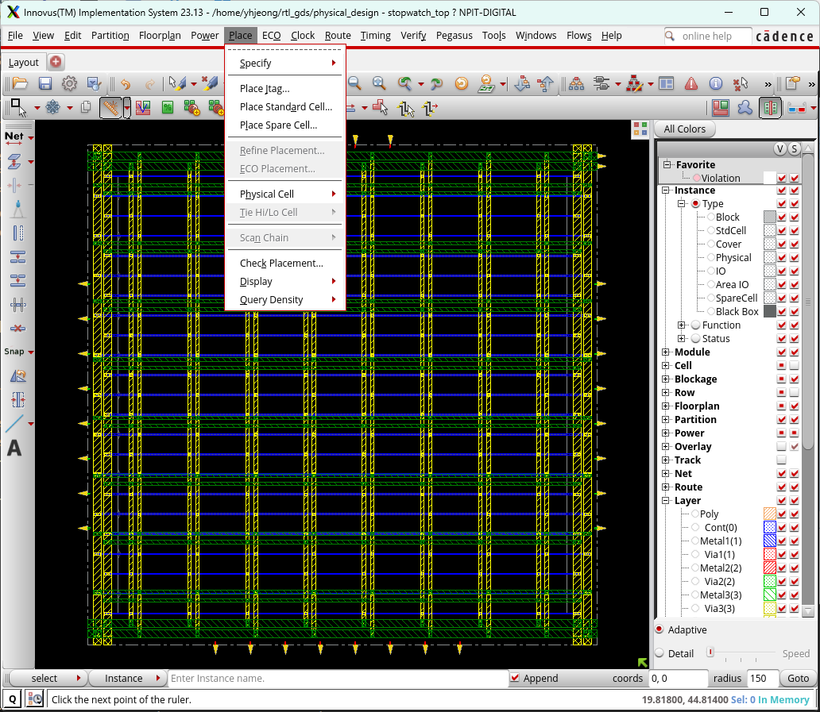
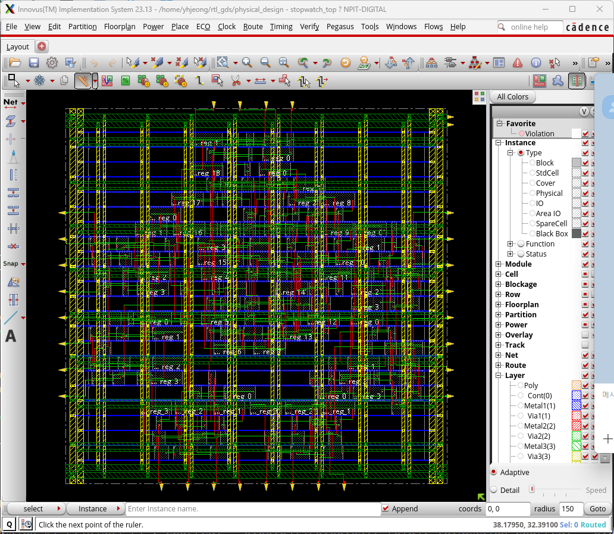
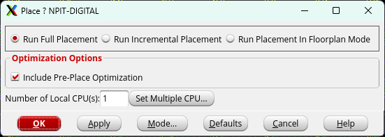
Place

Slide 25
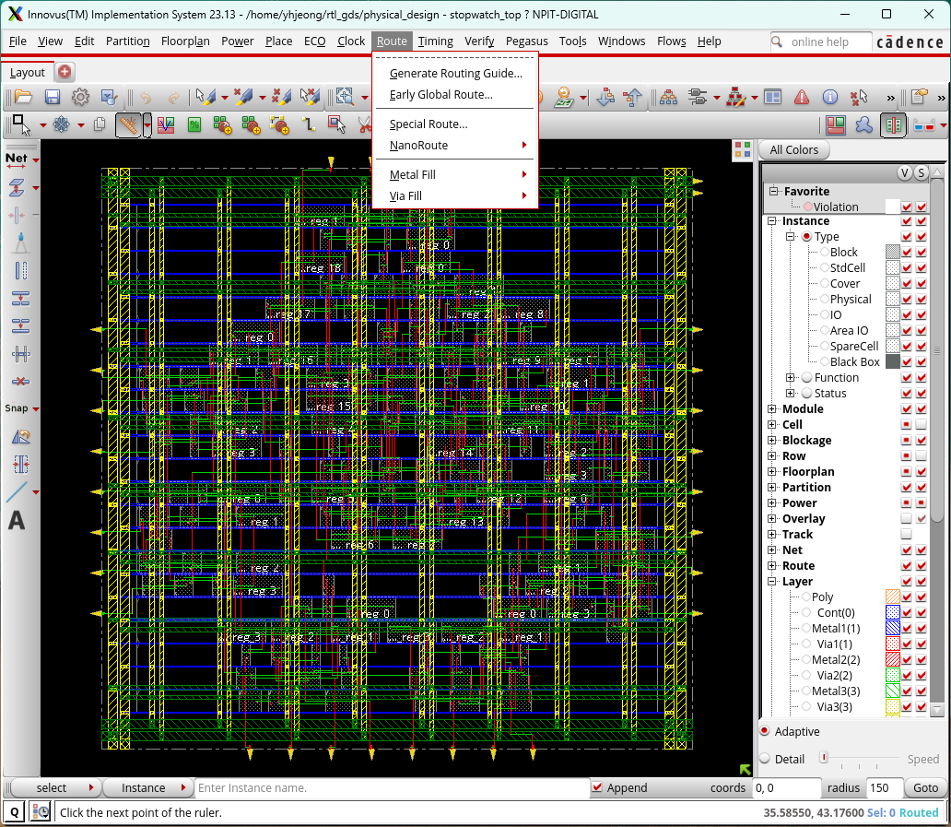
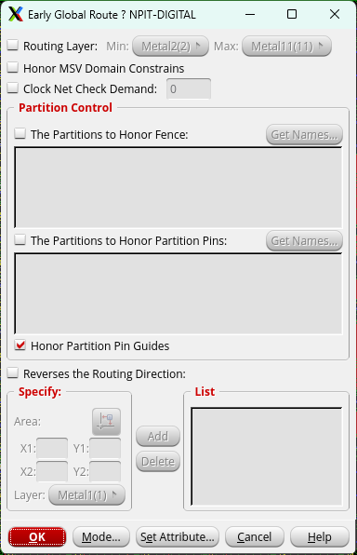
Early Golbal Route

Slide 26
Clock Tree Synthesis(CTS)

Slide 27
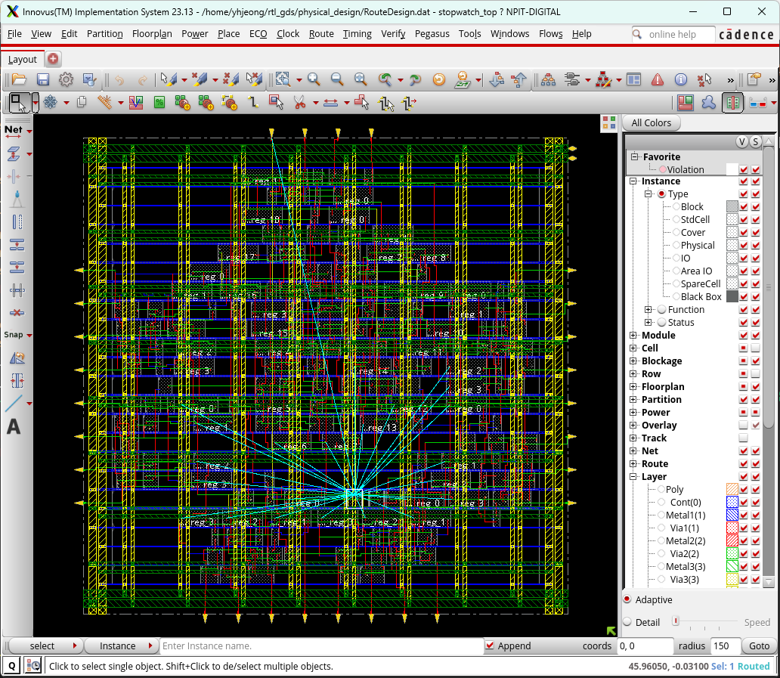
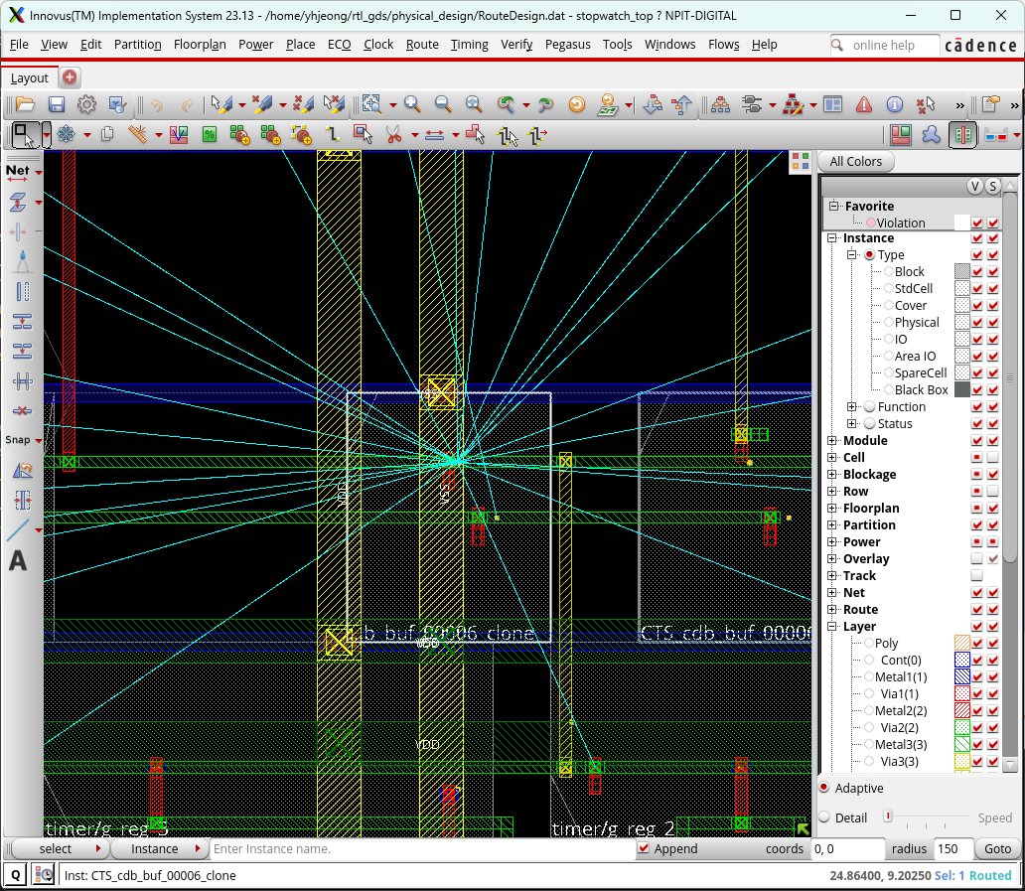
CTS
create_clock_tree_spec
ccopt_design
순서대로 입력
set_interactive_constraint_modes [all_constraint_modes -active]
set_propagated_clock [all_clocks]

Slide 28
Route

Slide 29
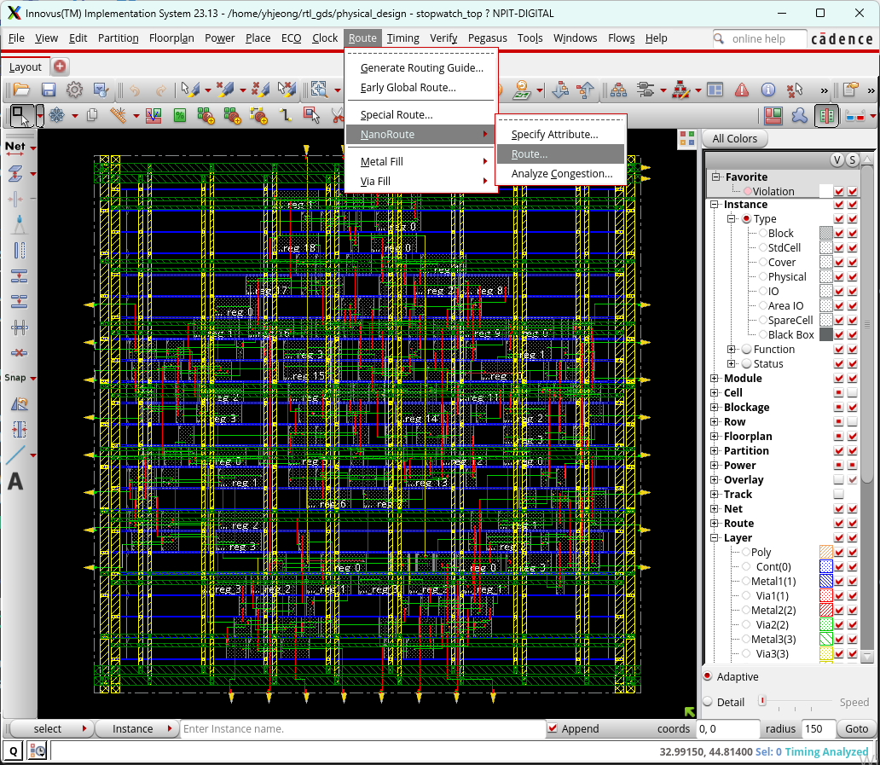
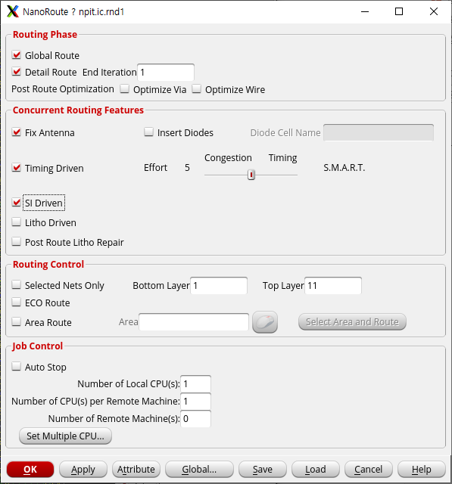
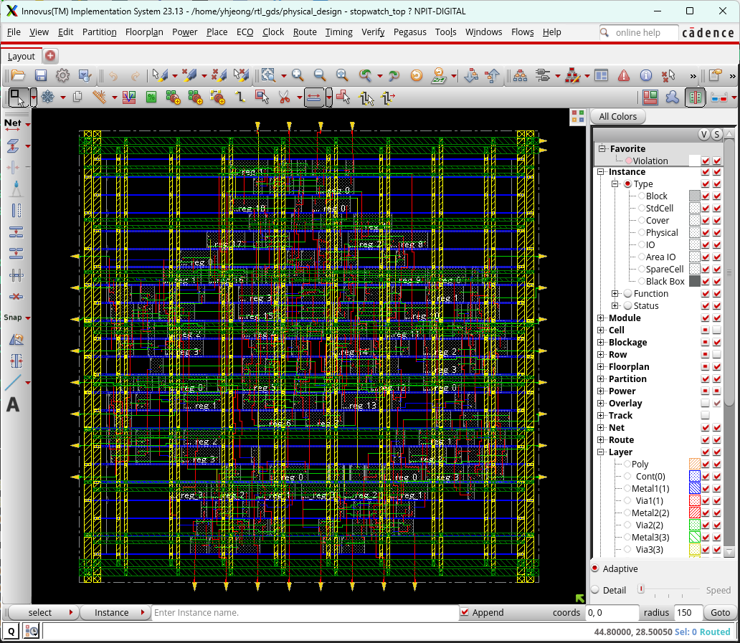
Nano Route

Slide 30
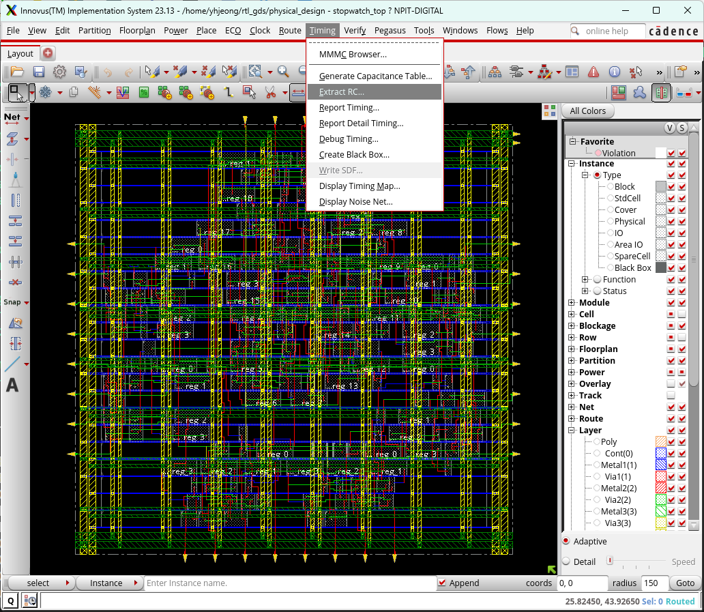
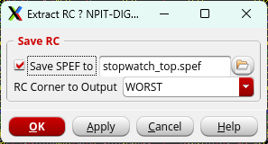
Extract RC

Slide 31
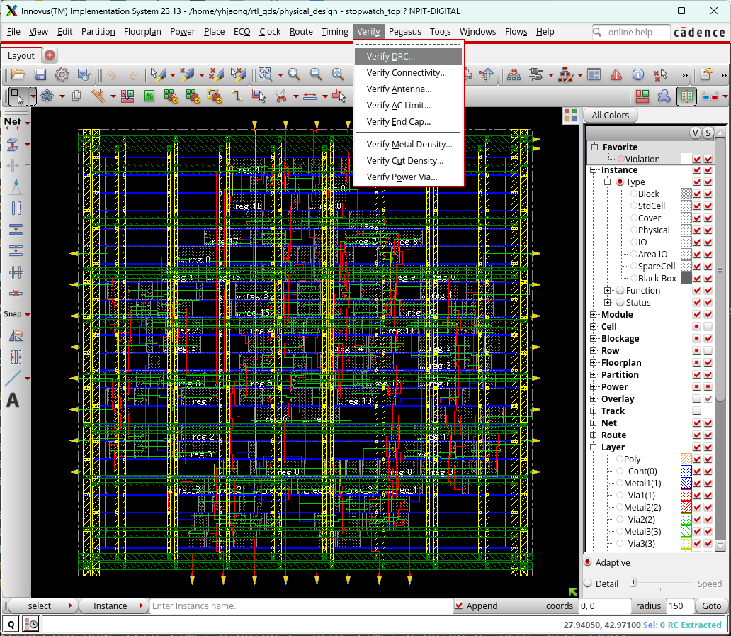
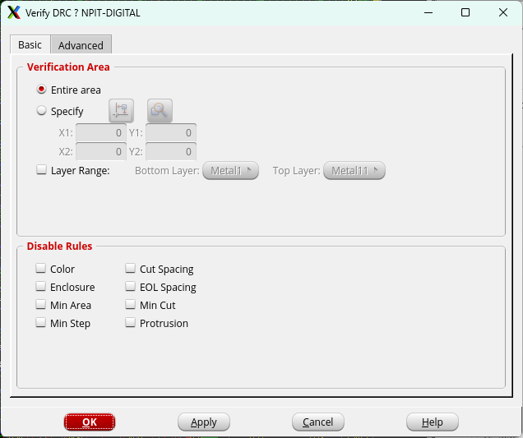
DRC

Slide 32

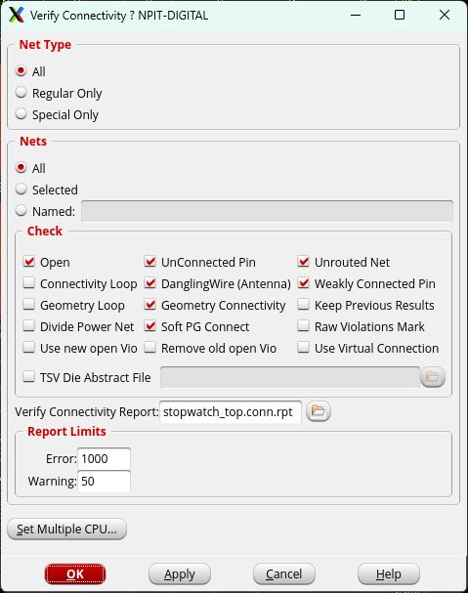
Connectivity

Slide 33
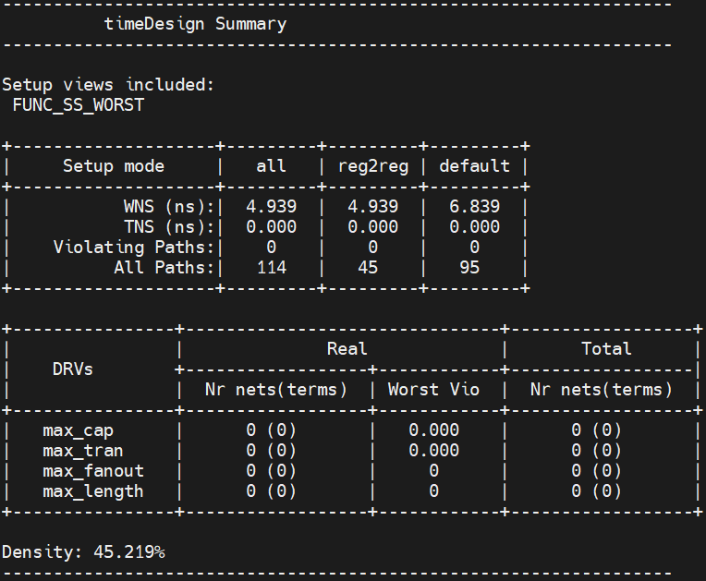
time_Design –postRoute
선입력 후 실행
setDelayCalMode -SIAware false

Slide 34
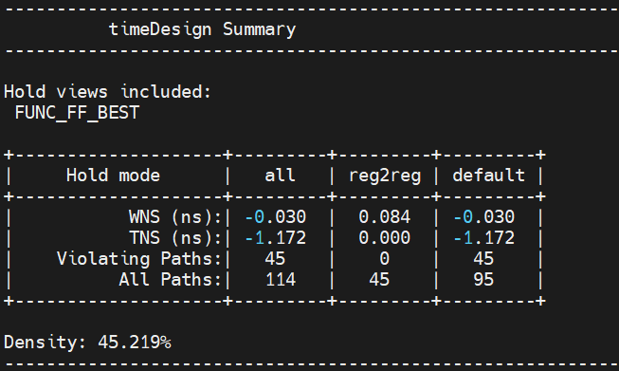
time_Design -postRoute -hold

Slide 35


Debug Timing
saveDesign -rc -def RouteDesign

Slide 36


Read Design
check_timing
report_annotated_parasitics
report_analysis_coverage
report_analysis_coverage -check_type data_setup -verbose untested -exclude_untested const
순서대로 입력

Slide 37


Analysis View

Slide 38



Add Repeater
report_analysis_coverage
write_eco -format innovus -output innovus.eco
순서대로 입력

Slide 39




Chip Finish

Slide 40



GDS Export

