Slide 1
Final Project Face API
Patil, Aniruddha
Deep Azure@McKesson
Dr. Zoran B. Djordjević

Slide 2
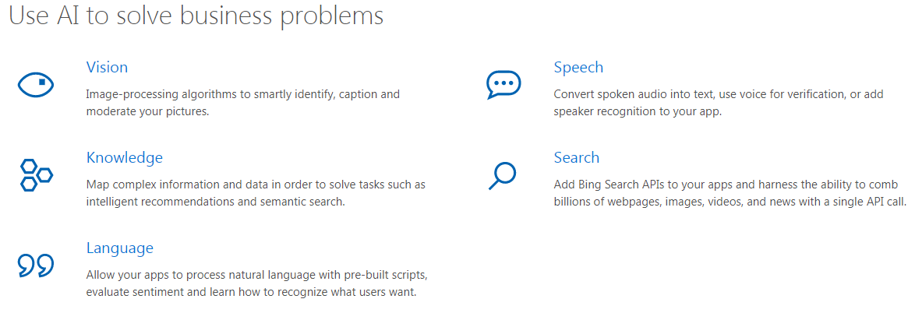
Introduction
Topic: Demonstration of Azure Face API
Problem: To collect data intelligence from people’s faces , their expressions and kind of attendance for a specific public gathering/event with use of Azure Cognitive Services - Face API (Cognitive Services- Vision), Azure Storage and Visualization with Pandas.

Slide 3
Introduction
Technology:
Azure Cognitive Services, Azure Storage- Tables, Pandas
Hardware: Intel i5-6300U CPU 2.4Ghz, 16 GB RAM, 64 bit Windows 7 OS
Software:
Technology / Tools | Description
Azure Cognitive Services – Face API | Azure’s Face API services
Azure Storage - Table | Azure’s Storage services - Table
Python 2.7 & 3.6 | Python 2.7 & 3.6 (Used 2.7 for Visualization due to 3.6 installation issues)
Microsoft Azure Storage Explorer | To manage Azure Table data

Slide 4
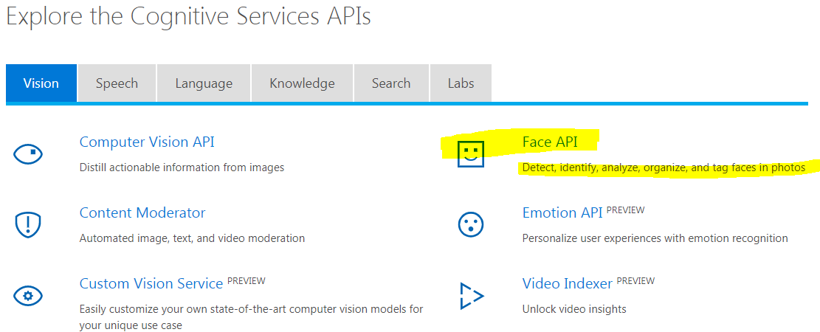
Azure Cognitive Services – Face API
Narrative:
Microsoft Face API is a cloud-based service that provides the most advanced face algorithms. Face API has two main functions: face detection with attributes and face recognition.

Slide 5
Azure Face API – Pros, Cons and Lessons Learnt
Pros :
- Azure Face API accurately delivers face attributes and specially age
- Face API can detect very small faces in images correctly. In one of my test image, it captured a face in picture on shirt person wearing in image
- Free pricing Tier is available for use
Cons:
- Azure Face API does not work with RAW image formats produced by cameras. It only works with JPG, BMP, GIF and PNG
- Free tier has limitation to run 20 calls in a minute
Lessons Learnt :
- There are multiple image data sources available to test with but lot of images are in non JPG format mostly RAW format. I could not get Python packages working with non JPG format images. I also saw that Azure Face API only works with JPG, BMP, PNG and GIF files.
- Azure Face API (Free pricing Tier) can only run 20 calls per minute. So when I was running for big batch, I was getting errors. I reduced down my input to < 20 for Demo. We can use time delay function to overcome this limit to some extent.

Slide 6
Azure Cognitive Services – Face API
Narrative: (continued)
Face Detection
Face API detects human faces with high precision face location in an image. Face rectangle indicating the face location in the image is returned along with each detected face and a series of face related attributes such as pose, gender, age, head pose, facial hair and glasses.
Face Recognition
Face recognition is widely used in many scenarios including security, natural user interface, image content analysis and management, mobile apps, and robotics. Four face recognition functions are provided: face verification, finding similar faces, face grouping, and person identification.

Slide 7
Azure Cognitive Services – Face API
Face Detection Demonstration Steps:
1. Subscribe to Face API
2. Download Image Database for testing Face API
3. Setup Azure Storage Account to be used for storing all image attributes
4. Learn Face API.
5. Code development to use Face API for Face Detection and collect face attributes in Azure Storage
6. Data Visualization & inference

Slide 8
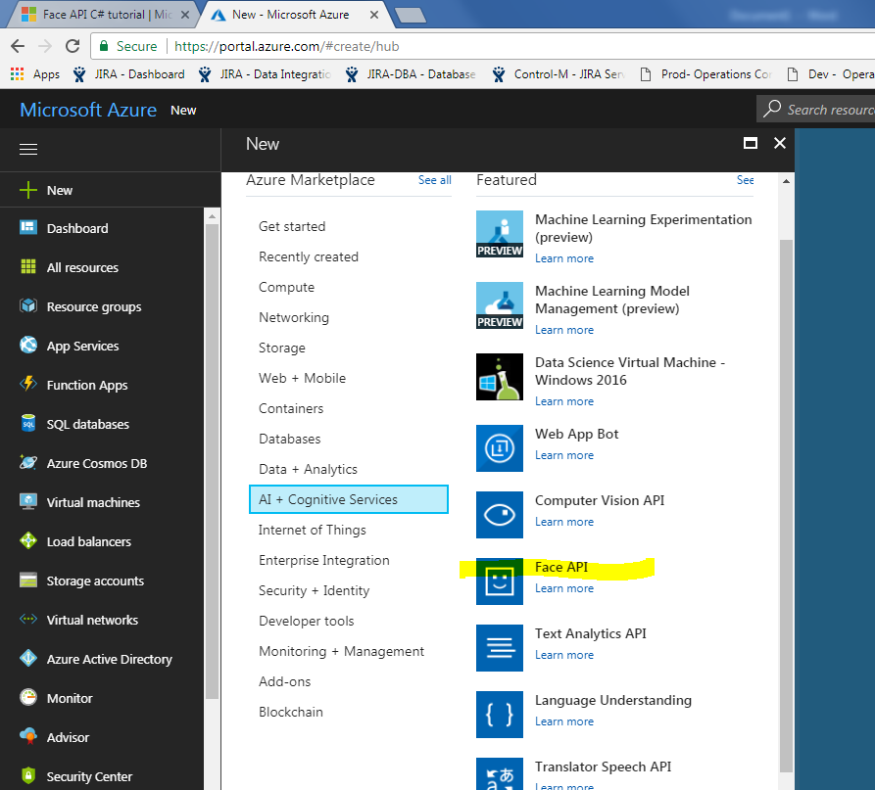
Subscribe to Face API
Login to Azure Portal and subscribe to Face API

Slide 9
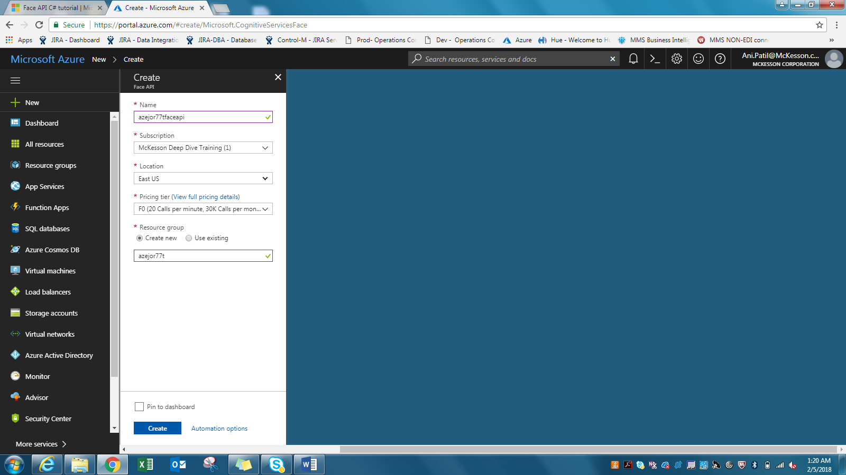
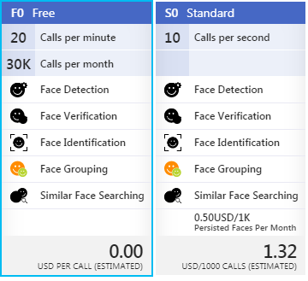
Subscribe to Face API
Below see that we have selected Free pricing Ties with 20 calls per minute limit

Slide 10
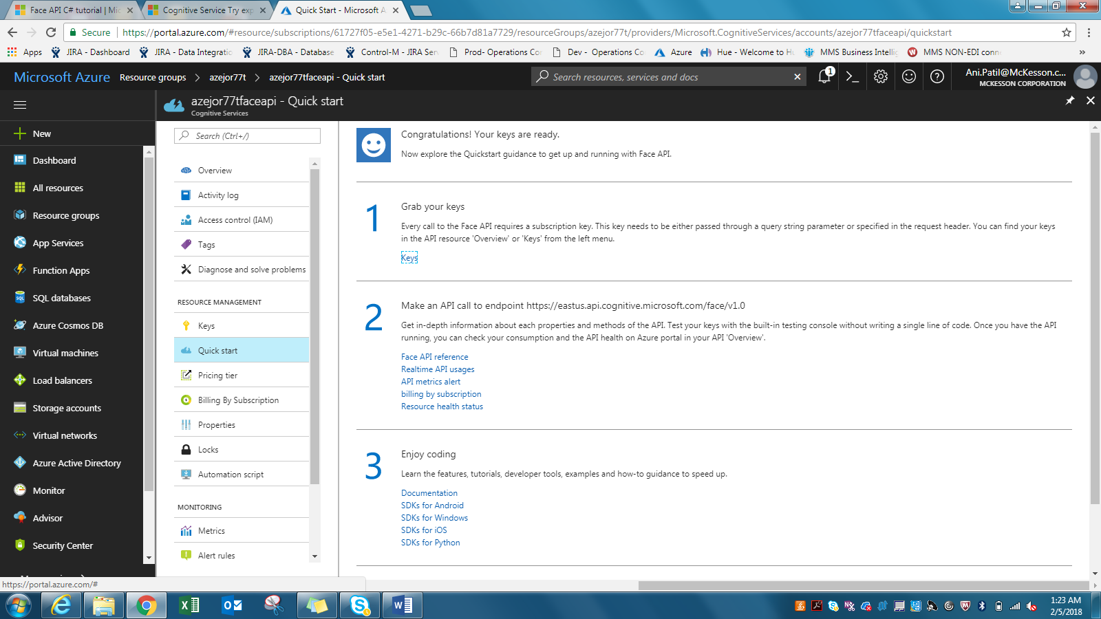
Face API
Grab your Keys from Option 1 pointed below

Slide 11
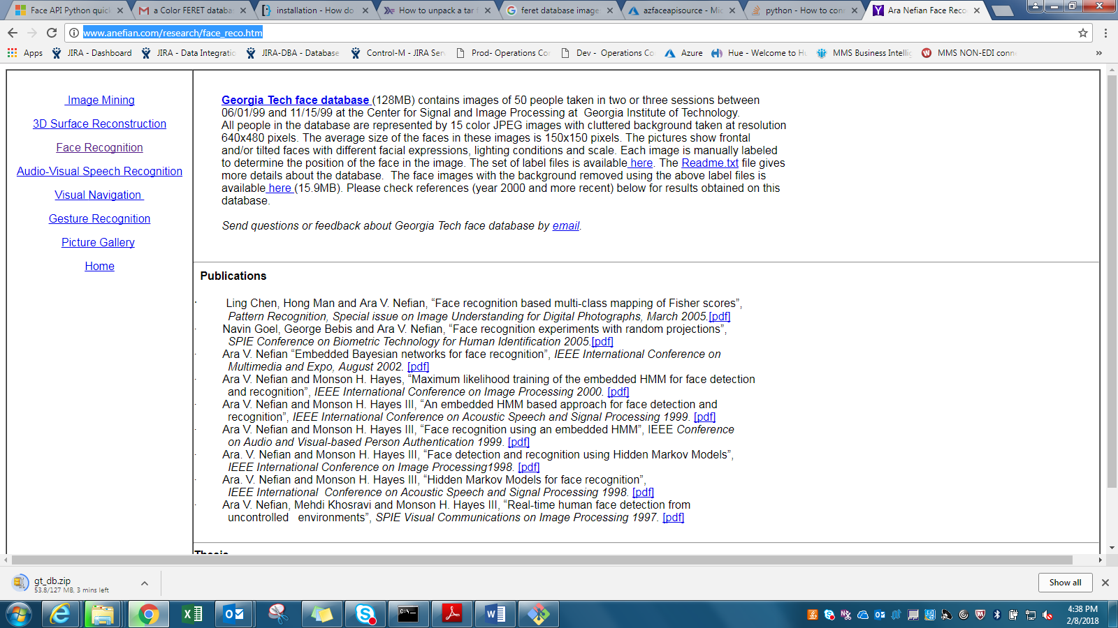
Input Data Source – Image DB
Image database
http://www.anefian.com/research/face_reco.htm
To download, click ‘Georgia Tech face database’ below

Slide 12
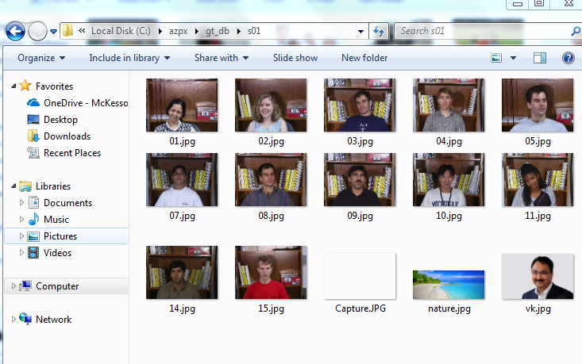
Input Data Source – Image DB
This Database has JPG images of multiple people in different lighting conditions. Complete database is about 128MB in size.
Download image database and take subset of images in a directory for Project demo. Below is a subset I used for this demo.
If you see below input images, I have added some random pictures which does not have any face in them. This is to test if Face API identify it correctly to not detect faces.

Slide 13
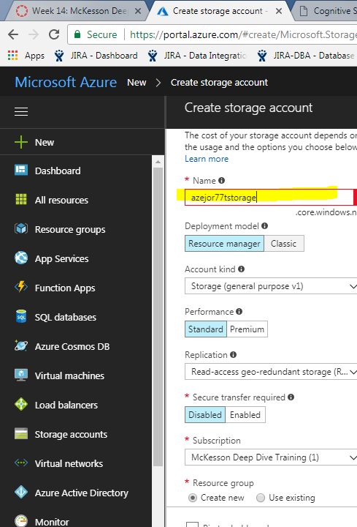
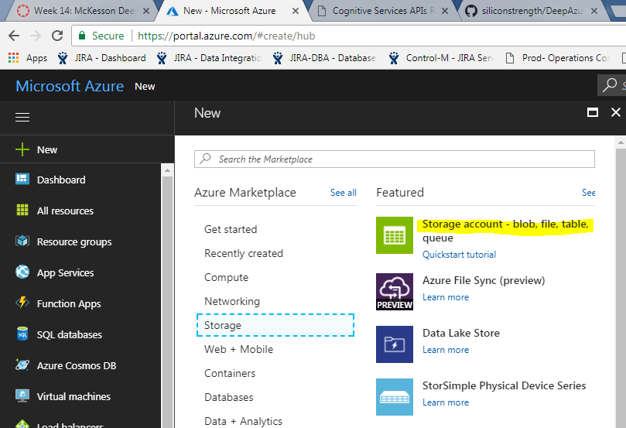
Create Azure Storage Account
Create Storage Account to store Face attribute results.

Slide 14
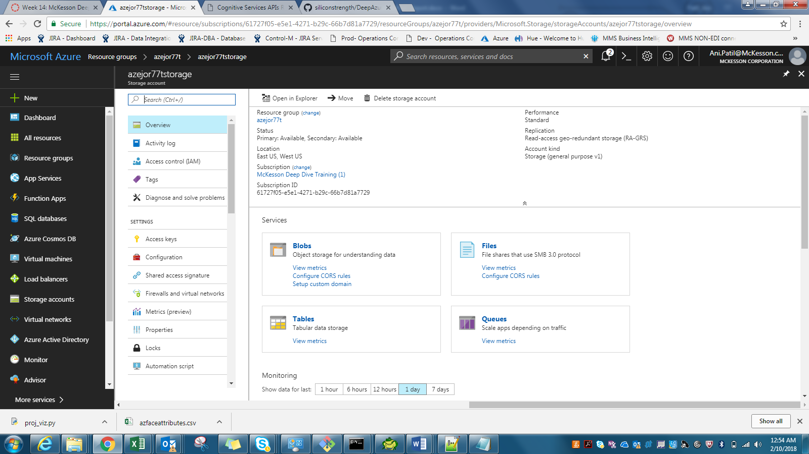
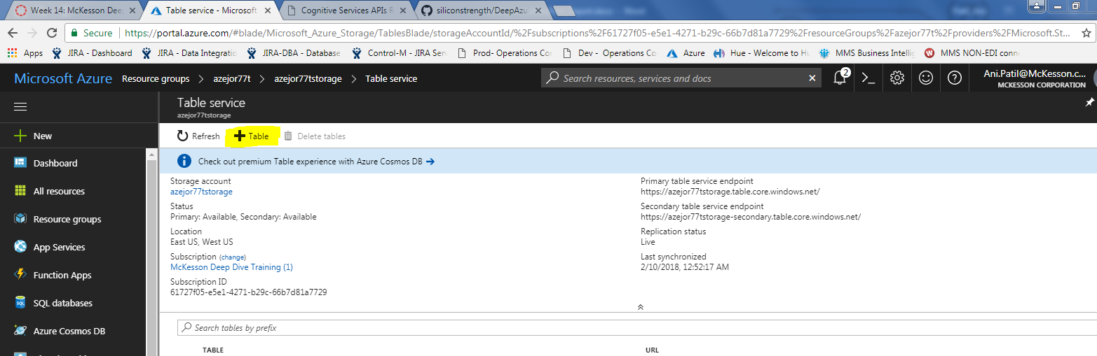
Create Azure Storage Table
Get in Storage Account, click on Tables and add a new table

Slide 15
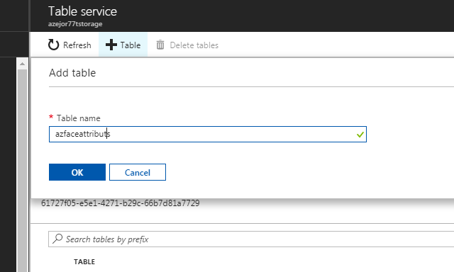
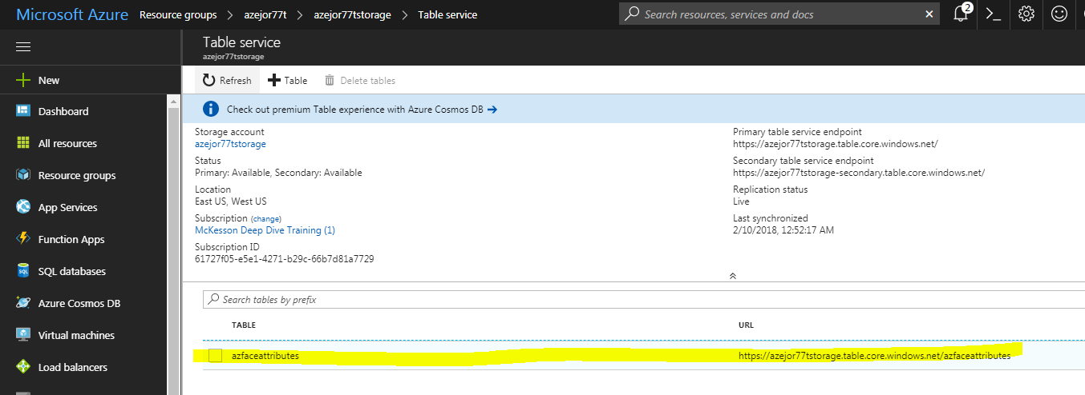
Create Azure Storage Table
Give a name to table to see it created as below images

Slide 16
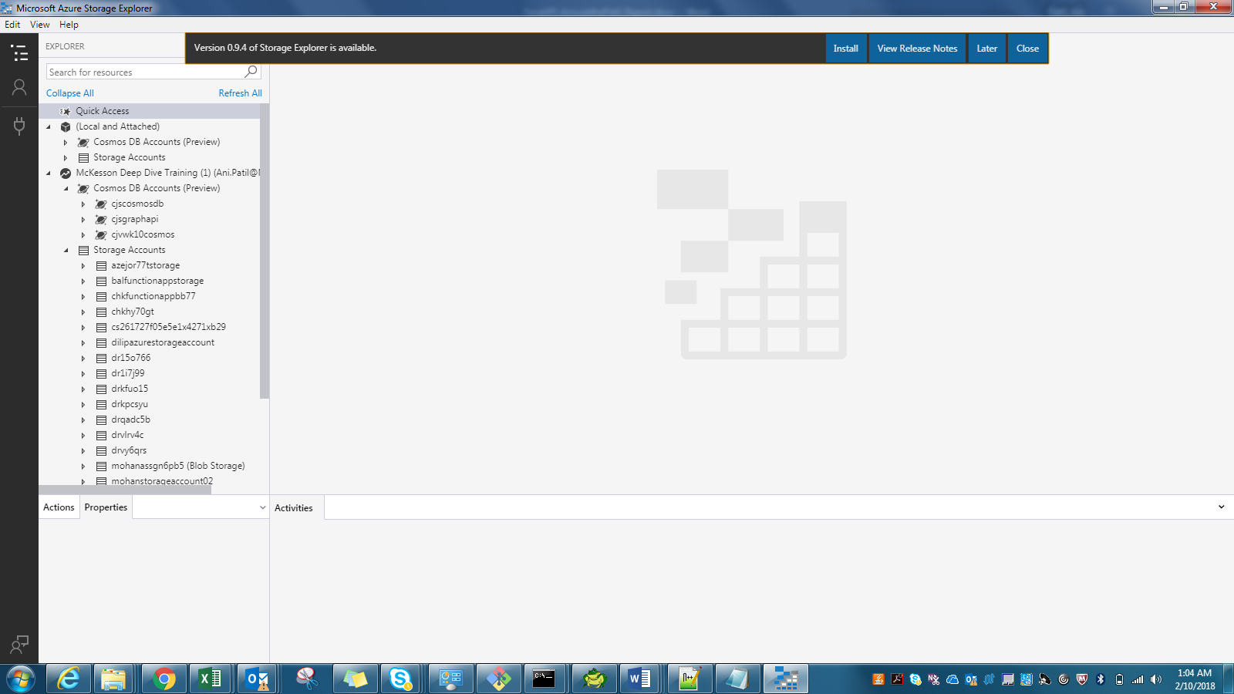
Microsoft Azure Storage Explorer
To access and manage this table, we will need to install – Microsoft Azure Storage Explorer. From link below-
https://azure.microsoft.com/en-us/features/storage-explorer/
Microsoft Azure Storage Explorer, when first opened, will ask for your Azure login credentials to connect to Azure storage

Slide 17
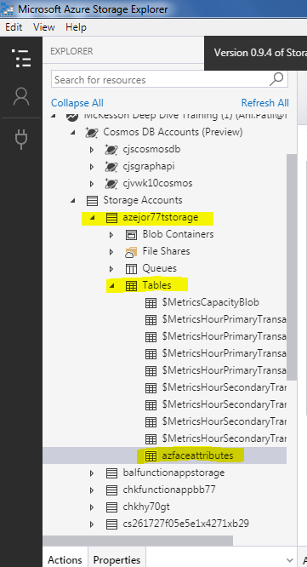
Microsoft Azure Storage Explorer
Once you click your storage Account, it will display respective tables inside it

Slide 18
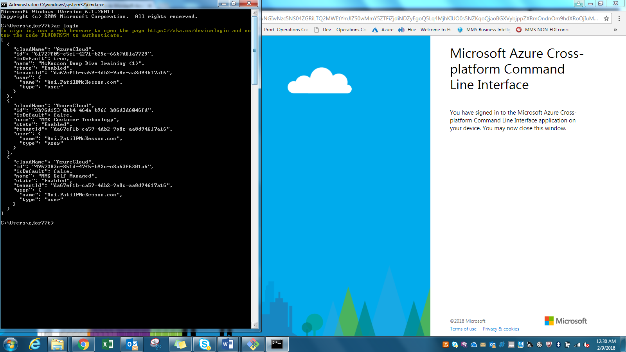
Python & Azure CLI Login
See that you have Python 3.6 installed.
If not, download Anaconda Python 3.6 distribution.
Login to Azure with Azure CLI

Slide 19
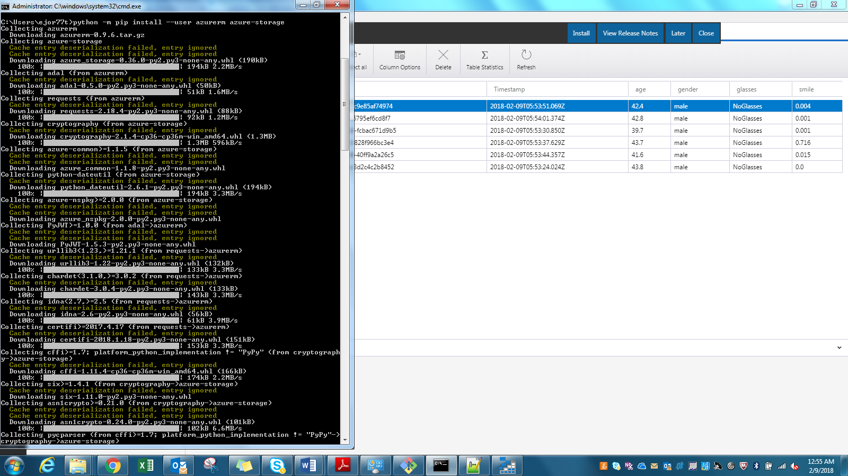
Install Azure Storage Package
Install storage package needed for working with Azure storage table

Slide 20
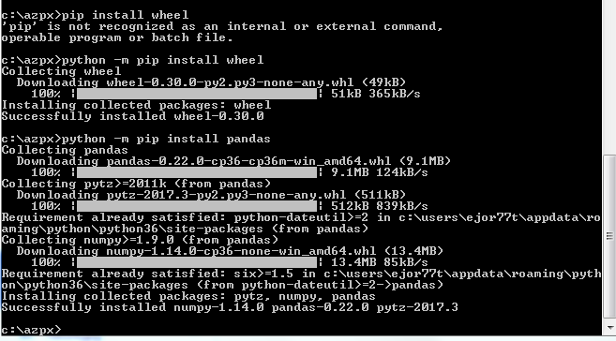
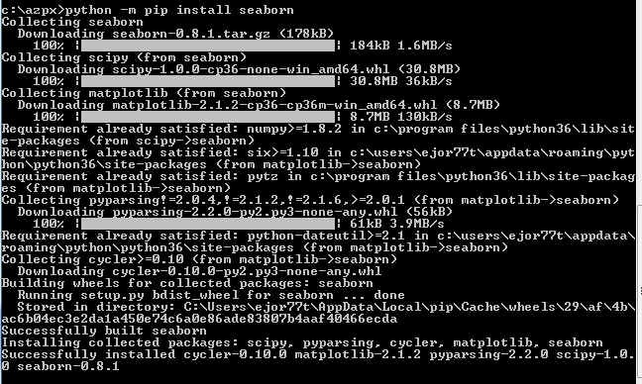
Install Pandas
Install wheel, pandas, seaborn – This we will need later for visualization

Slide 21
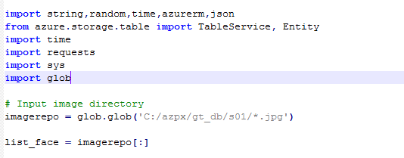
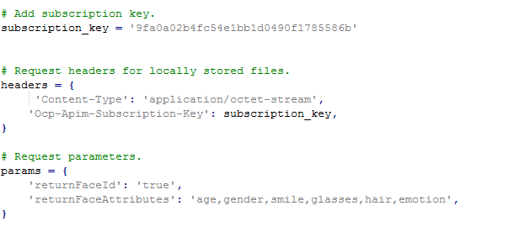
Face API Demonstration
Face API call and do some face detection and get face attributes
Below is code snippet of my Face API program- azfaceapi.py
Setting up subset of input images pulled from above Face Database to be processed by Face API-
Set subscription key for face API and header and params for request

Slide 22
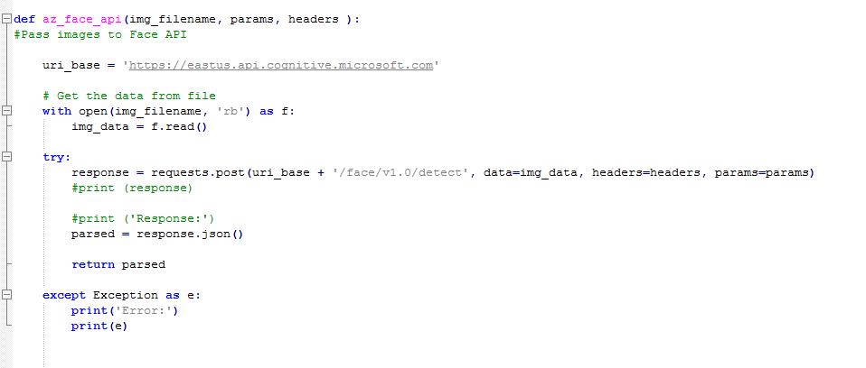
Face API Demonstration
Call Face API for each of input image to analyze and collect face attributes

Slide 23
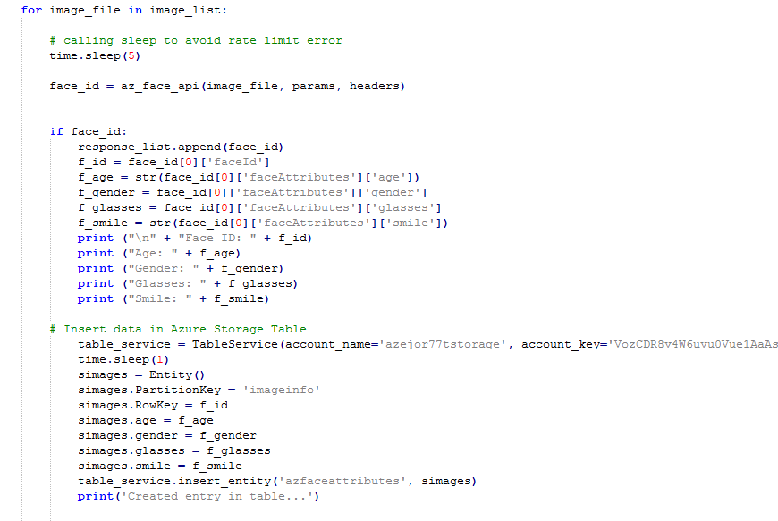
Store Face Attributes to Azure Storage
Once we get requested face attributes, result will be in JSON format. We will collect respective values and store them in Azure Storage table as below

Slide 24
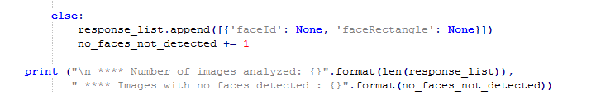
Validate results for images with No Face
We will also be checking for images with no faces in it and will count such images as below.
Snapshot of program output below shows 2 images with no face detected.

Slide 25
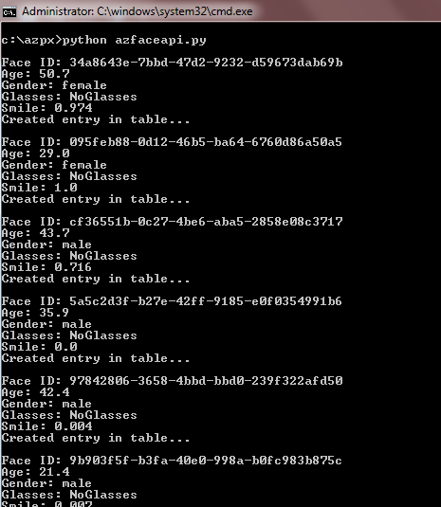
Run Face API Program
We will also be checking for images with no faces in it and will count such images as below

Slide 26
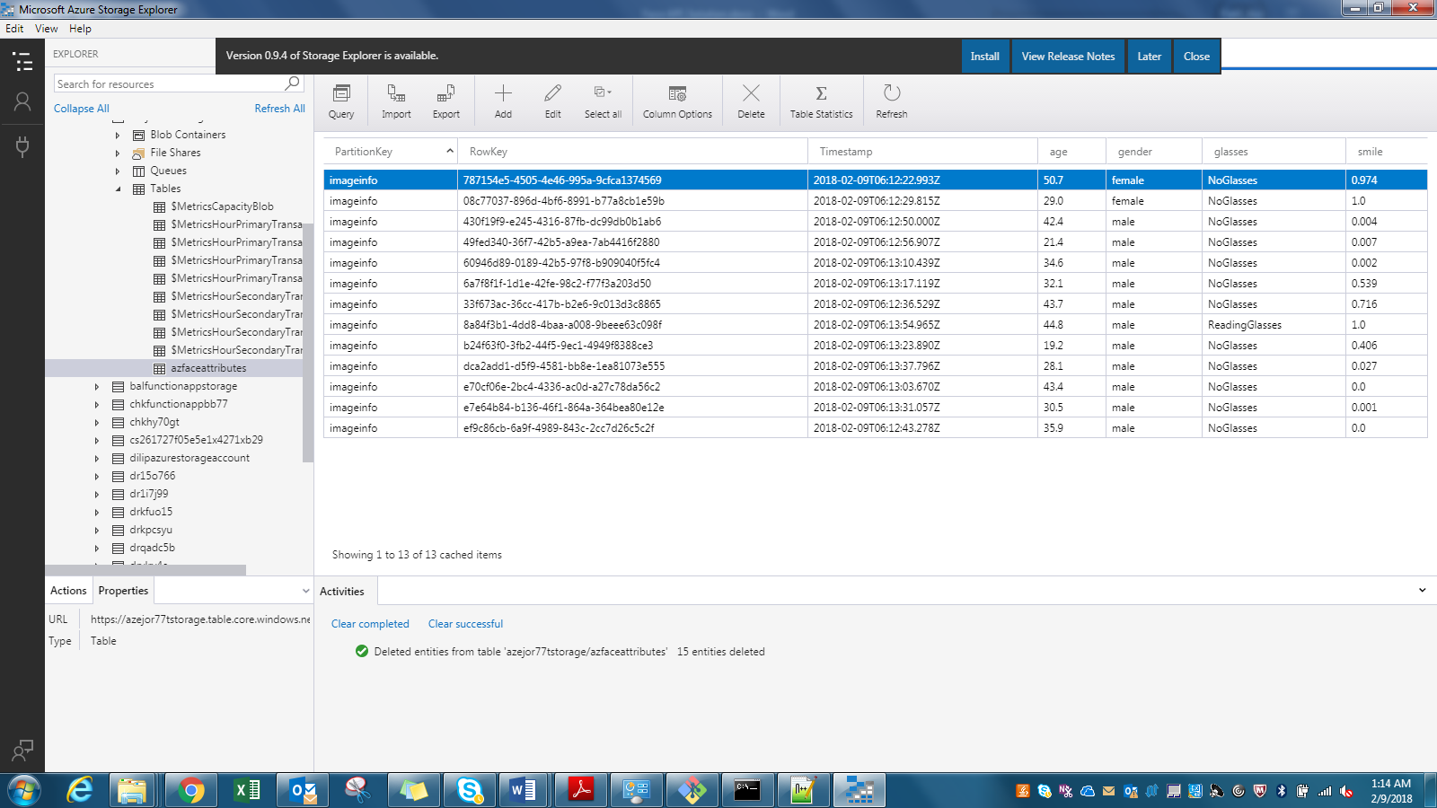
Face API Results stored in Azure Storage Table
Output of Face Detection Analysis is stored in Azure Table Storage and when looked through Microsoft Azure Storage Explorer will look as below-

Slide 27
Data Visualization
Run some data visualization on output data in above storage table. Please extract this table data as csv file – azfaceattributes.csv
Now we will use Pandas to run visualization. I have created python program proj_viz.py for same.
Python 3.6 on windows 7 machine was giving error on some of python pandas package installation so I ran visualization using Python 2.7 on Windows 10 machine.
In this python code, I have calculated some statistical figures covering group of faces analyzed. It pulls minimum, maximum, average, mean, median age and smile factor of group.
Visualization shows average age and average smiling face attribute for group of faces analyzed. I created Bar chart showing these averages.

Slide 28
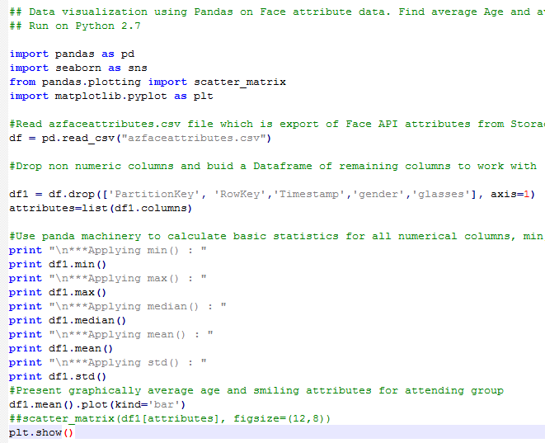
Data Visualization
Code snippet

Slide 29
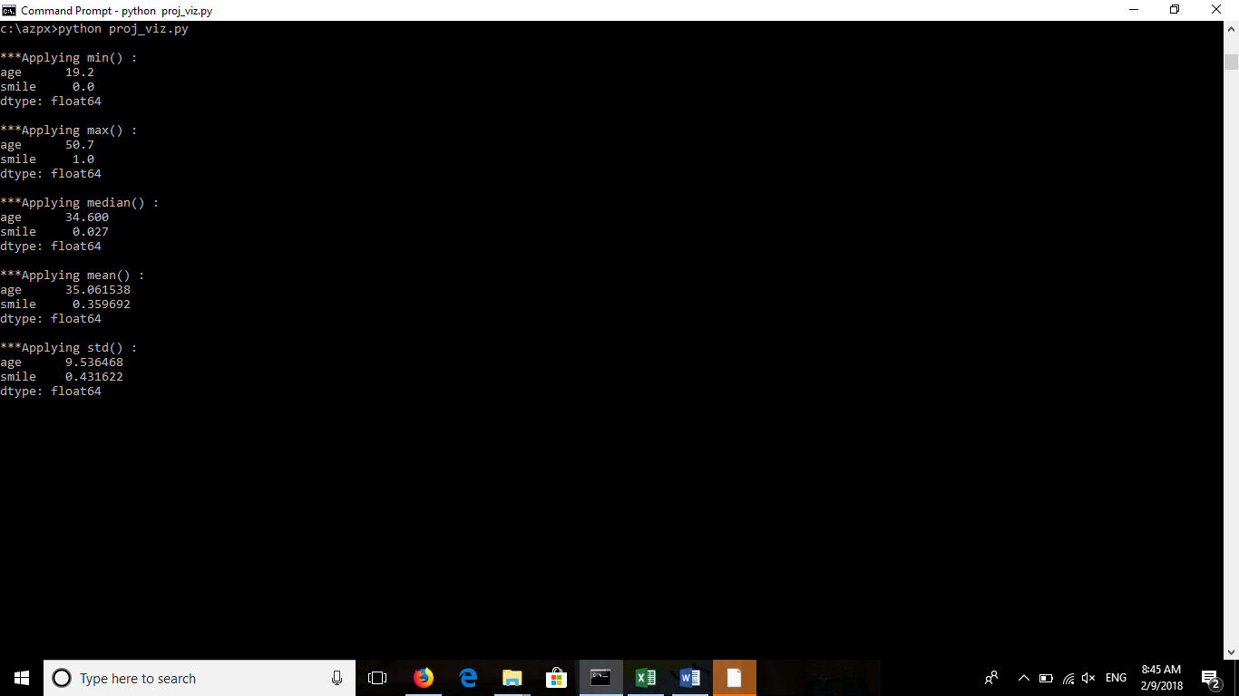
Data Visualization
Program will show data visualization as bar chart for average age and smile face attribute for all image faces for input data. Such data can be used for deriving social intelligence from public events.

Slide 30
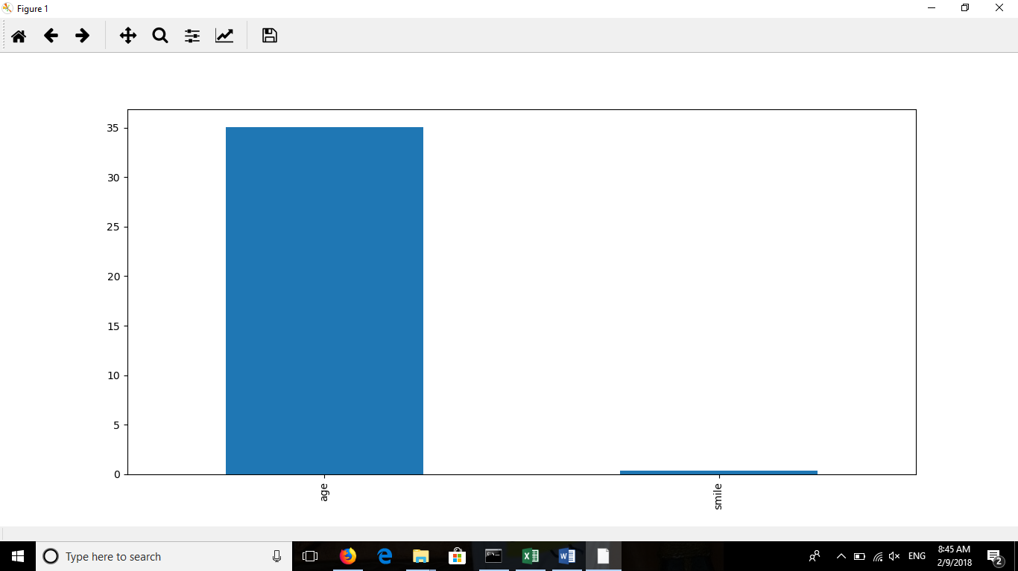
Data Visualization
You can see that average age of group is 34.6 and Smile factor of 0.35.

Slide 31
YouTube URLs, GitHub URL, Last Page
Two minute (short): https://www.youtube.com/watch?v=l_3xt2chxns
15 minutes (long): https://www.youtube.com/watch?v=7dBOHjJYPj4
GitHub Repository with all artifacts: https://github.com/siliconstrength/DeepAzureFinalProject

