Slide 1
Parameter matching

Slide 2
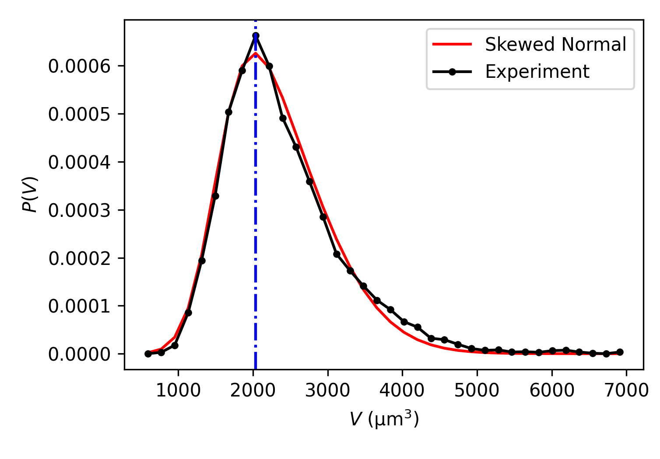
Experimental units
Temporal unit is set by the interval between two frames, dt*period = 0.0832 h = 5 min
Spatial unit is set by the reference cell volume, V_0 = 1520 µm³
The threshold value for T1 is 0.47 µm
System size is L=600µm
Density is 1886 cells/mm²

Slide 3
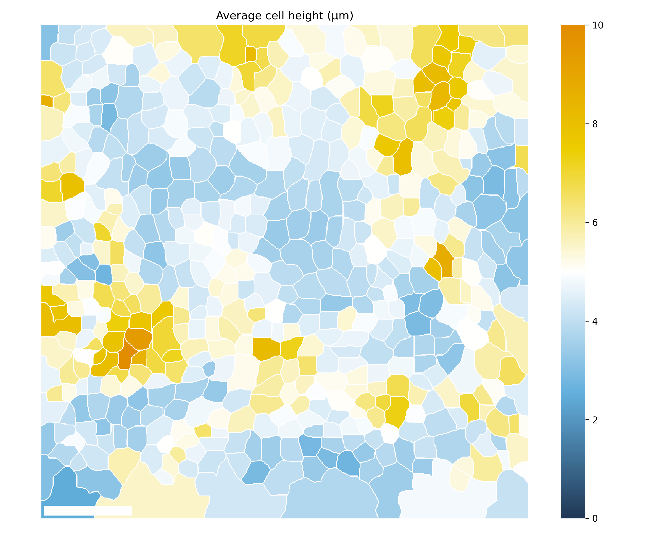
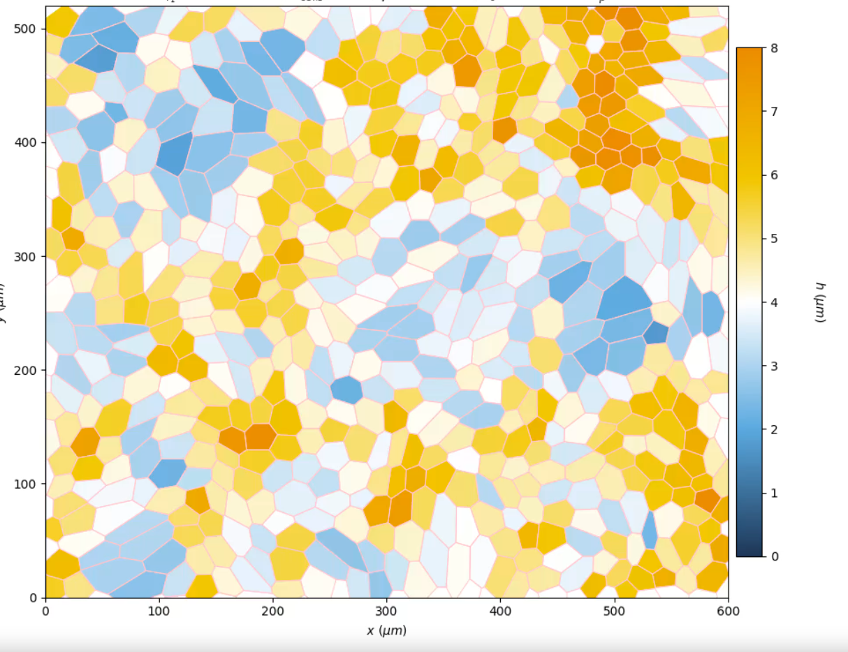

Slide 4
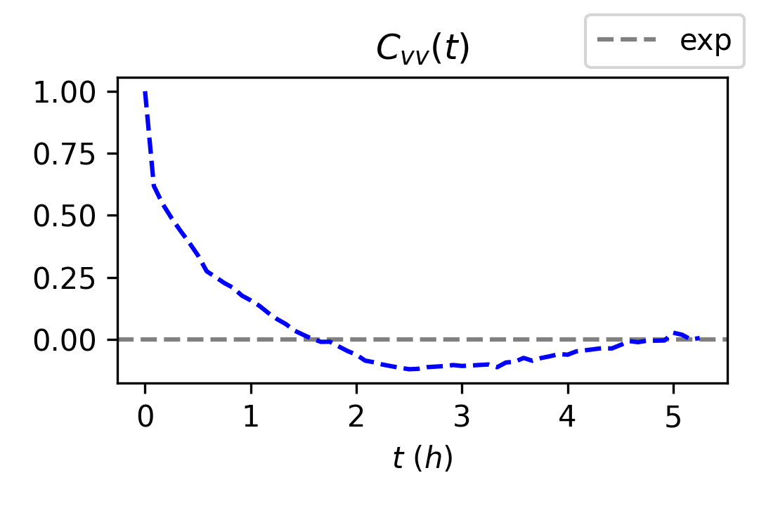
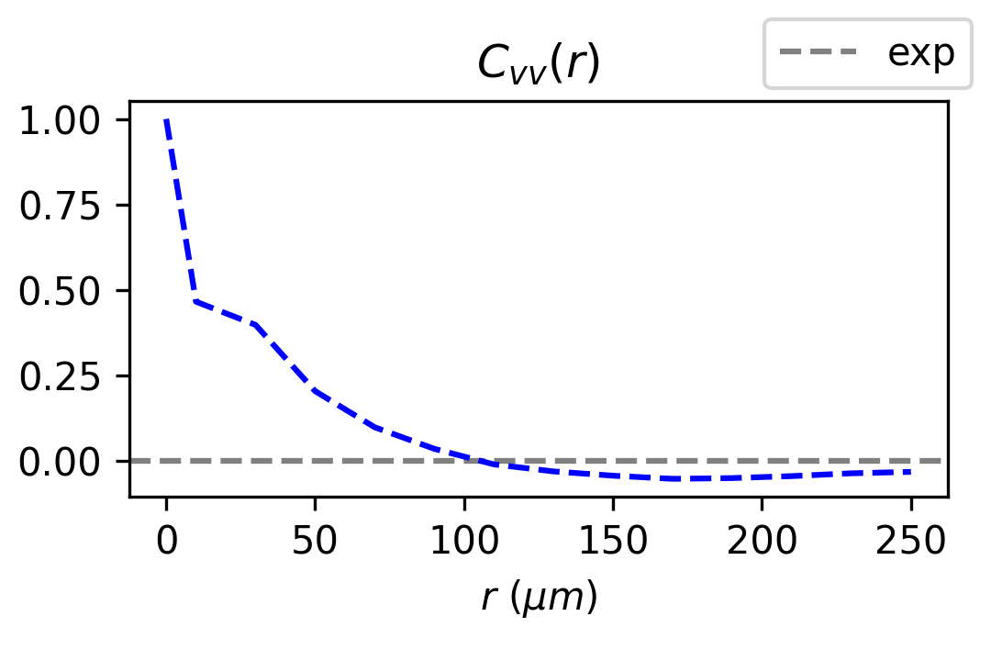
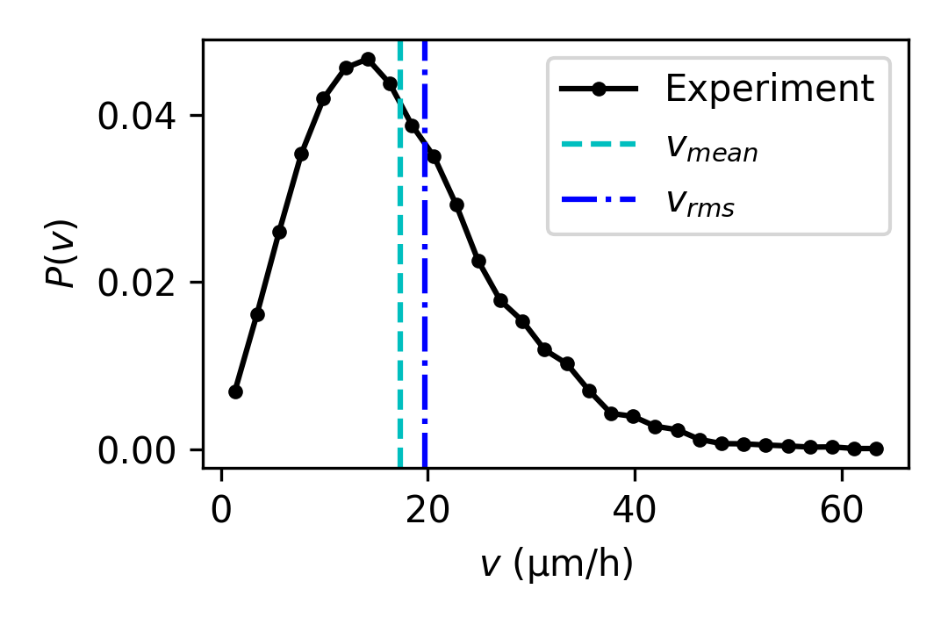
Initial guesses
Decay time of Cvv(t) is mostly determined by the persistence time.
The correlation length in Cvv(r) is determined by (Aτγ)^{(1/2)}
v0 is chosen to obtain correct vrms = 20 µm
Initial parameter guesses:
  τp = 1.5 h
  γ = 13 1/h, (A = 520 µm²)
  v0 = 100 µm/h

Slide 5
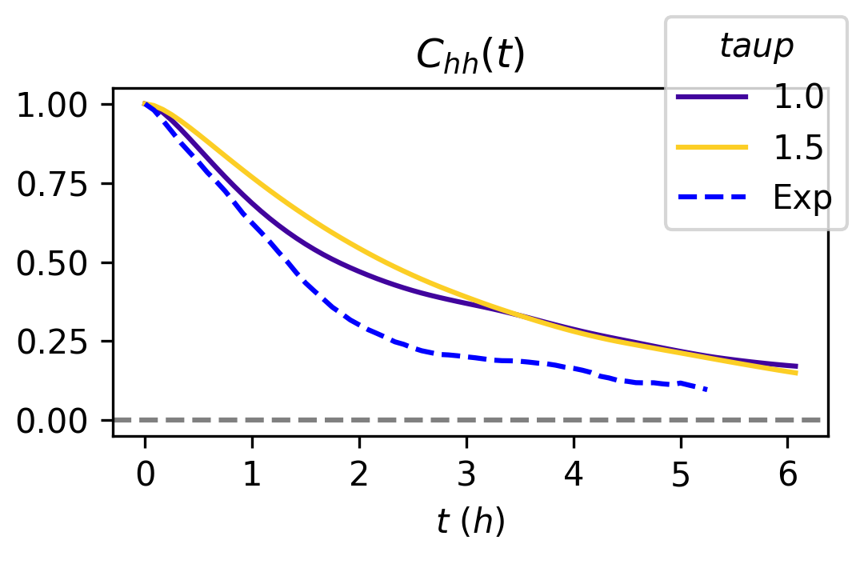
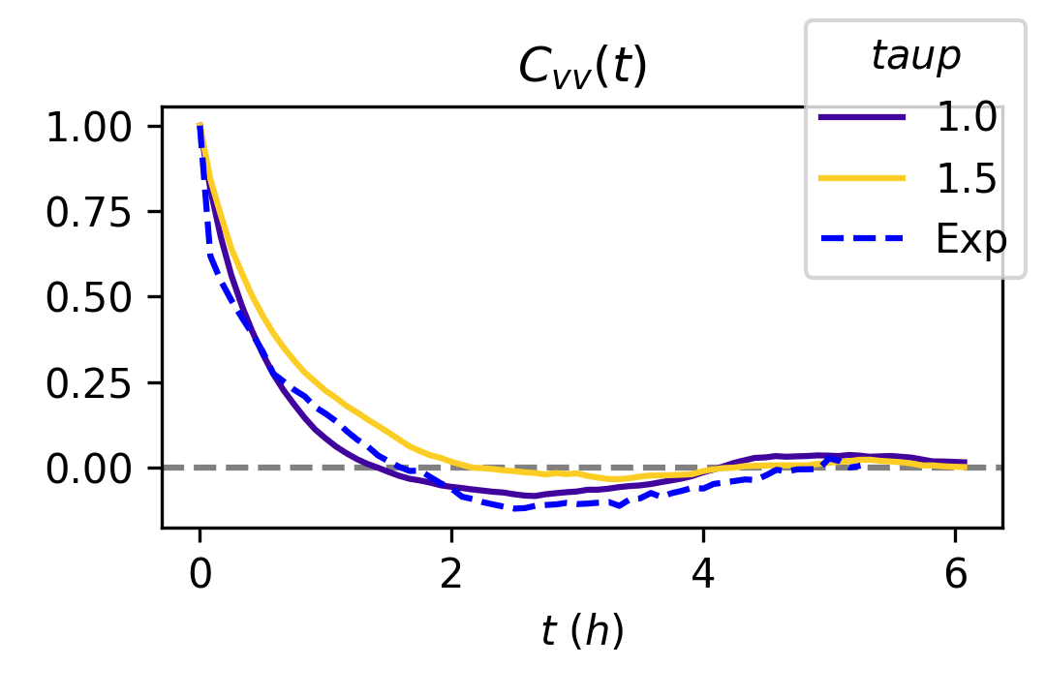
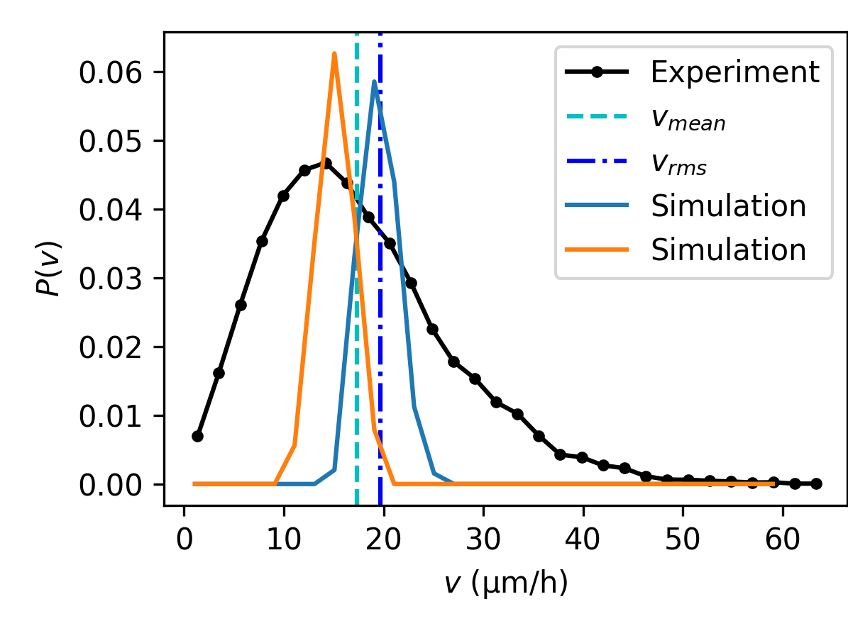
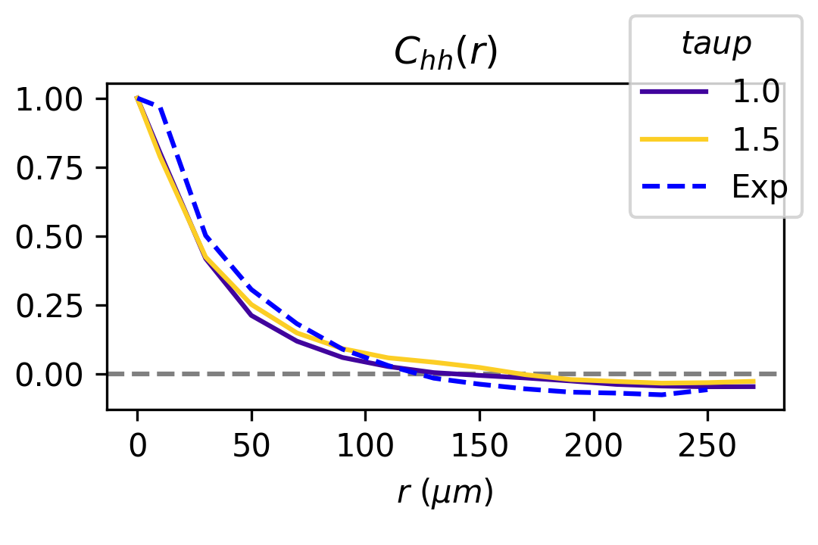
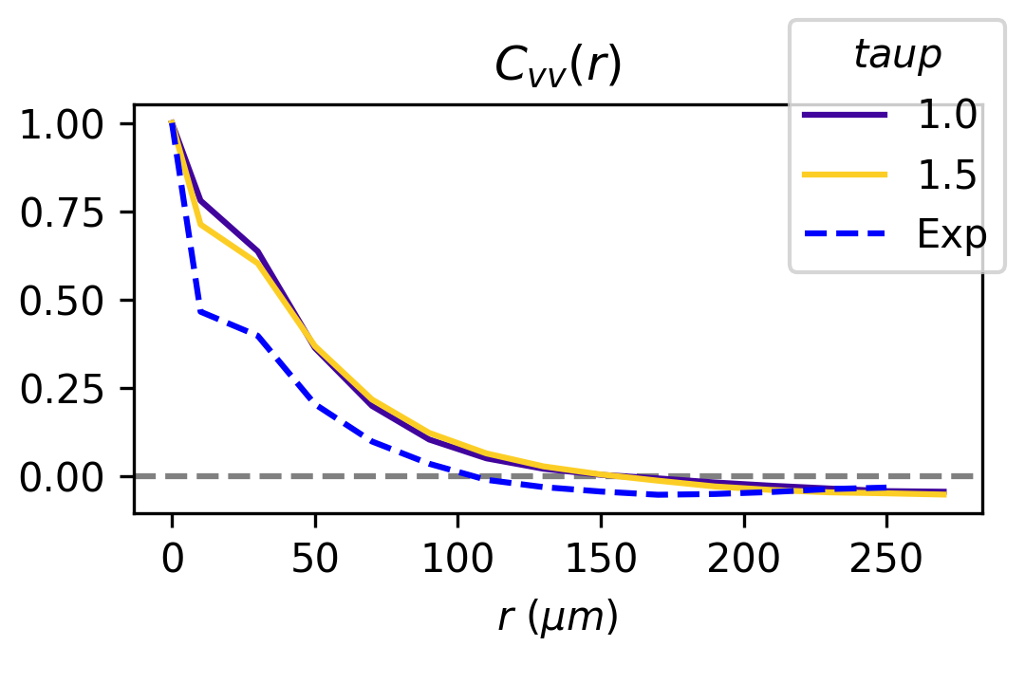
Matching correlations
γ = 13
v0 = 100
τp = 1
η = 1

Slide 6
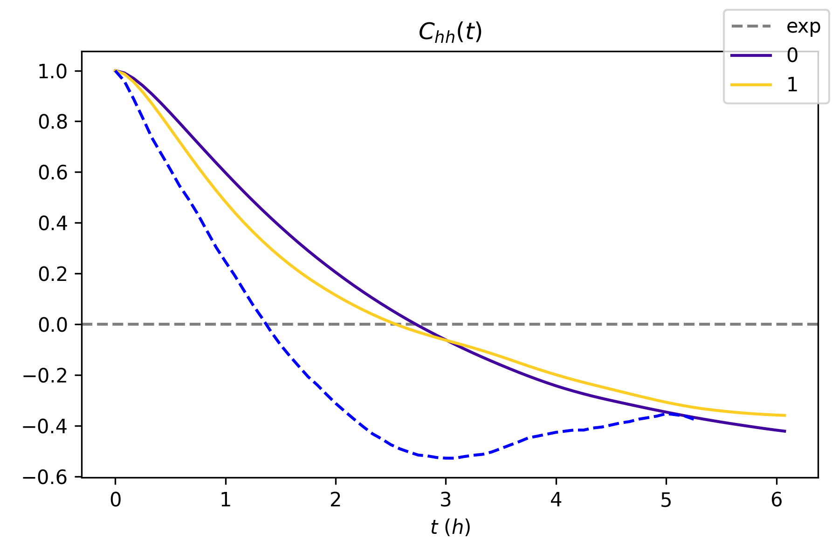
Taking Chh(t) of fluctuations around cellwise height

Slide 7
Cell speed
v0 is chosen to obtain correct vrms = 20 µm
vrms ≈ 0.2 v0
Increasing tau_p decreases vrms
Trying: eta=0.5, v0 in [20,40,60]
  Heights: dist: 40, 60; std: 20
  Areas: dist: > 60; std: 60
  Aspect ratios: dist: 60; std: 30
  Vrms: 0.2*v0
Trying: eta=[0.2, 0.5], v0=60
  Heights: invariant
  Areas: invariant
  Aspect ratios: invariant
  Vrms: 21-2*eta
Need v0 in order of 100 to get correct vrms, but this is leads to too aggressive dynamics (too large fluctuations).

Slide 8
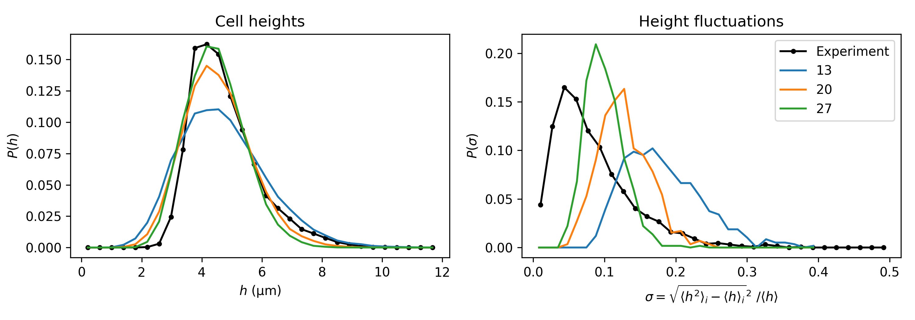
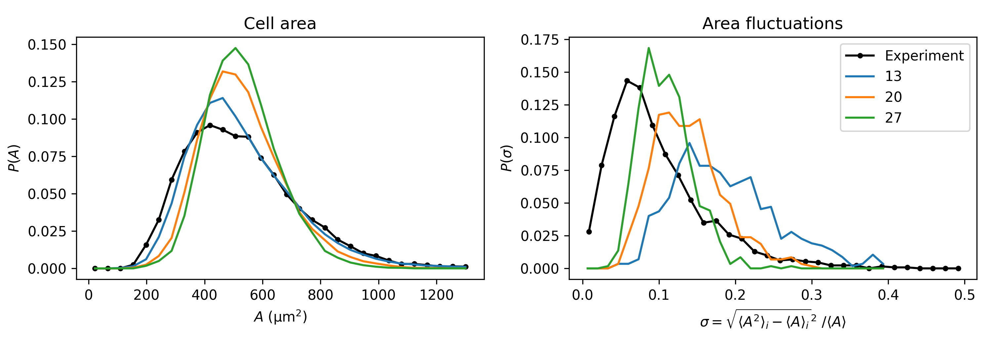
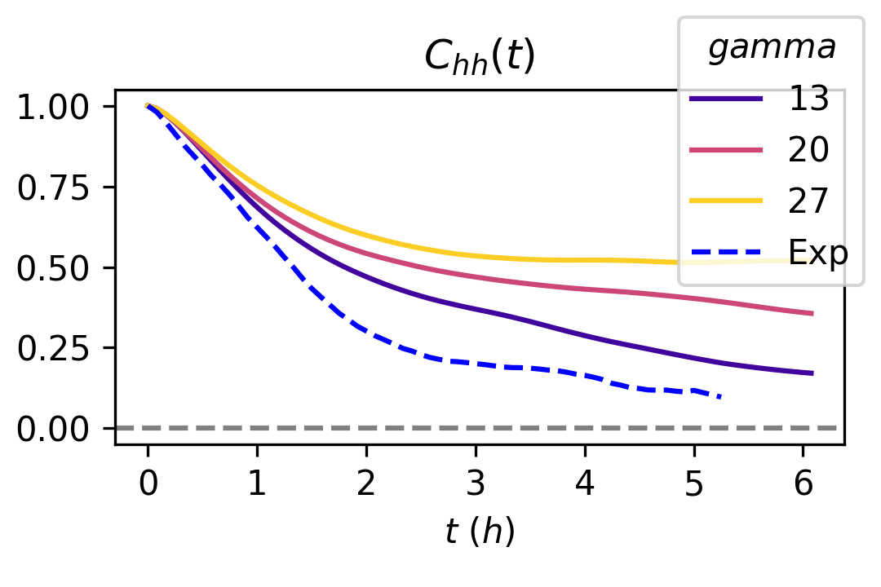
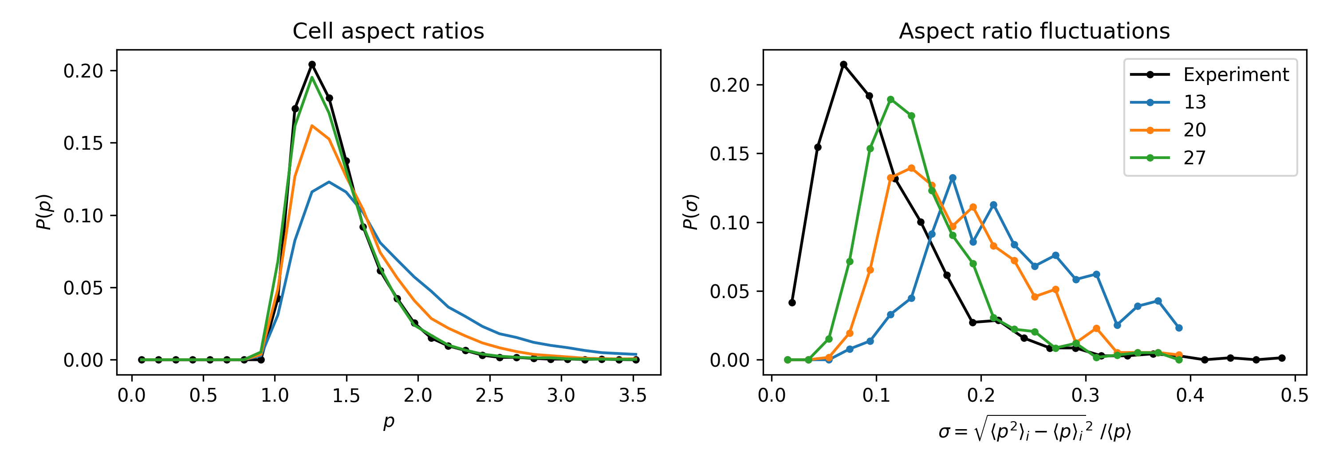
Matching fluctuations
Increase gamma for stiffer material
  ^{Moves Chh(t) higher}
  ^{Decreases vrms only slightly}
  ^{Decreases fluctuations!}
^{Can change eta}
  Hardly affects fluctuations, but decreases vrms
  Moves Cvv(r), Chh(r), and Chh(t) higher

Slide 9
Matching fluctuations
h, A, p distributions are reasonable
Fluctuations are too large
  Increase γ to get stiffer cells
  This also increases the decay time of Chh(t)
Need smaller amplitude but higher frequency. Is this possible in current model?

Slide 10
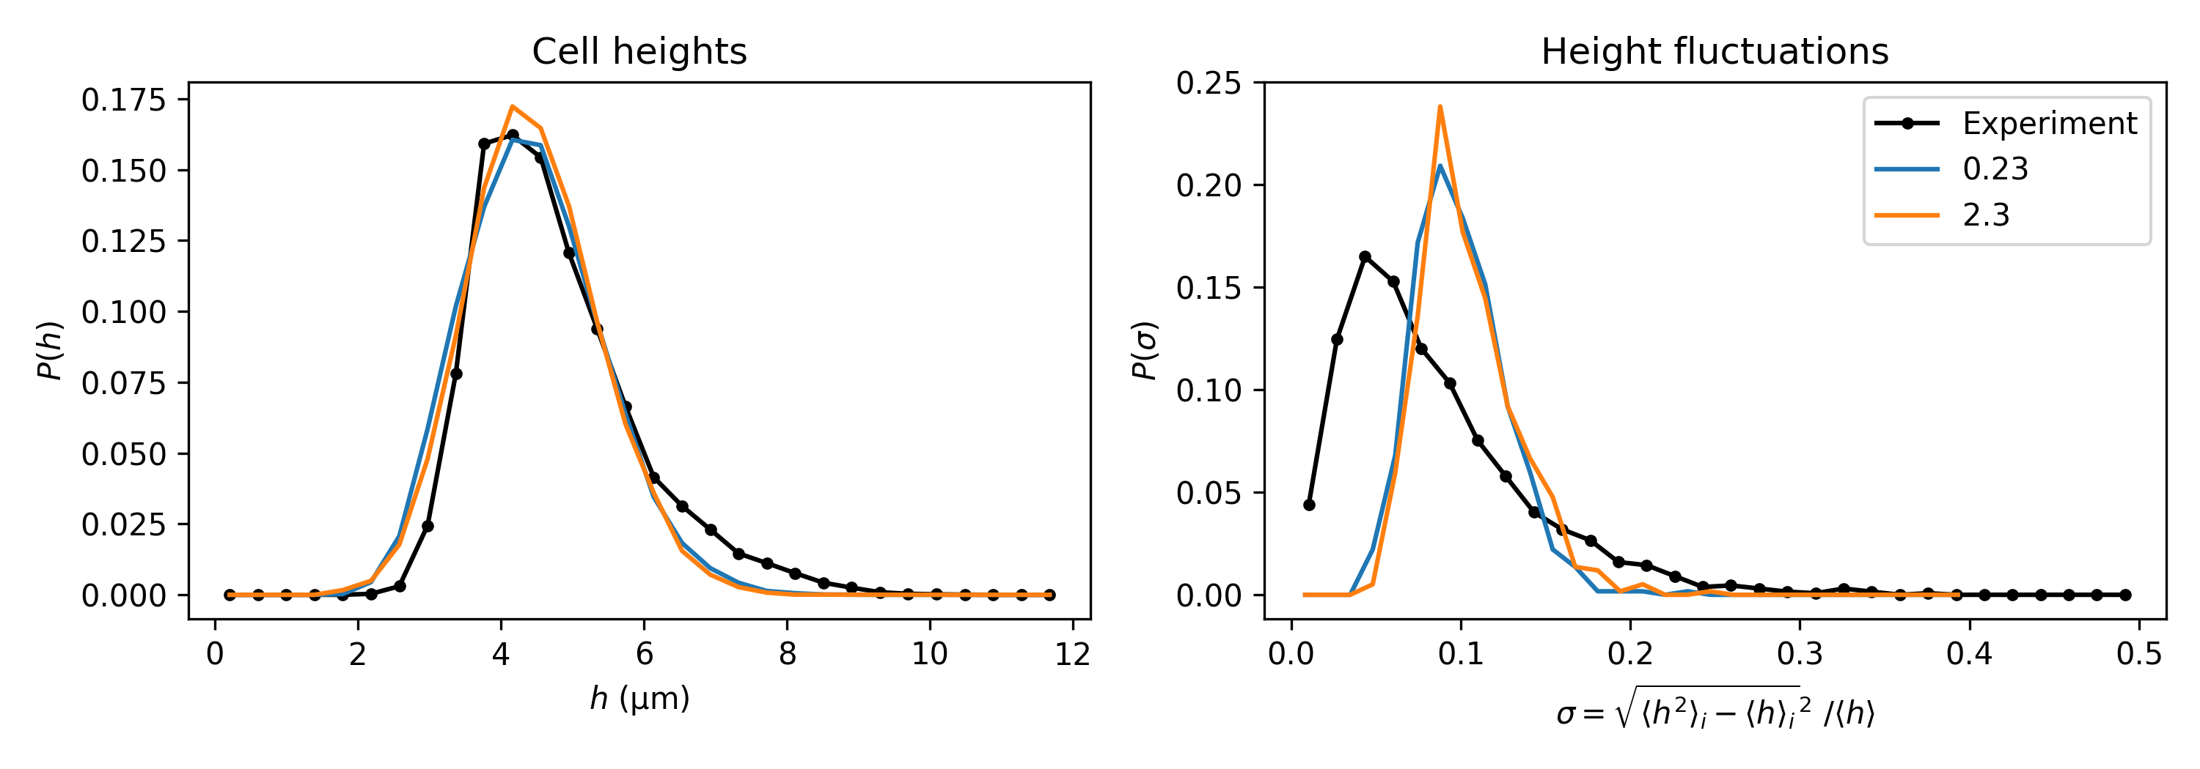
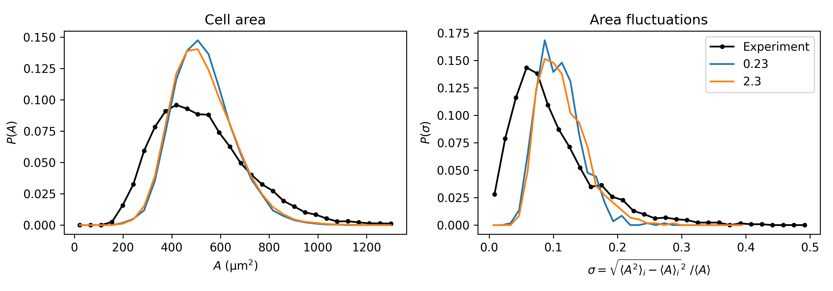
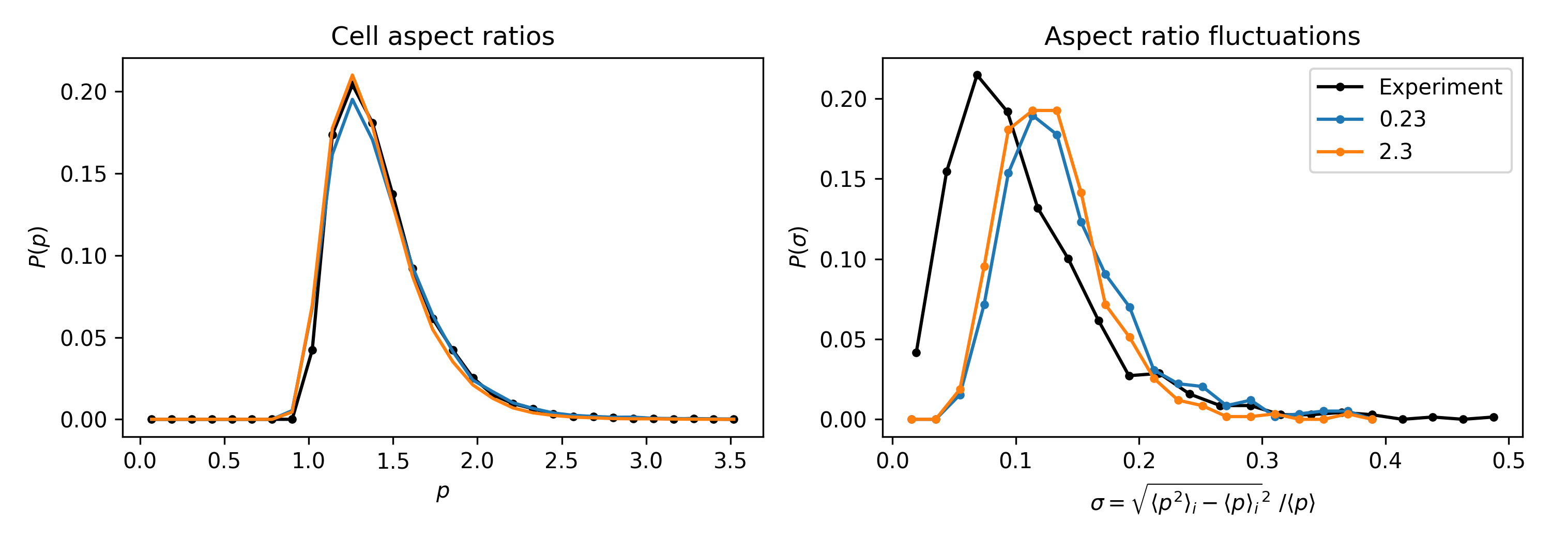
Matching fluctuations
Increasing threshold for T1-transitions to occur
  Cvv(r), Chh(r): invariant
  Cvv(t) shorter recovery from negative?, Chh(t): decreasing
  Negligible impact on fluctuations

Slide 11
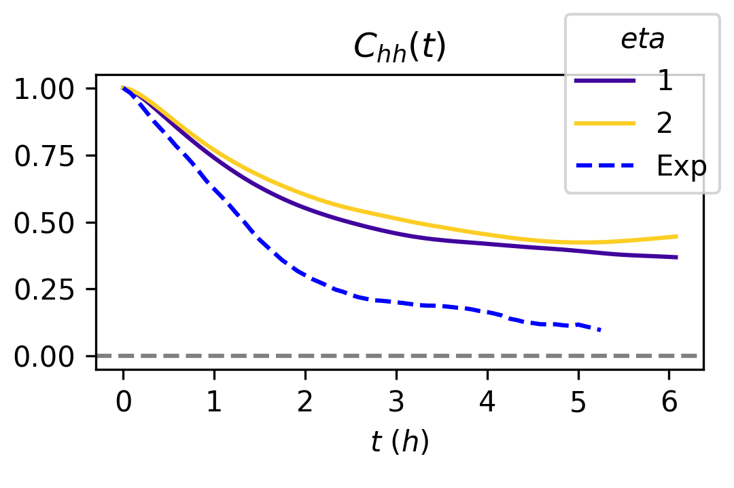
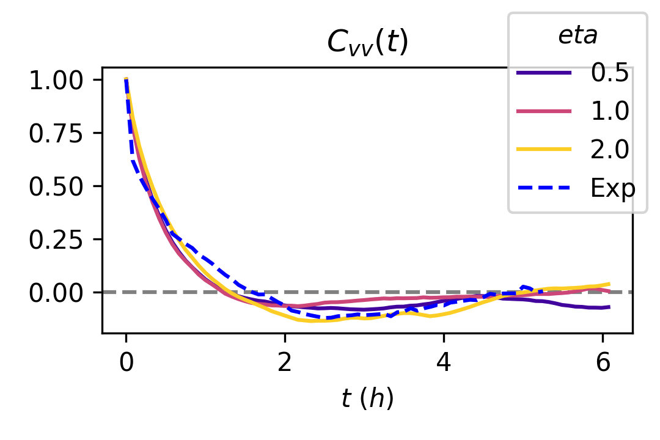
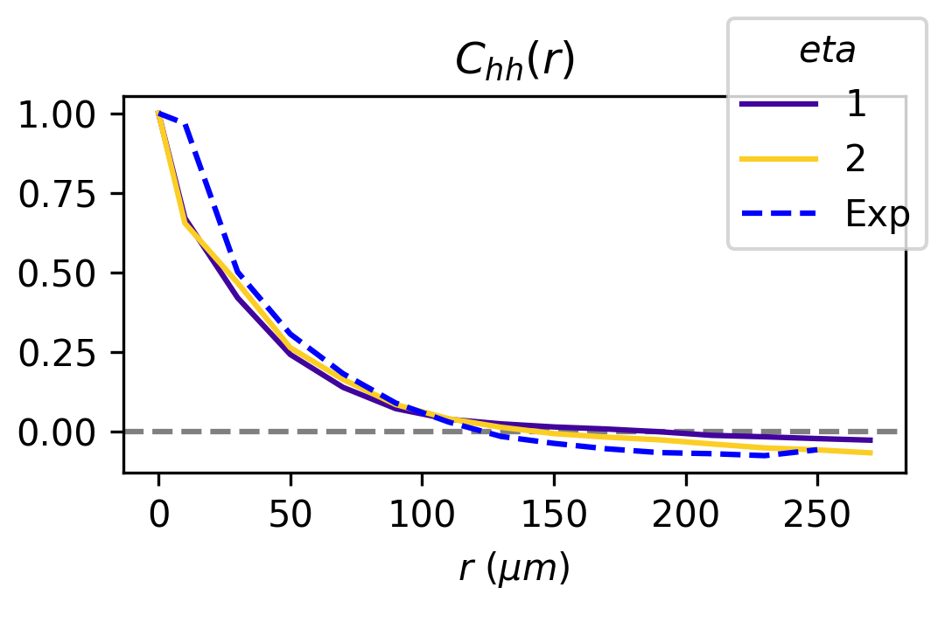
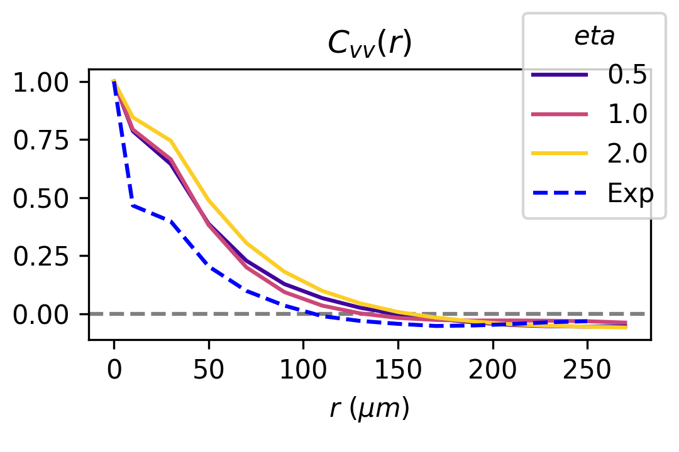
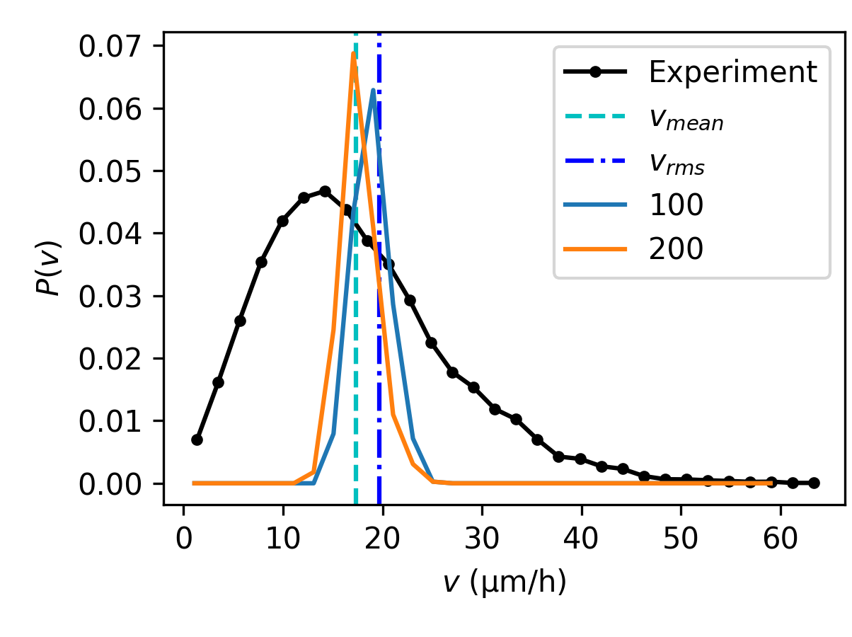
Matching correlations with stiffer cells
γ = 27
v0 = 120
τp = 1.2
η = 2

Slide 12
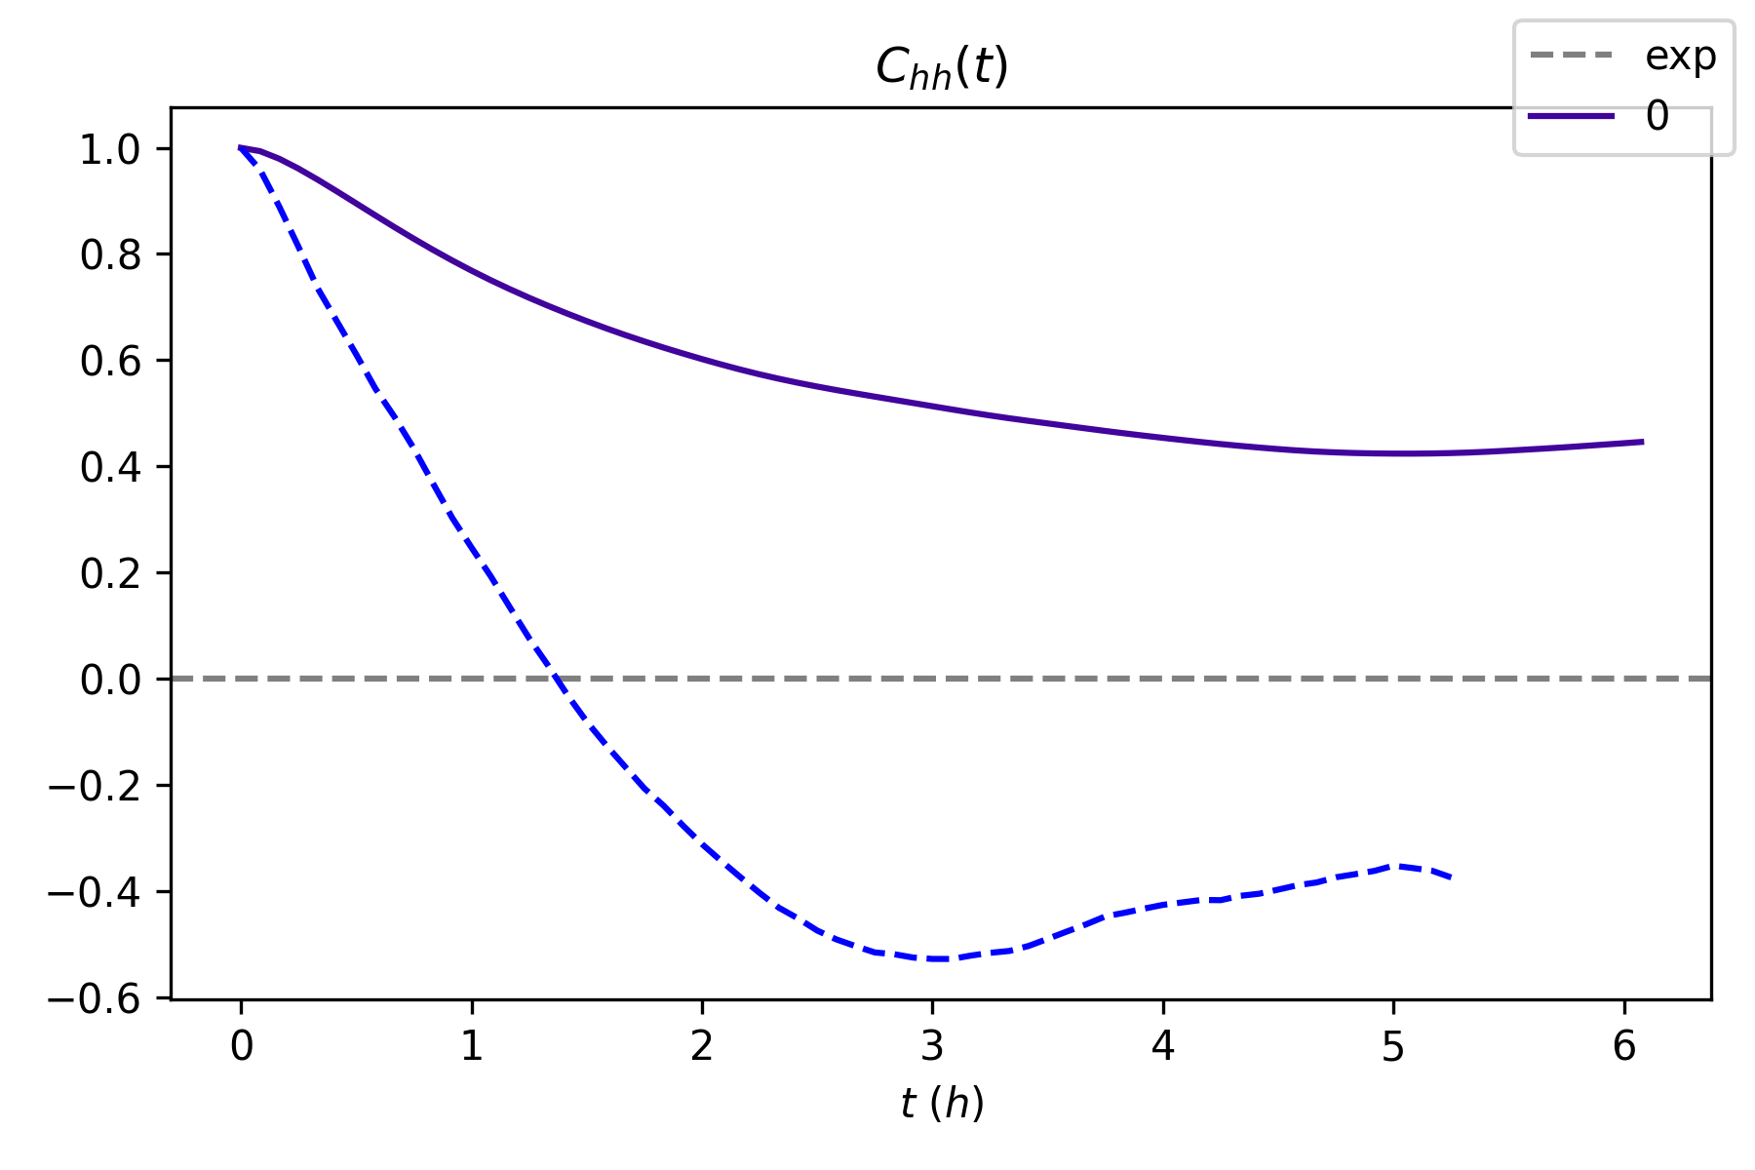
Taking Chh(t) of fluctuations around cellwise height

Slide 13
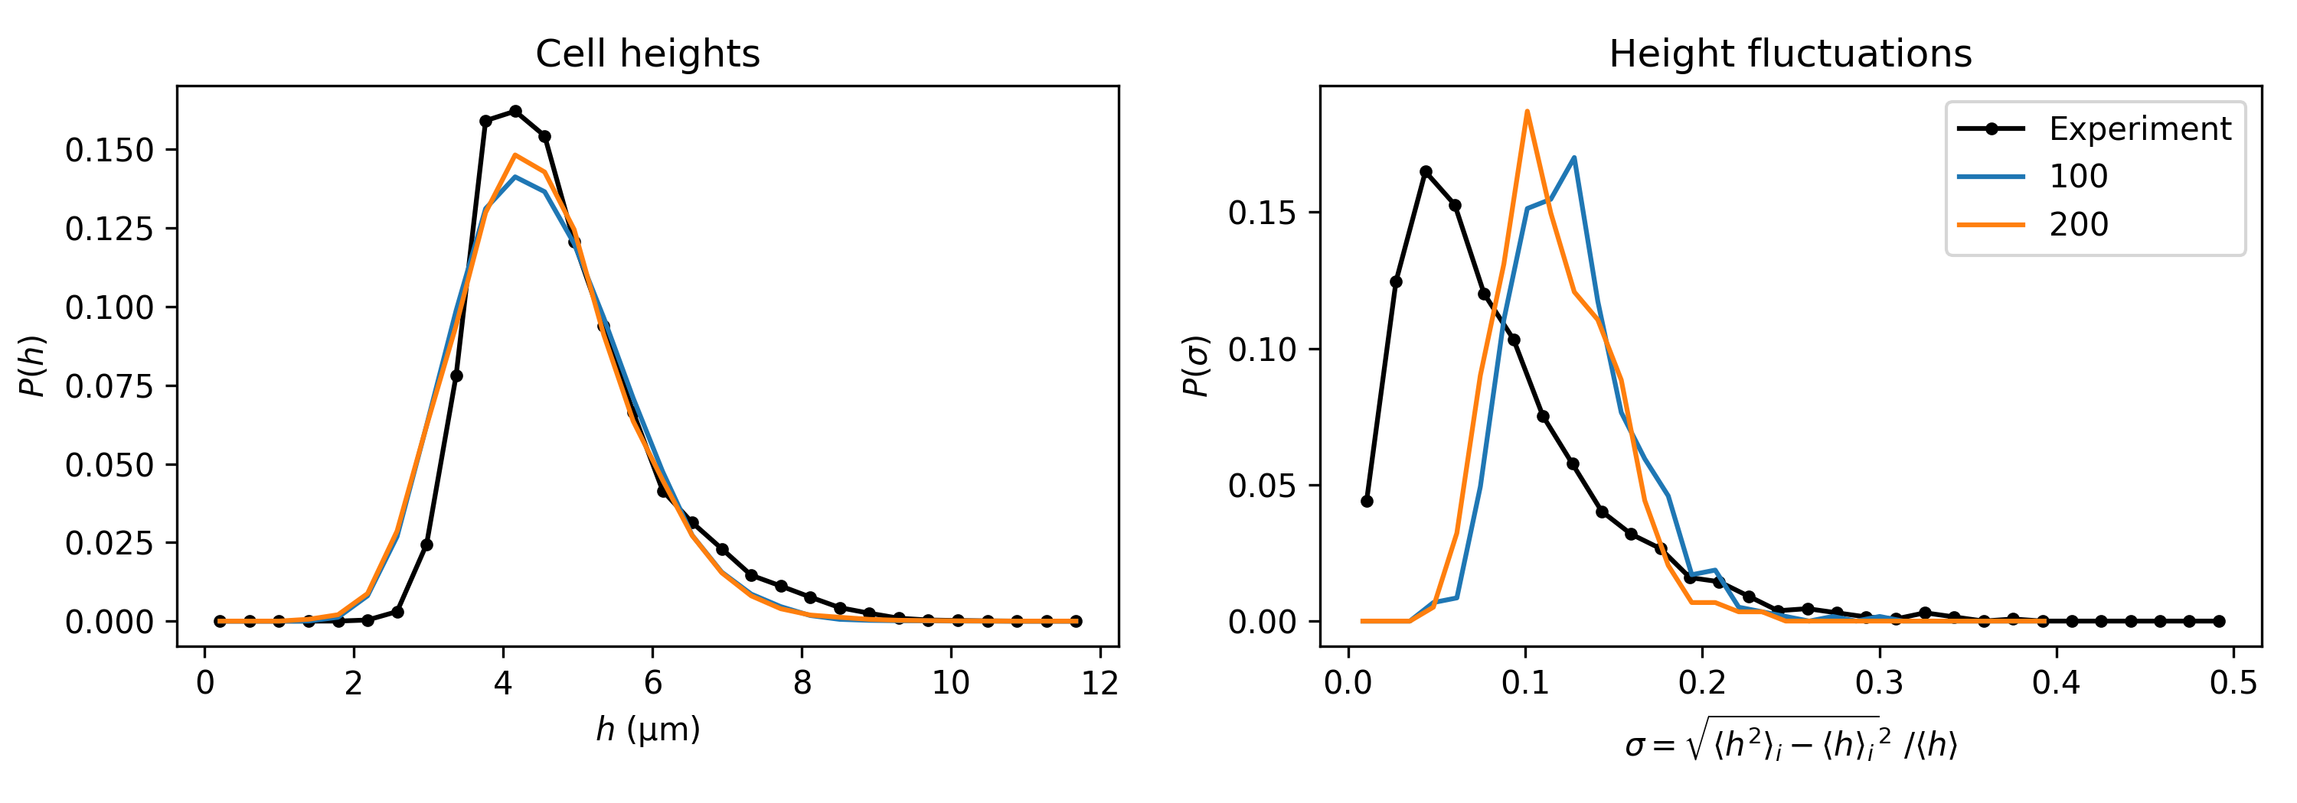
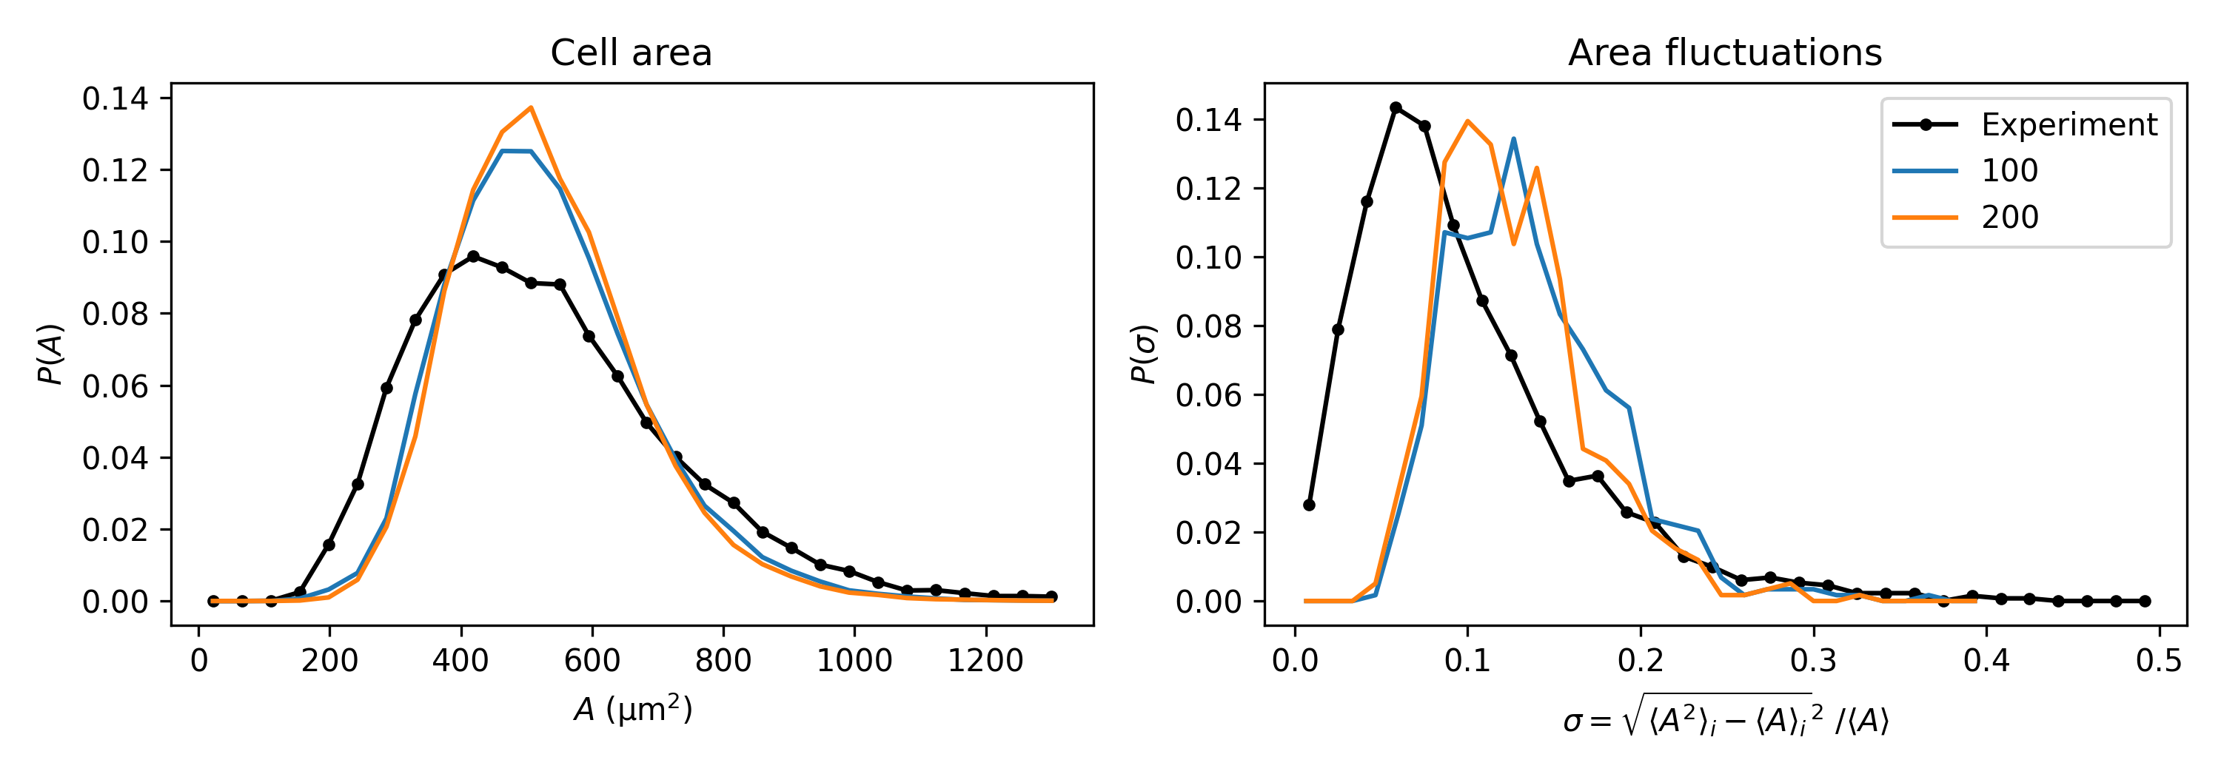
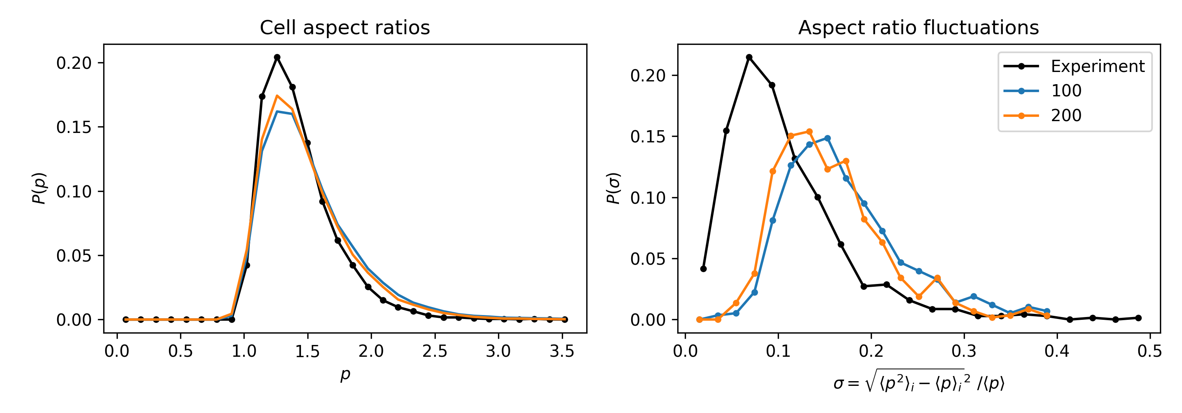
Summary
Trade-off between cell speed and amplitude of fluctuation
  v0 increases vrms, but also increase amplitude of fluctuations
  γ decrease amplitude of fluctuations, but decrease vrms
Fluctuations within experimental range require γ ≈ 100 1/h, v0 ≈ 200 µm/h
This comes at the cost of
  Decreasing ξ of Chh(r)
  Increasing ξ of Cvv(r)
  Increasing Chh(t) at t→∞
Not able to match this with Chh(t) for fluctuations around <h>cell
Need to introduce preferential direction of extension?

Slide 14
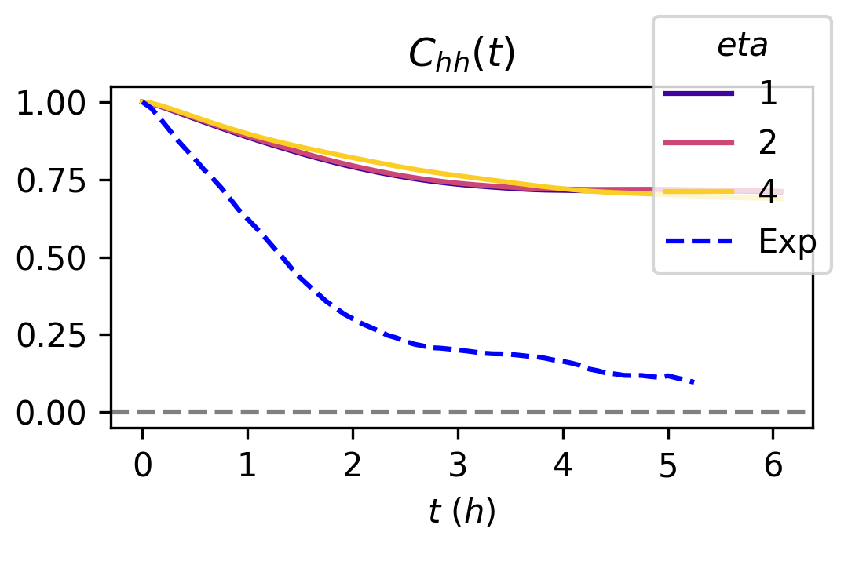
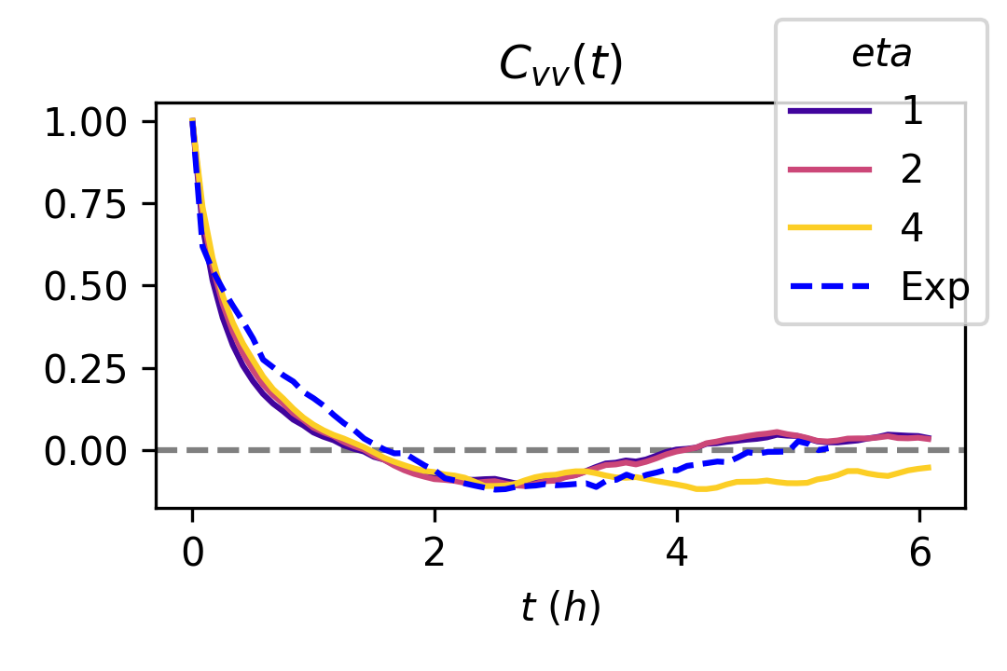
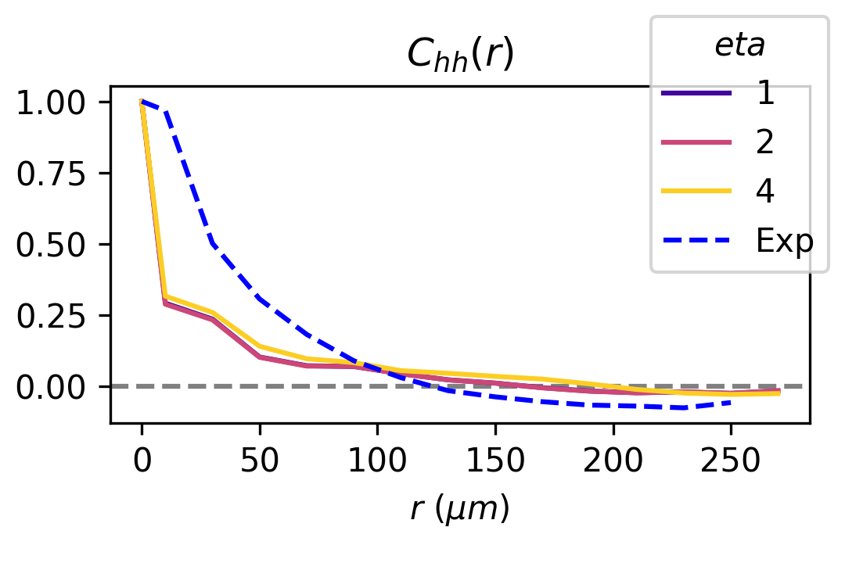
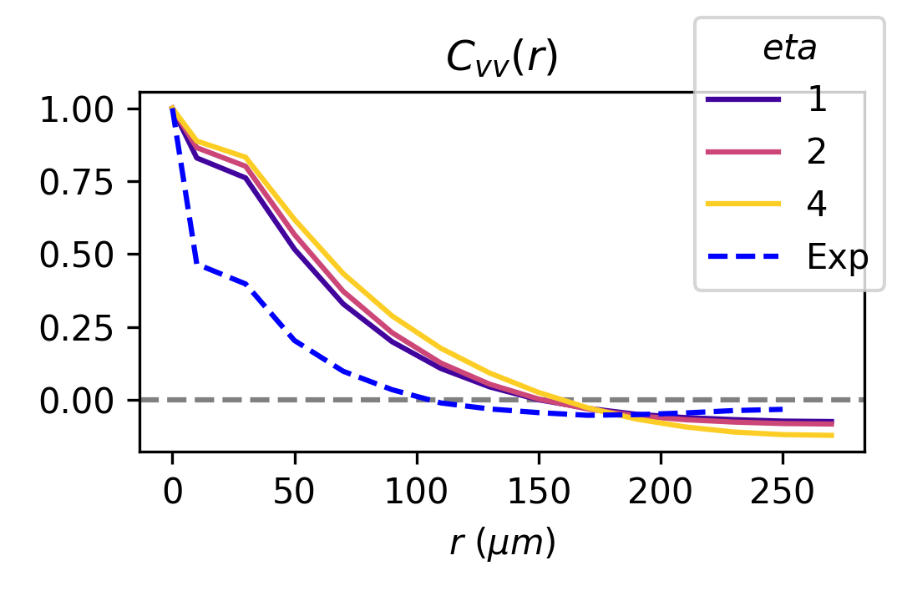
Rematching correlations and self-propulsion speed
^{Best set of parameters:}
  ^{Gamma = 100}
  ^{V0 = 200}
  ^{Taup = 2}
  ^{Eta = 2}

Slide 15
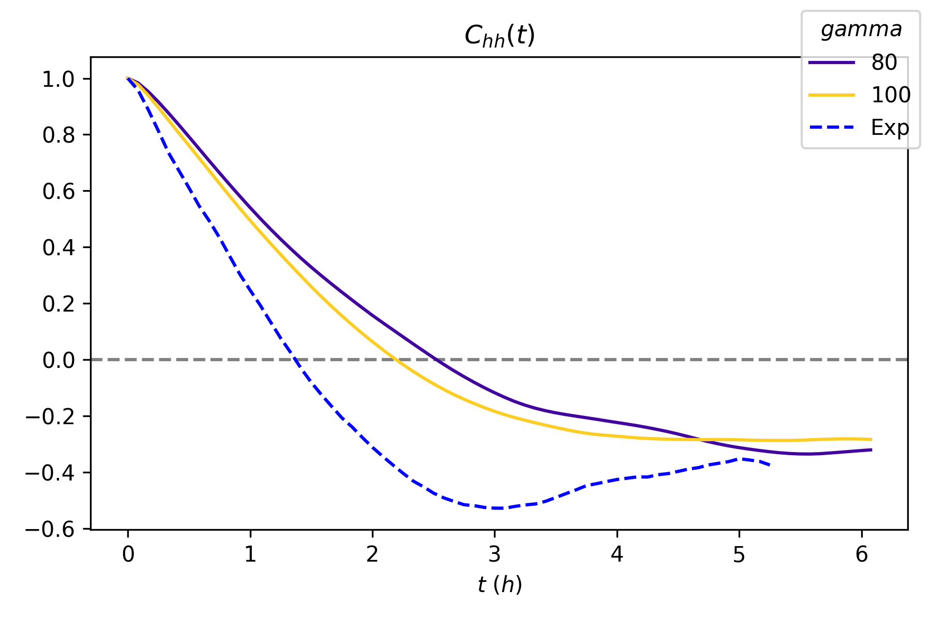
Taking Chh(t) of fluctuations around cellwise height

Slide 16
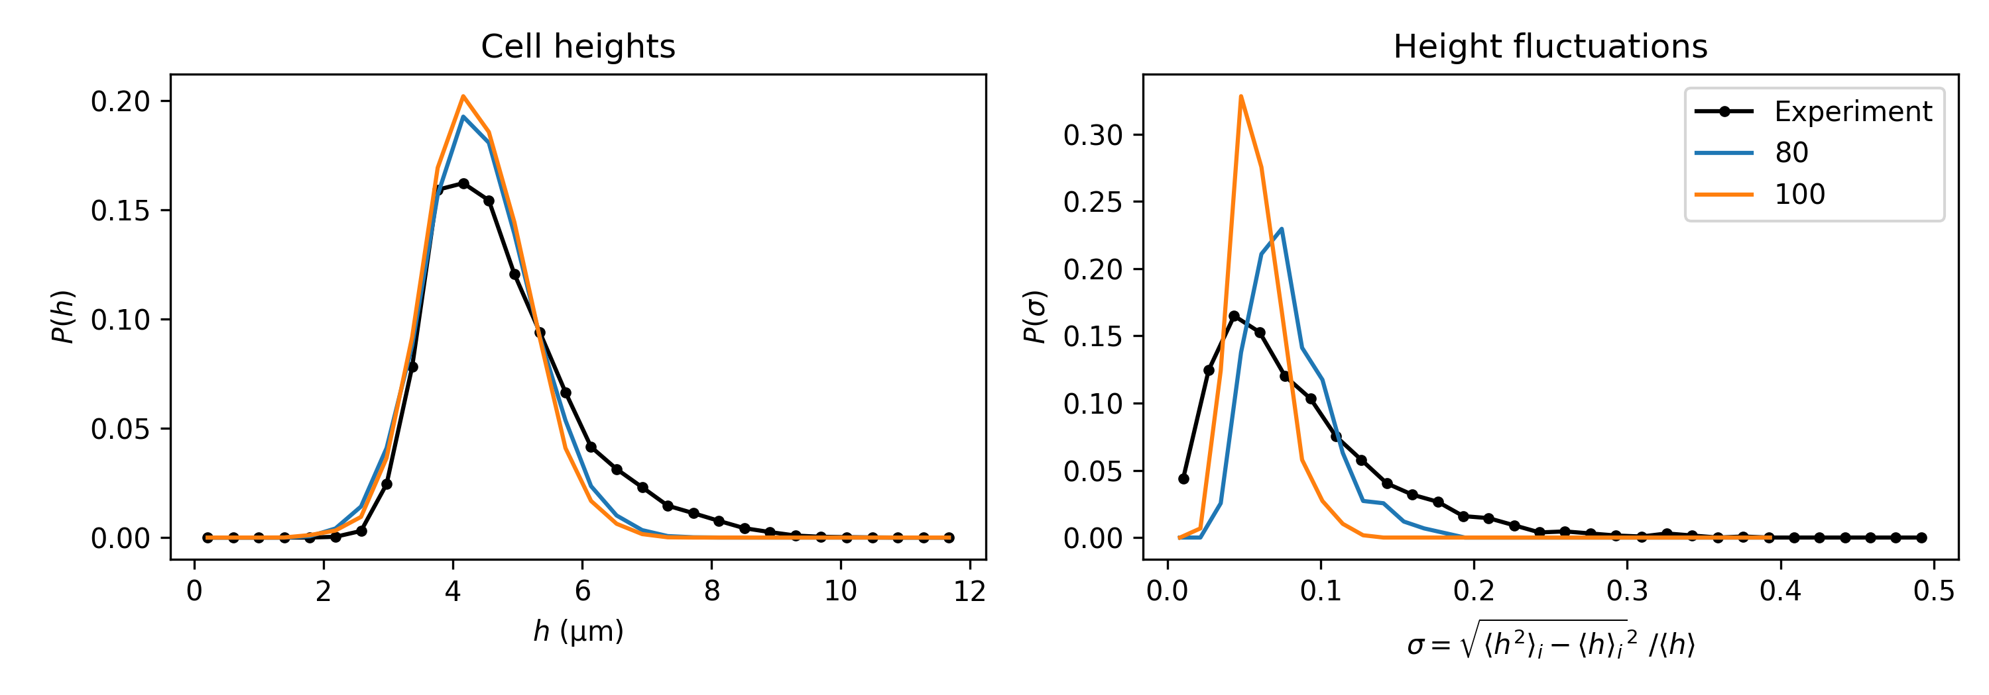
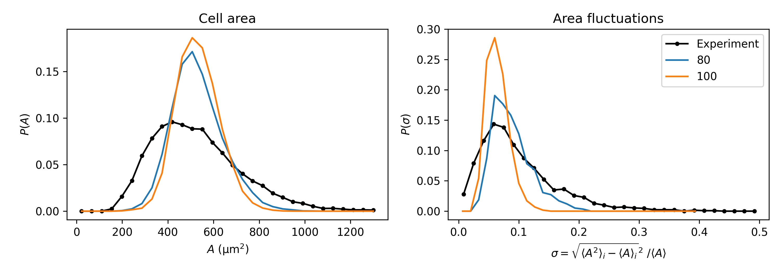
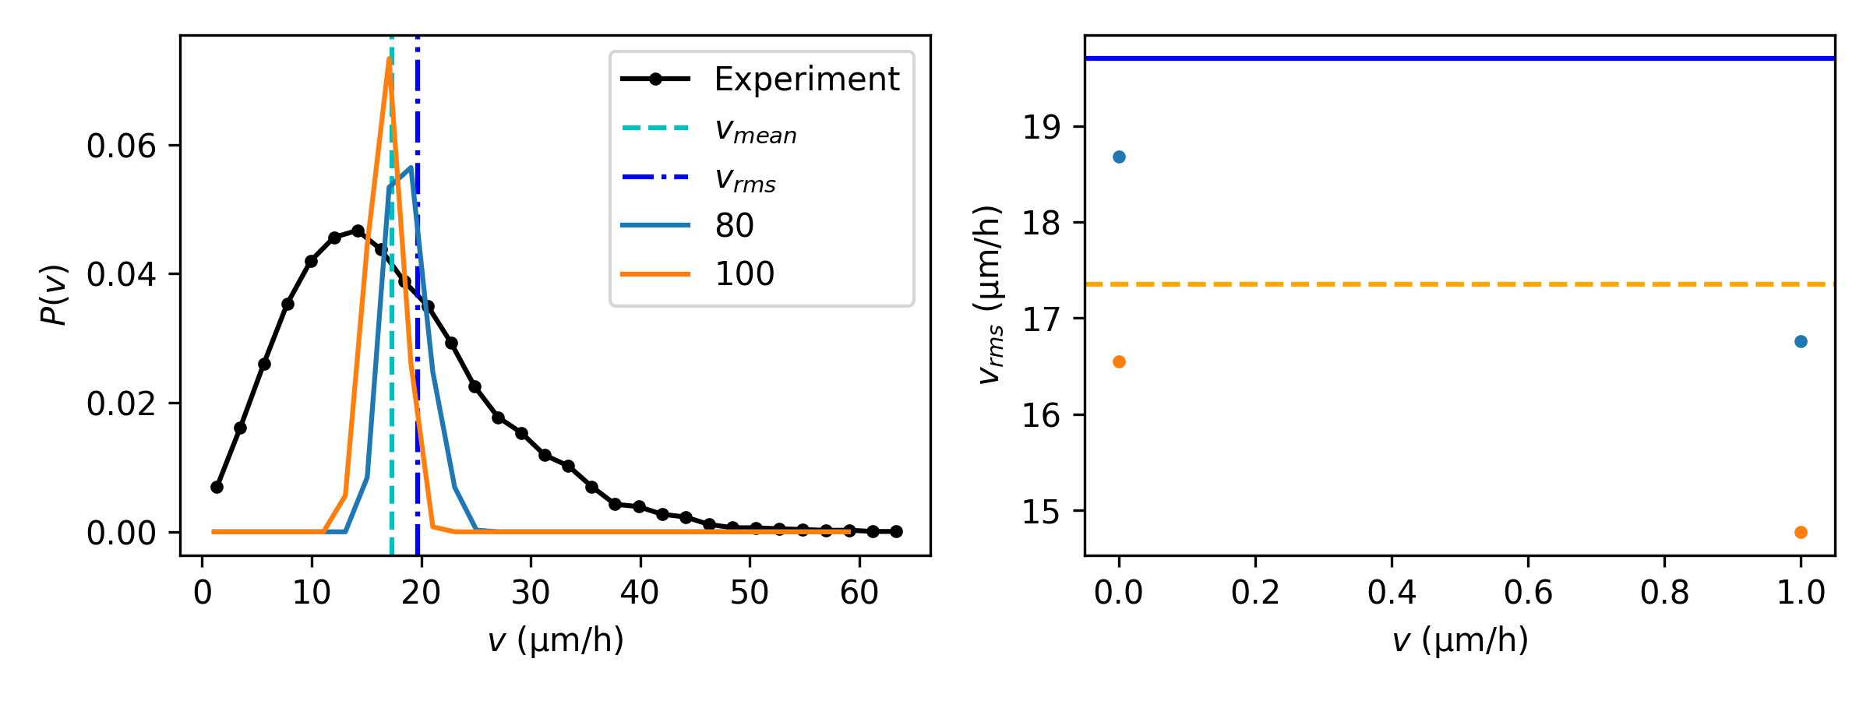
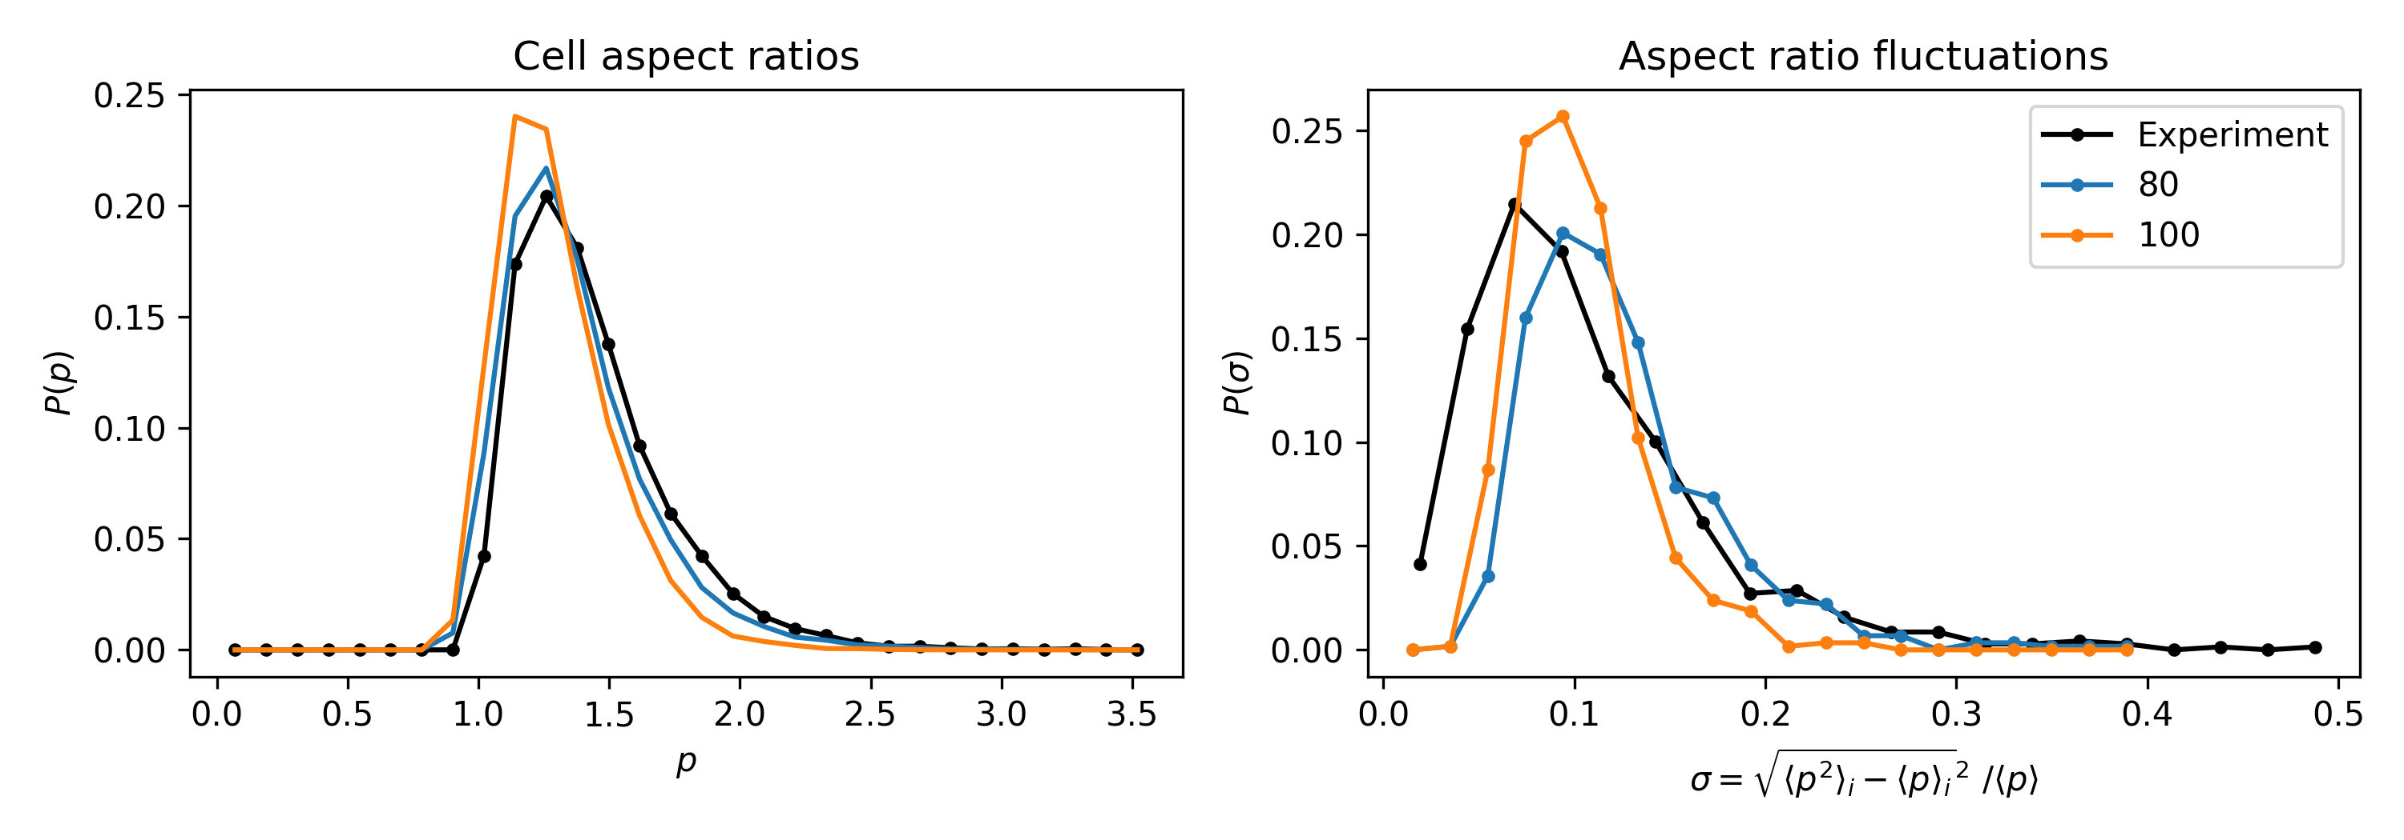
Summary
Keeping fluctuations low while matching the vrms requires high gamma

Slide 17
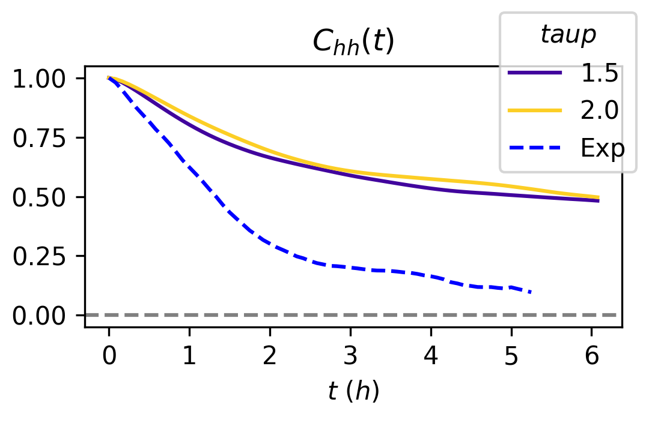
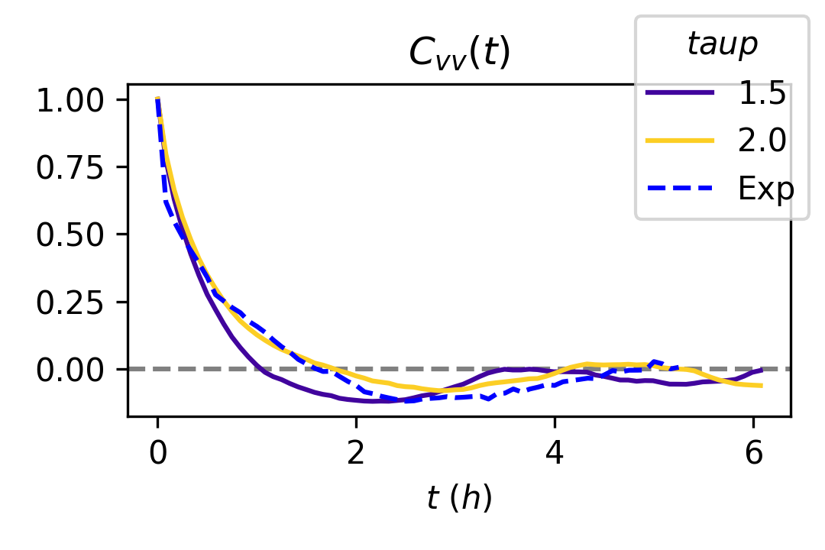
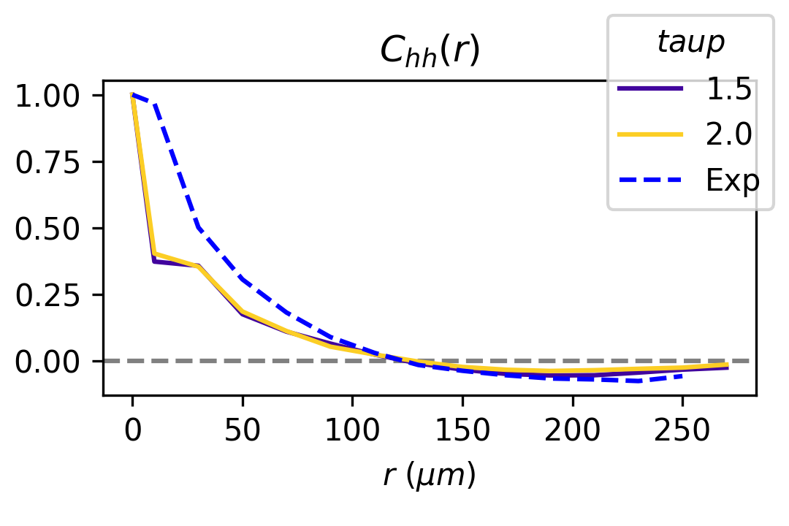
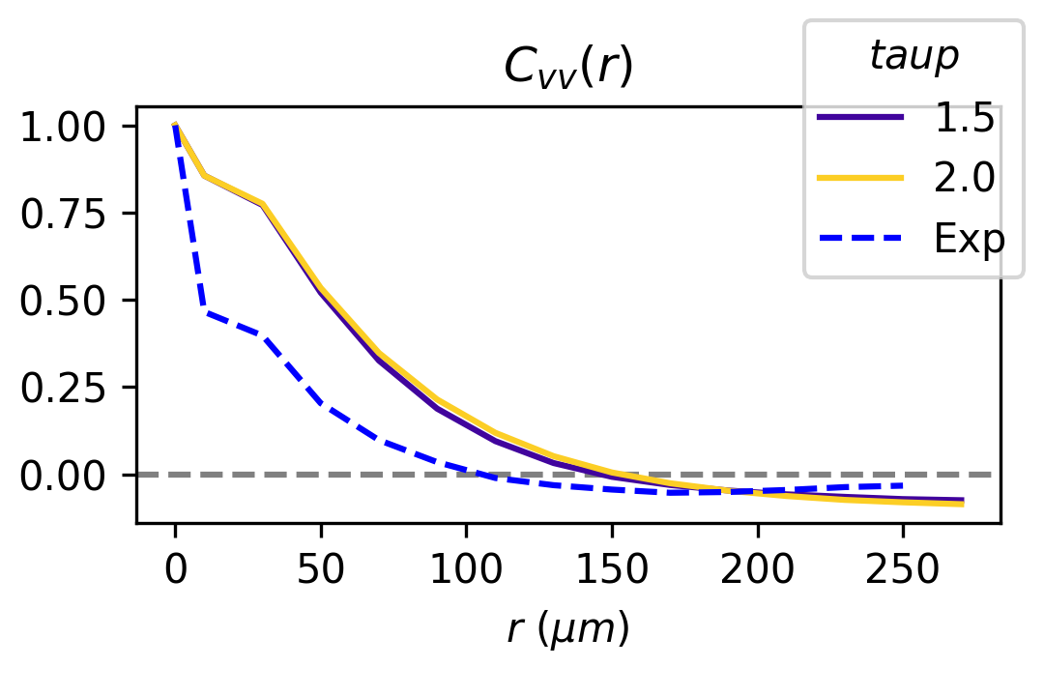
Rematching correlations and self-propulsion speed
^{Best set of parameters:}
  ^{Gamma = 50}
  ^{V0 = 150}
  ^{Taup = 2}
  ^{Eta = 2}

Slide 18
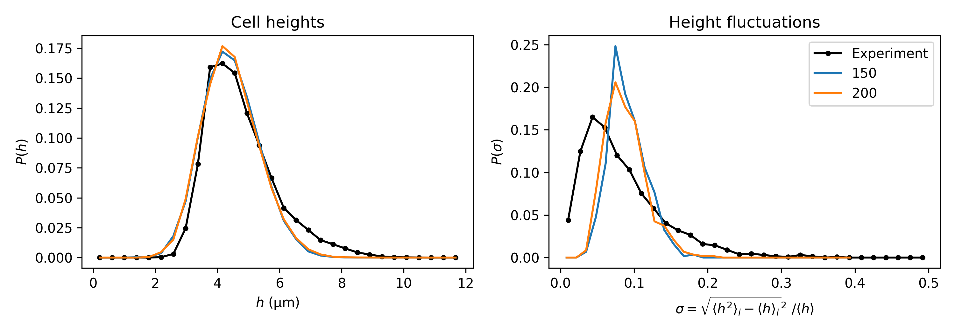
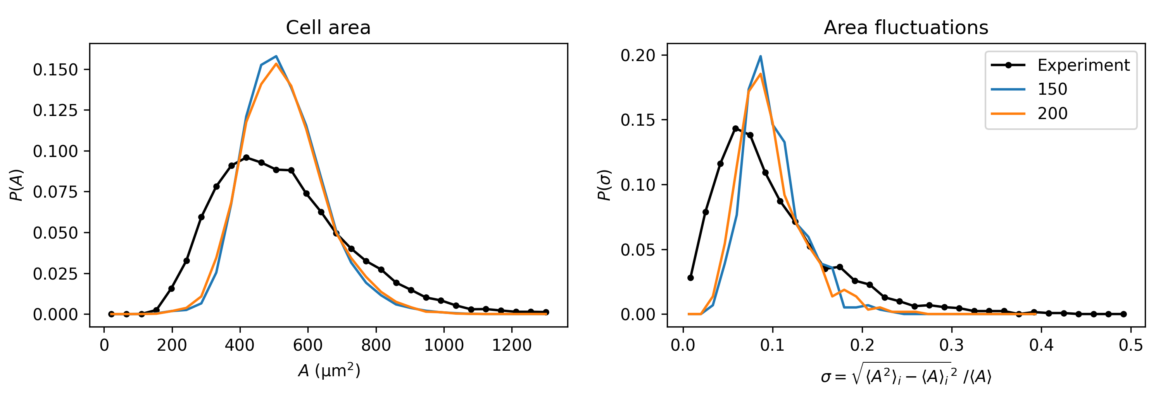
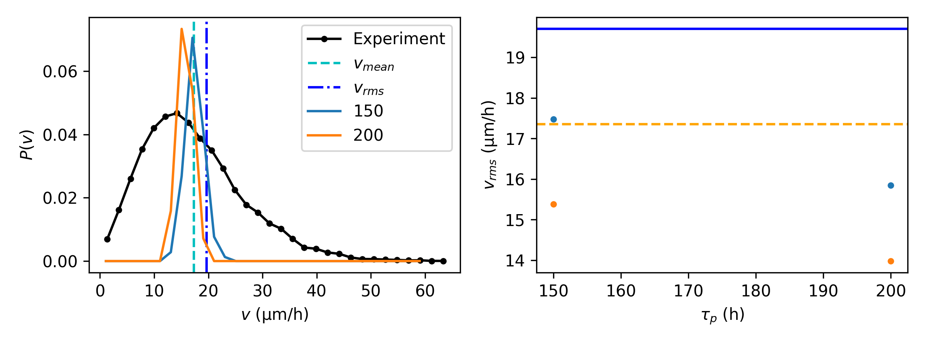
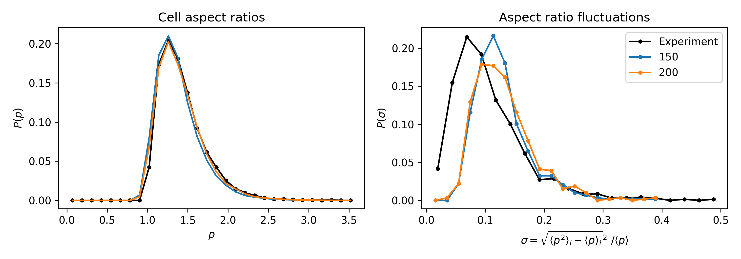
Summary
Keeping fluctuations low while matching the vrms requires high gamma

Slide 19
To do
Correlations of AA, VV, pp?
Bump in correlation

