Slide 2
Content
Data
Feature extraction & Normalization
Evaluation criteria
workflow
RFECV
ML
Combining results
Results

Slide 3
Data
ABIDE II DATASET
# of subjects: 1031
# of males: 794
# of females: 237
# of TD: 541
# of ASD: 490

Slide 4
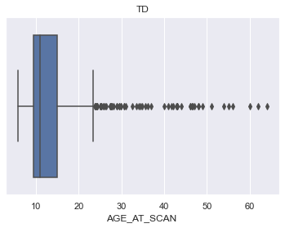
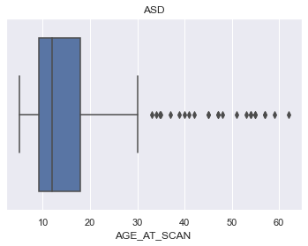
Data

Slide 5
DATA
TD subjects:
Awareness: 370 TD, 15 mild, 11 moderate
Cognition: 385 TD, 7 mild, 4 moderate
Communication: 384 TD, 8 mild, 4 moderate
Mannerism: 379 TD, 12 mild, 5 moderate
Motivation: 376 TD, 12 mild, 8 moderate
ASD subjects:
Awareness: 75 TD, 59 mild, 92 moderate, 106 sever
Cognition: 57 TD, 50 mild, 97 moderate, 128 sever
Communication: 46 TD, 42 mild, 99 moderate, 166 sever
Mannerism: 40 TD, 36 mild, 88 moderate, 189 sever
Motivation: 81 TD, 43 mild, 113 moderate, 116 sever

Slide 6
Feature extraction & Normalization
Median + IQR, std → 0.52 specificity, 1 sensitivity, 0.76 bacc
Median + IQR, minmax → 0.53 specificity, 1 sensitivity, 0.766 bacc
20,40,60,80 percentile, std → 0.33 specificity, 0.93 sensitivity, 0.63 bacc
20,40,60,80 percentile, minmax → 0.588 specificity, 1 sensitivity, 0.79 bacc

Slide 7
Evaluation criteria

Slide 8
Workflow
MRI volumes → Freesurfer → directory with surf files → (Python starts here) Feature extraction into one csv file (D) → Joining D with the pheno data provided by ABIDE II → Categorize each subject based on each SRS module → [D_comm, D_motivation, D_mannerism, ….] Each D_i contained the SRS of “almost” all subjects → For each D_i do RFECV → GridSearchCV → Find from each GridSearchCV, the top classifier (clc) → split D_i into training and testing → Train clc using training D_i and test it on testing D_I → generate the pseudo metric table

Slide 9
Feature selection
Linear SVM: TOP Performing
Logistic regression
ExtraGradientBoosting tree
Random Forest

Slide 10
Classifiers
LSVM
LR
XGB
RF

Slide 11
Combining results
The output of each behavioral pipeline are:
1. Set of selected features (S)
2. hyper-parameters optimized classifier (C )
3. Pseudo-metric to evaluate the performance of that behavioral model (M)
For every new subject:
For every behavioral report
Features are selected using S_i
Prediction using C_i
Trust score is estimated using the combinations of M is multiplied by the prediction
Calculate the weighted average decision of all classifiers

Slide 12
Results
Balanced accuracy of each behavioral model: 100%
Combined accuracy: 73%
Note: These results are for the pipeline running over the whole subjects. While results from Feature extraction and normalization slides are for the pipeline running over subjects between the age of 10 to 13

Slide 13
Report

