Slide 1
Diagnosing autism by building up SRS behavioral report
By: Mohamed Tarek Ali

Slide 2
Content
Hypotheses
Origin of the idea
The Big Picture
Why SRS not ADOS?
Results
Next steps

Slide 3
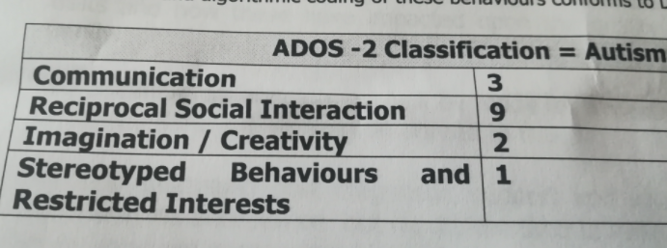
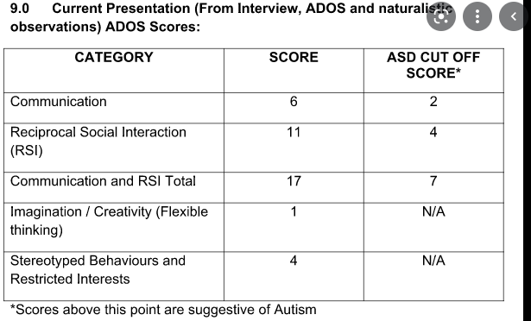
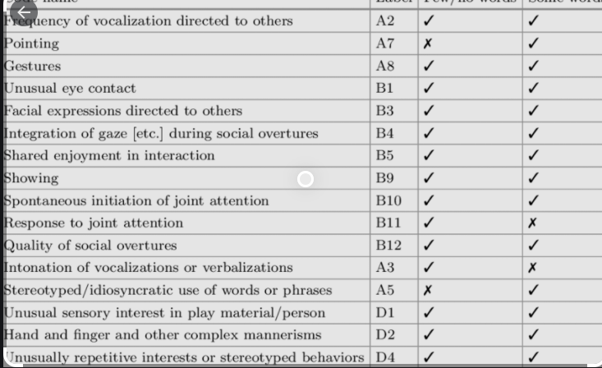
Origin of the idea
Notes:
When we diagnose ASD, our ML model is not only classifying the disorder encoded in the features extracted from the brain, but also mimicking the behavior of the interviewer that concluded the behavioral scores from a given subject

Slide 4
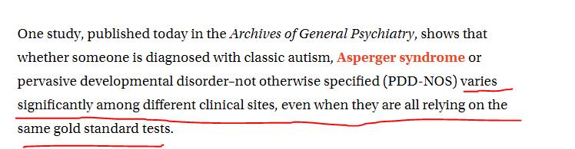
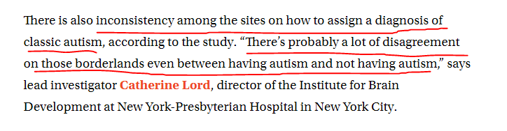
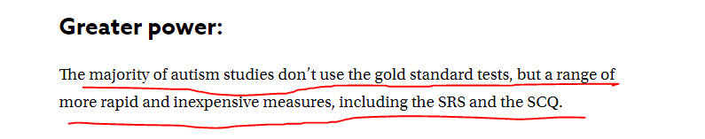
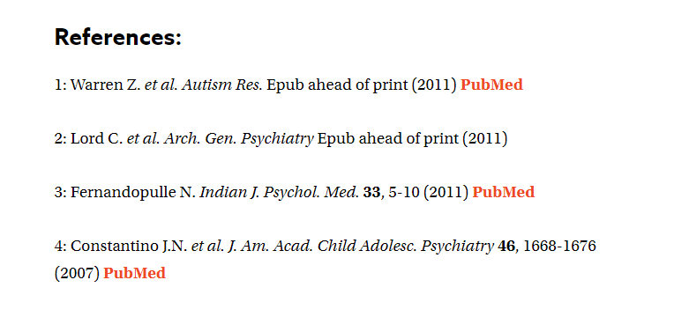
Origin of the idea
https://www.spectrumnews.org/news/autism-tests-struggle-to-balance-accuracy-and-speed/

Slide 5
Hypotheses
Autism is not a defined entity by itself, however it is defined in terms of social behavior such as eye contact, communication, manners, cognition, and self awareness.
Autism definition/spectrum border changes with every version of the DSM. Therefore, sticking to a standard and diagnose autism using its definition will get our software to be obsolete at some point in the future.
Creating a neurocircuit for each social behavior and aggregating the decisions made by those neurocircuits to diagnose a subject will allow us to have a more robust and durable software than can be adjusted for any DSM updates.
Getting the extreme ASD subjects and use their different behavioral scores to create neurocircuits that differentiate them from ideal typically developed subjects will convert diagnosing autism into adjusting thresholds that will meet DSM standards with high accuracy
Functionality causes brain to change its structure to decrease the resistance for the repeated brain tasks such that the more you perform the task, the easier it gets. REF: https://www.scientificamerican.com/article/how-does-a-mathematician-s-brain-differ-from-that-of-a-mere-mortal/

Slide 6
Origin of the idea
MRI
Our software
Preprocessing MRI using FreeSurfer
Scanning brain with the features that are assumed to be responsible of the given behavior
Behavioral report with the scores along with the final decision
Observing behavior and giving scores
Processing questions and behaving accordingly
Interviewer/Physician
Subject
Questions being asked
Answers being given + behavior being observed

Slide 7
Big Picture
Transformed data
Behavioral report
Demographic data
Demographic data
Training Module
Responsibilities:
Initialize and set the hyper parameter space for different ML models (linear/non-linear)
Feature selection for each behavioral test using all available classifiers
Train all the machine learning models to classify sever vs TD according to each behavioral report
Select the top performing classifier for each behavioral test
Production Module
Responsibilities:
Utilize selected classifiers to predict new subjects behavioral severity
Aggregate all the predicted scores to assign final diagnosis
Data Loader
Responsibilities:
Extract morphological features for each voxel/vertex in the brain.
Summarize/transform the morphological features for each brain region to reduce noise
Selected classifiers for
Behavioral test #1
Behavioral test #2
MRI volumes
Transformed data
.
.
.
Behavioral test #N

Slide 8
Rationale behind using SRS
There are SRS scores for TD as well as ASD. While ADOS is only for ASD
SRS, although it is not a gold standard, it has a strong predictive power close to, if not equal to, ADOS. REF: https://pubmed.ncbi.nlm.nih.gov/32243021/
Data missing from ADOS is more than that of SRS. Therefore, using SRS will allow us to utilize more subjects in the experiment.

Slide 9
Results - Communication

Slide 10
Results - Cognition

Slide 11
Results - Mannerism

Slide 12
Results – Awareness (ubuntu)

Slide 13
Results – Motivation (ubuntu)

Slide 14
Results - Total

Slide 15
Results
Majority voting using communication, total, cognition, and mannerism with equal weights:
sensitivity: 0.7621951219512195
specificity : 0.7164556962025317
balanced accuracy : 0.7393254090768756
f1 : 0.7246376811594204
confusion matrix : [[250 78]
[112 283]]

Slide 16
Future work/improvements/What’s next
Easy to implement ideas
Add the missing modules to the final output (Motivation and awareness)
Instead of using equal weights, will weigh each module based on its accuracy.
Try different feature representation, instead of median +/iqr, will be 20th quantile, 40th quantile, 60th quantile, 80th quantile for each brain region for each feature.
Create models to classify moderate vs TD and mild vs TD.
Challenging to implement ideas
Use autoencoders to find reduce each morphological feature points within each brain regions to maximize separation between classes. (Supervised autoencoders paper in NIBS https://proceedings.neurips.cc/paper/2018/file/2a38a4a9316c49e5a833517c45d31070-Paper.pdf).
Instead of classifying severity as (Sever-Moderate-Mild) vs TD, we perform regression to estimate the SRS score from each module and use the same criteria used to diagnose ASD given those scores.

