Slide 1
ABIDE II – Basic cohort analysis
Mohamed T. Ali

Slide 2
Summary stats
Stat | ASD | TD
Count | 521 | 593
Gender | 444 Males, 77 Females | 412 Males, 181 Females
Age (mean, std) | (14.8, 9.0) | (15.0, 9.0)
Kindly note that, although the mean and std of age is similar across the whole dataset, it varies significantly across sites, which will be demonstrated in the following slides

Slide 3
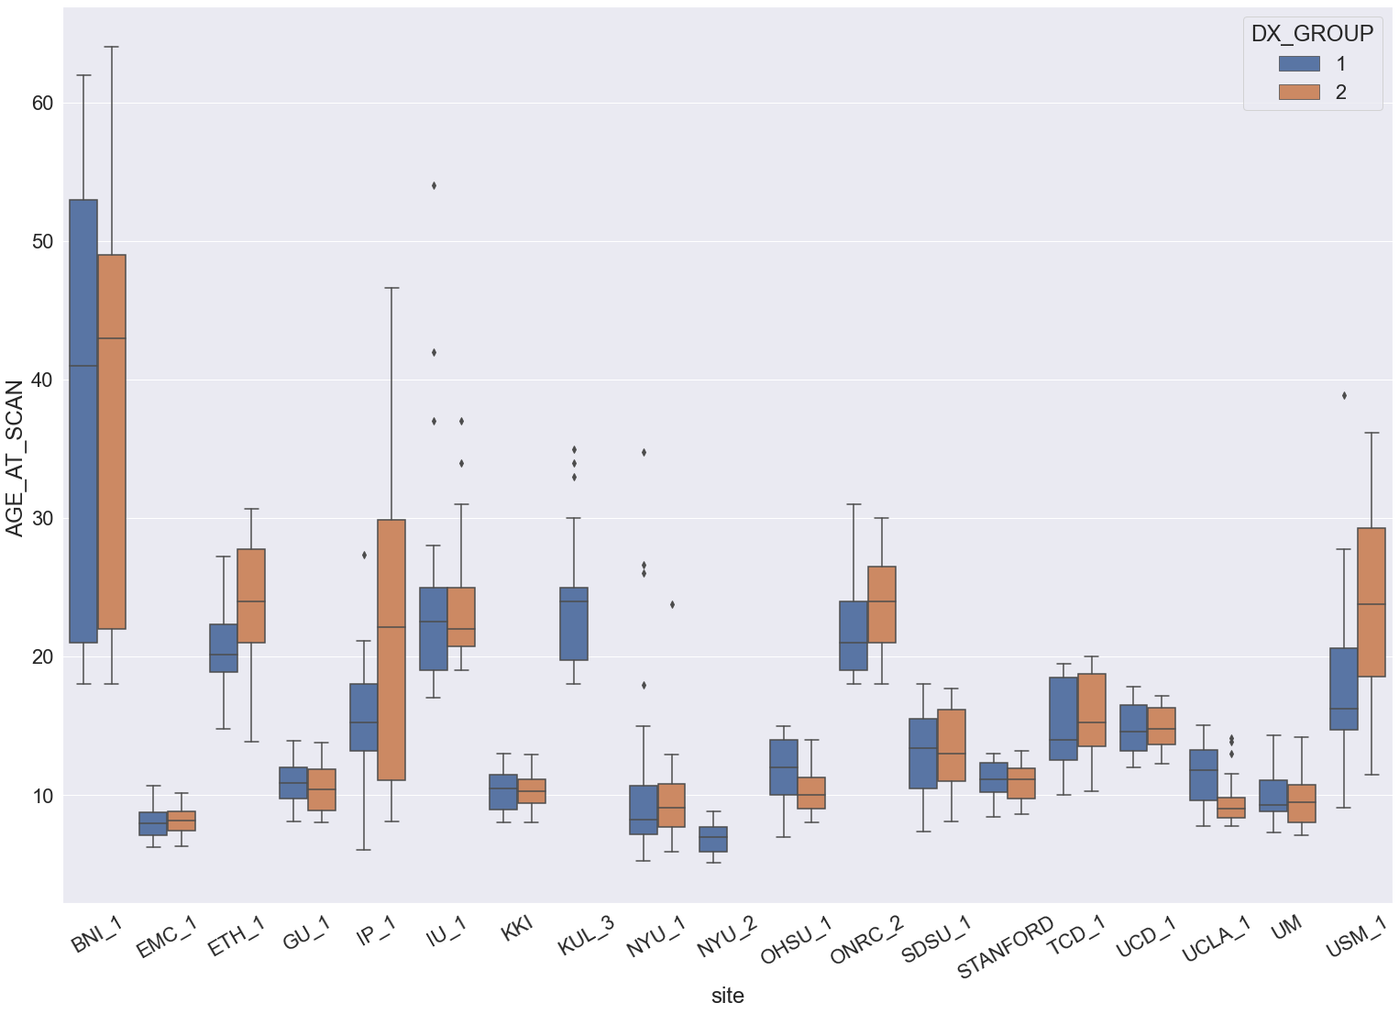
ASD
TD

Slide 4
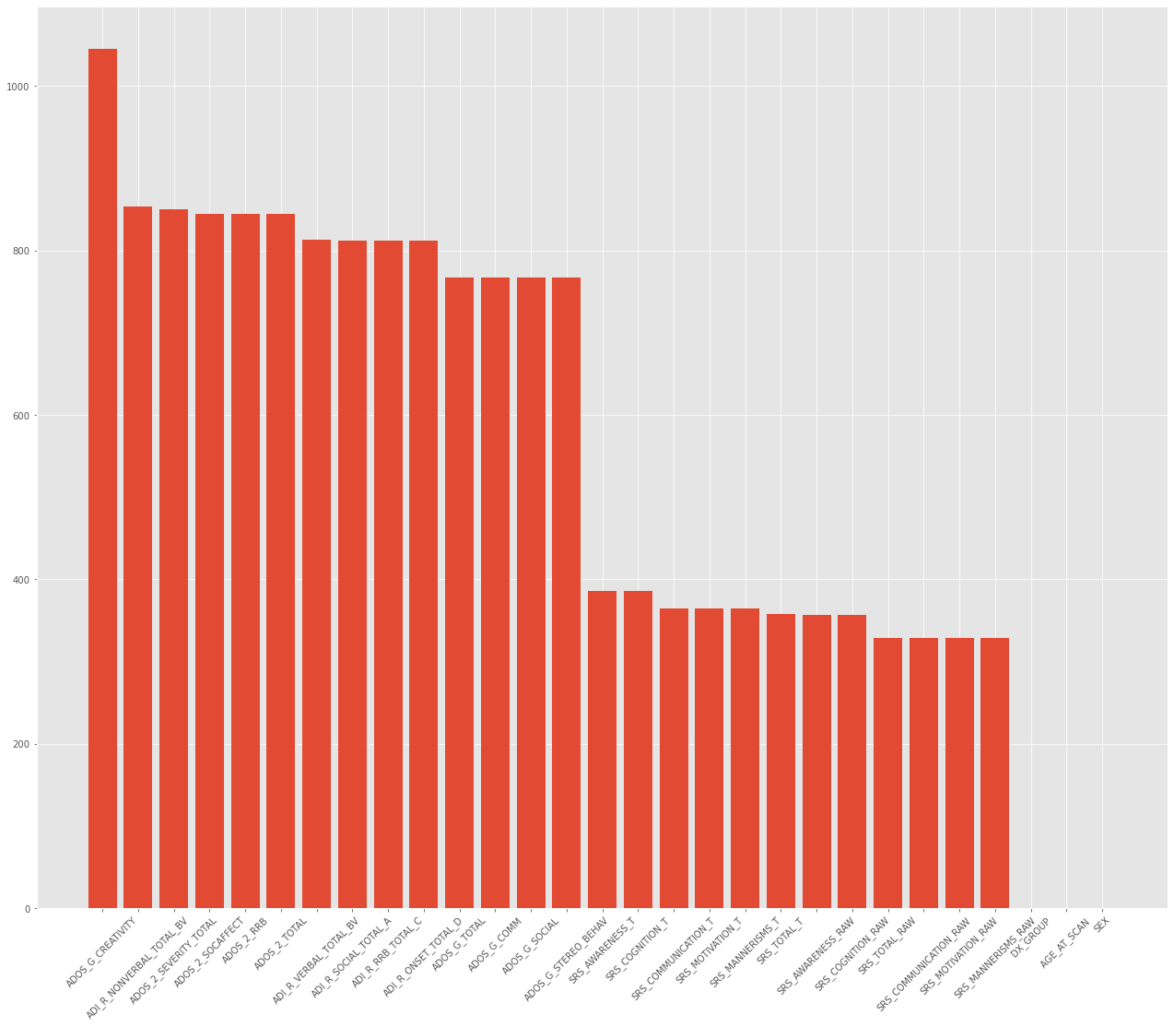
Missing values for each column

Slide 5
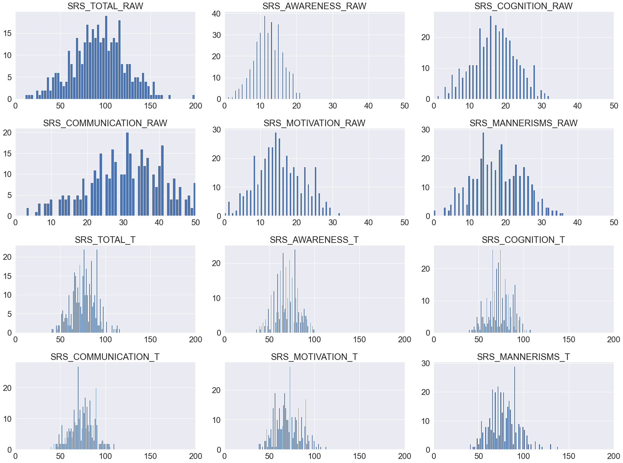
IF SRS IS USED
 | ASD | TD
COUNT | 332 | 396

Slide 6
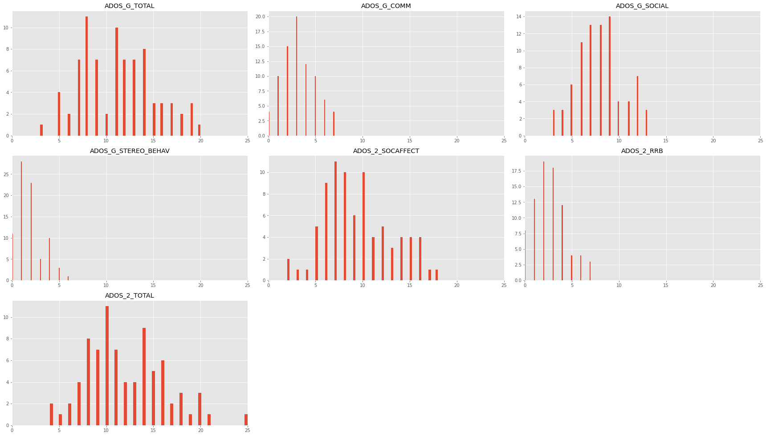
IF ADOS is used
 | ASD
COUNT | 81

