Slide 1
Diagnosing Autism in terms of behavioral report
By: Mohamed T. Ali

Slide 2
Content
Idea
Workflow – Training
Workflow – Testing
Study cases

Slide 3
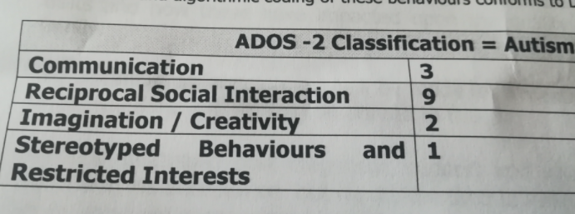
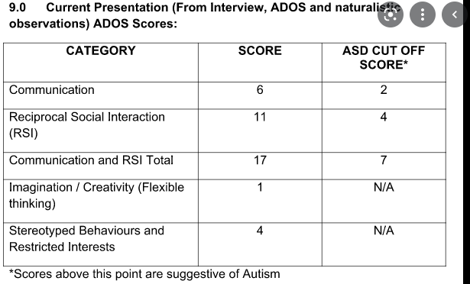
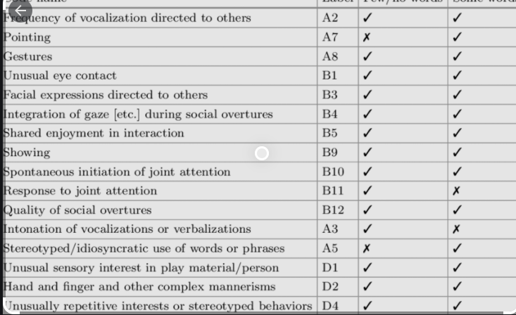
IDEA
Notes:
When we diagnose ASD, our ML model is not only classifying the disorder encoded in the features extracted from the brain, but also mimicking the behavior of the interviewer that concluded the behavioral scores from a given subject

Slide 4
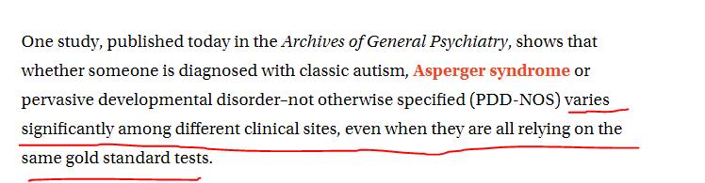
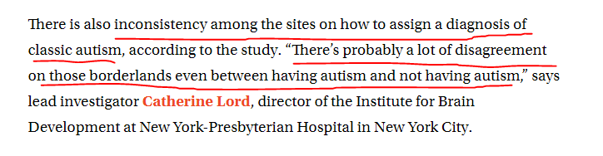
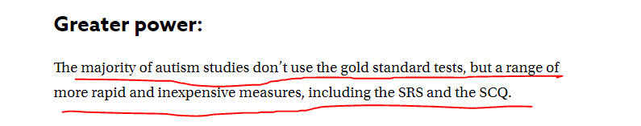
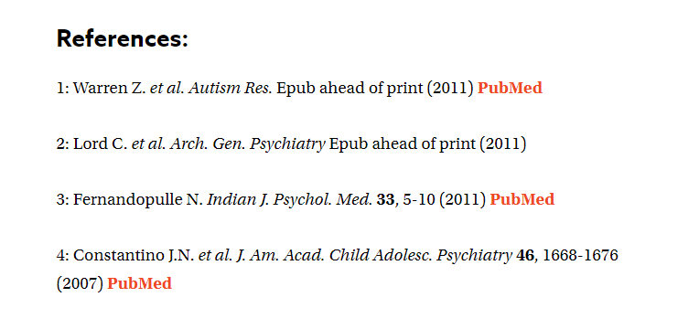
IDEA

Slide 5
IDEA
MRI
Our software
Preprocessing MRI using FreeSurfer
Scanning brain with the features that are assumed to be responsible of the given behavior
Behavioral report with the scores along with the final decision
Observing behavior and giving scores
Processing questions and behaving accordingly
Interviewer/Physician
Subject
Questions being asked
Answers being given + behavior being observed

Slide 6
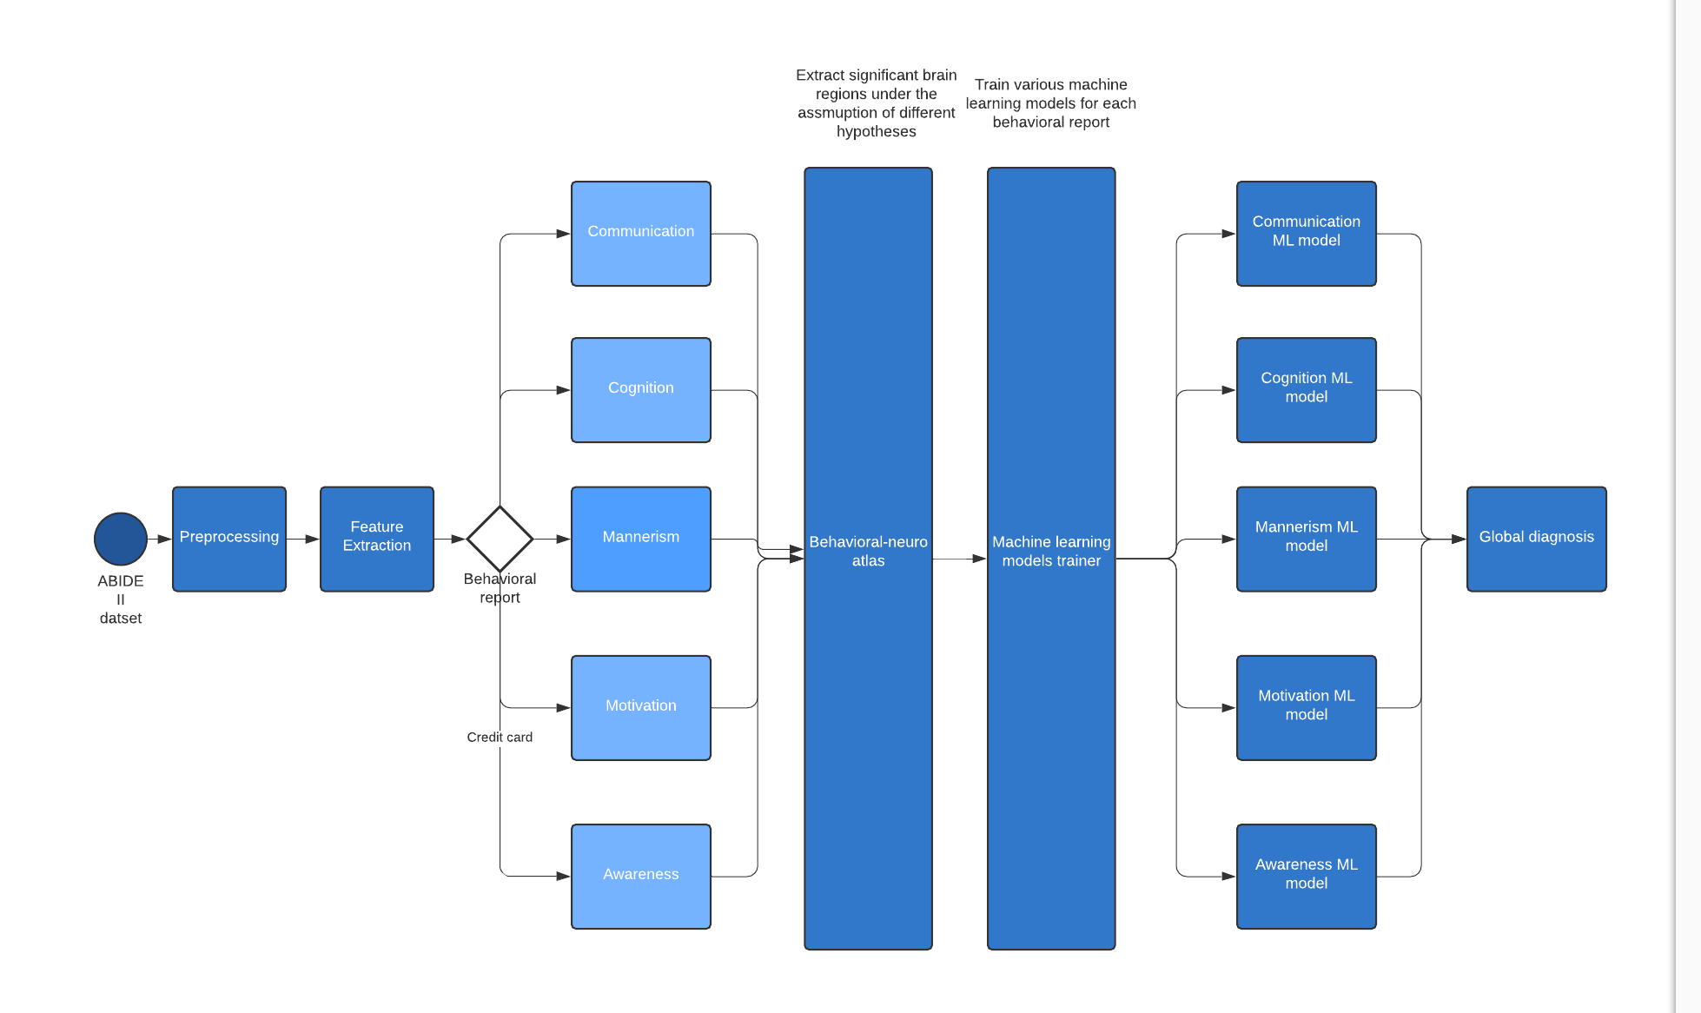
Workflow - Training

Slide 7
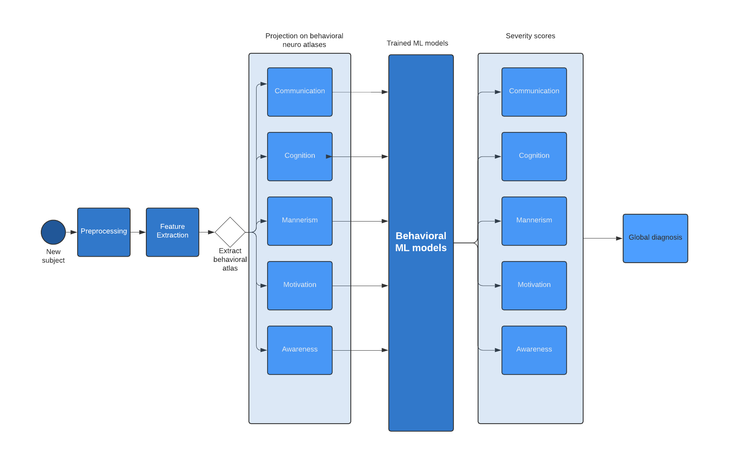
Workflow - Testing

Slide 8
Study case

