Slide 1
Influence of population size, # samples and online versus offline for
obstacle avoidance task
foraging

Slide 2
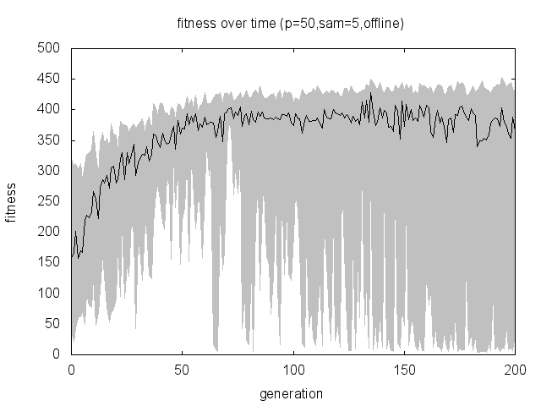
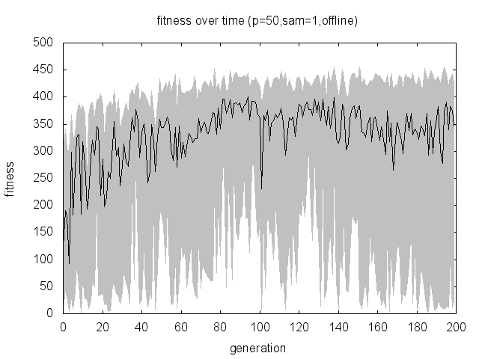
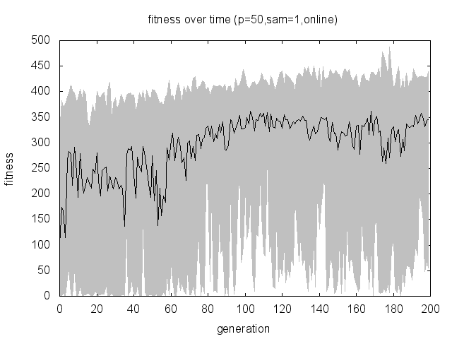
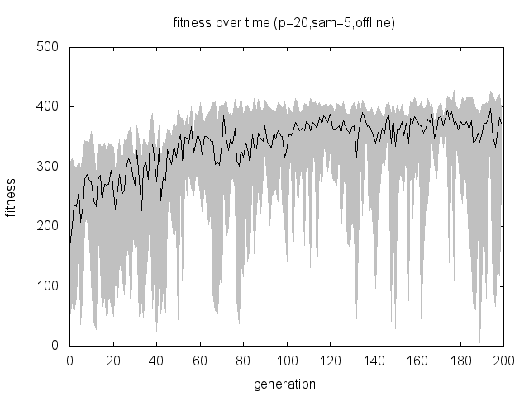
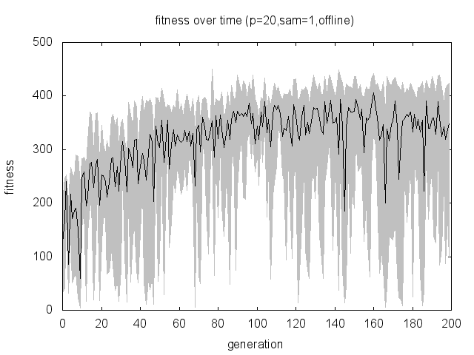
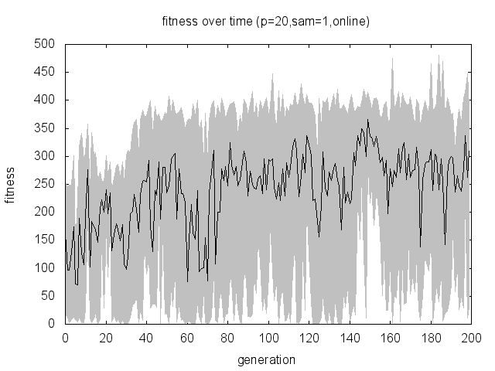
Conclusions on fitness function obstacle avoidance: A lower population size decreases the average fitness a little. This can be due to the higher diversity in the larger population size resulting in better controllers. The high diversity might also explain the worse fitness values. Decreasing sample size effect both populations in the same way: more volatility and decreased fitness. The effect of online results in even lower fitness and for the smaller population size in even more volatility
5 samples offline 1 sample offline 1 sample online
Pop size 20 pop size 50
Different runs gave different graphs for this setup

Slide 3
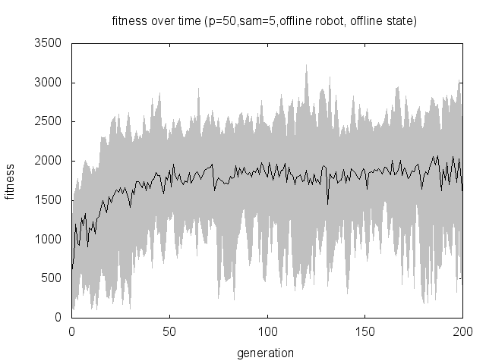
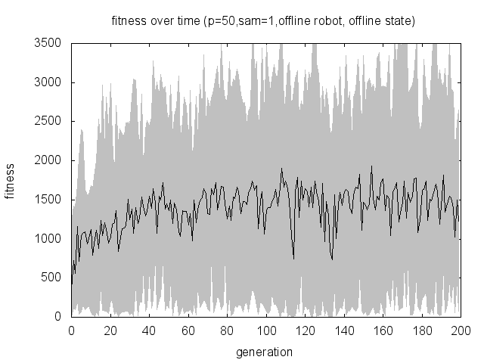
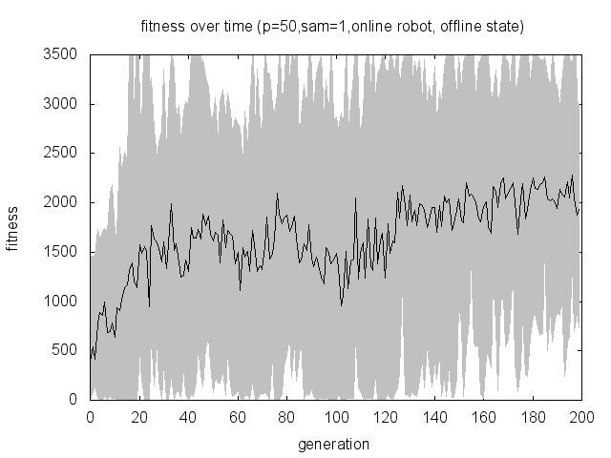
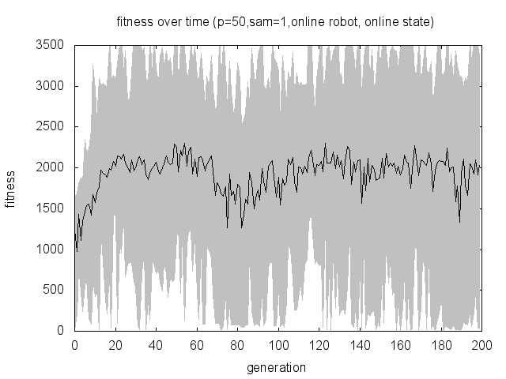
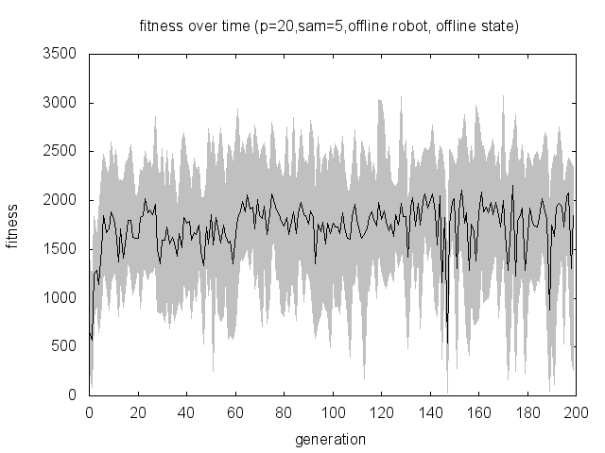
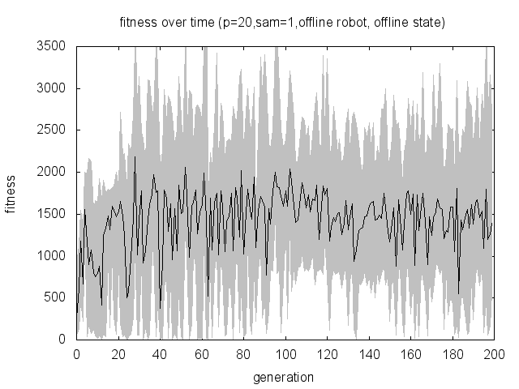
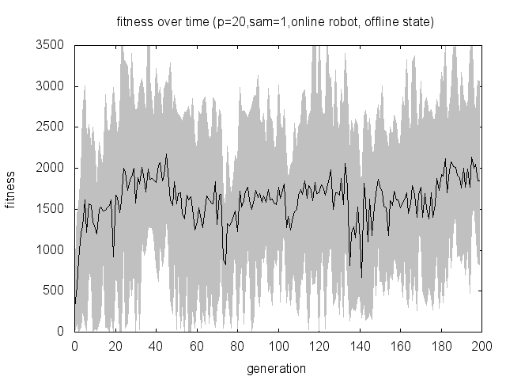
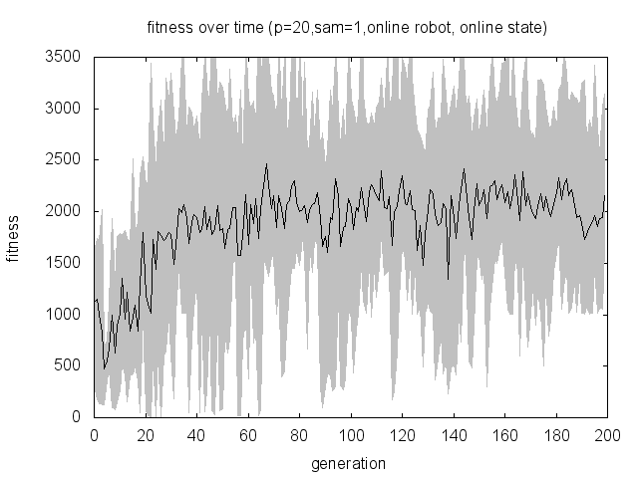
Conclusions on fitness function foraging (1000steps): Don’t really know. End fitness is actually quite similar in all setups. Pop size 50 has more volatility in worse/best annd pop size 20 more volatile in average. End fitness is around 2000 (always having puck and driving around well.
5 samples offline 1 sample offline 1 sam online loc 1 sam online loc+state
Pop size 20 pop size 50

Slide 4
To do both tasks: 2 Qualitative assesment, wrap up the obstacle avoidance (10 runs each?), with bumps, (ook geen optimaal behaviour want niet obst ontwijken??) Eindelijk goed foraging behaviour: punten voor het hebben en bonus voor wegbrengen. Maar in 2e en derde run heb ik dit behaviour niet meer gezien... 4e wel weer. Grotere populatie? Voor meer diversiteit? Of neat parameters voor meer diversiteit? Doel = een base waar hij altijd juiste behaviour laat zien. Anders stellen de grafieken niets voor. Toch maar wel taak ertussen?

