Slide 1
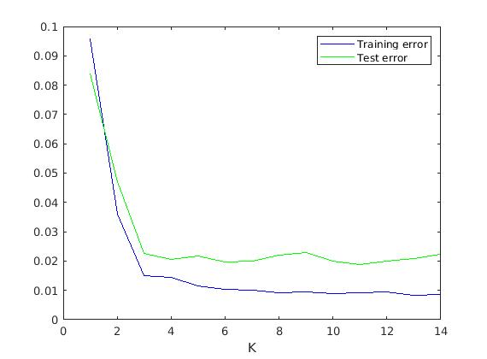
What is the optimal number of bases in DCFNet?
Liu Wing Ki(20100260), Nie Rong(20458617), Ye Yushi(12207894)
5.2. Analysis(Limitation)
1. Introduction
4. Result
The maximum number of bases is 14 only. When we try to implement the model with more than 15 bases, error message appears.
The number of bases required to model the weights and minimizes the test errors is of interest to us because the required number of bases may be large.
6. Conclusion
2. Experimental design
The optimal number of bases should be 6 because the training error and test error can not decrease further.
We try to run the demo example for K={1,2,3,…,50} with MNIST Database.
5.1. Analysis(Graph)
6. Reference
3. Data sets
From K=1 to K=3, the test error drops rapidly to nearly 0.02. From K=1 to K=6,the training error declines to less than 0.02. However, after K=6, the test error and training error does not decrease further.
Qiang Qiu, Xiuyuan Cheng, Robert Calderbank, Guillermo Sapiro, DCFNet: Deep Neural Network with Decomposed Convolutional Filters, ICML 2018. arXiv:1802.04145.
MNIST database of handwritten digits has training set of 60,000 examples and test set of 10,000 examples.

Slide 2
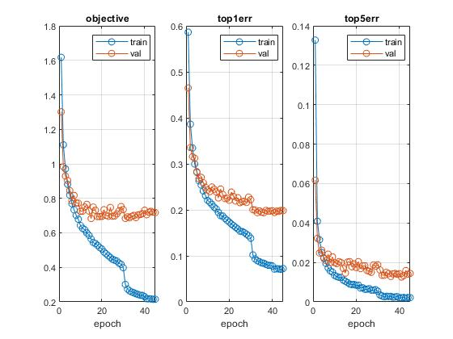
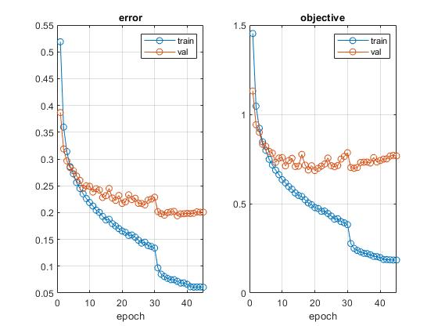
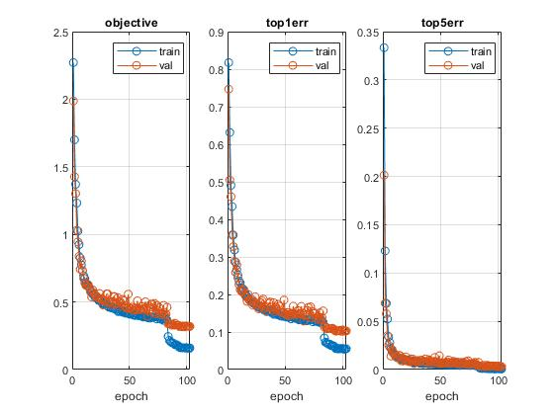
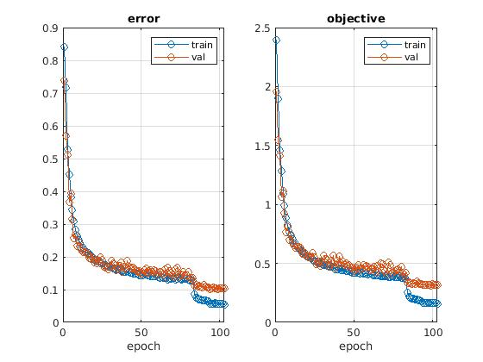
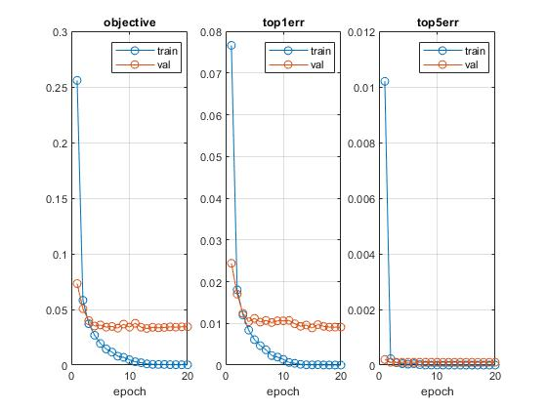
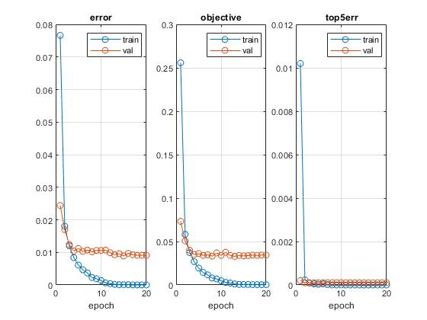
What is the effect of overfitting on CNN-related models?
Liu Wing Ki(20100260), Nie Rong(20458617), Ye Yushi(12207894)
1. Introduction
3. Data sets
4.2. Result(Cifar-10)
The question of what the effect of overfitting on CNN-related models has been of great concern to researchers. The concern is that when the number of parameters increases, the training errors may decrease but the test errors may not decrease.
MNIST database of handwritten digits has training set of 60,000 examples and test set of 10,000 examples.
Cifar-10 dataset consists of 60,000 32X32 color images in 10 classes.
Lenet
Simple neural network
DAG neural network
4. 1. Result(MNIST)
Network-in-Network
Simple neural network
DAG neural network
Lenet
2. Experimental design
We run the examples on MNIST and Cifar-10 in Matconvnet to observe the movements of test errors after the training errors decreases to nearly zero.
Simple neural network
DAG neural network
Conclusion Test error does not decrease when the training error reaches nearly zero

