Slide 1
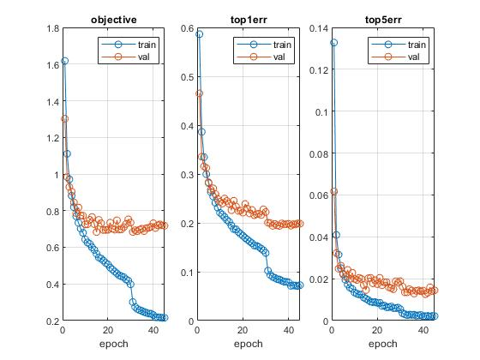
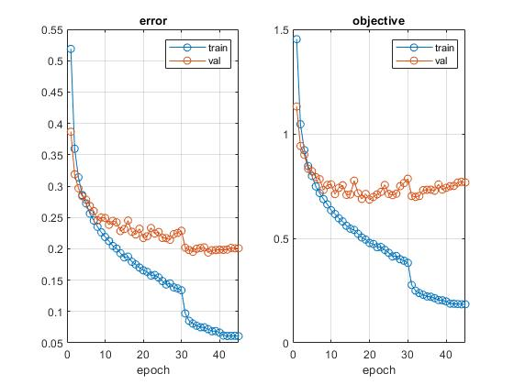
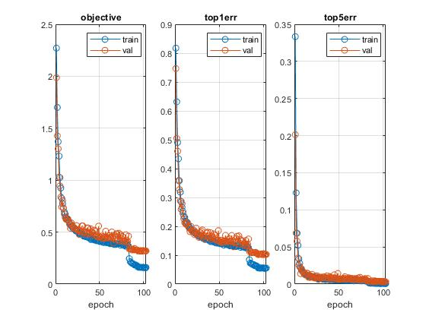
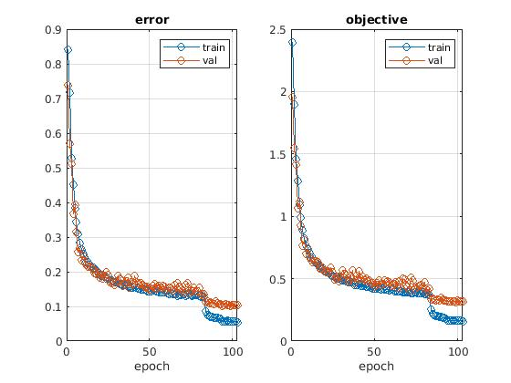
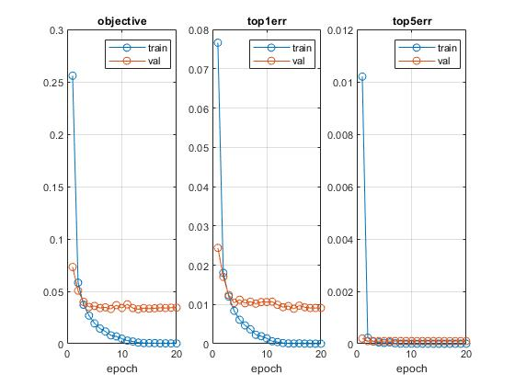
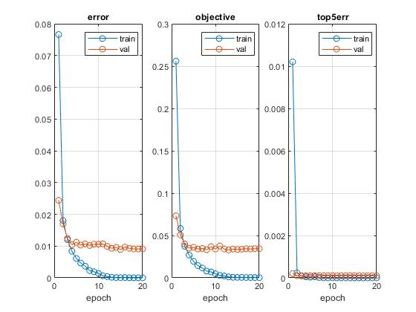
What is the effect of overfitting on CNN-related models?
Liu Wing Ki(20100260), Nie Rong(20458617), Ye Yushi(12207894)
1. Introduction
3. Data sets
4.2. Result(Cifar-10)
The question of what the effect of overfitting on CNN-related models has been of great concern to researchers. The concern is that when the number of parameters increases, the training errors may decrease but the test errors may not decrease.
MNIST database of handwritten digits has training set of 60,000 examples and test set of 10,000 examples.
Cifar-10 dataset consists of 60,000 32X32 color images in 10 classes.
Lenet
Simple neural network
DAG neural network
4. 1. Result(MNIST)
Network-in-Network
Simple neural network
DAG neural network
Lenet
2. Expirimental design
We run the examples on MNIST and Cifar-10 in Matconvnet to observe the movements of test errors after the training errors decreases to nearly zero.
Simple neural network
DAG neural network
Conclusion Test error does not decrease when the training error reaches nearly zero

