Slide 1
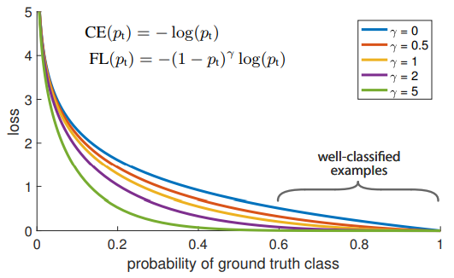
MATH 6380J Project 2: Image Classification and Deep Learning
Zengqiang Yan and Pei Wang {z.yan, pwangai}@connect.ust.hk
Department of Computer Science and Engineering, HKUST
1. Introduction
3. Cross Entropy Loss (CEL) vs. Focal Loss (FL)
5. Validation Results
We have conducted experiments on semi-conductor image classification challenge. The main goal of this project is to explore different potential solutions to improve the prediction accuracy. More specifically, we have proposed to solve the classification problem from both the network architecture and the loss function perspectives.
Due to the highly imbalanced ratio between bad samples and good samples in the dataset, classifying bad samples would be relatively difficult while classifying good samples might be relatively easier. Therefore, we further use the focal loss to penalize those mis-classified samples (probably bad samples).
Network | Notes | Accuracy
ResNet18 | Original Structure | 0.92624
ResNet18 | Trimmed Structure | 0.94049
ResNet18 | Weighted Cross Entropy | 0.95472
ResNet18 | Dice Loss (DL) | 0.96017
SqueezeNet | Weighted Cross Entropy | 0.92871
SqueezeNet | DL | 0.93068
Analysis: According to the experimental results in the Table, as the parameter 𝛾=2, mis-classified samples would be penalized. It is supposed that the model could learn more effective features for classification. However, due to the learning capacity of Alexnet, those well-classified samples would be negatively influenced.
Solution: Using deeper models.
2. Semi-conductor Image Classification Dataset
The semi-conductor image classification challenge is a binary classification problem, namely good vs. bad semiconductors. The dataset is highly imbalanced, where there are totally 3000 bad samples and 27000 good samples. To solve the imbalance problem, we mainly adopt the following two methods:
1. Weighted loss function: Given the imbalance ratio, in loss calculation, we assign 0.9 to bad samples and 0.1 to good samples in both forward and backward passes.
2. Data augmentation （DA）: The most straight-forward way is to duplicate those bad samples to reach the same number of the good samples. In addition, we also explore to change the way to construct mini-batches to guarantee that the ratio between bad samples and good samples in each mini-batch is balanced.
3. Processing: Basic image processing steps like image normalization or random crop are able to generalize data and prevent overfitting.
6. Analysis & Conclusion
Loss Functions: In the experiments we have tested three different losses, which are CE, FL and DL. CE is sensitive to data imbalance and requires more hyper parameters like class weight. FL is proposed to address the imbalance for dense object classification, and therefore less suitable for this binary case. As a overlap based measurement, DL no longer suffers from data imbalance for the binary cases and outperforms others.
Networks: Three widely used CNNs are validated on this classification task. From the results we could observe that ResNet slightly outperform the others for better feature extraction and less computation expense.
4. ResNet18 & SqueezeNet
The basic ResNet-18 is adopted for this classification. ResNet makes use of the skip connection to focus the network on the residual of the feature map comparing to the input features. During the experiments we found that the binary classification task requires shallower network and therefore trimmed the last layer. Besides, the weight for two classes are adjusted for the severe data imbalance problem.
Due to the limitation of submission times, and there is no available ground truth for the test set, we random split 10% of the training data as validation for quick test.
We also tested SqueezNet together with ResNet with different hyper parameters, and the results are showed in the table.
Dataset | Method | Accuracy
Semi-conductor Dataset | Alexnet + Weighted CEL | 0.90506
 | Alexnet + FL + DA | 0.93561
 | Alexnet + CEL + DA | 0.94976
7. Contribution
Section 1-3: Zengqiang Yan
Section 4-6: Pei Wang

