Slide 1
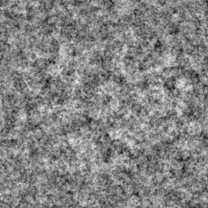
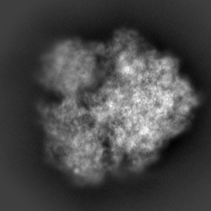
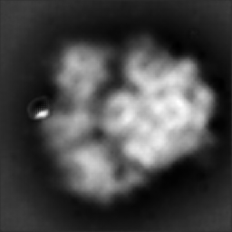
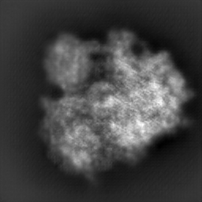
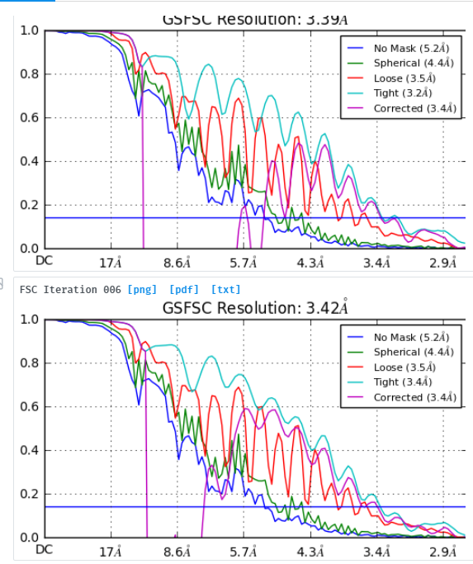
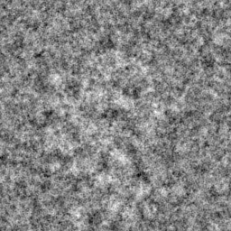
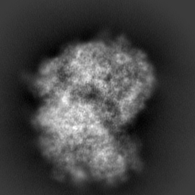
MATH 6380p Project 3: Denoising cryo-electron microscopy images.
Hanlin Gu^{1,2} , Song LIU¹ , Weiizhi Zhu²
¹Department of Chemistry, The Hong Kong University of Science and Technology, ²Department of Mathmetics, The Hong Kong University of Science and Technology,
Abstract
Methods and Materials
Conclusion
Faced with the large and unregular noise in cryo-em data:
1. we aim to use different traditional methods to denoise and look for which method is better by comparison.
2. Because the traditional methods can not grasp the feature of element, we want set a deep learning model to deal with the experimental data not only the simulation data. By reproducing the generative adversarial network(gan) and autoencoder (https://github.com/cianfrocco-lab/GAN-for-Cryo-EM-image-denoising), we find these two models can be fit for the large noise in the real condition.
Methods :We use three type of traditional methods: BM3D, KSVD, DDTF to denoise images. All three methods denoise images one by one and we take the batch size as 8 to search. In order to watch the sensitivity method respected to signal noise ratio(SNR), we denoise image in different SNR and observe the phenomenon. Also, we denoise image using GAN(https://github.com/cianfrocco-lab/GAN-for-Cryo-EM-image-denoising) and use the generator of this GAN to denoise image directly(we call this autoencoder method).
Criterion: And for criterion to determine whether the denoising method is good or not, we use the mean square error to judge, that is compute the l2 distance between clean image and denoising image.
1. Traditional methods in denoising cryo-em images are sensitive for SNR, especially in real data(due to low SNR). In this way, deep learning methods such as GAN and autoencoder can perform better when SNR is very low.
2. Gan can do better than autoencoder, the final resolution 3.39 is a little larger 3.2(original resolution).
Results
Discussion
The figure2 is the MSE value among 3 traditional methods in different SNR, we find:
(a)MSE of traditional method increase as the SNR decreases, especially when SNR in 0.05, it is so large. (b) DDTF perform better than other two methods.
Figure 3 is the denoised image by GAN and autoencoder, we find:
Only autoencoder(generator) can not denoise the pictures very well, it will make image blur.
Gan can denoise better in some extent.
Figure 4 is the reconstruction resolution after denoising, the resolution is 3.39.
The deep learning methods can grasp some real images features compared with traditional methods.
The deep learning methods such as gan may face overfitting problems. For example, the denoising results produced by gan may introduce some extra part in images.
The criterion only using MSE to estimate whether the method is good or not is not accurate. It needs other criterion.
Background And dataset
Background: Cryo-electron microscopy techniques(cryo-em) has become a popular method recently. It needs to froze the experimental sample to make the molecule motionless which will be good for observe the molecule. But it may introduce some noise from ice in the frozen process and from microscope. And the noise will decrease the resolution of image which will influence the classification and reconstruction of some element seriously.
Dataset: Our data mainly include two data, one is the simulation data, which is produced by adding Gaussian noise in the 2D projection image of some molecule, another is real data which is from EMBANK. It needs to notice that for real data, some clean image are gotten by software—cryosparc.
Noisy clean autoencoder gan
Future Directions
One direction is to change the structure of deep network to decrease the inaccuracy of denoising.
Other is apply some application problems into denoising methods. For example, some protein has different conformations, based on denoising images, it is meaningful to distinguish different conformations especially when conformation differences are very small.
Figure 3 denoising result using gan and autoencoder
Figure 4
Reconstruction
resolution after
denoising
Figure 1 noisy image and clean image
Figure 2 comparison among traditional methods in different SNR

