Slide 1
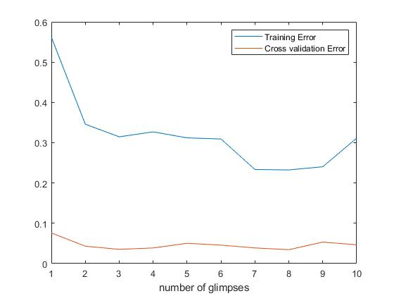
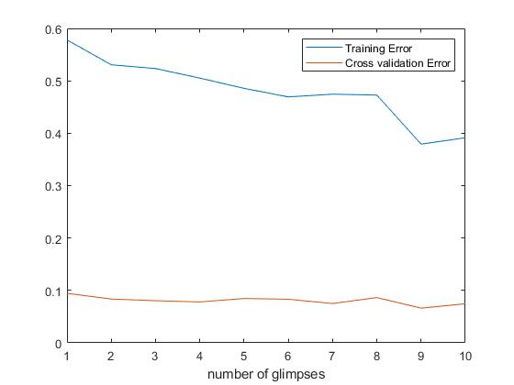
Performance of RAM model
Liu Wing Ki(20100260), Nie Rong(20458617), Ye Yushi(12207894)
1. Introduction
4.1 Result(RAM model)
4.2 Result(model comparison)
The Recurrent Attention Model(RAM) has attracted attention from many researchers.
The key idea of RAM is to give rewards to the agent who determines how to act and how to deploy its sensor.
Original MNIST
Cross validation error | Dagnn | Lenet | RAM
Original MNIST | 3.45% | 3.45% | 3.45%
2. Experimental design
6. Conclusion
We run the RAM model on original and cluttered MNIST dataset for different number of glimpses because the number of glimpses is a key parameter for RAM model.
Then, we compare cross validation errors in different CNN models with the experimental minimum cross validation error in RAM model.
The training errors are large in general perhaps other because the agent needs to decide how to act and deploy its sensor. However, the test errors are small in general probably because of learned parameters.
For original MNIST, CNN cross validation errors and the minimum cross validation error in RAM model are the same.
The conclusion is that we cannot rule out the possibility that RAM outperforms models.
Cluttered MNIST
3. Data sets
MNIST database of handwritten digits has training set of 60,000 examples and test set of 10,000 examples.
We mainly use the training set of original MNIST dataset and cluttered MNIST data set.
We evaluate the model based on the training errors and cross validation errors.
7. Reference
Mnih, V., Heess, N., Graves, A., & Kavukcuoglu, K. (2014). Recurrent Models of Visual Attention.

