Slide 1
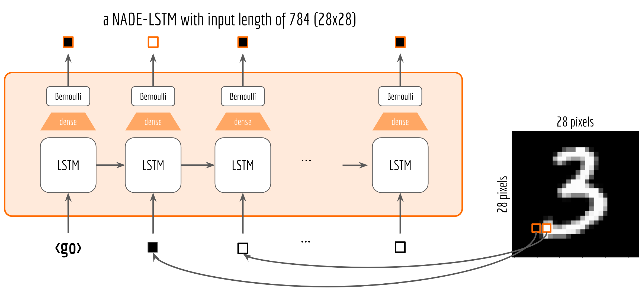
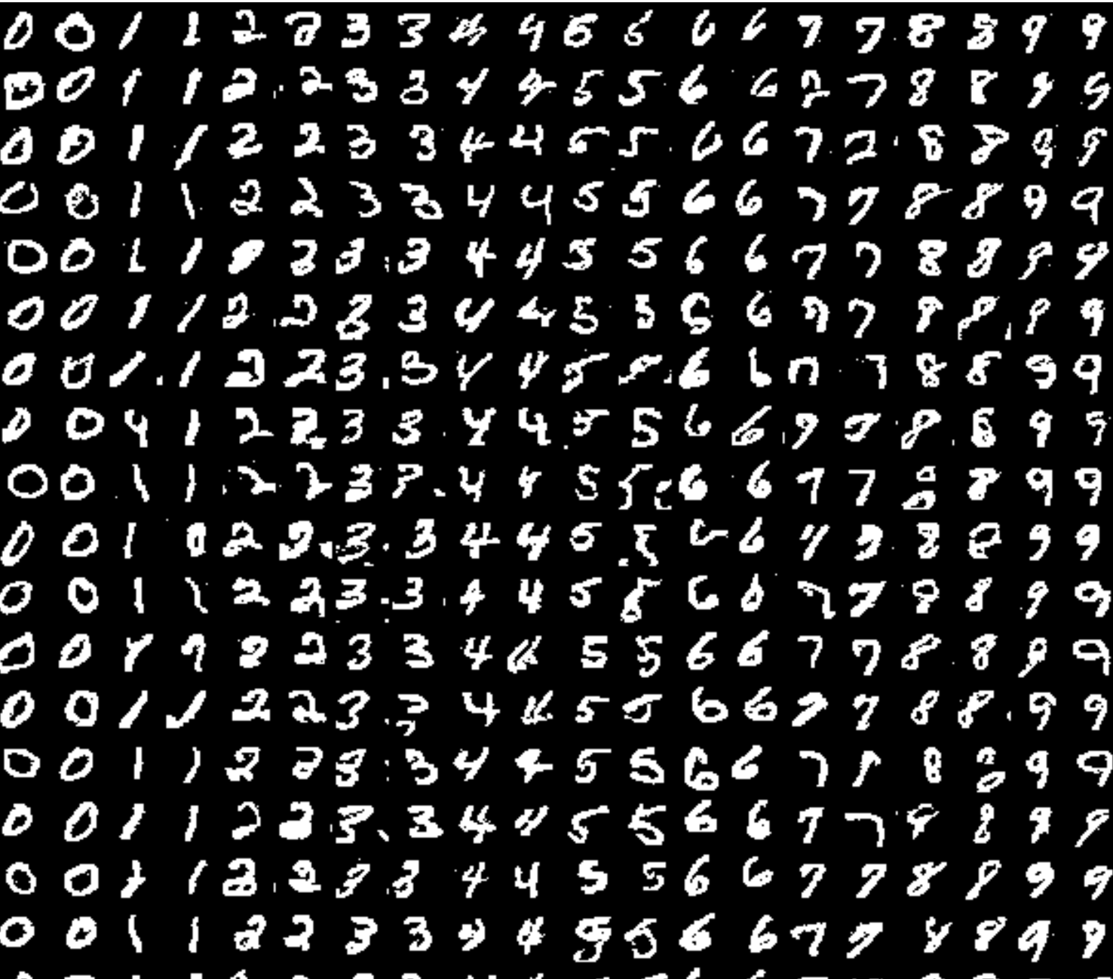
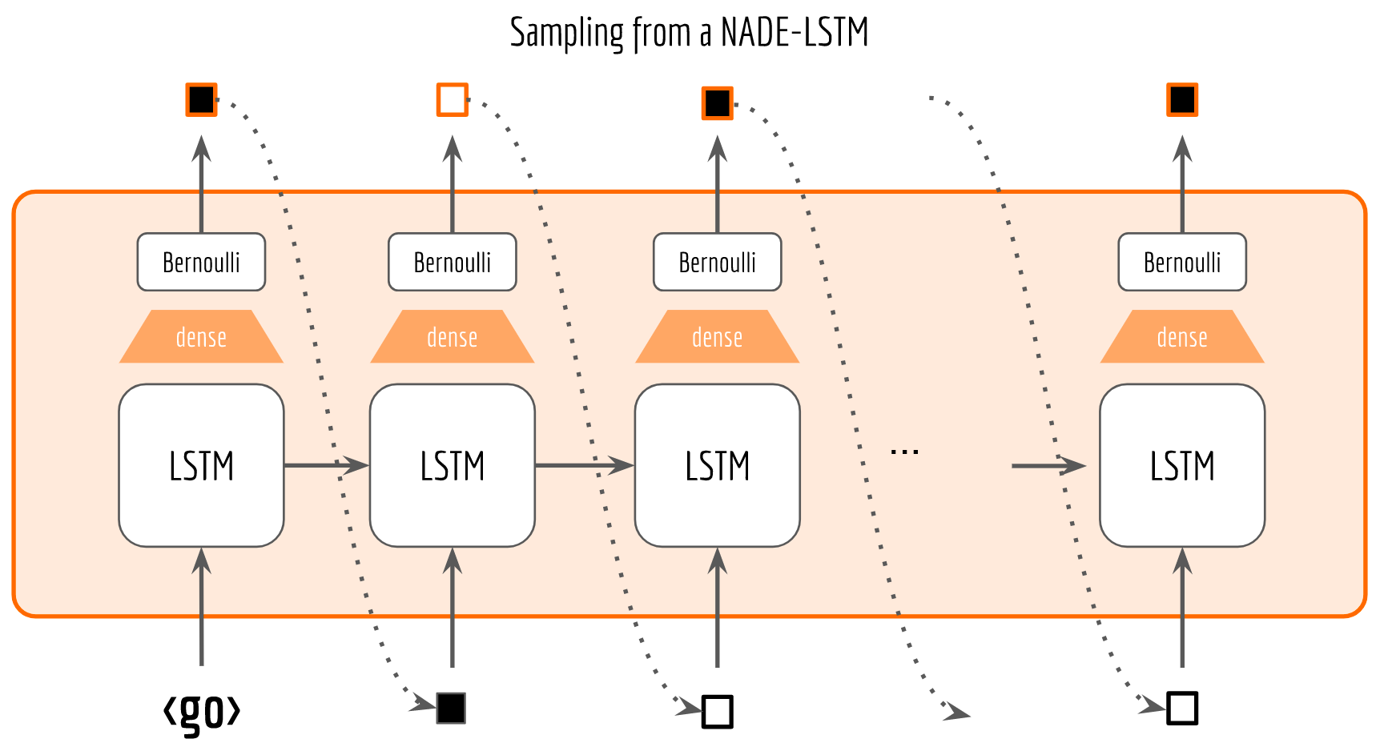
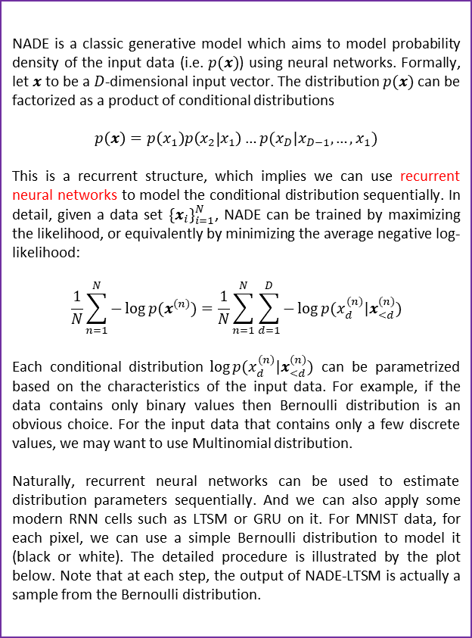
MATH 6380O Final Project: Images Generation via NADE-LTSM
Ye Yushi and Mao Hongyu {yyeaf, hmaoab }@ust.hk
Department of Mathematics, HKUST
1. Neural Autoregressive Distribution Estimation
3. NADE-LTSM with Sampling
NADE is a classic generative model which aims to model probability density of the input data (i.e. $p(x)$) using neural networks. Formally, let $x$to be a $D$-dimensional input vector. The distribution $p(x)$ can be factorized as a product of conditional distributions
$$p\left(x\right)=p\left(x_{1}\right)p\left(x_{2} | x_{1}\right)…p(x_{D}|x_{D−1},…,x_{1})$$
This is a recurrent structure, which implies we can use recurrent neural networks to model the conditional distribution sequentially. In detail, given a data set ${\{x_{i}\}}_{i=1}^{N}$, NADE can be trained by maximizing the likelihood, or equivalently by minimizing the average negative log-likelihood:
$$\frac{1}{N}\sum_{n=1}^{N}{−\log{p(x^{(n)})}}=\frac{1}{N}\sum_{n=1}^{N}{\sum_{d=1}^{D}{−\log{p(x_{d}^{(n)}|x_{<d}^{(n)})}}}$$
Each conditional distribution $\log{p(x_{d}^{(n)}|x_{<d}^{(n)})}$ can be parametrized based on the characteristics of the input data. For example, if the data contains only binary values then Bernoulli distribution is an obvious choice. For the input data that contains only a few discrete values, we may want to use Multinomial distribution.
Naturally, recurrent neural networks can be used to estimate distribution parameters sequentially. And we can also apply some modern RNN cells such as LTSM or GRU on it. For MNIST data, for each pixel, we can use a simple Bernoulli distribution to model it (black or white). The detailed procedure is illustrated by the plot below. Note that at each step, the output of NADE-LTSM is actually a sample from the Bernoulli distribution.
In the below we generate some MNIST-like images. The results showed that thought the model is still very rough (we didn’t apply any coevolutionary layer in it), it do generate some decent images very similar to the original ones. In future we may try this model on some more sophisticated datasets such as fashion-MNIST.
2. NADE-LTSM with Sampling
Sometimes it is not so reasonable to use distribution parameters estimated by last step as the input for next step. Instead, we may want to do sampling from the estimated distribution, and use the sample as the next input. The following figure visualizes this procedure.
7. References
[1] Uria, Benigno, et al. "Neural autoregressive distribution estimation." Journal of Machine Learning Research 17.205 (2016): 1-37.
[2] Hochreiter, Sepp, and Jürgen Schmidhuber. "Long short-term memory." Neural computation 9.8 (1997): 1735-1780.

