Slide 1
How I Learned to Stop Worrying and Love the Build
Ian Sillitoe (Darwin 627)
i.sillitoe@ucl.ac.uk

Slide 2
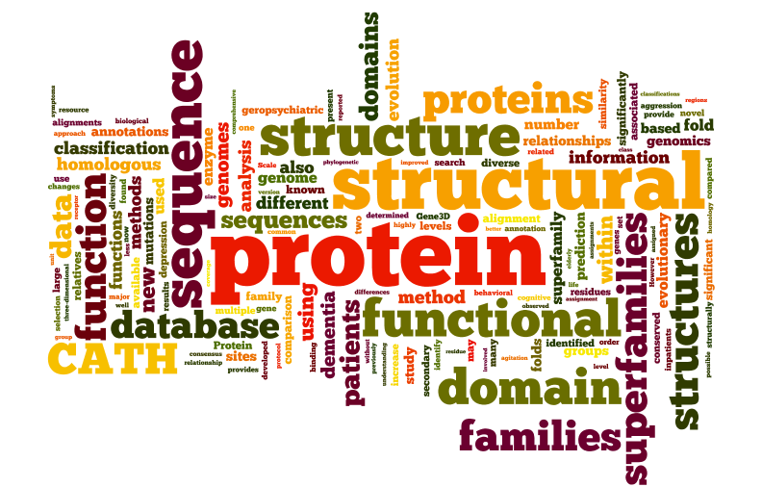
Orengo Group

Slide 3
Orengo Group
Prof Christine Orengo
Room 627, Darwin
6 Post docs, 6 PhD students
Computational Biology
Algorithms
Databases
Pipelines
Web services

Slide 4
Linux Services
20
Desktops / Laptops
6
General
Servers
3
Big VM Servers
50
Local HPC nodes
Version Control SVN, Git
Web Tools Apache, Varnish, FCGI, Solr, Tomcat
Databases PostgreSQL, Oracle, MySQL
Software Dev Perl, Python, Java, C++, Javascript
Sys Dev VM, Puppet, CentOS, Ubuntu

Slide 5
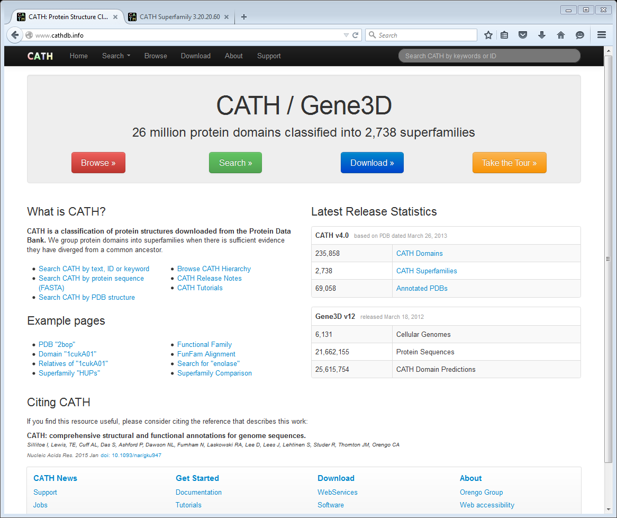
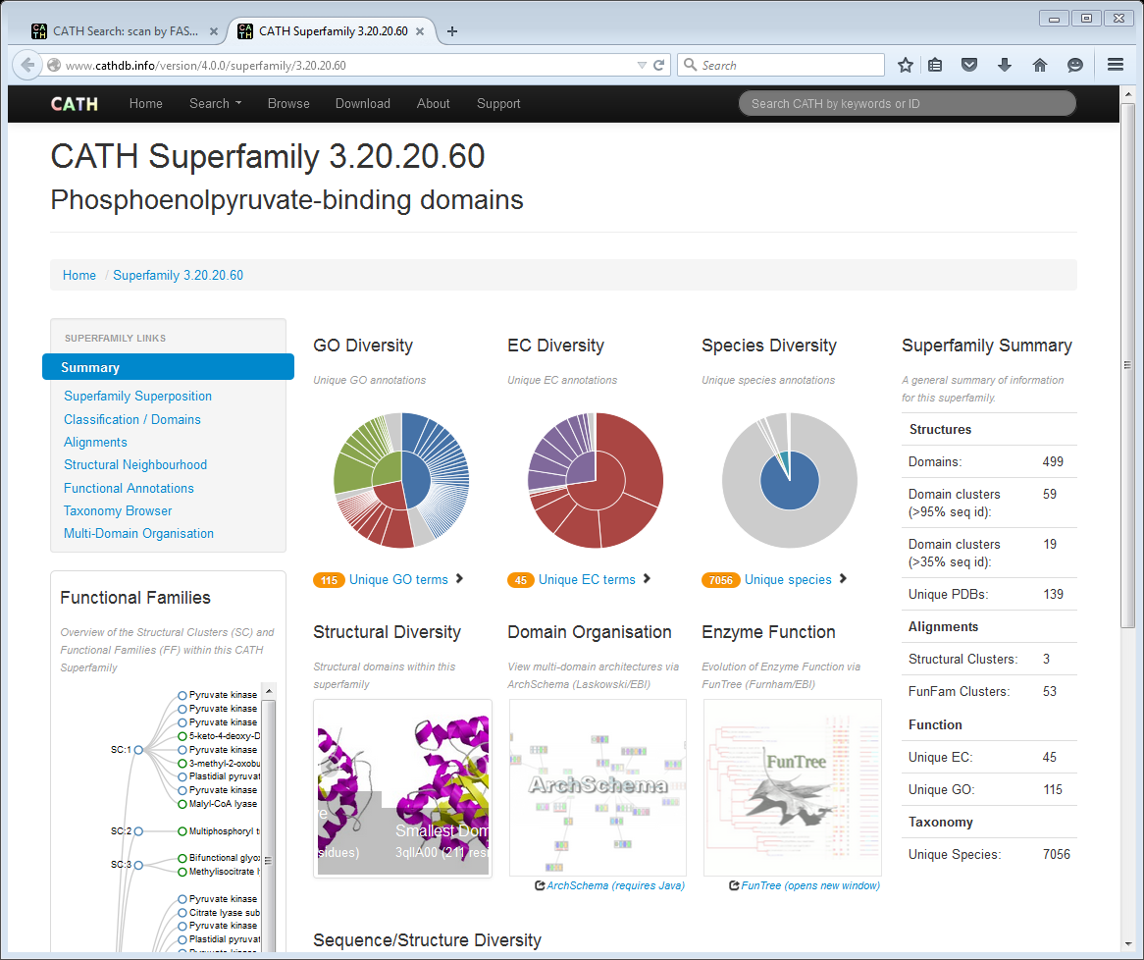

Slide 6
Challenge
Provide web application that is:
Efficient not CGI.pl
Robust no downtime, no bad links
Flexible encourage new features
Scalable deal with traffic, future proof
Maintainable > 1 developer

Slide 7
Efficient
Use MVC web application (not CGI.pl)
(MVC = Model / View / Controller)
e.g.
Perl Catalyst, Dancer, Mojolicious, …
Python Django, CherryPy, …
Ruby Rails, …

Slide 8
Robust
Continuous Integration (CI)
Everything gets put into group code repository
code, crontabs, tests, etc
All code has its own tests
Tests run automatically all the time
If tests PASS - shared code gets updated
If tests FAIL - we get an email
e.g. Jenkins CI, Travis CI, …

Slide 9
Flexible
Lots of (good) tests gives you…
Confidence to make changes
Confidence to accept changes from others
Continuous Integration lets you…
See your own changes in “beta” sites
MVC web applications make it easy to…
Create powerful, interactive web pages

Slide 10
Scalable
Move web code to Virtual Machine (VM)
SVN all common code in central repo
Puppet maintains machine requirements
Varnish web cache, load balance, failover

Slide 11


Develop, Build / Test, Deploy
VM server
DEVELOP
BUILD / TEST
orengobuild64
orengocatalyst01
Code Repo (SVN)
User 1
orengocatalyst02
orengocatalyst03
User 2
DEPLOY

Slide 12
Cache, Load Balance, MVC
VM server
orengobuild64
Web server
WEB
orengocatalyst01
Varnish
orengocatalyst02
CACHE
LOAD BALANCE
(and FAILOVER)
orengocatalyst03
Data
Source
A
Data
Source
B
Data
Source
C

