Slide 1
WeSay
Eric Albright
John Hatton
Mainland Southeast Asia

Slide 2

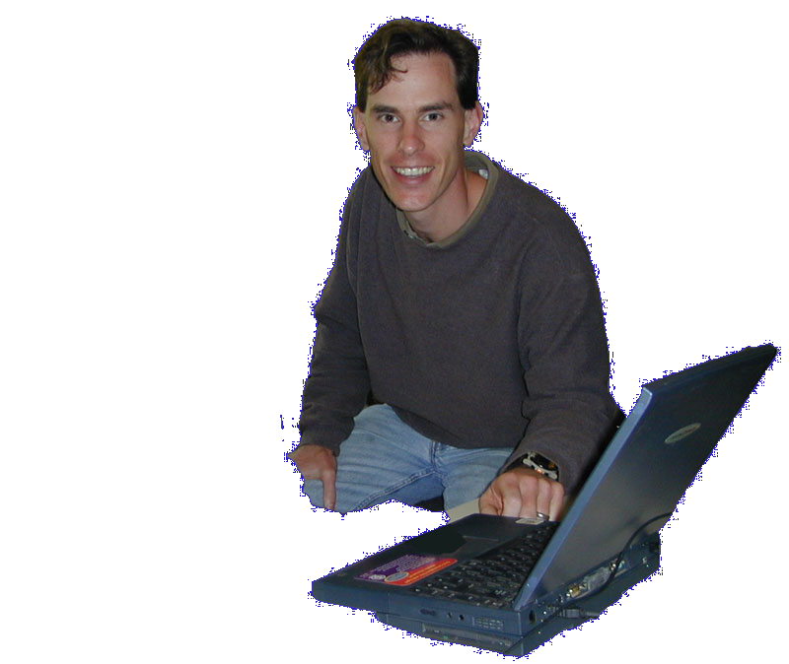
Why Another Dictionary
App?

Slide 3
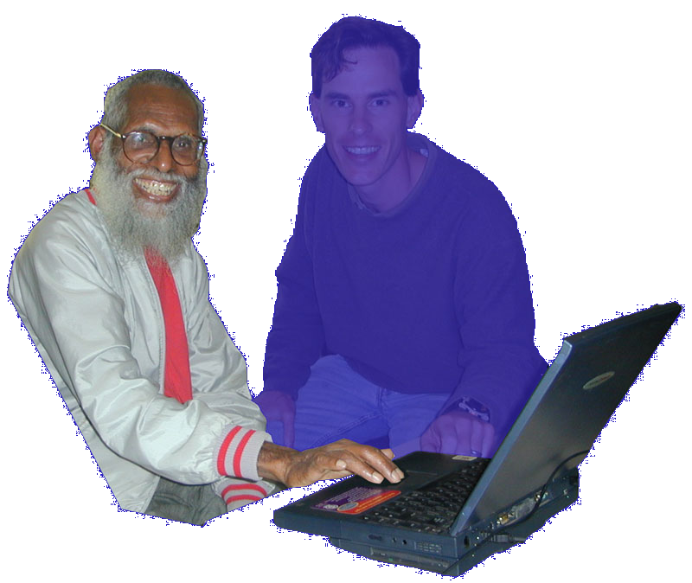
My
Turn
Notes:
But there are hundreds of situations where the language community is ready to develop their language, but they need tools designed for their needs. They have different problems than the outsider does, and they bring different strengths. We’re interested in what happens when We say he can do it.

Slide 4
WeSay:Words
Notes:
Low training/support
Deployment Options
Cooperation
DDP
Introduce demo: I’m going to show you…

Slide 5

Getting Started
Empty Thai Project

Slide 6

w to write good examples

Slide 7

Filling out Fields
Thai after collecting words

Slide 9

“Random Access”
Thai after collecting Examples

Slide 10

Recap

Slide 11

WeSay Admin
Run WeSay Admin

Slide 12
Distinctives
Low training/support
  Task oriented
  No file system access
  Easy to localize
  Automated backup

Slide 13
Distinctives
Deployment Options
  Windows Boxes
  Linux
  2B1 Laptop (OLPC)

Slide 14
Distinctives
Cooperation
  Native speaker ←→ advisor
  Community
Notes:
Interaction with FLEX, Toolbox (with SOLID)
“Do it yourself” initial stages of DDP
Community: simple printouts, impressive-looking reports

Slide 15
Schedule
November Gather Feedback
Jan Trial Runs
March “1.0”

Slide 16
Thanks!
Mike Cochran
Intl Language Software Development
Berm Lee
Andy Palmowski & Neil Mayhew
Linux Software Development
Alan Yam
MSEA Academic Computing

Slide 17
WeSay.org

Slide 18
Near Future
Graphite
Semantic Domains
Sorting
Fast Search
Printouts
2B1-laptop

Slide 19
Possible Future
Custom fields
Email integration
Extensions via Python/ VB.net, etc.
WeSay: Stories
Notes:
WeSay:Stories: record & transcribe native stories

