Slide 1
WeSay
Eric Albright
John Hatton
Mainland Southeast Asia

Slide 2

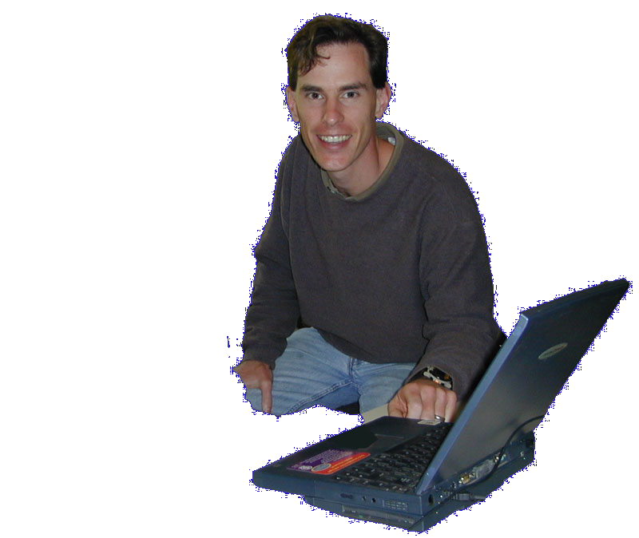
Why Another Dictionary
App?

Slide 3
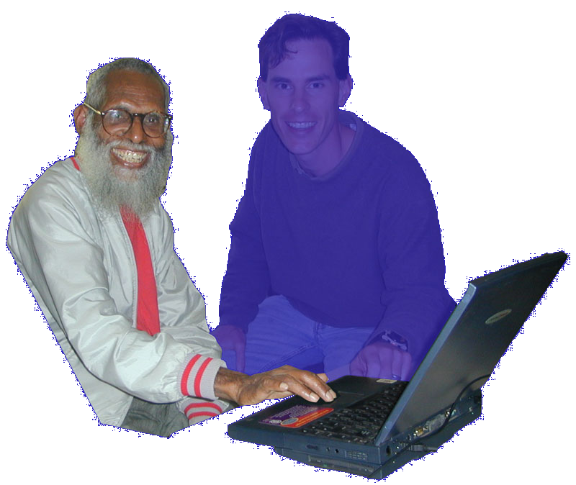
My
Turn
Notes:
But there are hundreds of situations where the language community is ready to develop their language, but they need tools designed for their needs. They have different problems than the outsider does, and they bring different strengths. We’re interested in what happens when We say he can do it.

Slide 4
WeSay:Words
Notes:
Deployment Options
Cooperation
DDP
Low training/support
Introduce demo

Slide 5

Getting Started

Slide 6

w to write good examples

Slide 7

Filling out Fields

Slide 9

“Random Access”

Slide 10

WeSay Admin

Slide 11

Distinctives
Low Training/ Support
  Task orientation
  No file system access
  Sparse UI
Automated backup
Text-based localization
Cooperates with FLEx

Slide 12
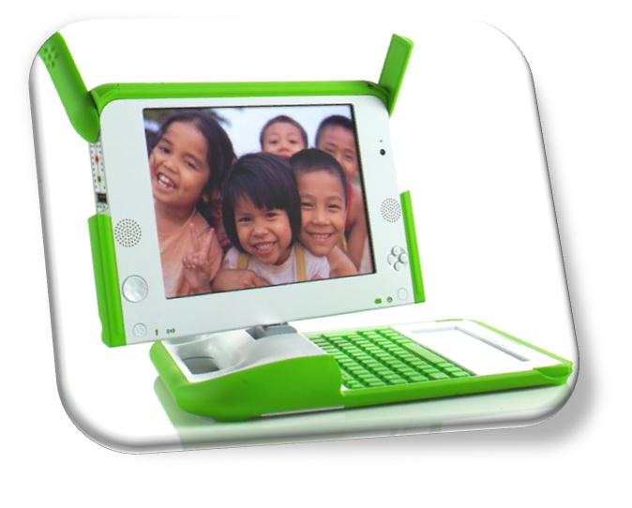


Deployment

Slide 13
WeSay.org

